Slide 1

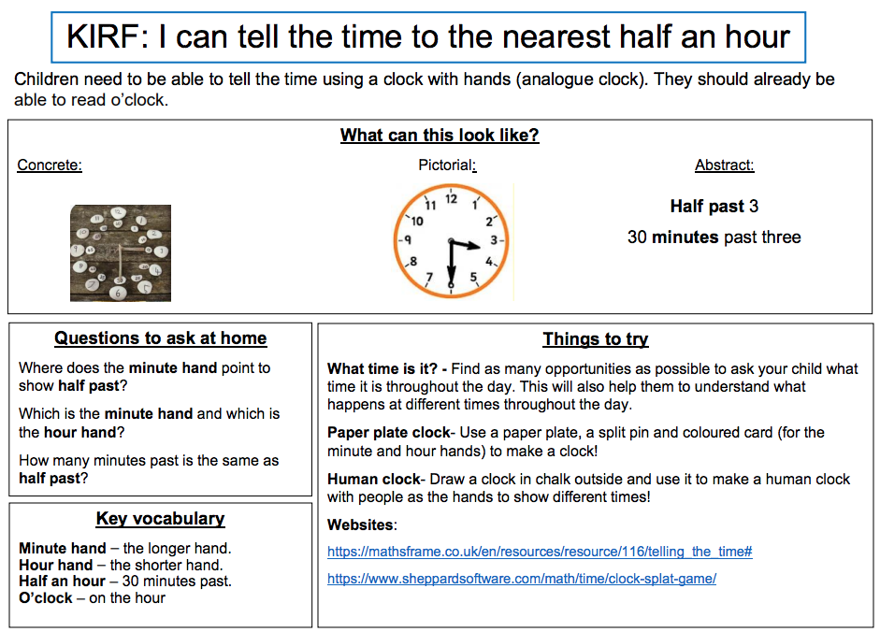
Year 1 – Summer 2

Slide 2
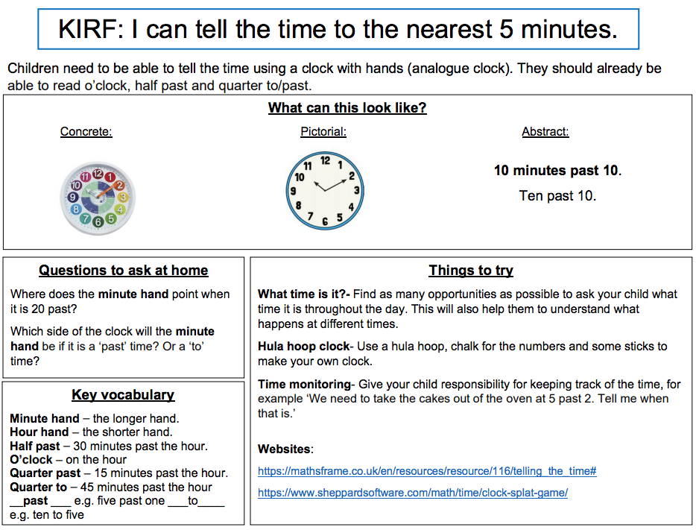
Year 2 – Summer 2

Slide 3
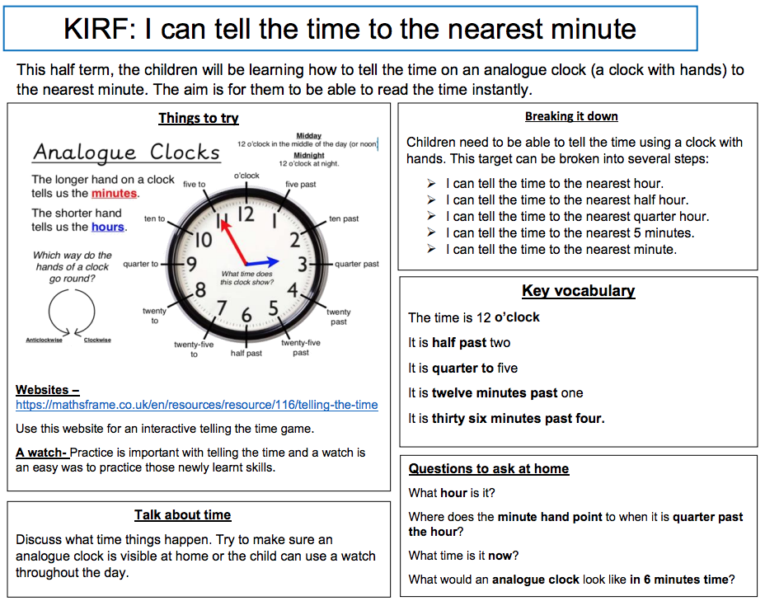
Year 3 – Summer 2

Slide 4
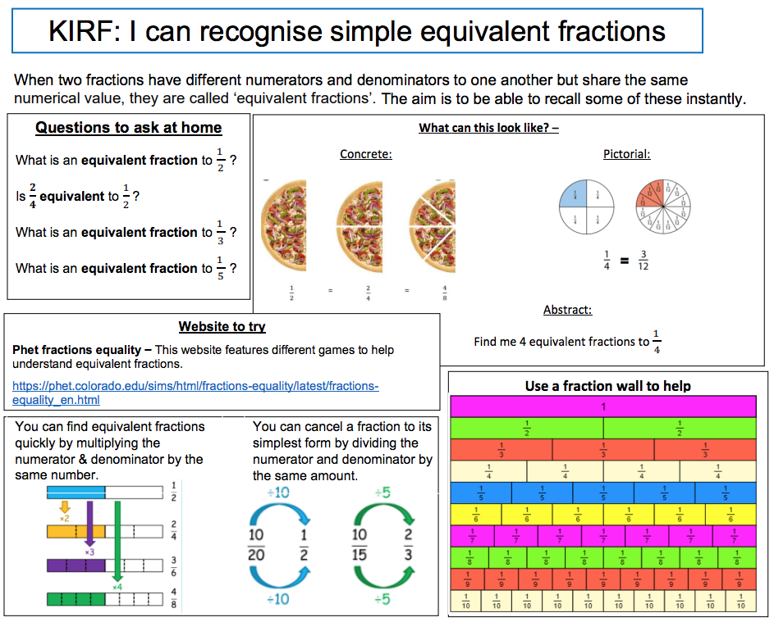
Year 4 – Summer 2

Slide 5
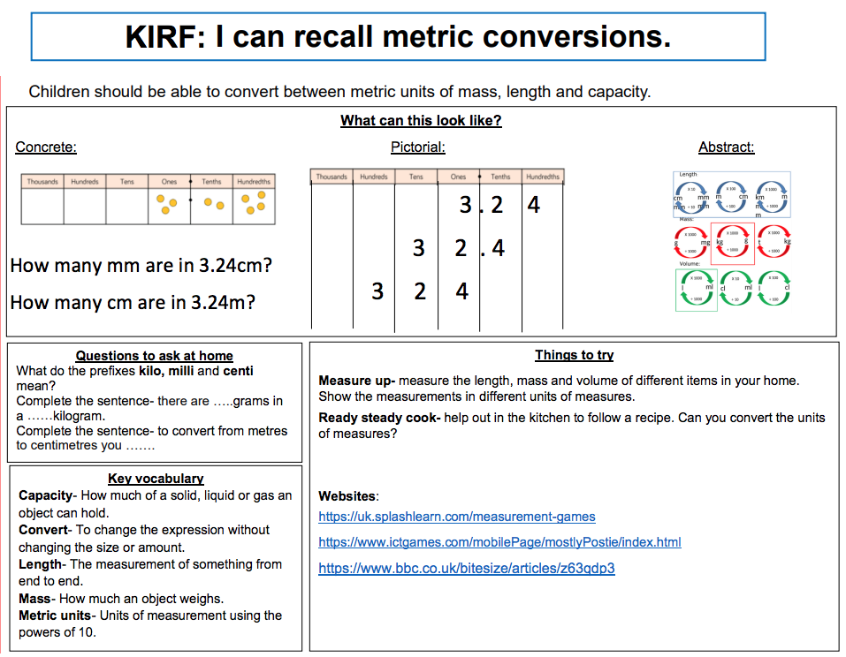
Year 5 - Summer 1

