Slide 1

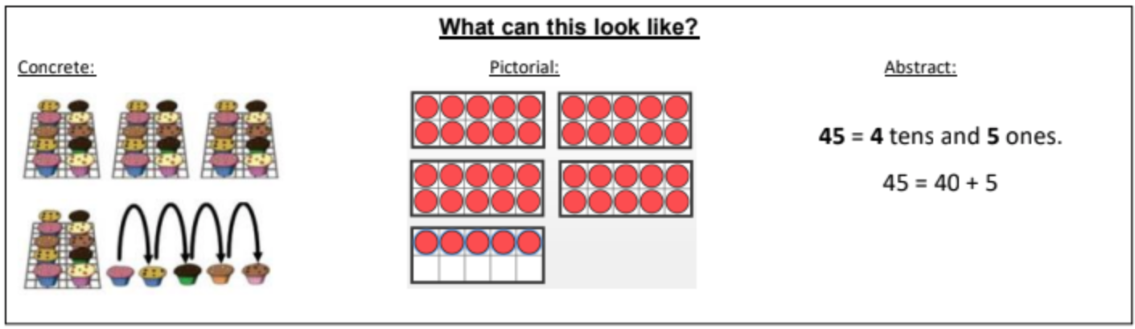
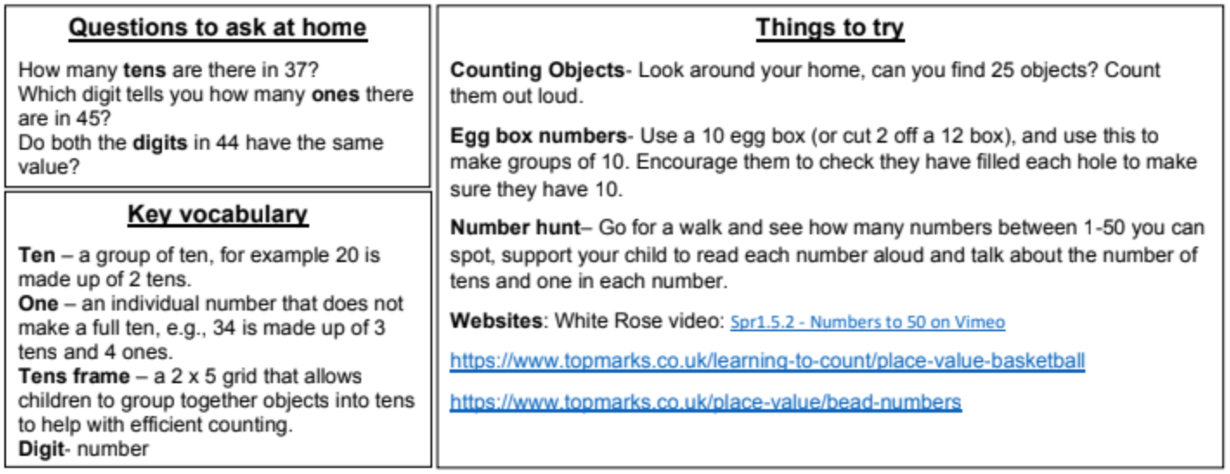
KIRF: I can recognise numbers to 50
Children need to be able to use their knowledge of numbers to 20 to help them read and write numbers to 50. in addition to this, they need to partition (split) each number in to tens and ones.
Year 1 –Spring 2

Slide 2
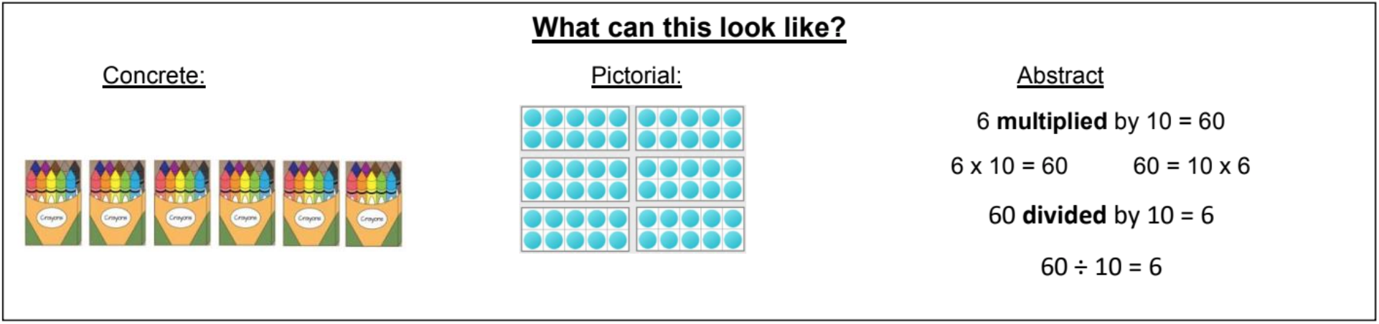
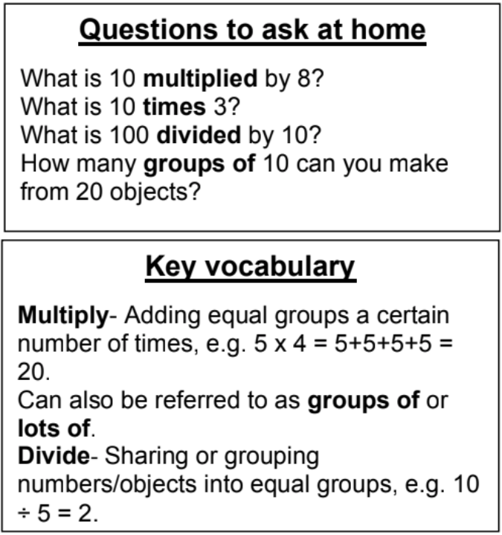
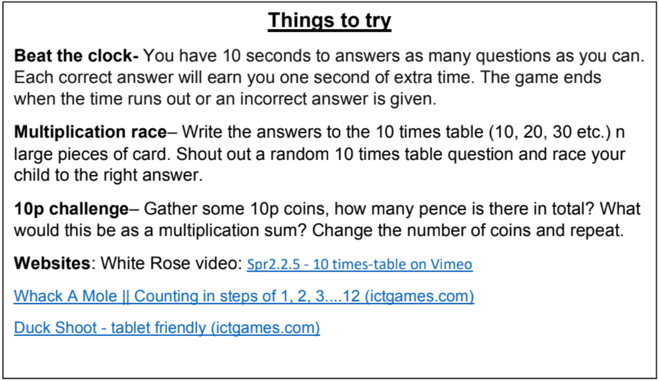
KIRF: I know the 10 times tables (multiplication and division)
Being able to recall the multiplication and division facts for the ten times table is a key skill for KS1 learners. They should already be able to count forward and back in tens, however they also need to be able to recall the facts in any order and find missing numbers ( e.g. __ x 10 = 60).
Year 2 – Spring 2

Slide 3
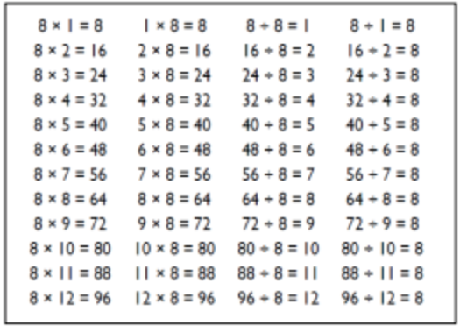
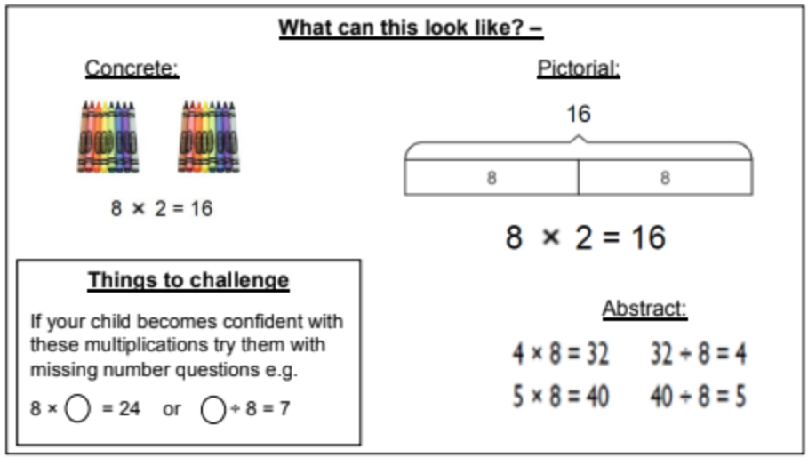
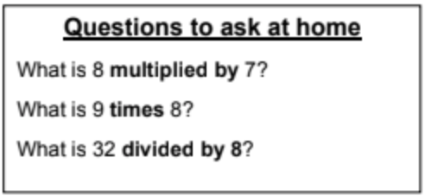
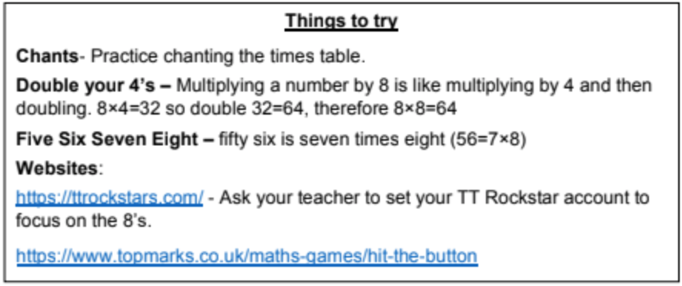
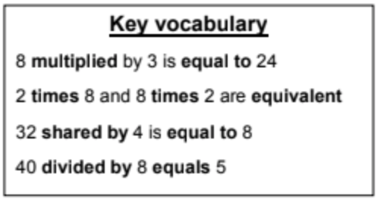
KIRF: I know the 8 times tables (multiplication and division)
It is important that children are able to recall the multiplication and division facts for the 8 times table. Children need to be able to recall the facts in any order and find missing numbers ( e.g. __ x 8 = 56).
Year 3 – Spring 2

Slide 4
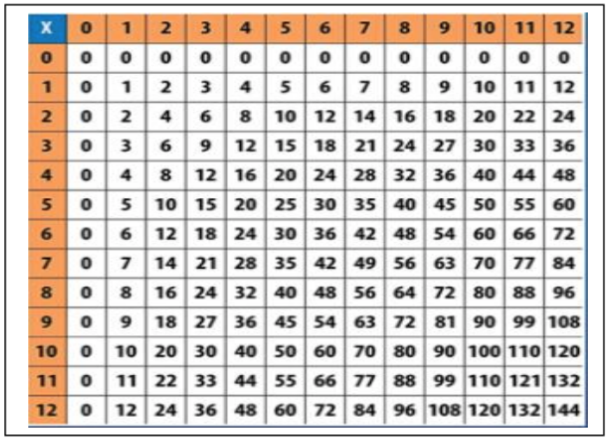
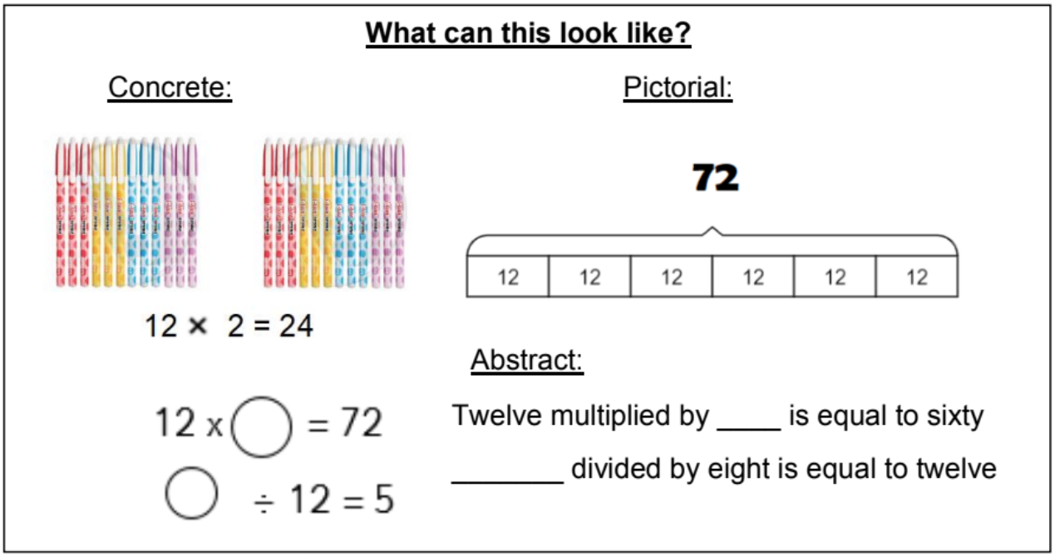
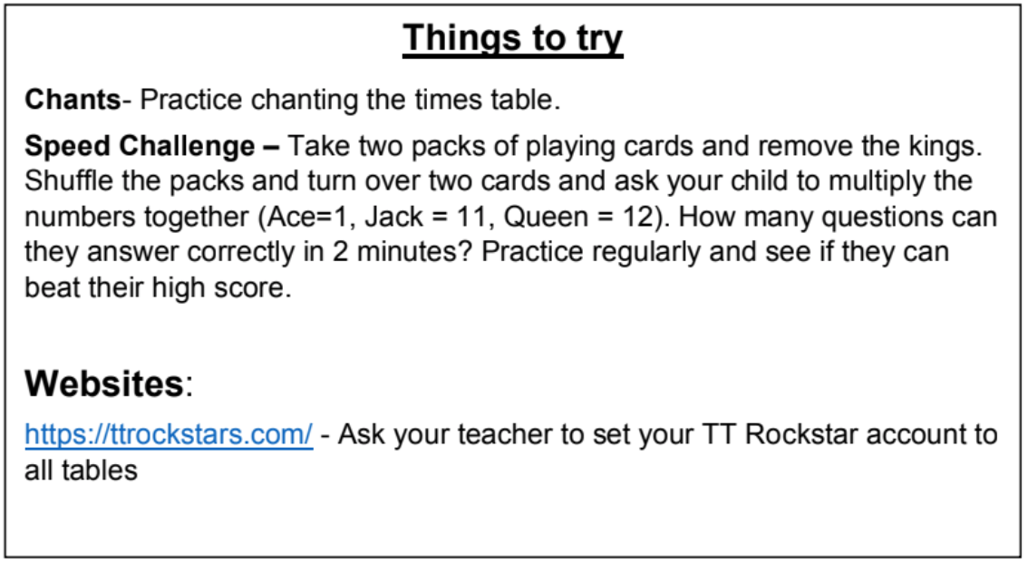
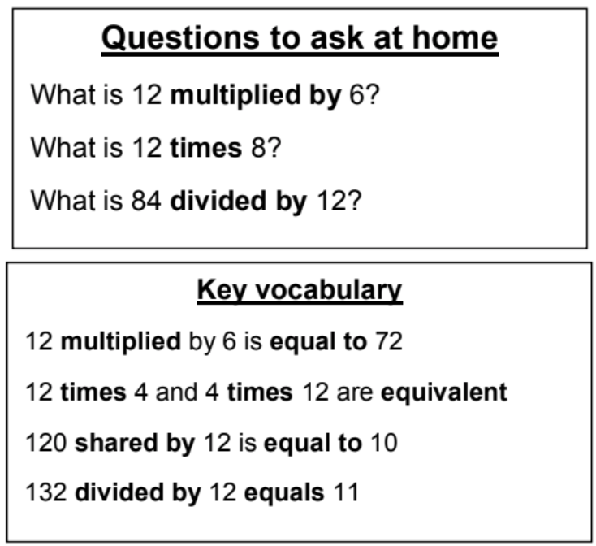
KIRF: all the table facts to 12x12(multiplication and division)
The multiplication facts are fundamental to so many areas of the maths curriculum. Therefore it is important that children can recall the table facts quickly.
Year 4 – Spring 2

Slide 5
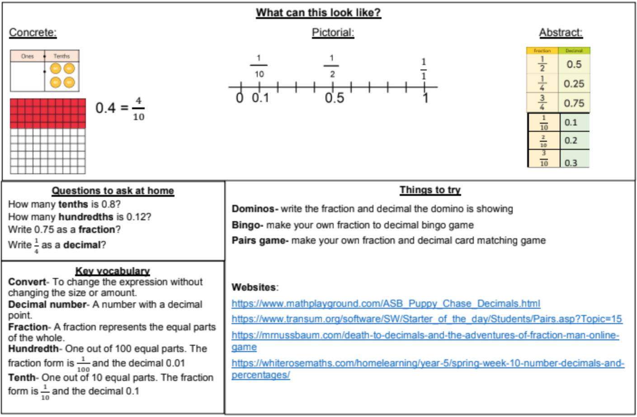
KIRF: I can recognise equivalent fractions and decimals
.
In year 5 children learn about the relationship between fractions and decimals. It is important that they are able to instantly recall the equivalences.
Year 5 – Spring 2

Slide 6
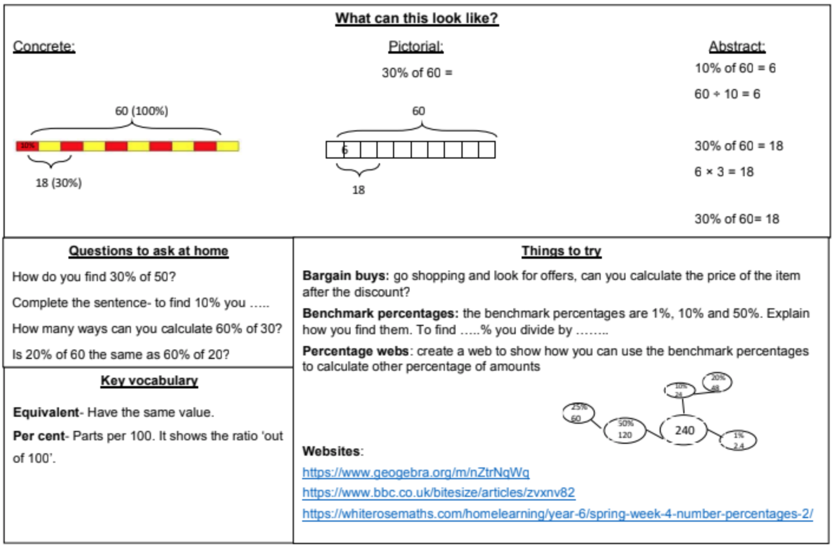
KIRF: I can convert between fractions decimals and percentages.
Children should be able to use known fractional equivalences to find percentages of amounts. They must be able to recall how to find common percentages instantly.
Year 6 – Spring 2

