Slide 1

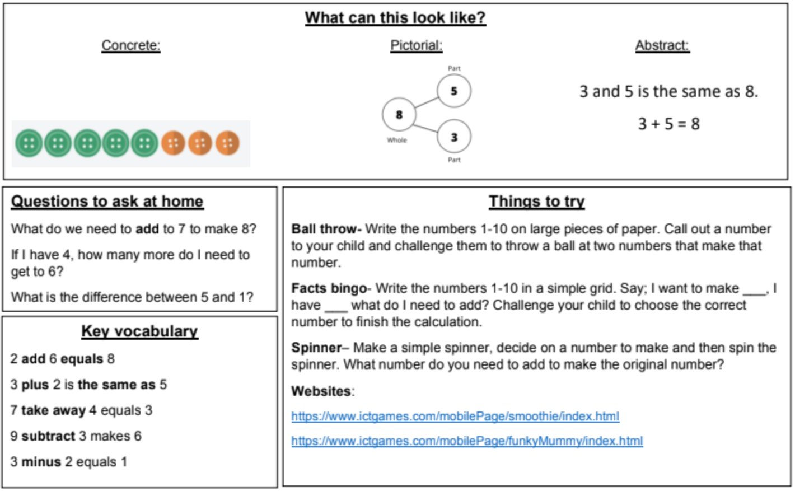
KIRF: I know facts within 10
Children are expected to know the composition of all the numbers to 10. For example 5 + 2 = 7 or 3 + 4 = 7. Children should also start to use their understanding to find missing numbers, for example 4 + ? = 7
Year 1 –Spring 1

Slide 2
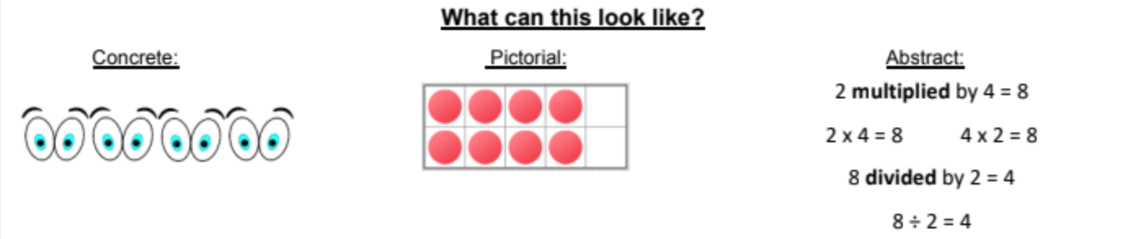
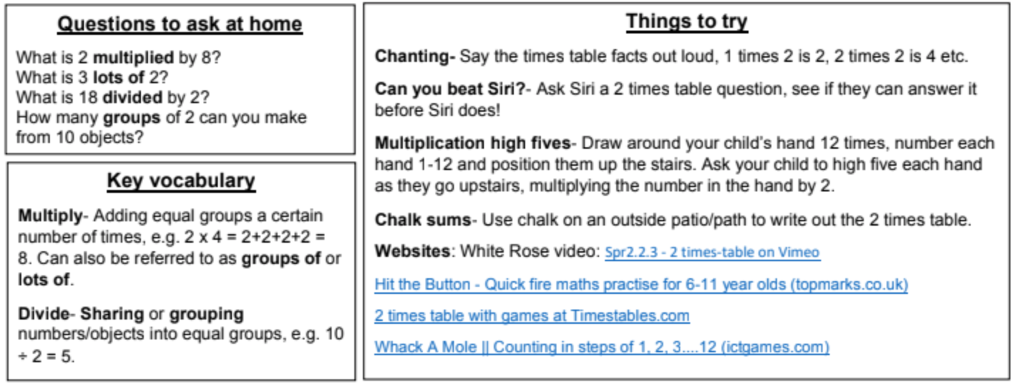
KIRF: I know the 2 times tables (multiplication and division)
Being able to recall the multiplication and division facts for the two times table is a key skill for KS1 learners. They should already be able to count forward and back in twos, however they also need to be able to recall the facts in any order and find missing numbers ( e.g. __ x 2 = 16).
Year 2 – Spring 1

Slide 3
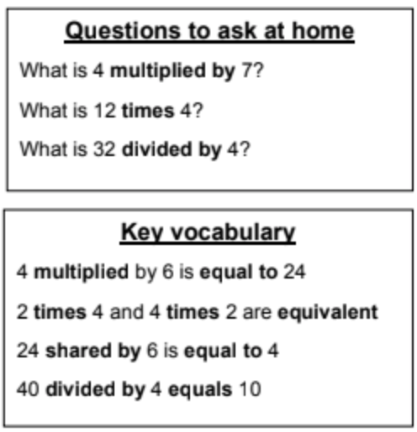
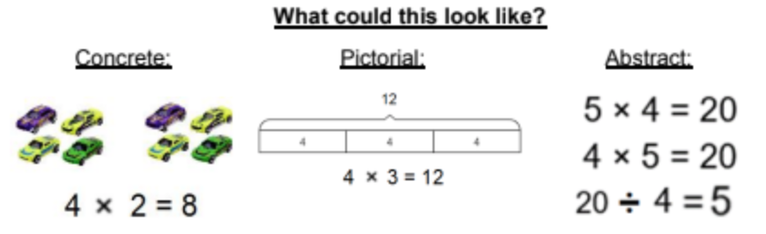
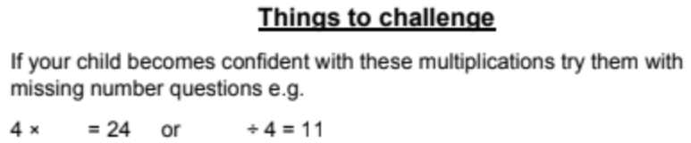
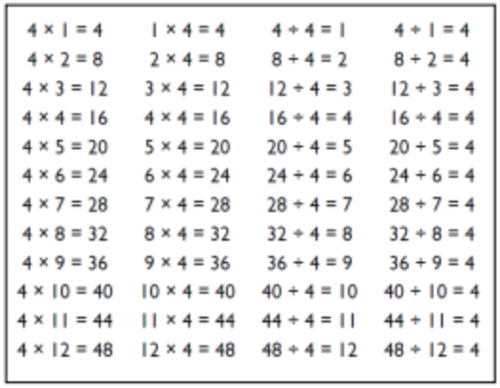
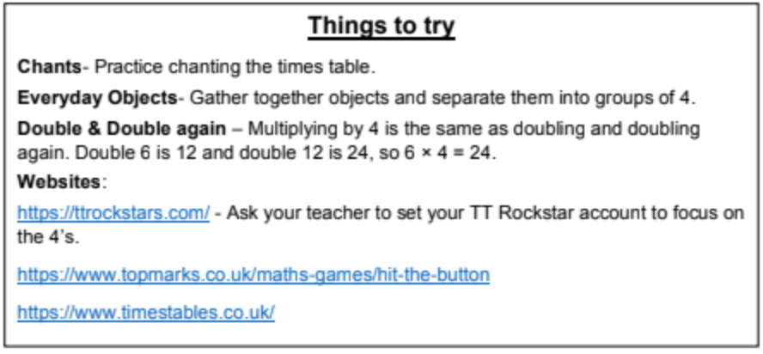
KIRF: I know the 4 times tables (multiplication and division)
Being able to recall the multiplication and division facts for the four times table. Children need to be able to recall the facts in any order and find missing numbers ( e.g. __ x 4 = 16).
Year 3 – Spring 1

Slide 4
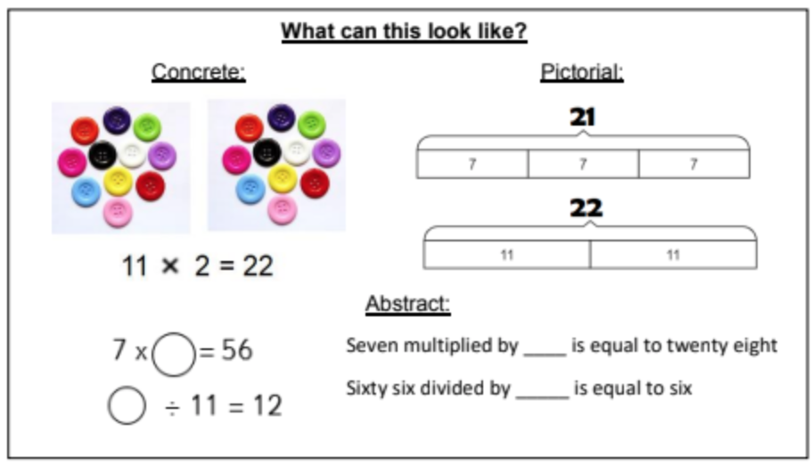
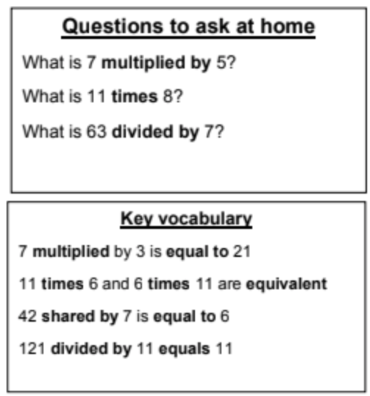
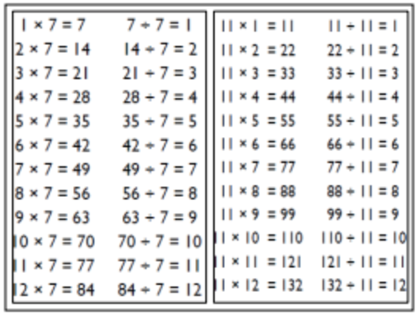
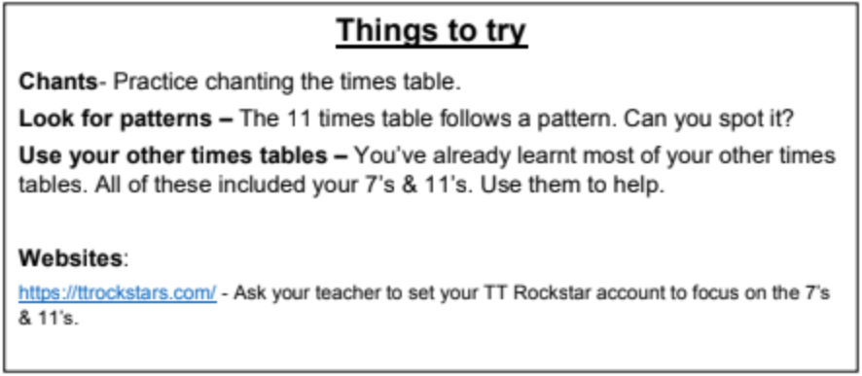
KIRF: I know the 7 and 11 times tables (multiplication and division)
Being able to recall the multiplication and division facts for the seven and eleven times table. Children need to be able to recall the facts in any order and find missing numbers ( e.g. __ x 7 = 28).
Year 4 – Spring 1

Slide 5
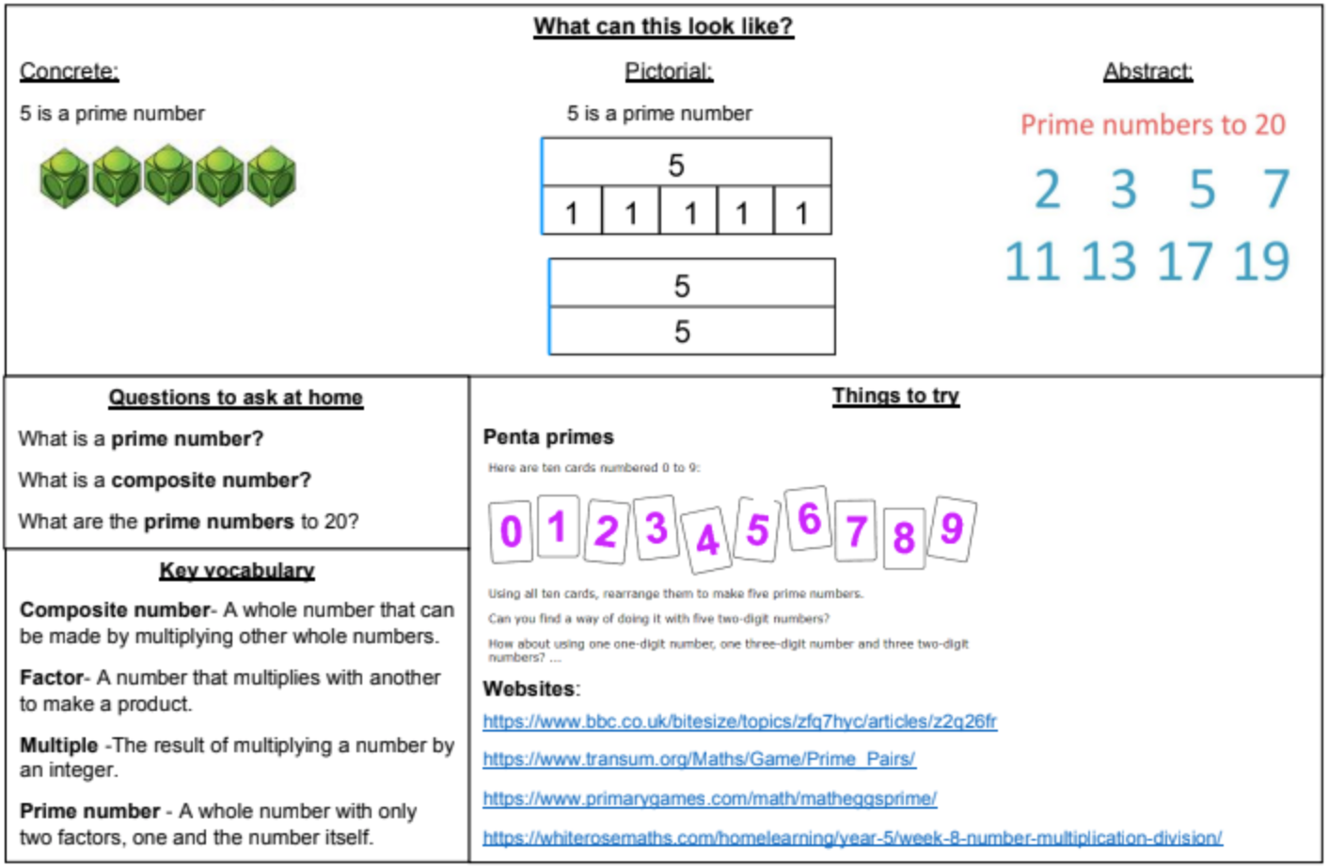
KIRF: I can identify prime number to 20 .
A prime number is a number with only 2 factors (itself and 1). The aim is the children are able to recall all the prime numbers to 20 instantly.
Year 5 – Spring 1

Slide 6
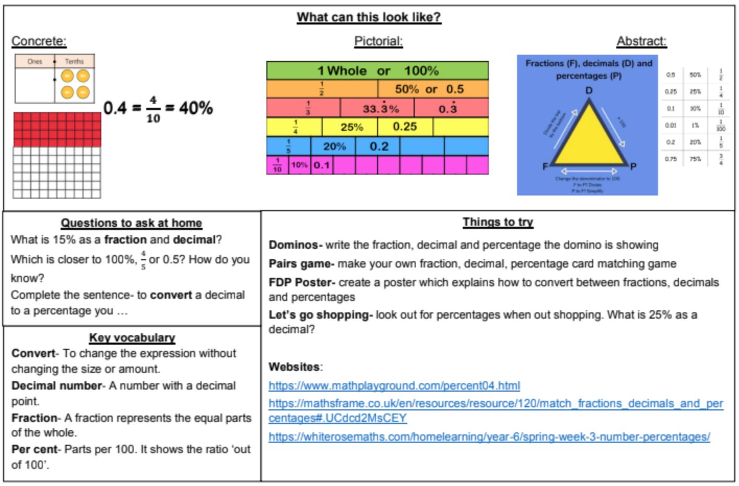
KIRF: I can convert between fractions decimals and percentages.
.
Children should be able to convert between fractions, decimals and percentages as well as being able to recall common equivalences.
Year 6 – Spring 1

