Slide 1

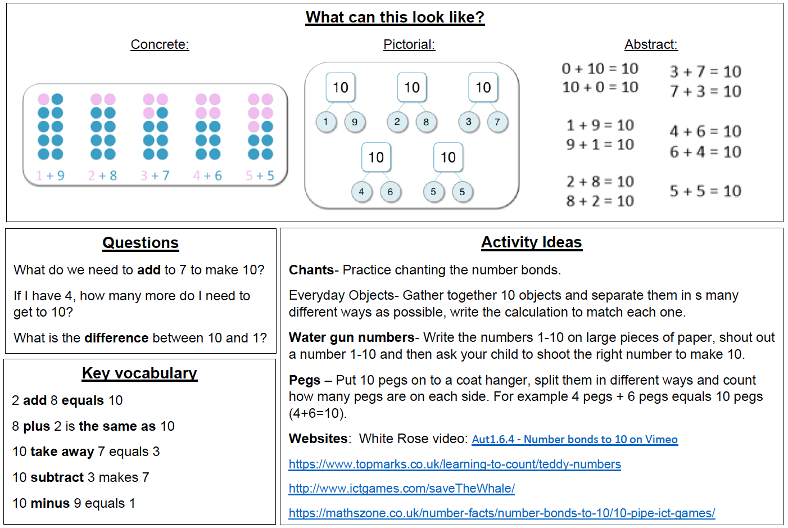
KIRF: I know number bonds to 10
Number bonds show us how numbers join together. They are very important for addition and subtraction. This half term, the children will be learning number bonds that make 10; they should be able to recall these independently.
Year 1 – Autumn 2

Slide 2
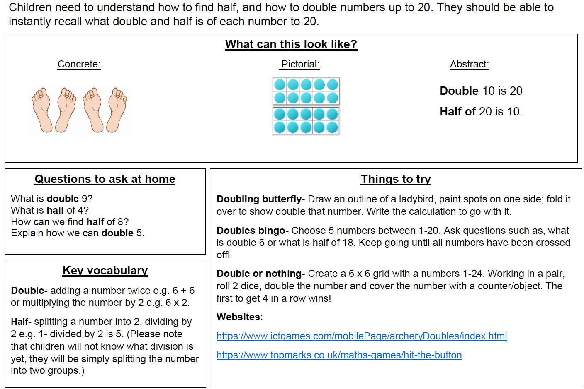
KIRF: I know doubles and halves of numbers
4
Year 2 – Autumn 2

Slide 3
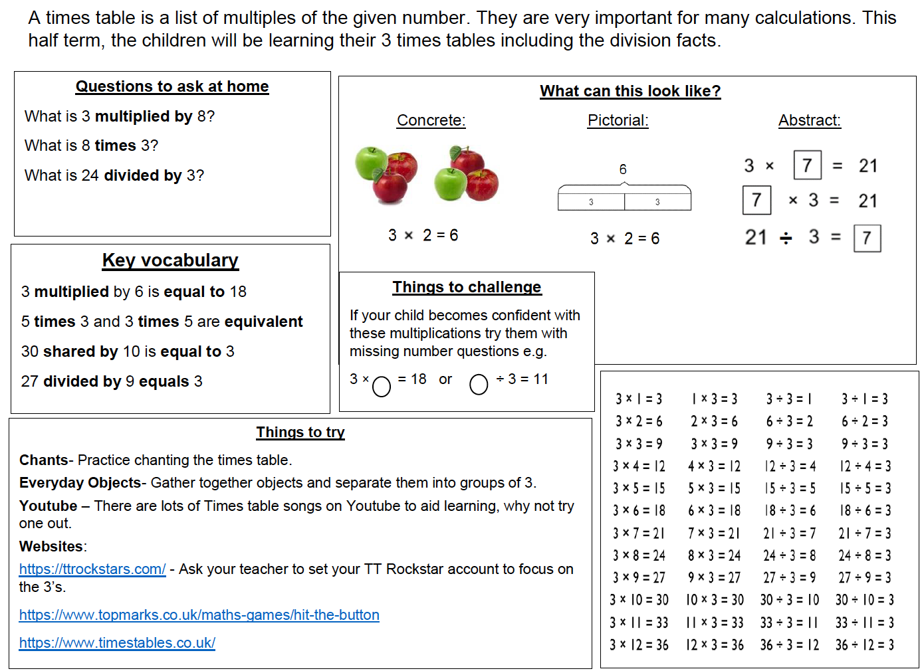
KIRF: I know the 3 times table (multiplication and division facts)
Year 3 – Autumn 2

Slide 4
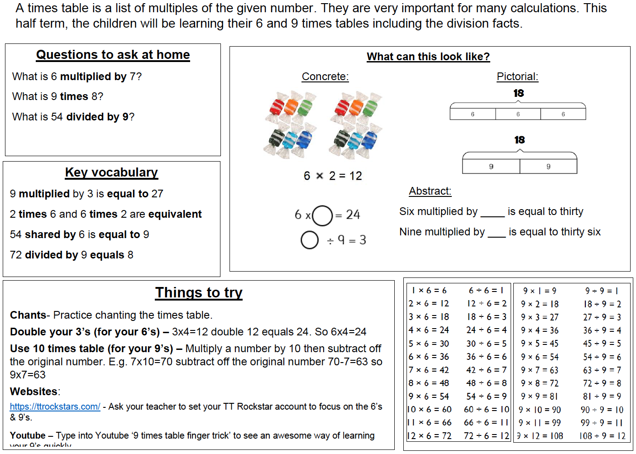
KIRF: I know the 6 and 9 times table (multiplication and division facts)
Year 4 – Autumn 2

Slide 5
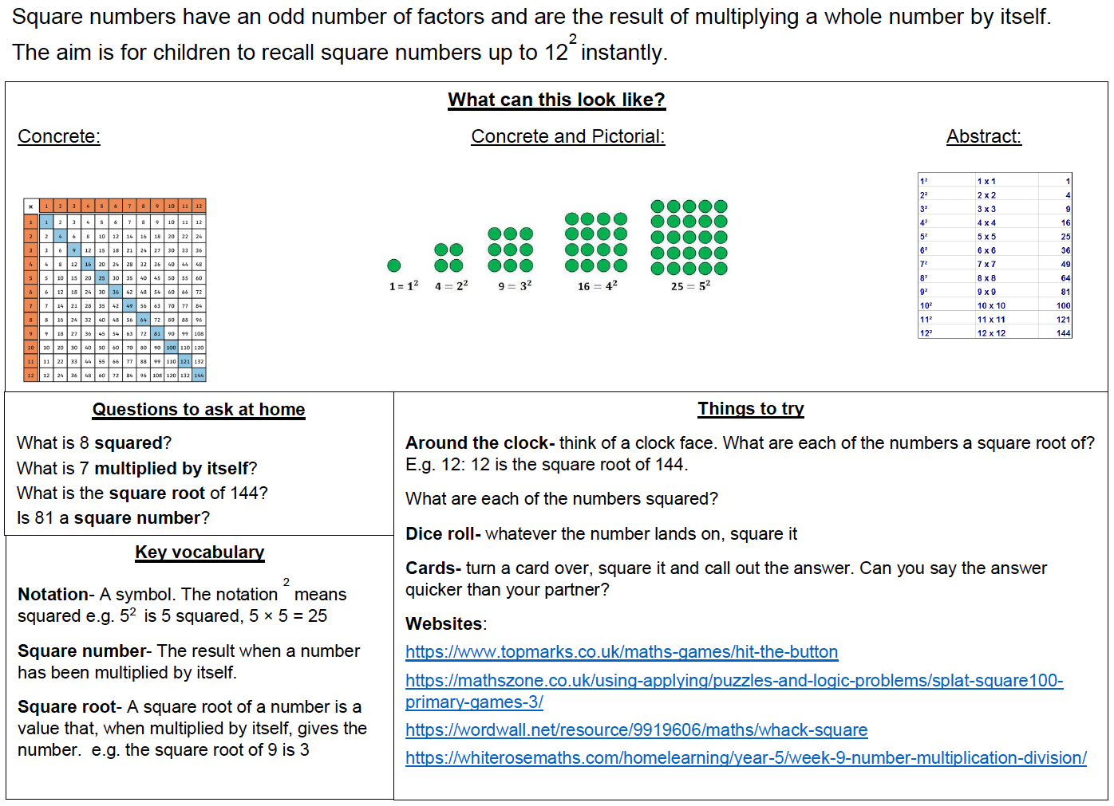
KIRF: I can recall square numbers up to 12 and their square roots.
2
Year 5 – Autumn 2

Slide 6
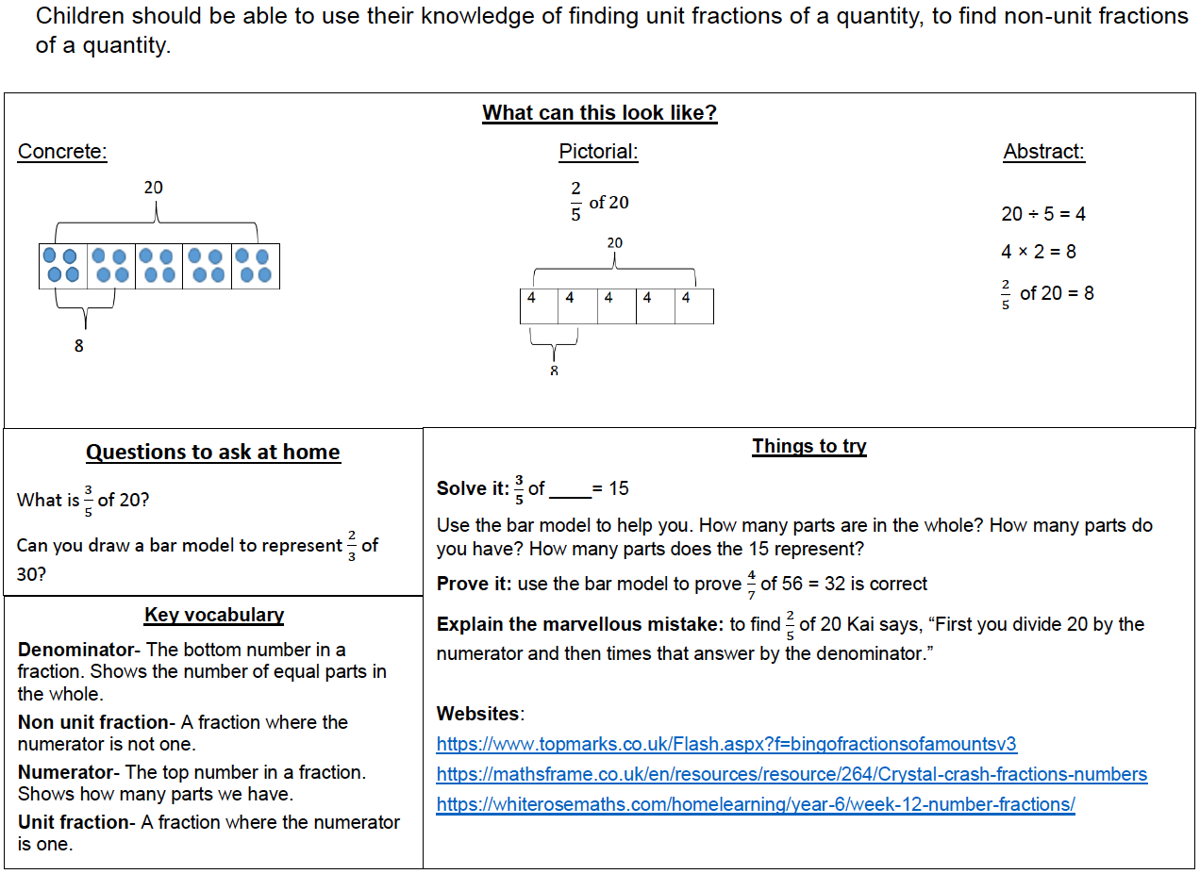
KIRF: I can find a fraction of an amount.
Year 6 – Autumn 2

