Slide 1

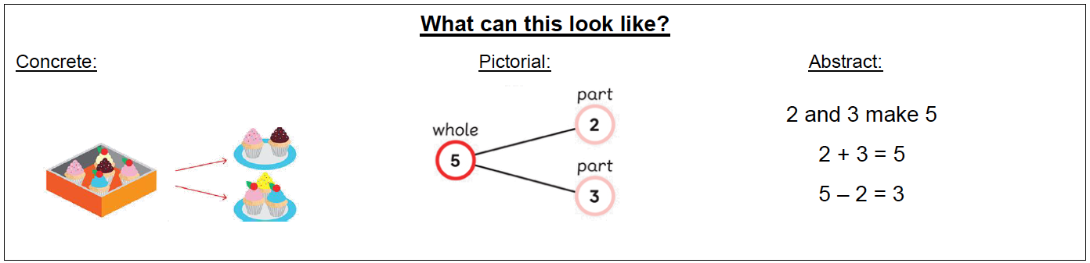
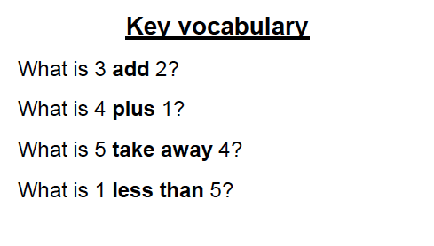
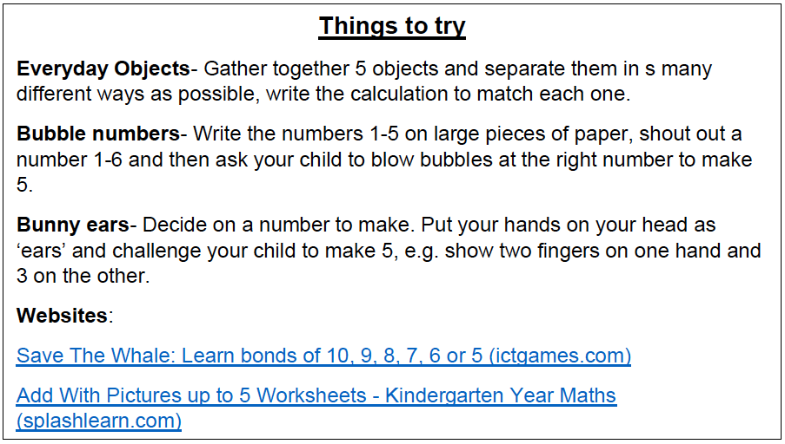
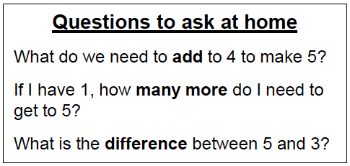
KIRF: I know number bonds to 5
Number bonds show us how numbers join together. They are very important for addition and subtraction. This half term, the children will be learning number bonds that make 5; they should be able to recall these independently.
Year 1 – Autumn 1

