Slide 1

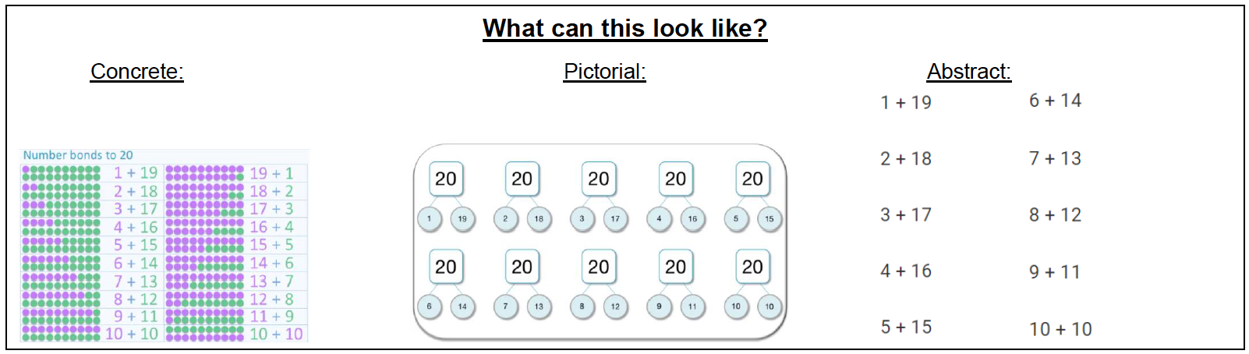
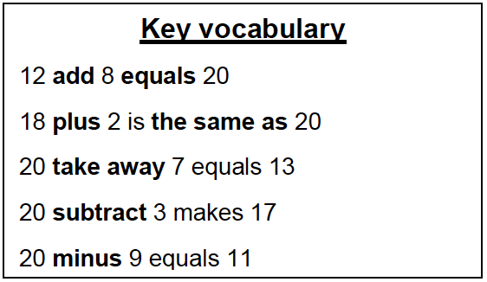
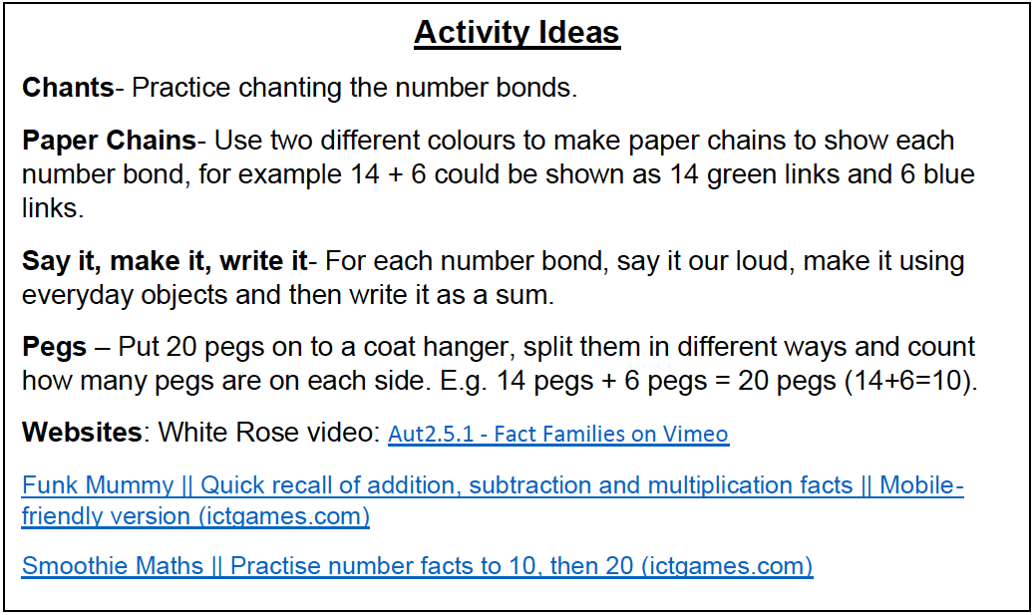
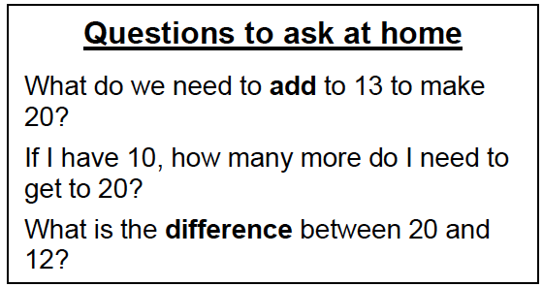
KIRF: I know number bonds to 20
Number bonds show us how numbers join together. They are very important for addition and subtraction. This half term, the children will be learning number bonds that make 20; they should be able to recall these independently.
Year 2 – Autumn 1

