Slide 1

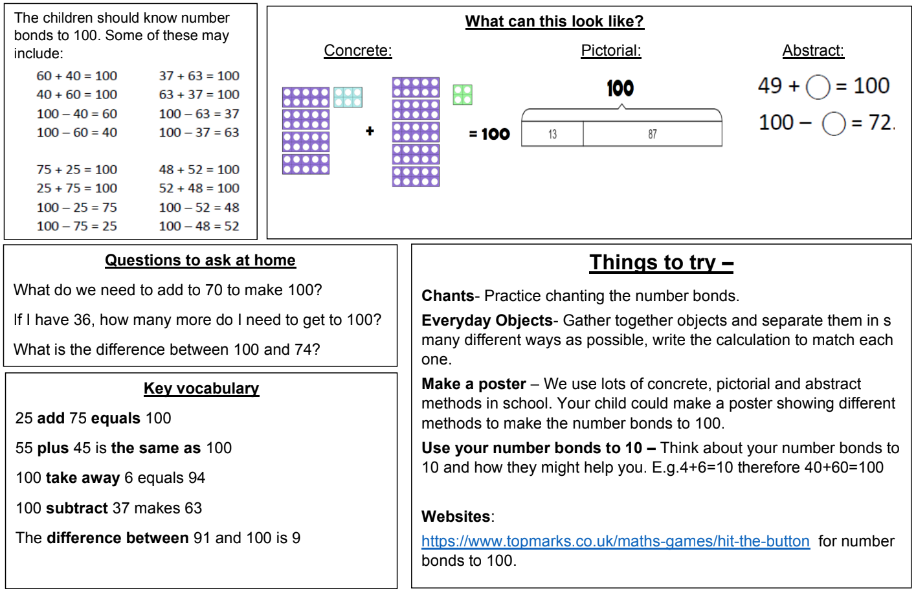
KIRF: I know number bonds to 100
Number bonds show us how numbers join together. They are very important for addition and subtraction. This half term, the children will be learning number bonds that make 100; they should be able to recall these independently.
Year 4 – Autumn 1

