Slide 1

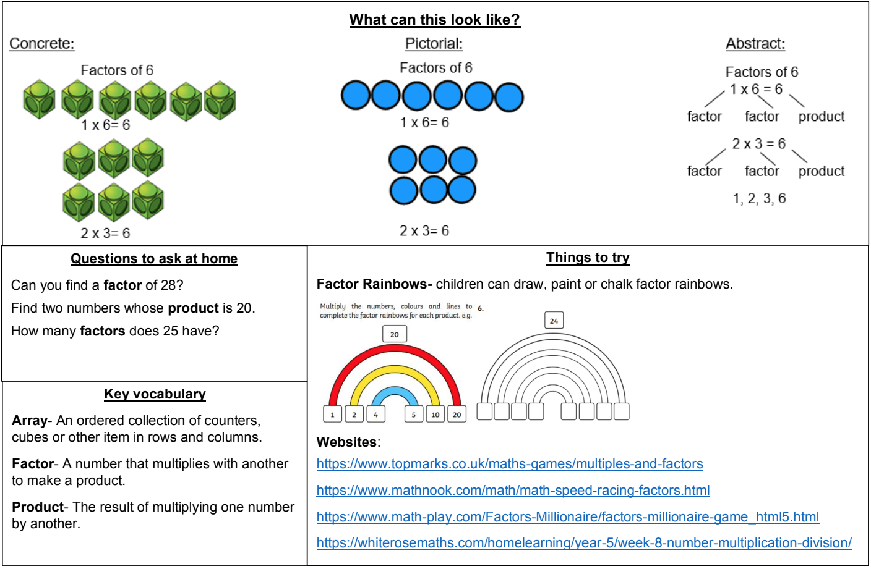
KIRF: I can find factor pairs of a number
Children should know all multiplication and division facts up to 12 x 12. When given a number in one of these tables, they should be able to state a factor pair which multiply to make this number.
Year 5 – Autumn 1

