Slide 1

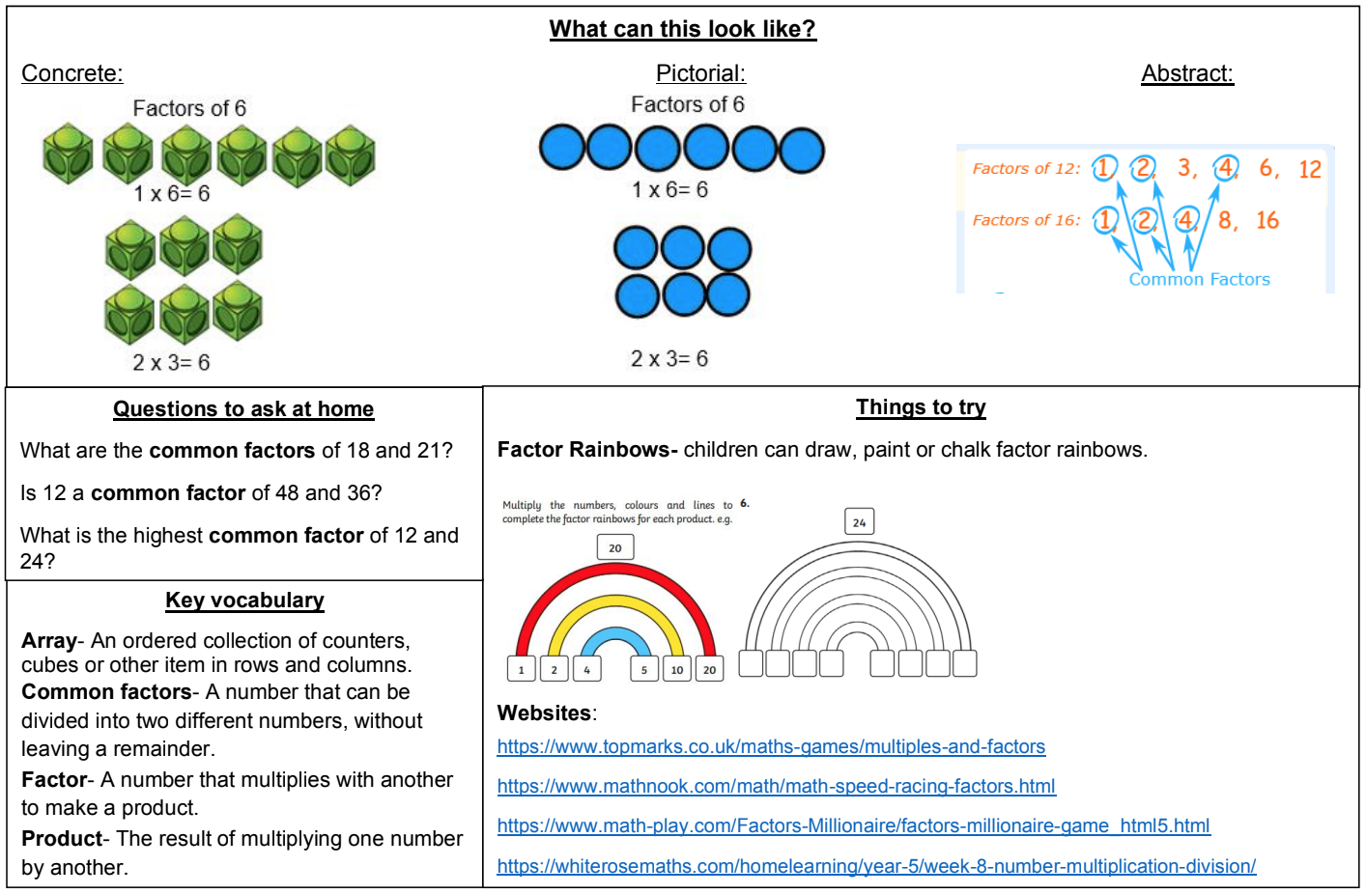
KIRF: I can identify common factors of a pair of numbers
Children should be able to use their knowledge of factors to find common factors of two numbers.
Year 6 – Autumn 1

