Slide 1

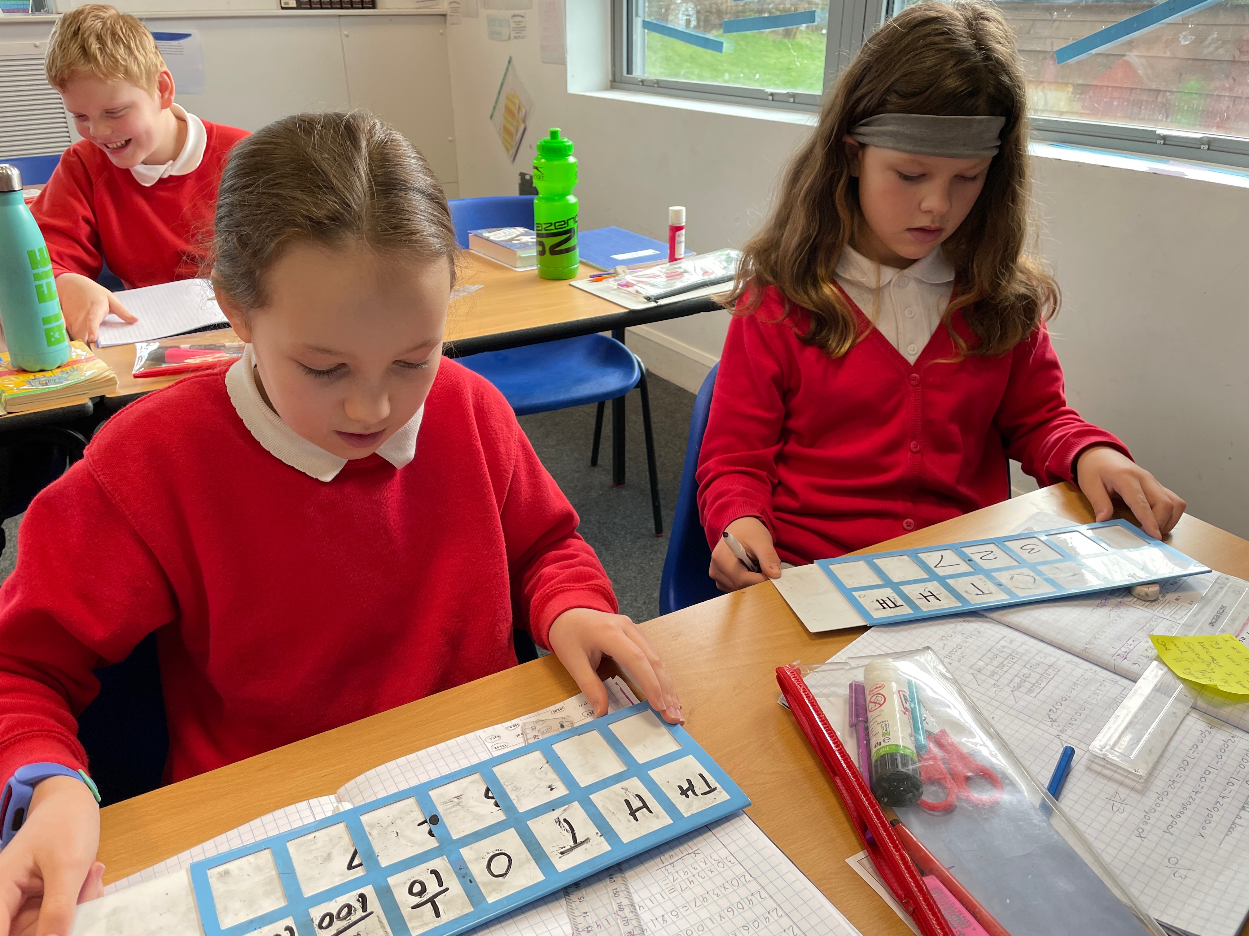
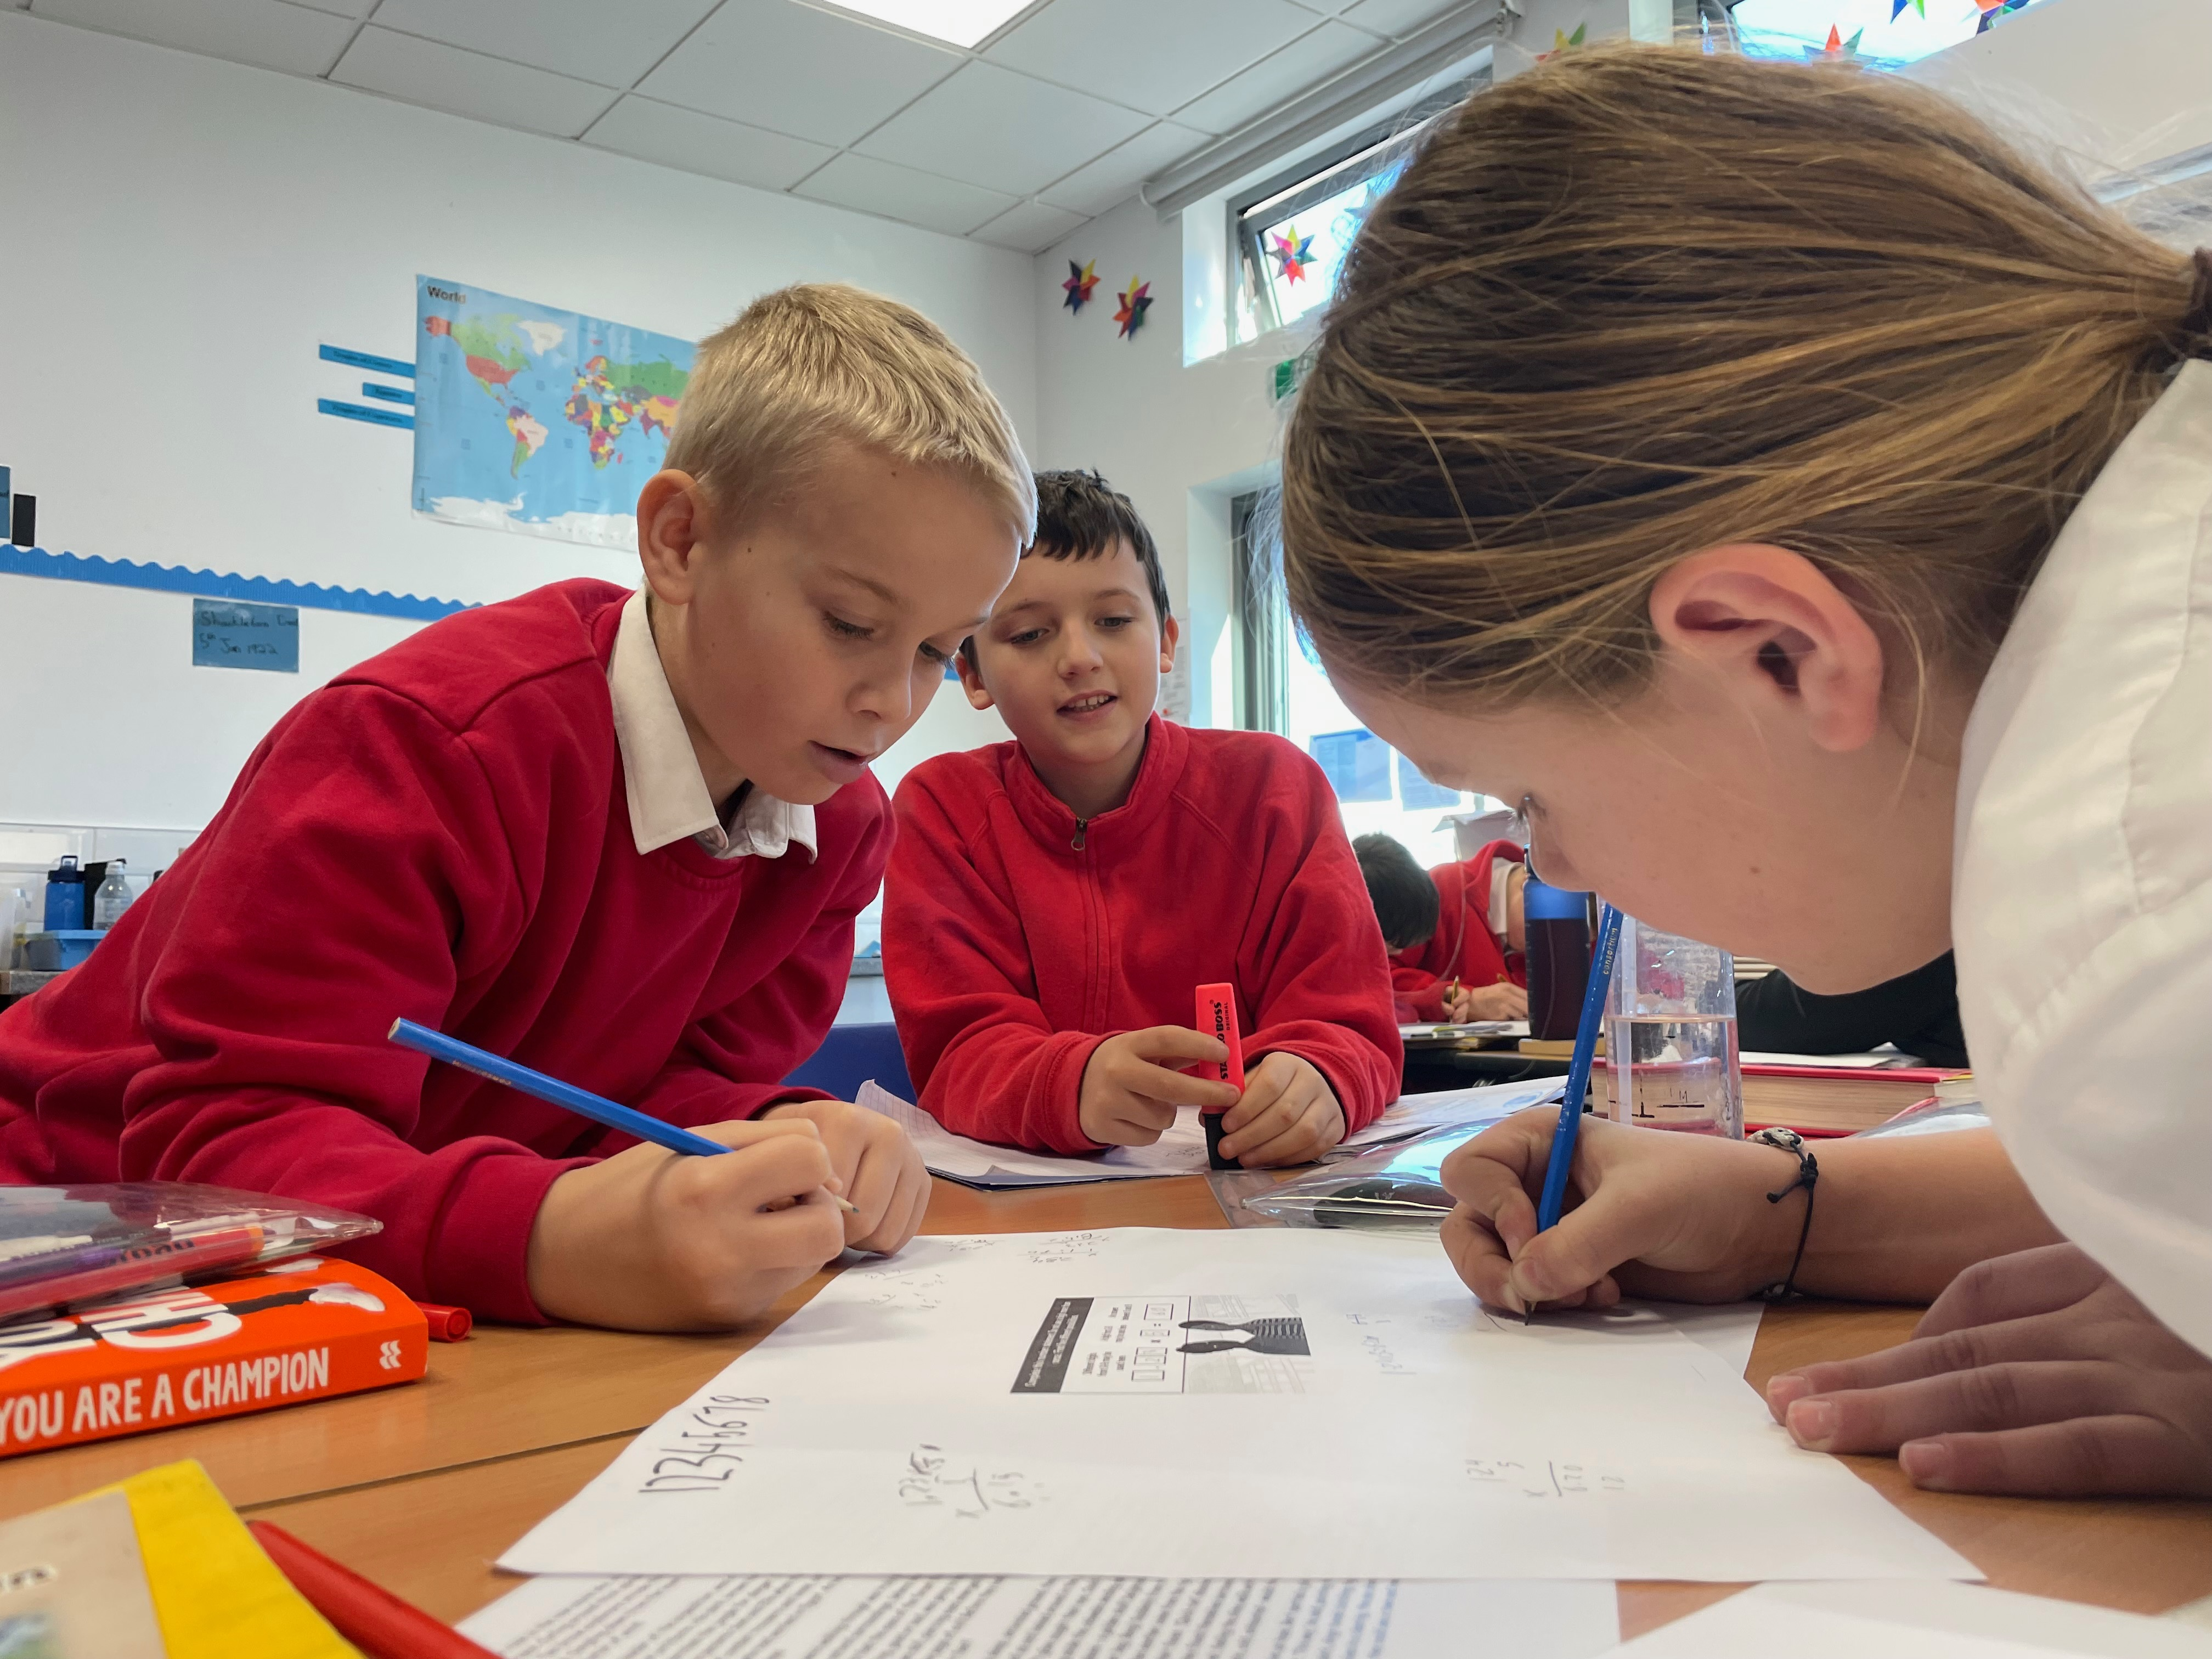

Statutory Assessment Tests 2022
Year 6 SATs 2022 Presentation for Parents, Carers & Guardians
Monday 17th January 2022

Slide 2
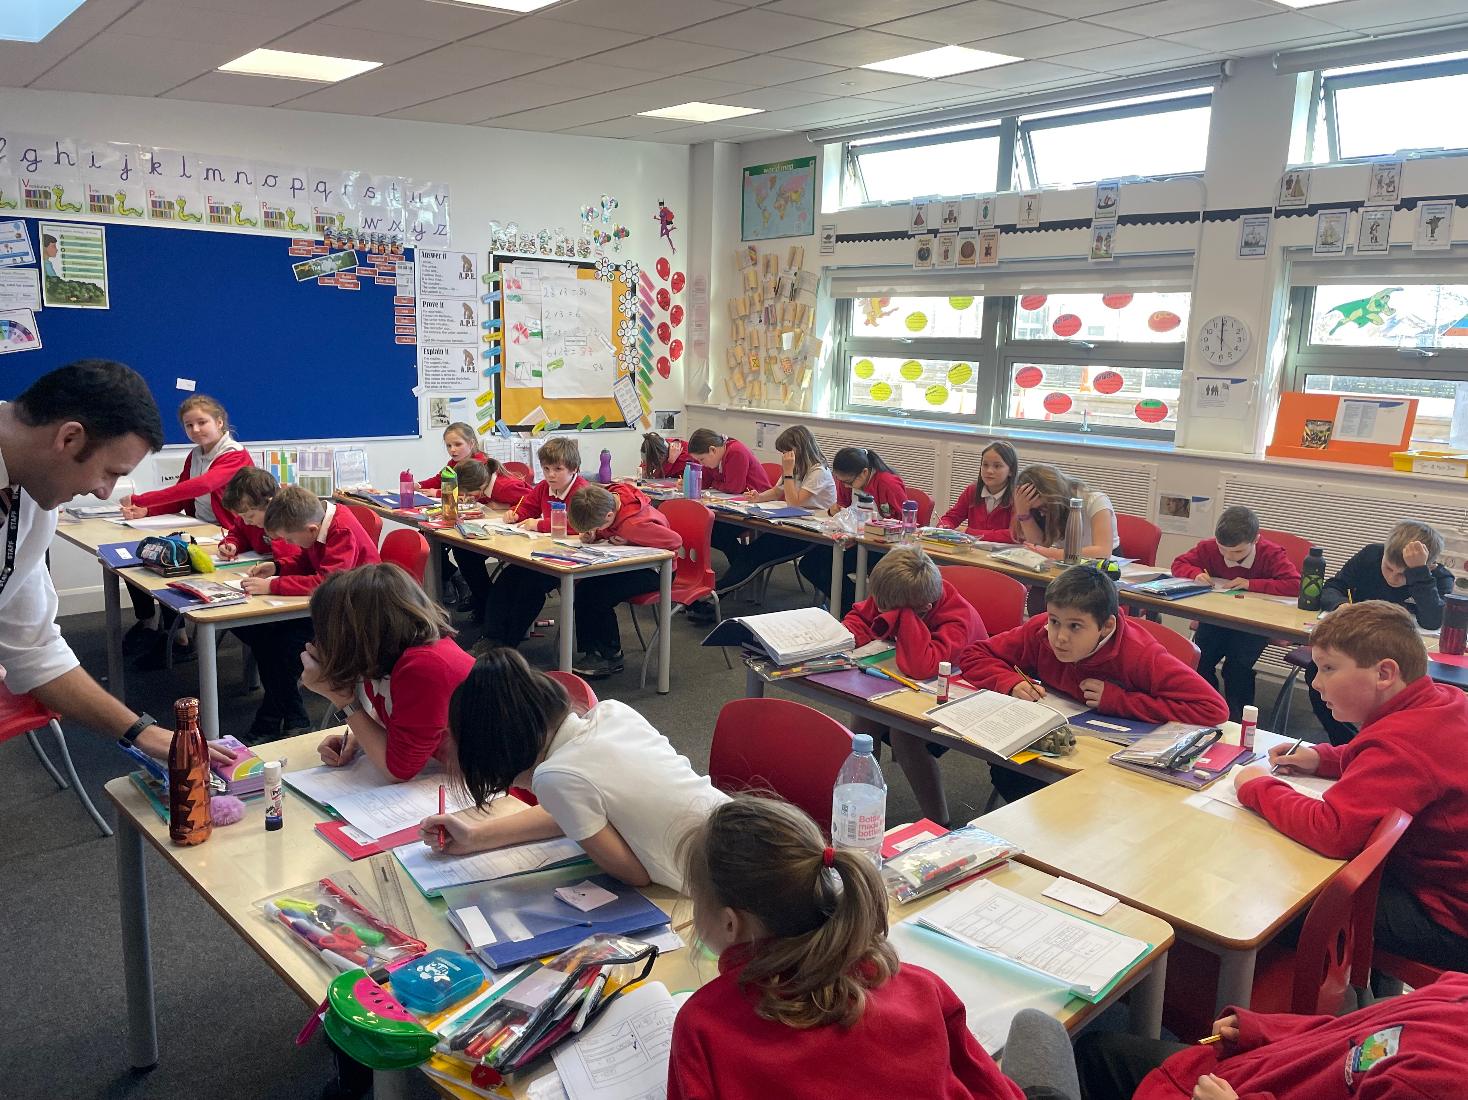
What are the SATs?
SATs are the Standardised Assessment Tests that are given to
children at the end of Key Stage 2.
The SATs take place over four days, starting on
Monday 9th May ending on Thursday 12th May.
The SATs papers consist of:
  Spelling, punctuation and grammar (paper 1: Grammar/ Punctuation/ Spelling) – Monday 9th May
  Spelling, punctuation and grammar (paper 2: Spelling test) – Monday 9th May
  Reading – Tuesday 10th May
  Maths (paper 1: Arithmetic) – Wednesday 11th May
  Maths (paper 2: Reasoning) – Wednesday 11th May
  Maths (paper 3: Reasoning) – Thursday 12th May
Writing is assessed using evidence collected throughout Year 6. There is no Year 6 SATs writing test.
The key stage 2 tests will be taken on set dates unless your child is absent, in which case they may be able to take them up to 5 school days afterwards.

Slide 3
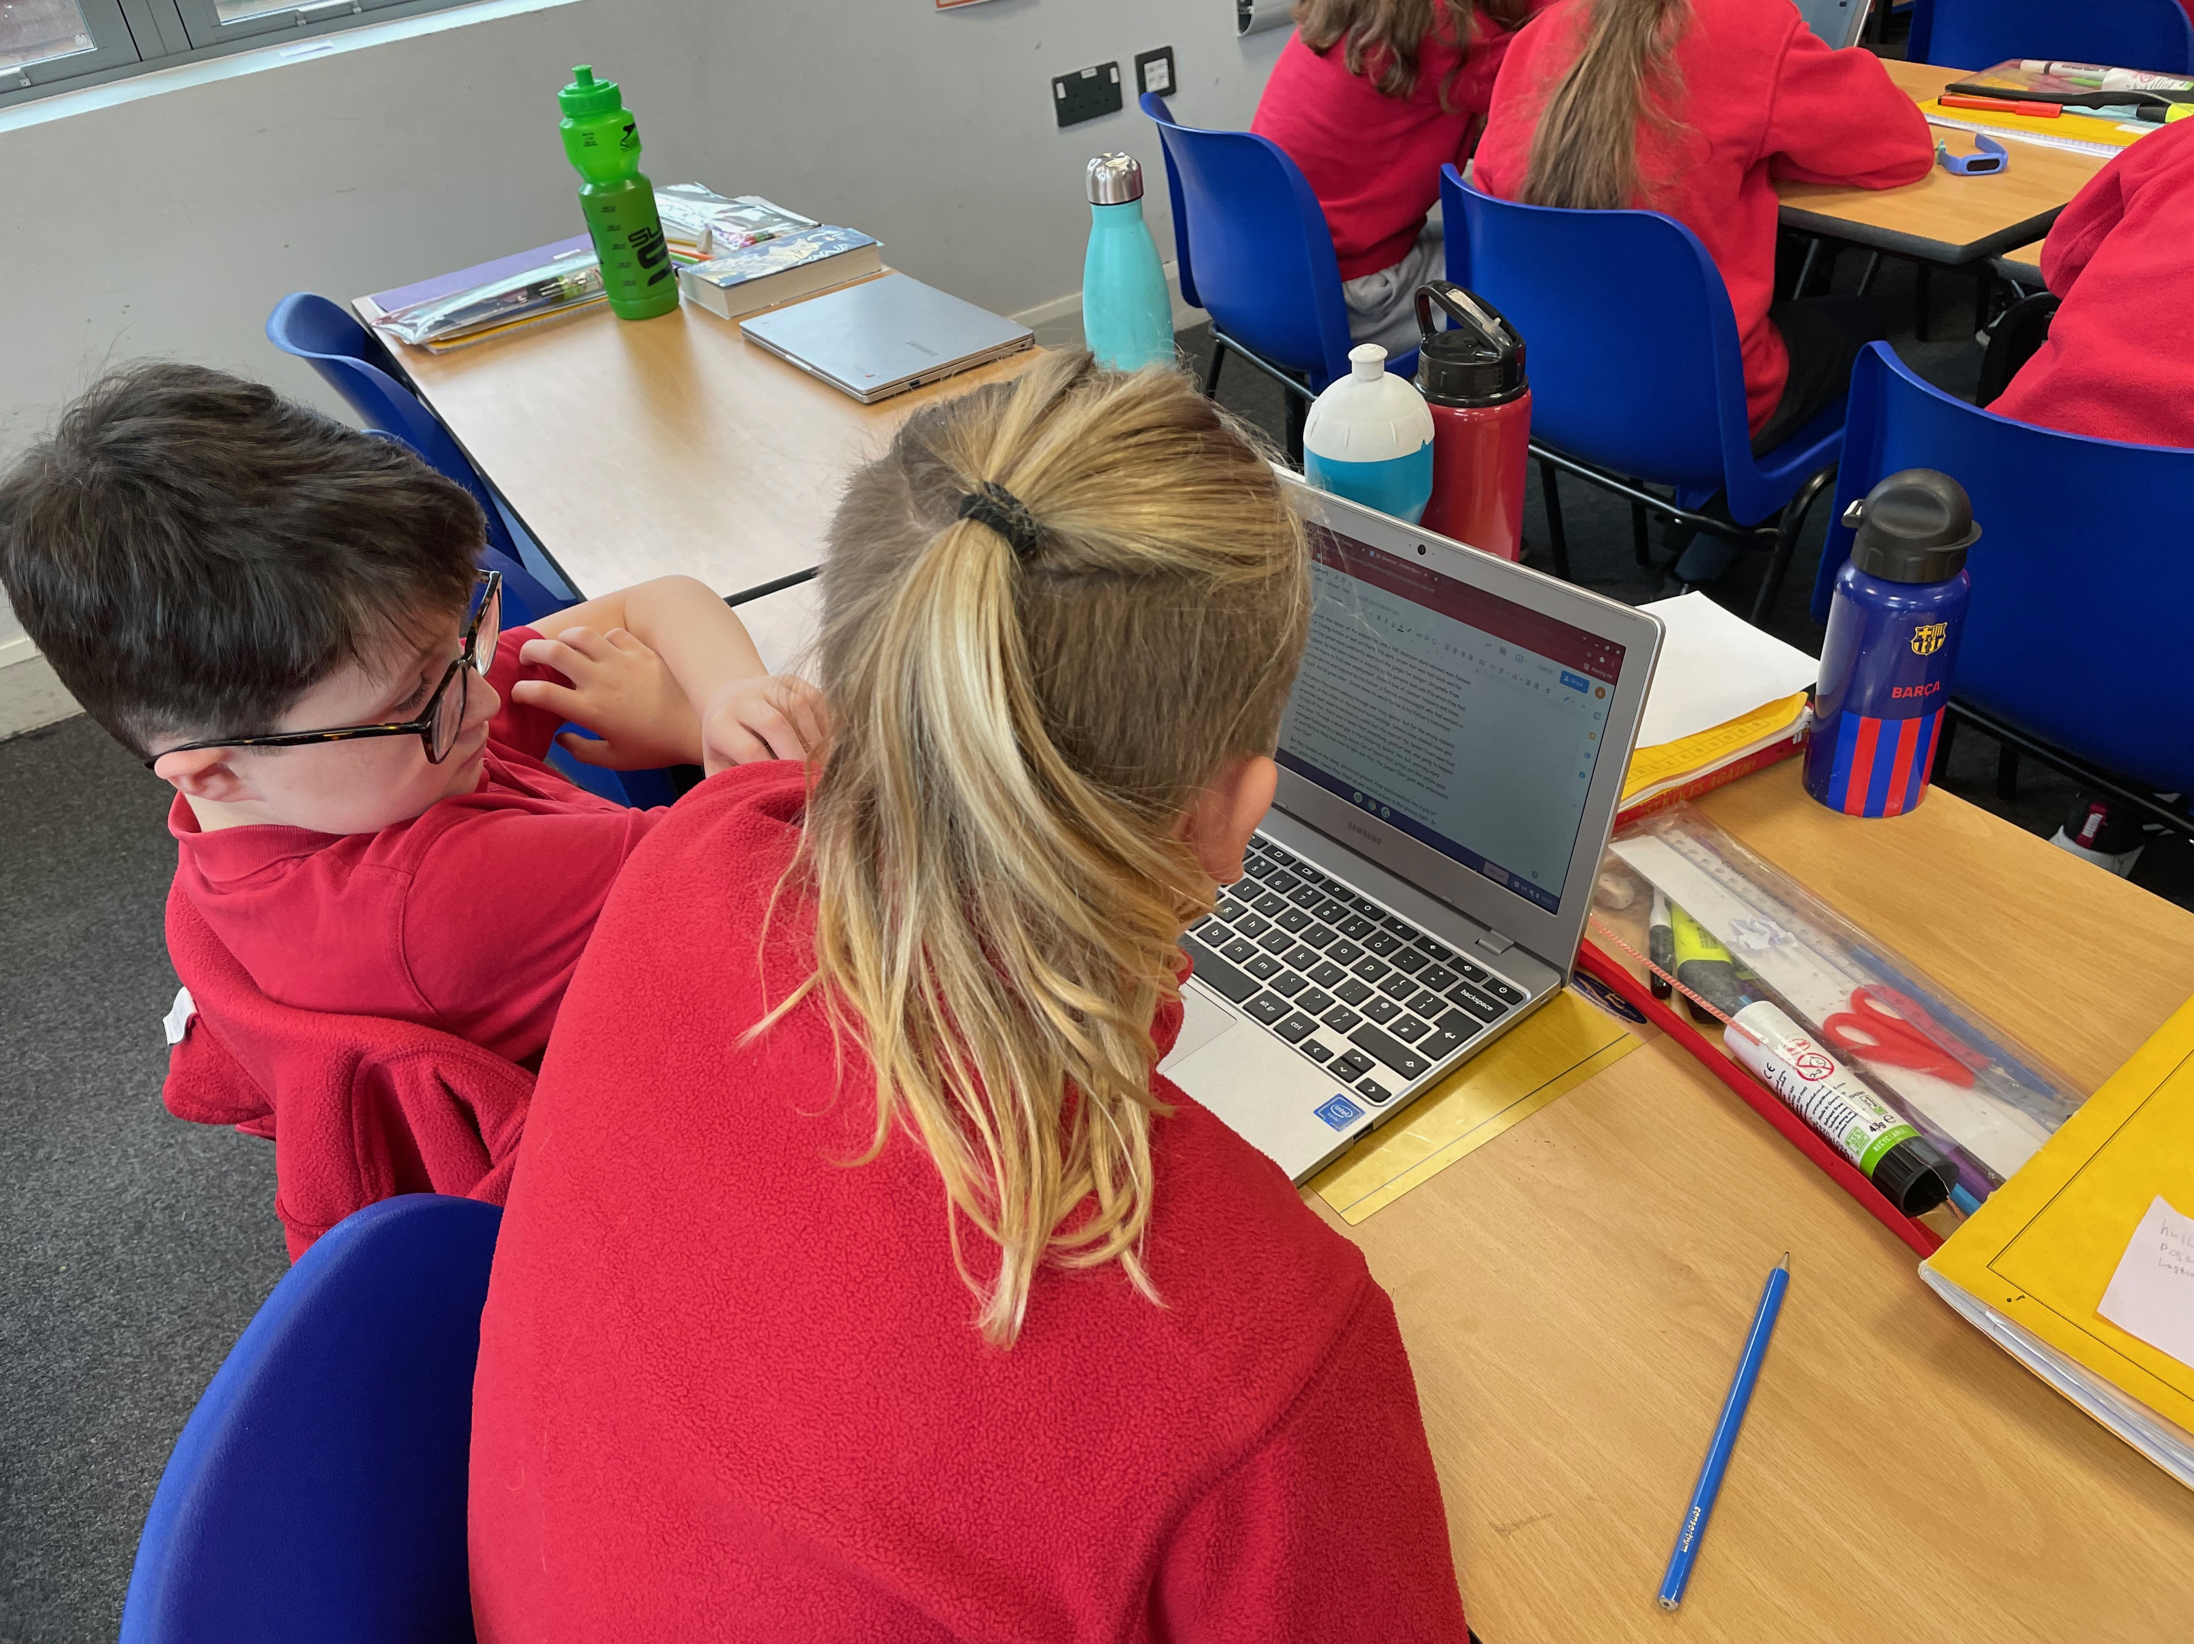
When and how the SATs are completed
The tests take place during normal school hours, under exam conditions.
Children are not allowed to talk to each other from the moment the assessments are handed out until they are collected at the end of the test.
After the tests are completed, the papers are sent away to be marked externally.
The results are then sent to the school in July.
Each test lasts no longer than 60 minutes:
  Spelling, punctuation and grammar (paper 1: Grammar/ Punctuation) – 45 minutes
  Spelling, punctuation and grammar (paper 2: Spelling) – 15 minutes
  Reading – 60 minutes
  Maths (paper 1: Arithmetic) – 30 minutes
  Maths (paper 2: Reasoning) – 40 minutes
  Maths (paper 3: Reasoning) – 40 minutes

Slide 4

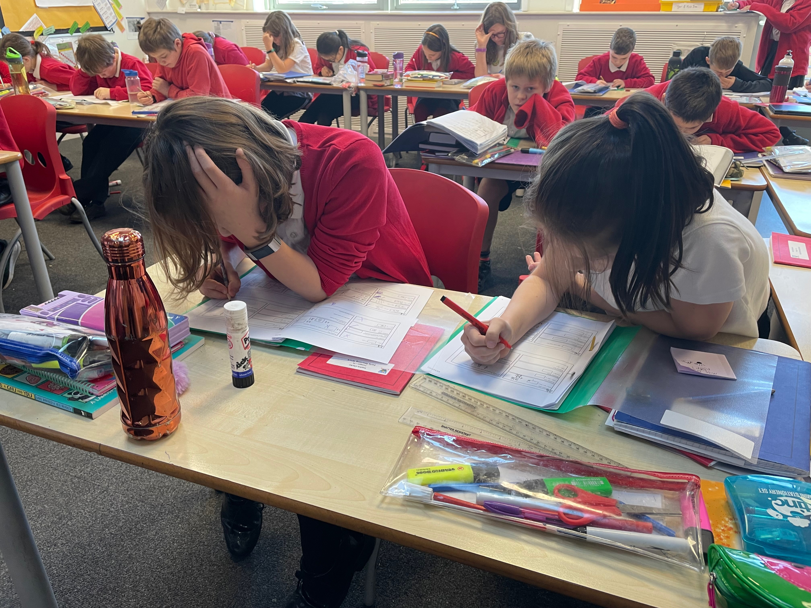
Specific arrangements for SATs:
Children with additional needs (who have similar support as part of day-to-day learning in school) may be allotted specific arrangements, including:
Additional (extra) time;
Tests being opened early to be modified;
An adult to scribe (write) for them;
Using word processors independently;
An adult to read for them (including a translator);
The use of prompts or rest breaks;
Arrangements for children who are ill or injured at the time of the tests.
Pupils with an EHCP are automatically allowed up to 25% additional time (except for the spelling paper, which is not strictly timed). Pupils who use the modified large print or braille versions of the tests are automatically allowed up to 100% additional time.

Slide 5
What sort of results are reported?
Once marked, the tests will be given the following scores:
A raw score (the total number of marks achieved for each paper);
A scaled score (which is explained below);
A judgement of whether the National Standard has been met.
After marking each test, the external marker will convert the raw score to a scaled score. Even though the tests are made to the same standard each year, the questions must be different. This means the difficulty of the tests may vary. Scaled scores ensures an accurate comparison of performance over time.
When the scaled score is given, it is given in a range from 80 to 120.
A scaled score of 100 or more is meeting the national standard.
There are no separate tests for higher achieving pupils; however, a scaled score over 110 would show that a child is working above the national standard.

Slide 6
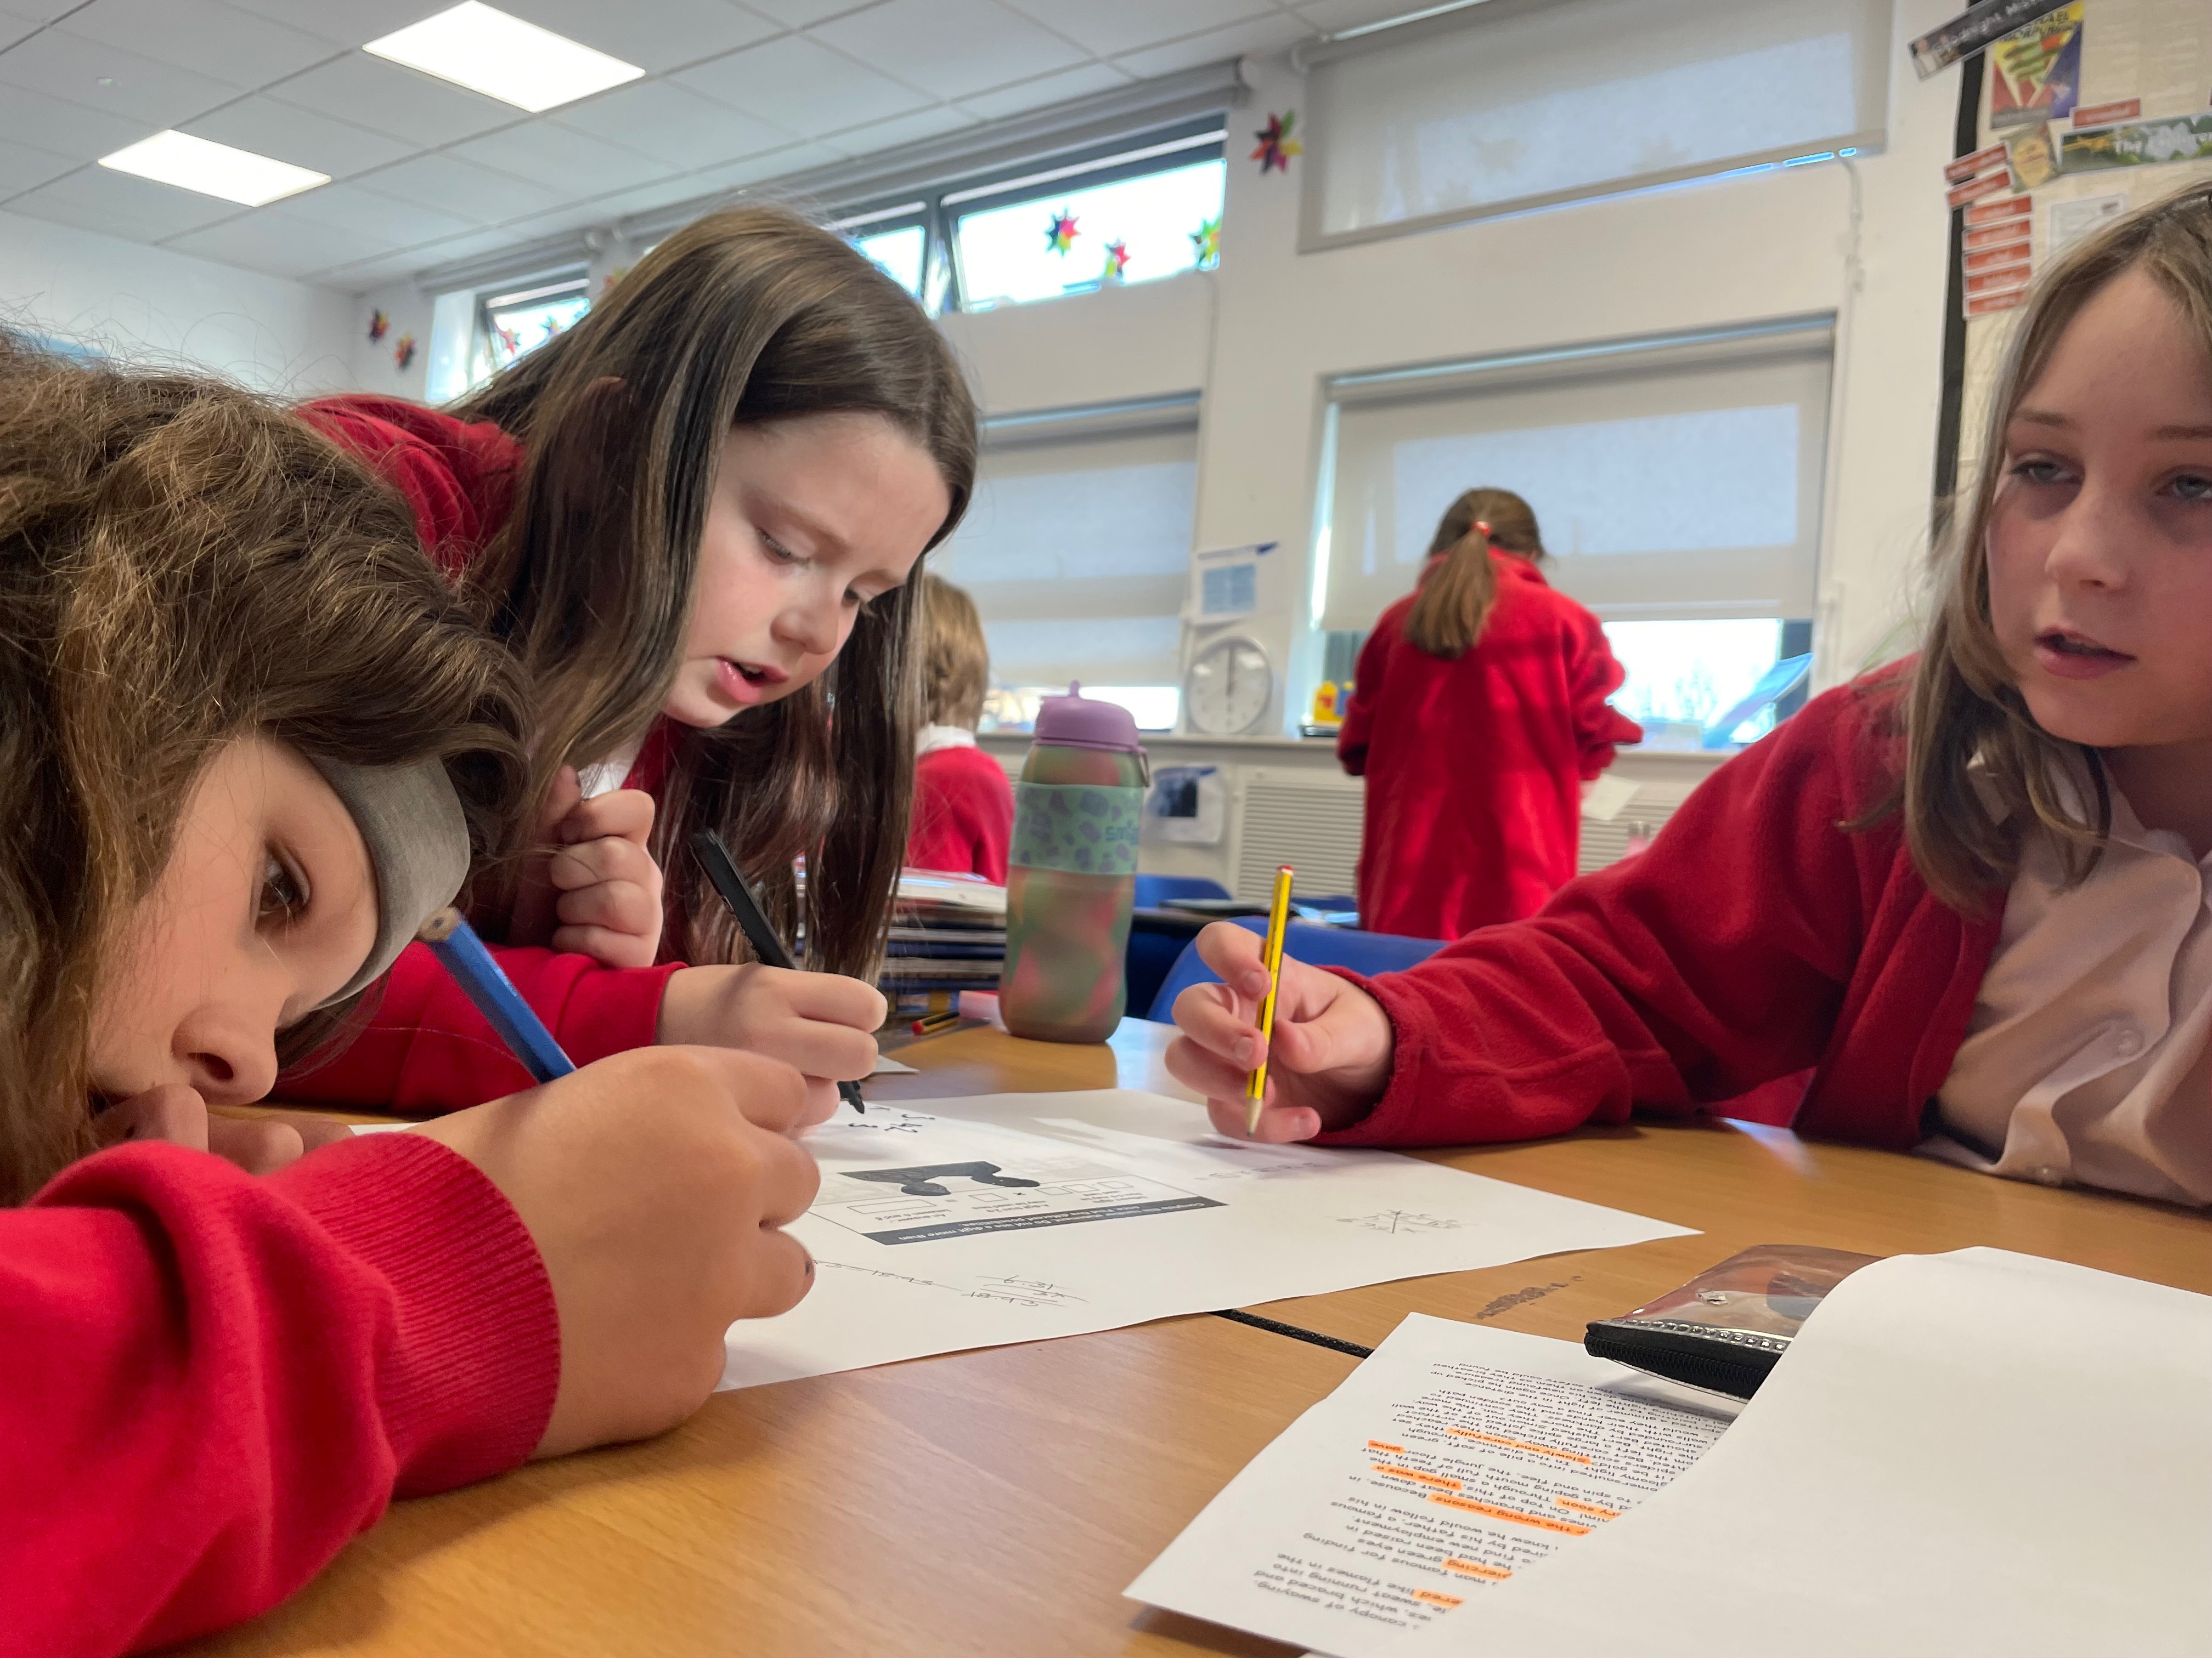
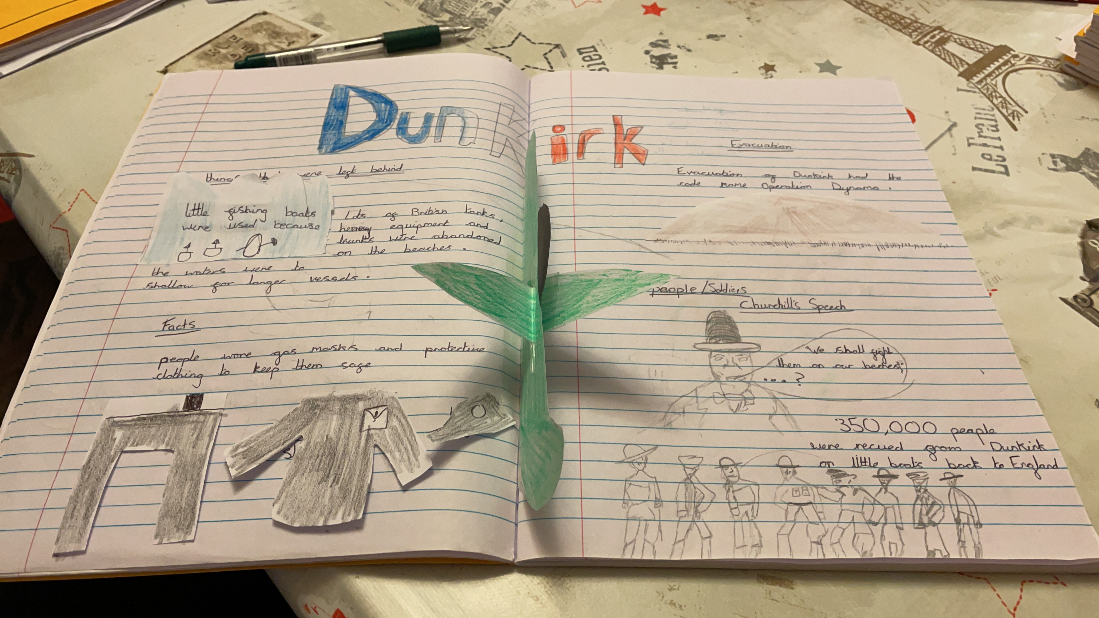
Spelling, Punctuation and Grammar: Monday 9th May
Spelling, Punctuation and Grammar consists of two papers.
Paper 1 focuses on all three elements (spelling, punctuation and grammar). The paper lasts for 45 minutes.
Paper 2 consists of a spelling test only. It should take approximately 15 minutes, although this is not a set amount of time (pupils should be given as much time as they need to complete the test).

Slide 7
Spelling, Punctuation and Grammar: Paper 1
The children will have been working hard with their class teacher on developing and securing their knowledge of the technical vocabulary needed in this test.
This test focuses on:
Grammatical terms/ word classes;
Functions of sentences;
Combining words, phrases and clauses;
Verb forms, tenses and consistency;
Punctuation;
Vocabulary;
Standard English and formality.
This test requires a range of answer types but does not require longer formal answers.
Notes:
The question types include:
Circling
Drawing lines to connect
Multiple choice questions (including ticking tables)
One-word answers
Short answer questions

Slide 8
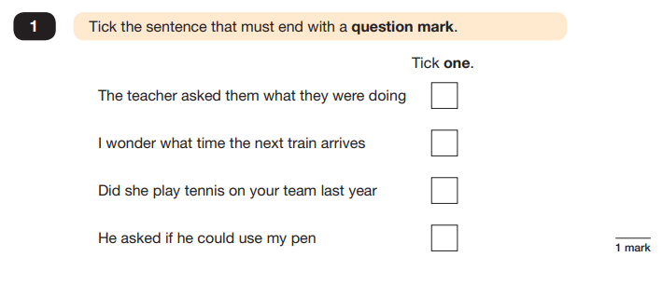
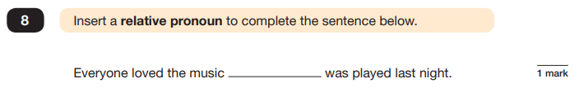
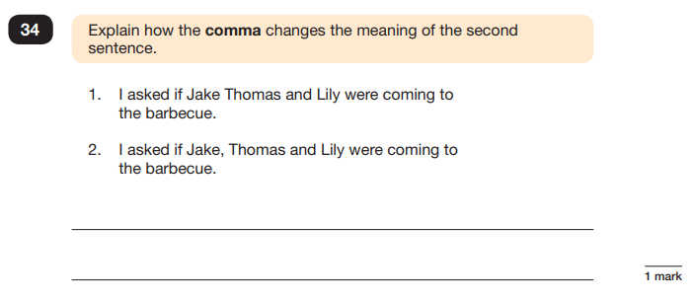
Spelling, Punctuation and Grammar: Paper 1
Example questions:
e.g. that, which
✓
e.g. The first sentence is about two people and the second sentence is about three people.
Notes:
For questions 8 and 34, there are various correct answers.

Slide 9
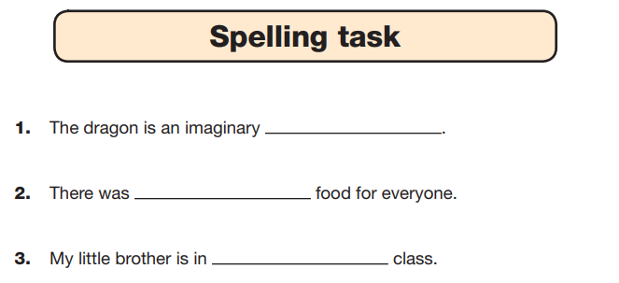
Spelling, Punctuation and Grammar: Paper 2
Paper 2 is a shorter paper that focuses solely on spellings.
Example questions:
Notes:
There is a spelling script that accompanies this. Example:
The word is creature. The dragon is an imaginary creature. The word is creature.

Slide 10
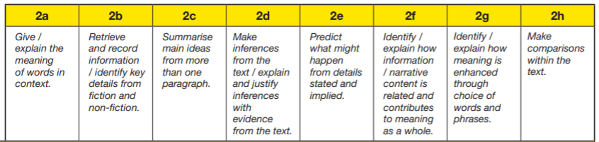
Reading
The Reading paper will take place on Tuesday 10th May.
There is one reading test that lasts for 60 minutes.
The test is designed to measure if the children’s comprehension of age-appropriate reading material meets the national standard. There are three different set texts for children to read. These could be any combination of non-fiction, fiction and/ or poetry.
Retrieval and inference questions made up 39 of the 50 marks available.
Notes:
30 minutes- on Wednesday 13th
It’s worth 40 marks and will cover the four operations
It assess their understanding of BIDMAS as well as percentages and properties of number. Calculations will include decimals and fractions of numbers
The paper generally starts with easy questions and gets harder as you move through.
As you can see the number of marks is signaled at the side.
Majority are 1 mark but long multiplication and division are worth 2. In these questions chn may get a mark for their working if they have used the correct written method and have only made on minor error.

Slide 11
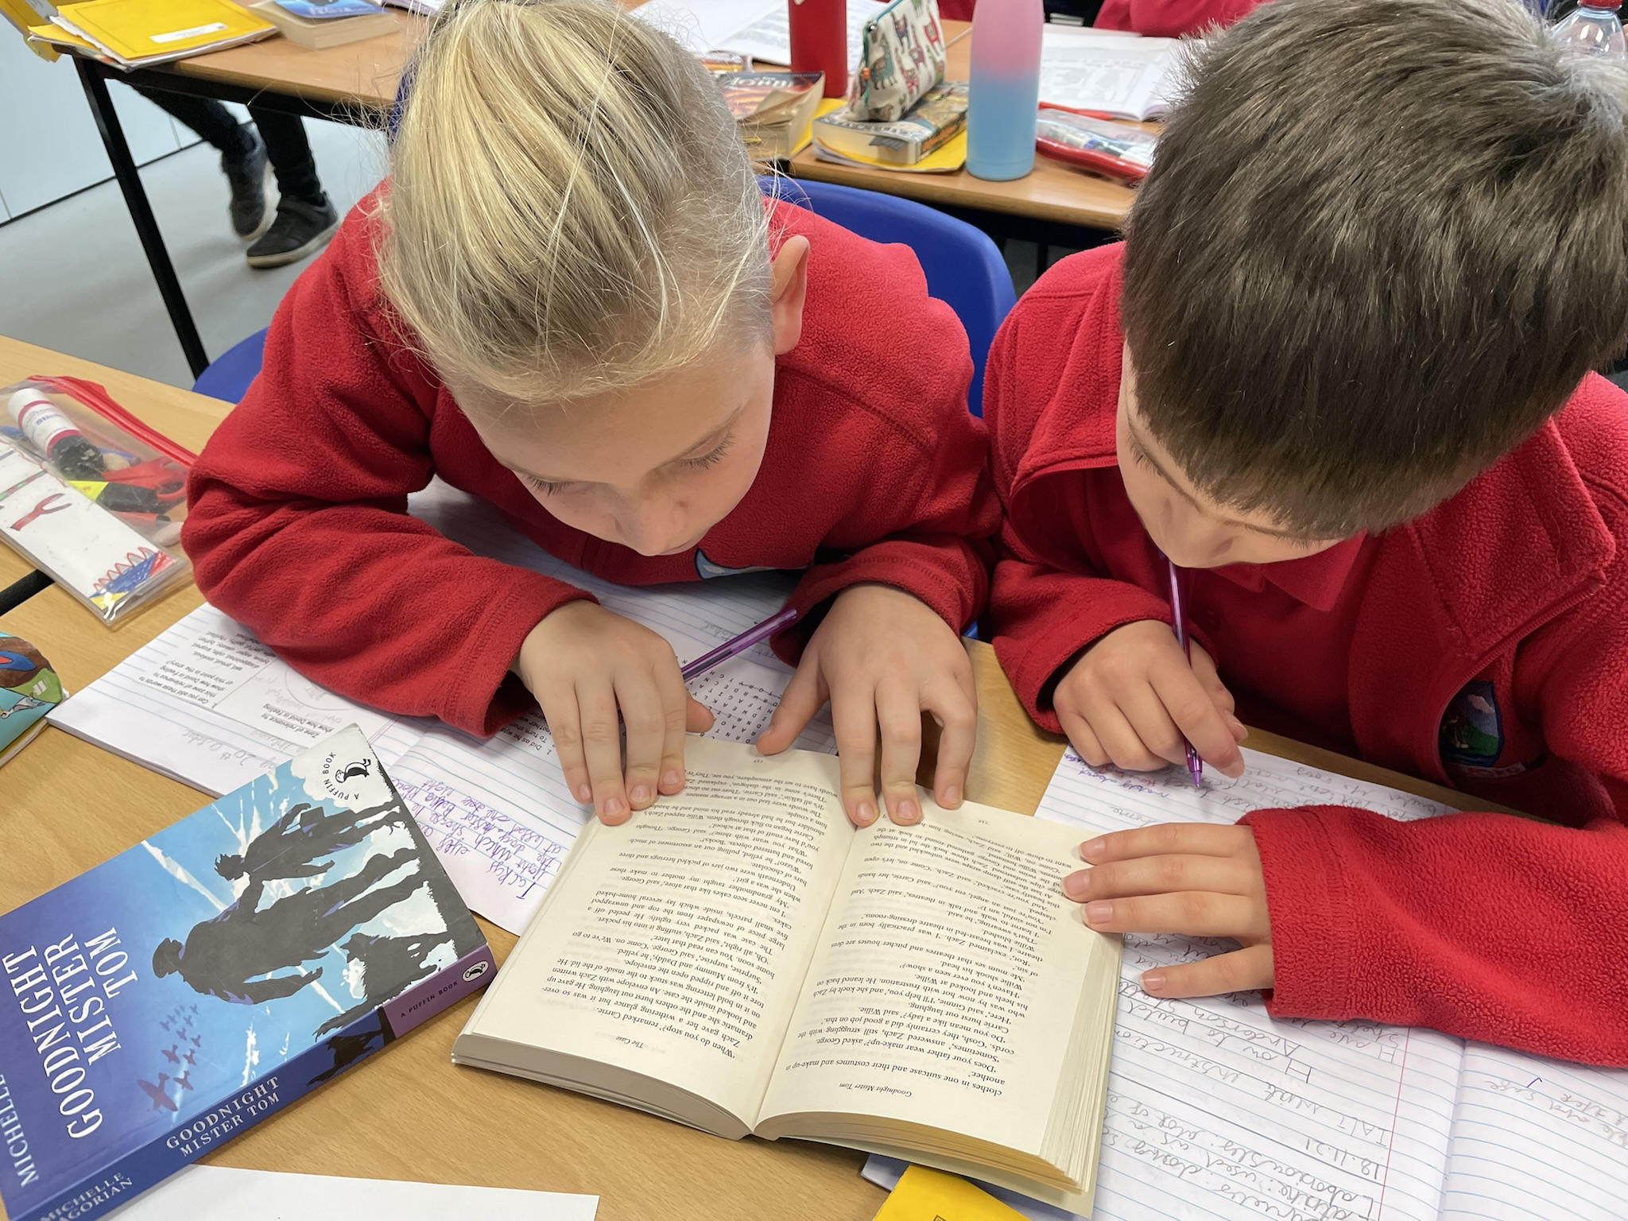
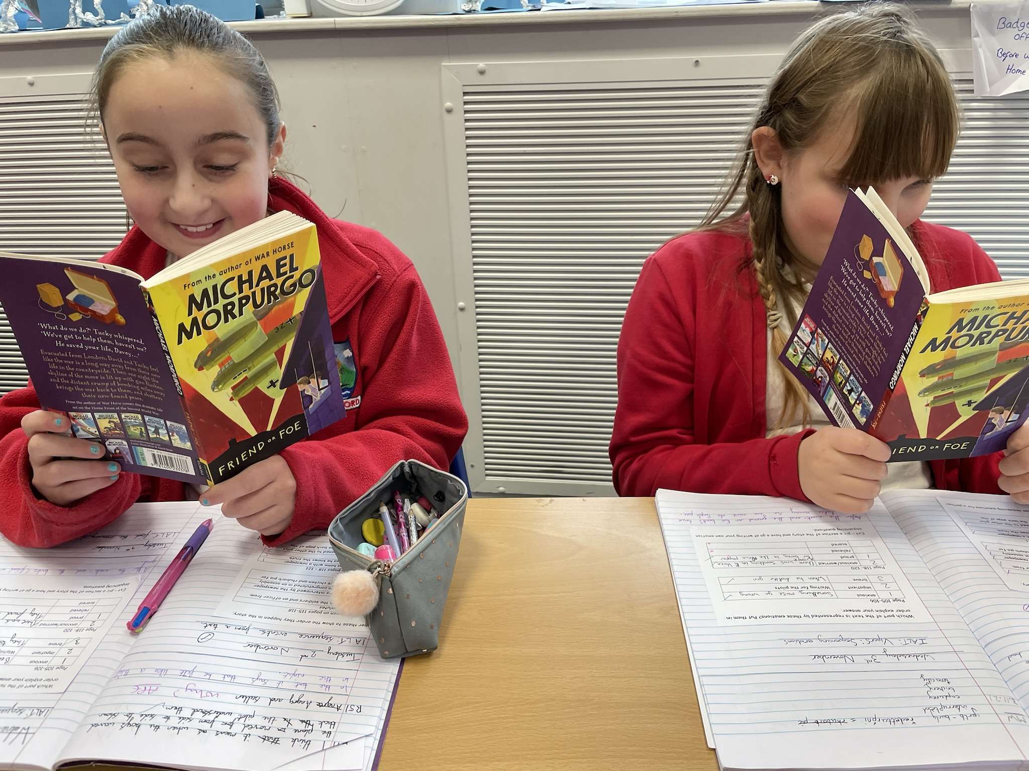
Reading
Since the current testing formation for the SATs began in 2016, there has been a tendency for three types of questions to be the most popular.
In the 2019 Reading SATs paper,
12% of marks could be gained from answering questions involving giving and explaining the meaning of words in context;
42% of marks could be gained from answering questions involving retrieving and recording information or identifying key details from a text;
36% of marks could be gained from answering questions involving making inferences from a text and justifying inferences with text evidence.
When reading with your child at home try focusing on these types of questions.
Notes:
Example questions to ask at home:
What does this word mean?
Which word in this paragraph is the closest in meaning to…?
What [character] doing when [event] happened?
True or false questions about a paragraph/ text.
Why do you [character] did [event]? Can you think of another reason?

Slide 12
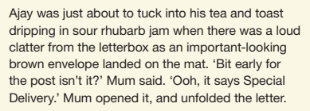
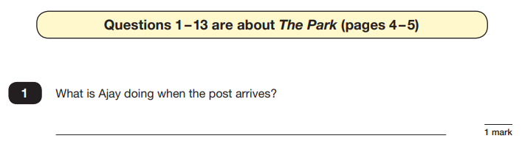
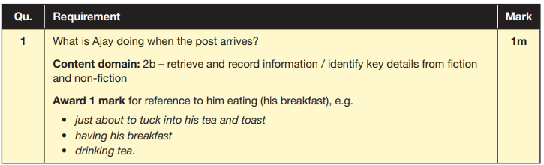
Reading
The reading SATs paper requires a range of answer styles.
Example questions:
Notes:
Question styles include:
Multiple choice questions
One-word answers
Short answer questions
Multiple mark (long answer) questions

Slide 13
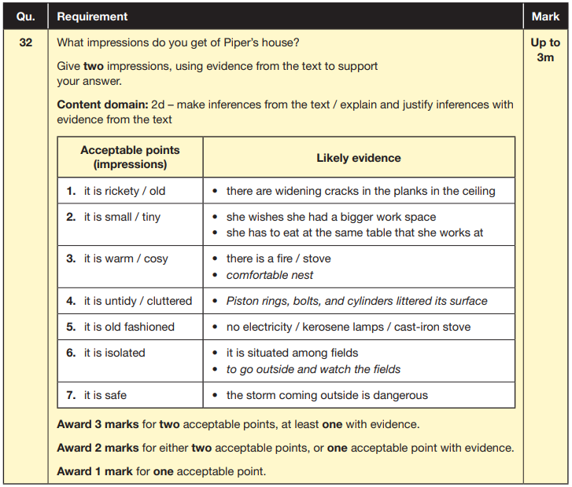
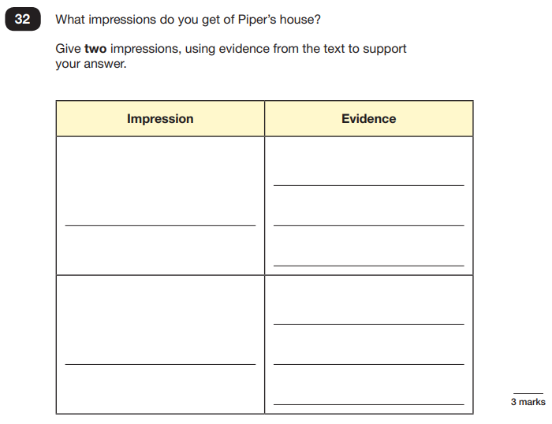
Reading
Example questions:
Based on text 3: Music Box
Notes:
This question is based on the whole text (2 pages).

Slide 14
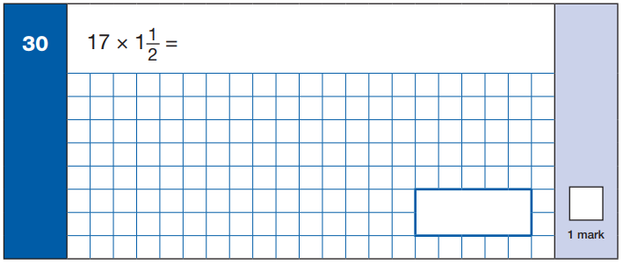
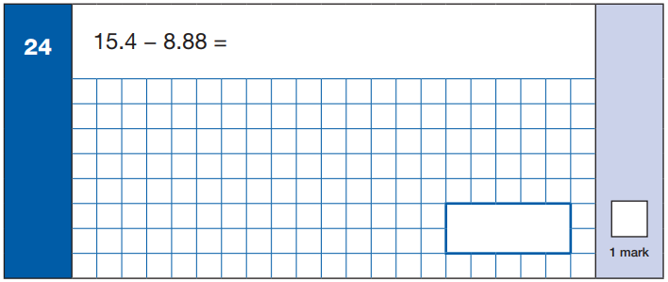
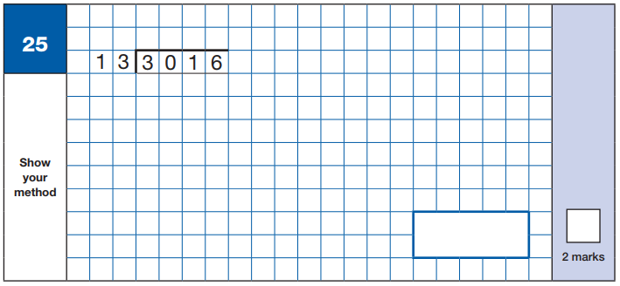
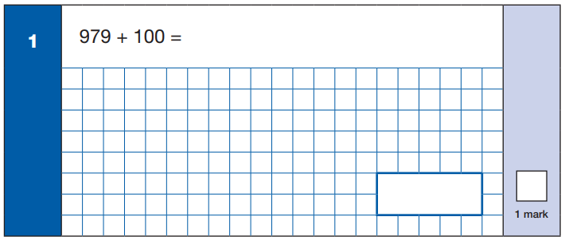

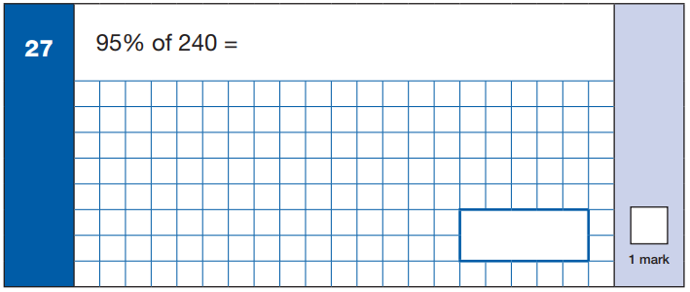
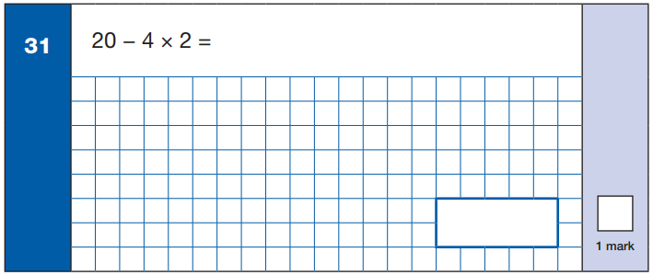
Maths Paper 1 (Arithmetic)
Maths Paper 1 (Arithmetic) will take place on Wednesday 11th May.
It has a standard timing of 30 minutes and is worth a total of 40 marks.
It covers the four operations (division, multiplication, addition, subtraction and mixed operation calculations requiring BIDMAS), as well as number properties, calculating percentages of amounts, calculations using decimals, and calculations using fractions.
Example questions:
Notes:
30 minutes- on Wednesday 13th
It’s worth 40 marks and will cover the four operations
It assess their understanding of BIDMAS as well as percentages and properties of number. Calculations will include decimals and fractions of numbers
The paper generally starts with easy questions and gets harder as you move through.
As you can see the number of marks is signaled at the side.
Majority are 1 mark but long multiplication and division are worth 2. In these questions chn may get a mark for their working if they have used the correct written method and have only made on minor error.

Slide 15
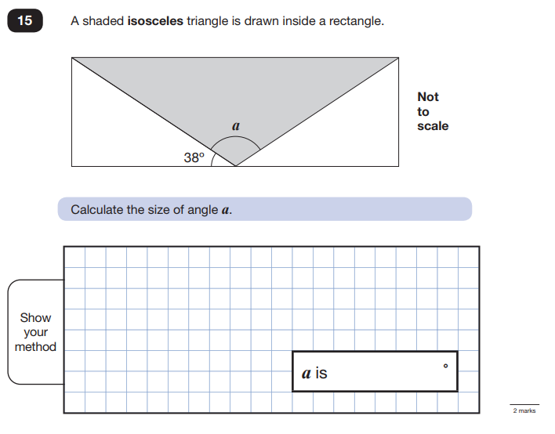
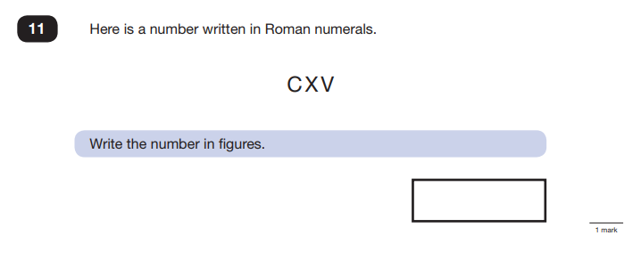
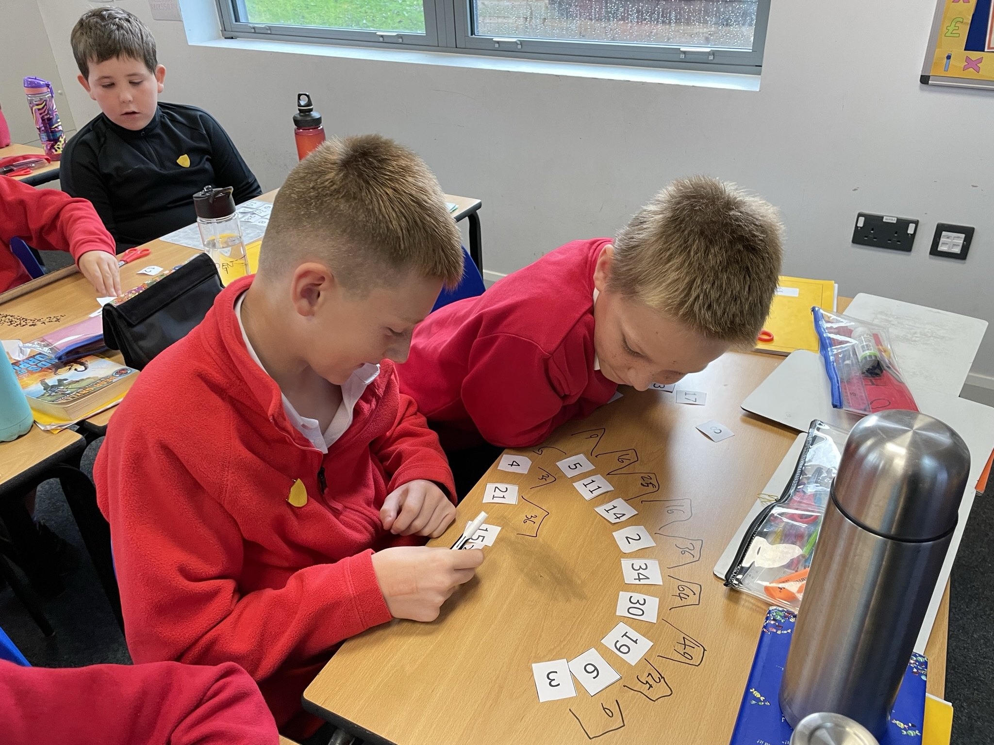
Maths Papers 2 & 3 (Reasoning)
Maths Paper 2 (Reasoning) will take place on Wednesday 11th May.
Maths Paper 3 (Reasoning) is scheduled for Thursday 14th May.
Both have standard timings of 40 minutes and are worth 35 marks each.
Paper 2 requires children to demonstrate their mathematical knowledge and skills, as well as their ability to solve problems and their mathematical reasoning.
Notes:
After a break
Reasoning paper 1 – is the same day and lasts 40 minutes - Paper 2 is on the following day.
Both papers are worth 35 points and assess chns mathematical knowledge (Roman numerals ml/l) and skills as well as their problem solving and reasoning

Slide 16
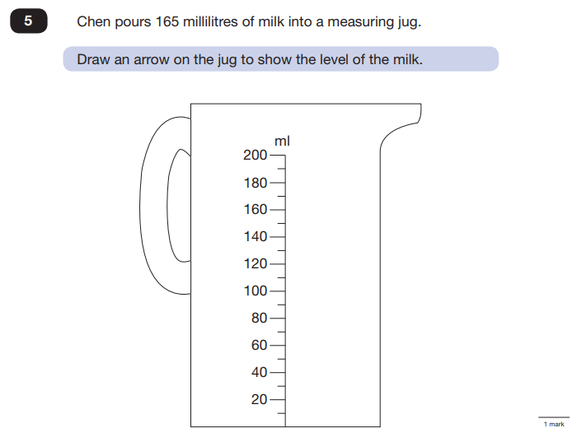
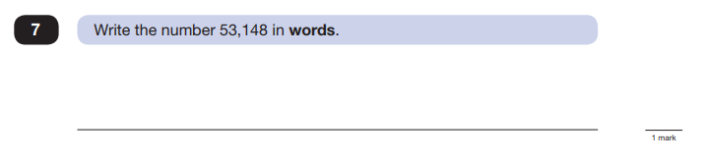
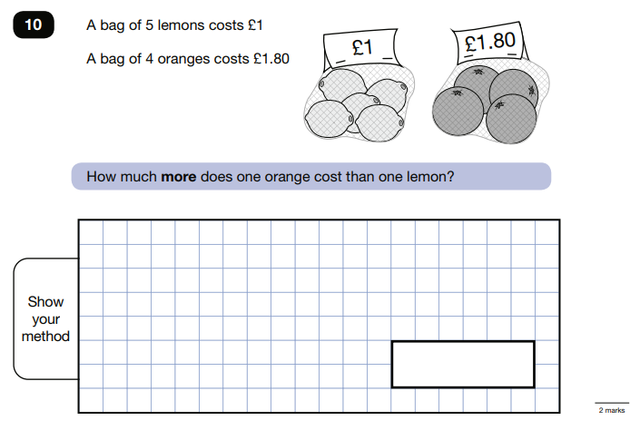
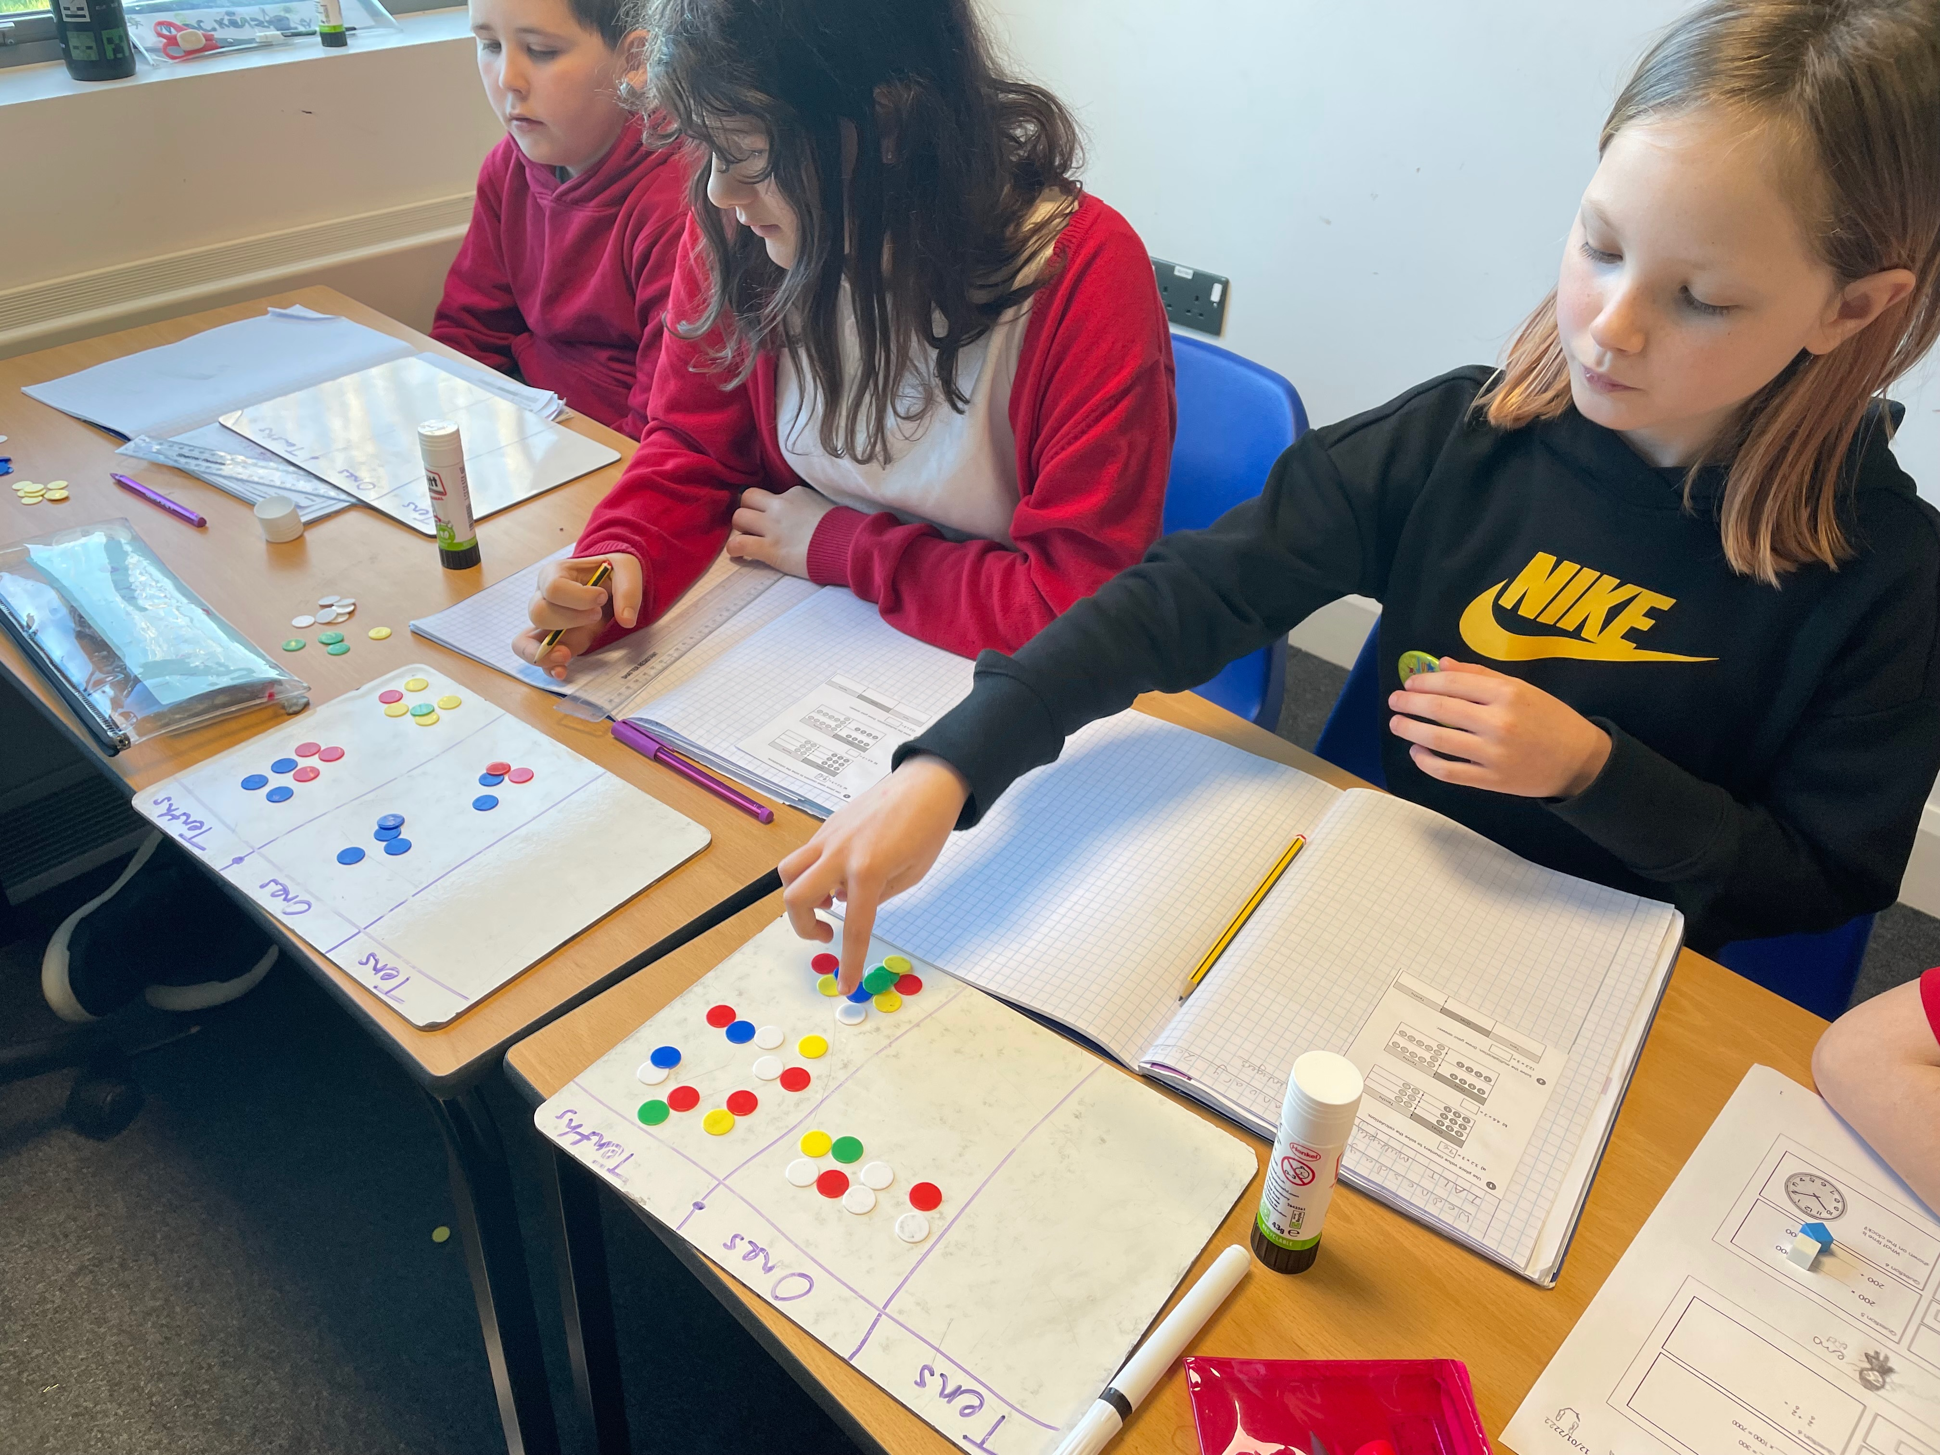
Questions focus on the following Mathematical topic areas:
- Number and place value– including Roman Numerals;
- Addition, subtraction, multiplication and division (calculations);
- Geometry – properties of shapes;
- Geometry – position and direction;
- Statistics;
- Measurement – including length, perimeter, mass (weight), volume, time and money;
- Algebra;
- Ratio and proportion;
- Fractions, decimals and percentages.
The questions get harder throughout the paper.
It is not unusual for a child to be unable to complete the entire paper in time.
Take a look!
Notes:
We’ve got some sample papers her for you to have a look at but you will see that they they cover all aspects of the maths curriculum

Slide 17

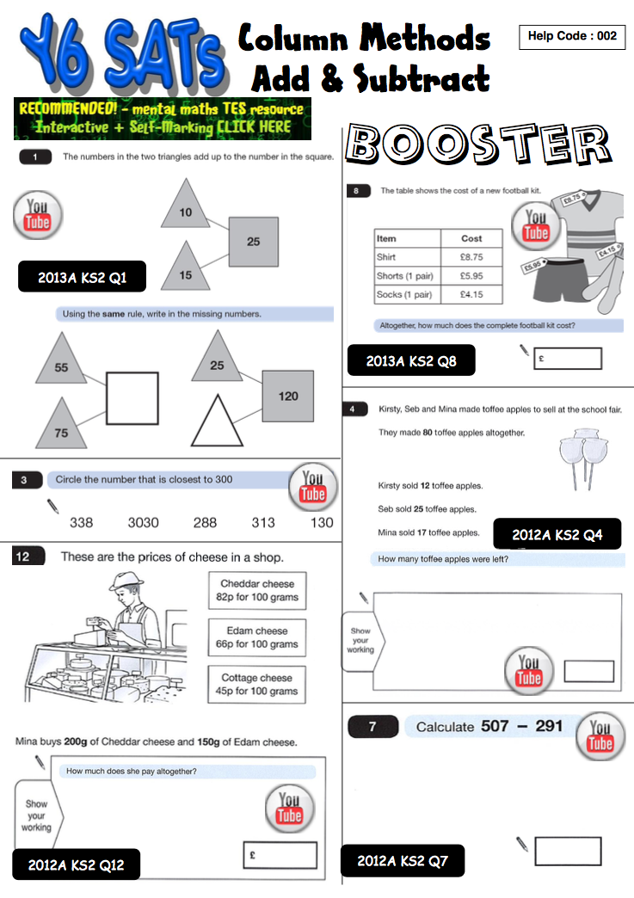
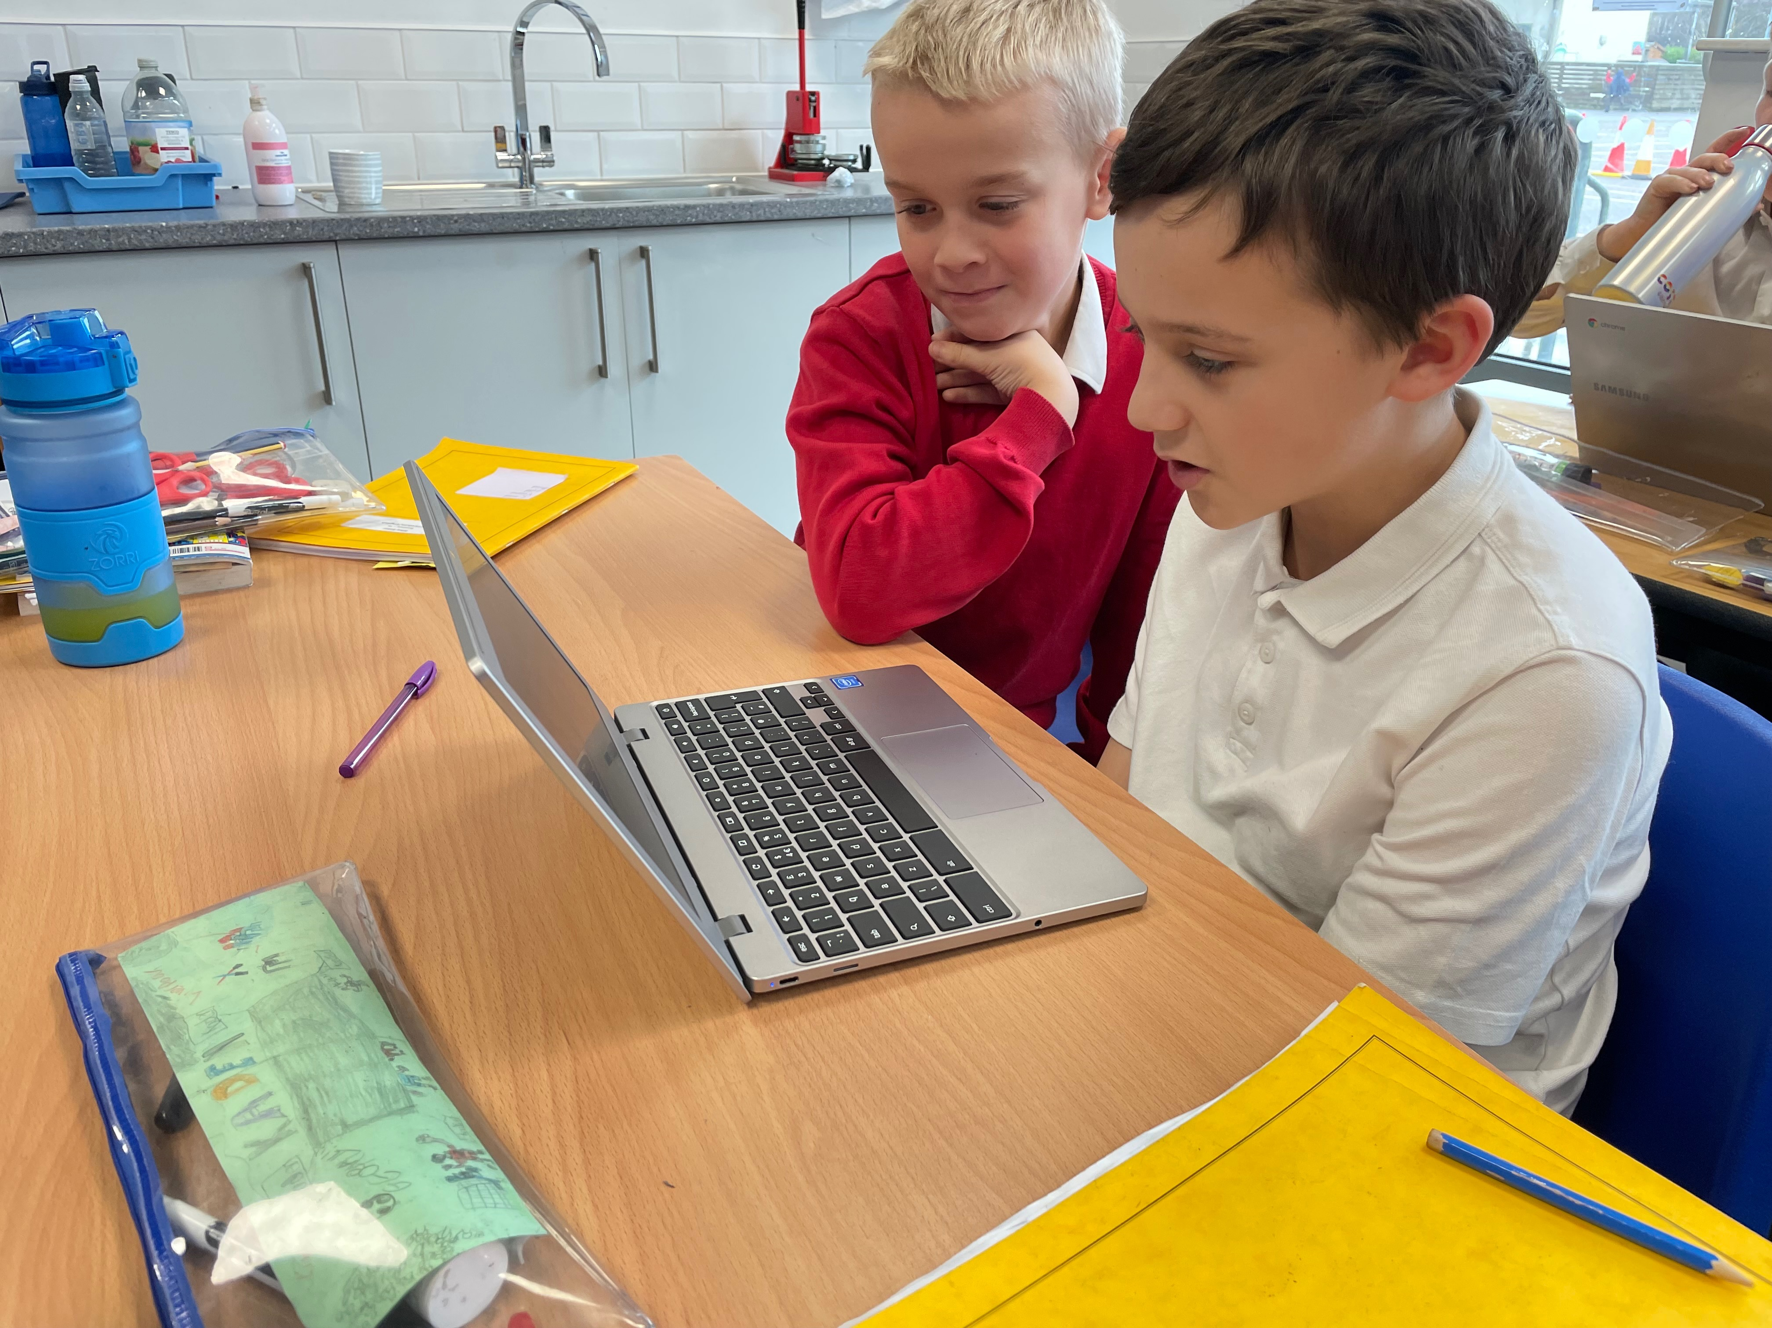
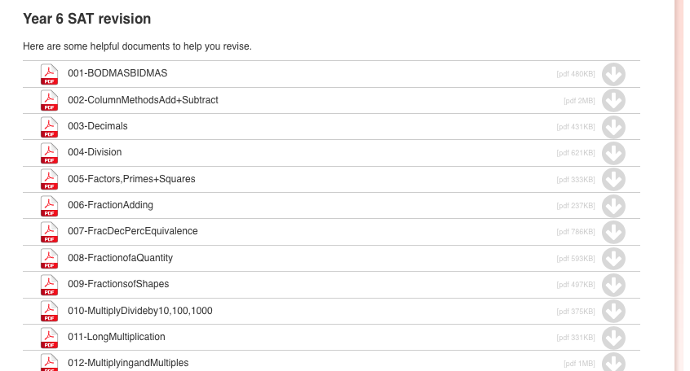
http://www.camelford.cornwall.sch.uk/learning/overview_curriculum_topics/maths.html
Notes:
Website under maths you can find these documents.
These have previous SAT questions on them and then a link to a youtube video that shows you how to solve them.

Slide 18
How can I support my child in preparing for their SATs?
Firstly, a positive attitude goes a long way – so as much encouragement and support as possible (but we don’t need to tell you that)!
Some further tips:
• Attend any meetings the school holds about SATs;
• Direct any questions or concerns you have about SATs to your child’s teacher, rather than worry your child with them;
• Give your child opportunities to go outside and avoid overuse of screens - this can apply to leisure pursuits as well as how they study;
• Try to provide a quiet corner of the house for homework and study, that’s as free from distractions as possible;
• Encourage your child to talk to their teacher or another adult they trust if they express persisting anxieties about SATs. Remember that a small amount of anxiety is normal and not harmful;
• If your child is unwilling to talk to their teacher, talk to them yourself;
• Plan something nice and fun for the weekends after SATs – this will help your child give them something to look forward to;
• Ensure your child is eating and drinking well, and getting a suitable amount of sleep.

Slide 19
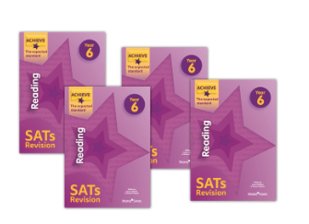
Revision Guides
Revision guides
English,
Maths,
Spelling, Punctuation and Grammar.
Buy for £2.50 (£5.99 online) each
Borrow (£2.50 deposit, which is returned providing the book is in good condition)
Practice Books
Buy at £2.50
Take a look / complete the letter

Slide 20
Remember this about SATs:
SATs focus on what they know about Maths and English
They won’t reflect how talented they are at Science, Geography, Art or PE, and they certainly won’t highlight positive personal characteristics such as kindness and integrity.
SATs results don’t always tell the whole story
The results will say they DID or DIDN’T meet a certain standard, but not necessarily by what margin. Additionally, the thresholds tend to change each year according to overall national performance, so what was classed as ‘did meet the expected standard’ in 2016 may have been considered a ‘did not’ in 2015 so don’t let your child see SATs as a simple case of ‘pass’ or ‘fail’.
SATs last for one week
In reality it’s just one or two papers lasting 30-60 minutes each day. You can’t emphasise enough the importance of keeping that in perspective.

Slide 21
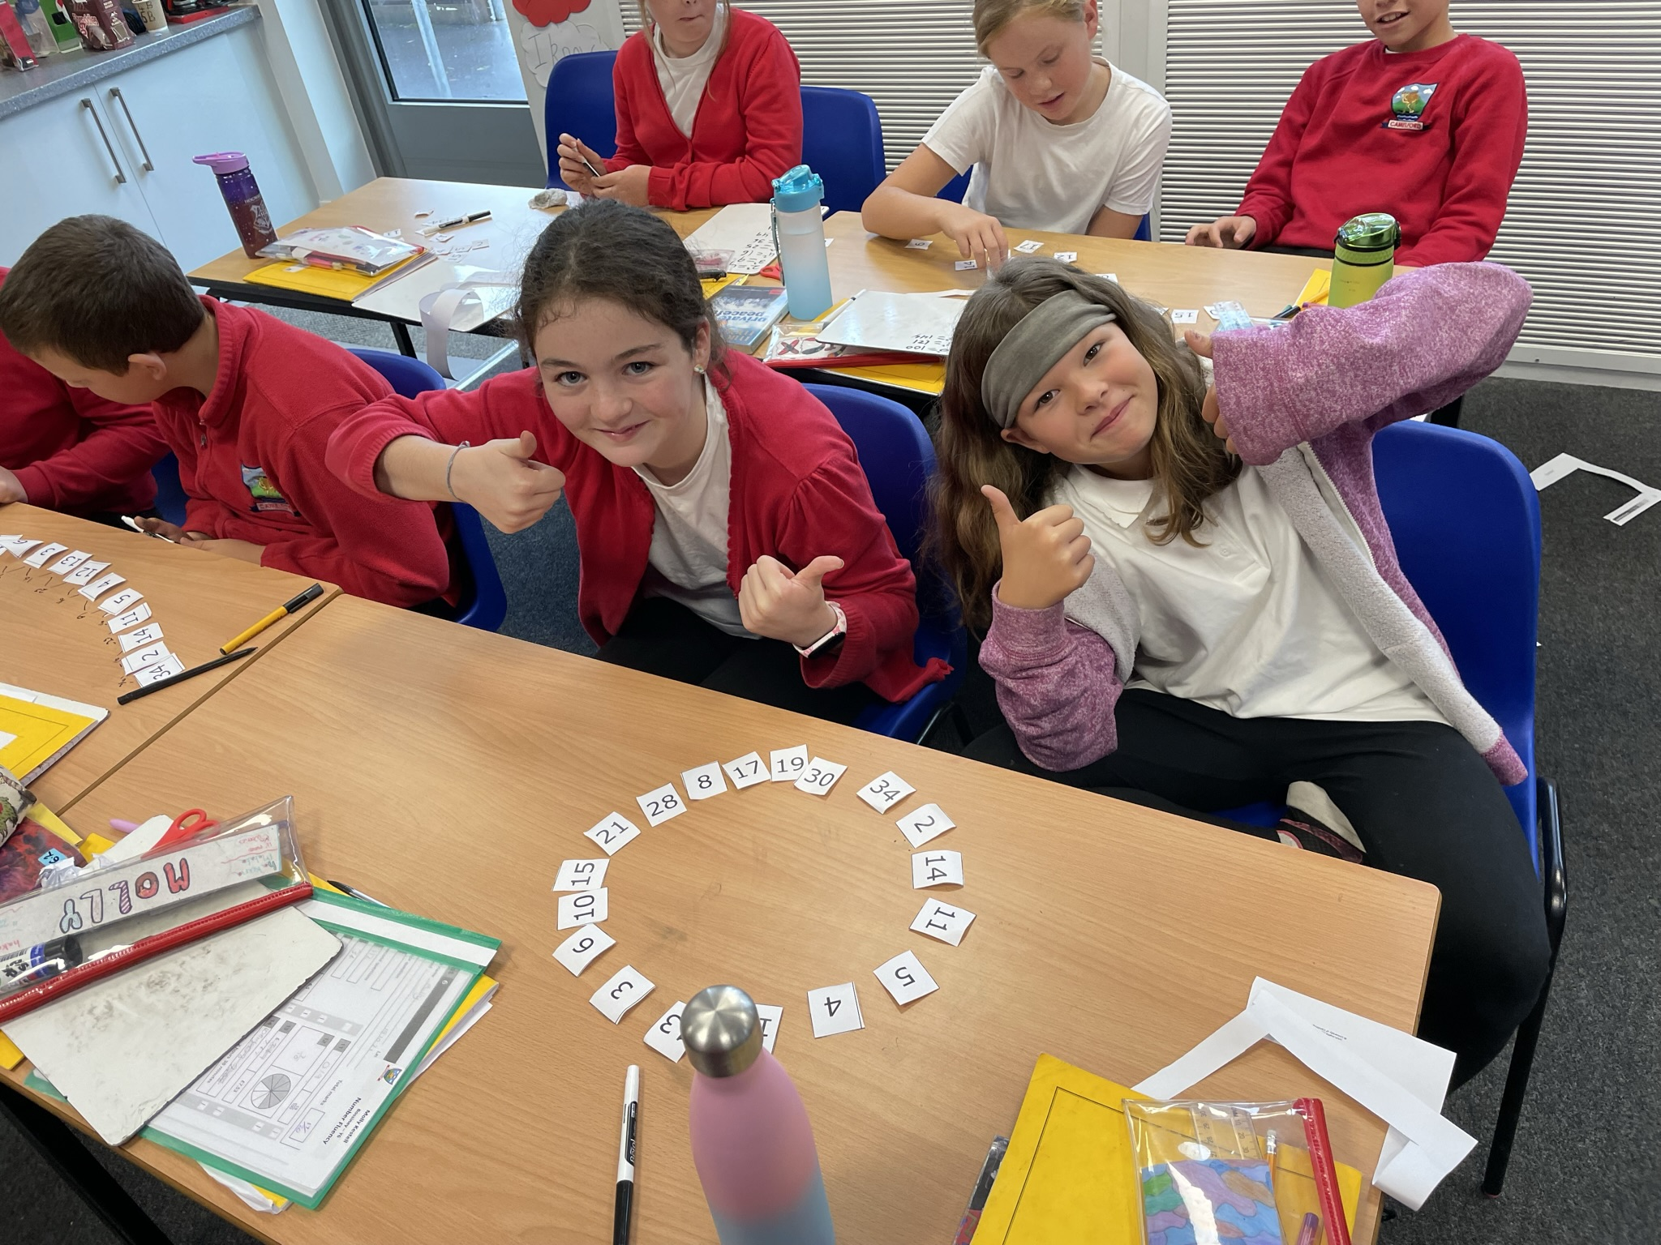
What should I do if I’m worried about my child?
It would be unnatural for SATs not to induce a certain degree of worry or anxiety but there is, of course, a tipping point.
SATs should not:
affect a child’s appetite;
affect a child’s ability to sleep;
alter a child’s personality;
induce panic, tears or disengagement from lessons;
be a reason not to attend school.
Steps to take:
Talk to the school
Is your child showing the same symptoms at school as they are at home? Is there anything else going on at home which may be contributing to your child’s overall level of stress? Work with the school so everyone concerned can be offering the support that’s needed.
Spend time with your child
Try to understand what aspect of SATs concerns them most. Is it the worry of ‘failing’? Is it the worry of getting stuck on a paper? If your child can pinpoint what’s bothering them most, you can take specific steps to help reassure them.
Try not to project your own anxieties or views on the SATs
If you don’t believe in SATs, or do not think your child should be doing them, then neither will they.
Encourage your child to talk to their teacher
SATs are obviously linked to school, so don’t be surprised if they favour the reassurance of teachers above family members.

