Slide 1


The Multiplication Tables Check
(MTC)

Slide 2
“Leaving primary school with a fundamental grasp of basic numeracy is as important as leaving being able to read. And just as the phonics check has helped more children learn to read, this will ensure more pupils know their times tables.”
Nick Gibb, Schools Minister (2018)

Slide 3
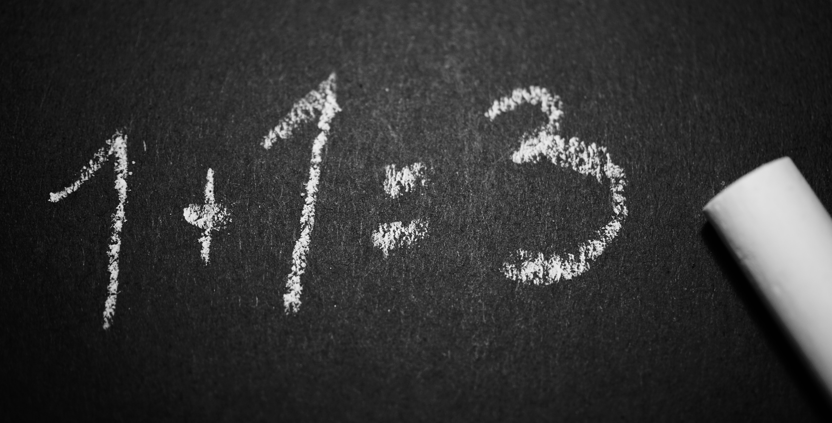
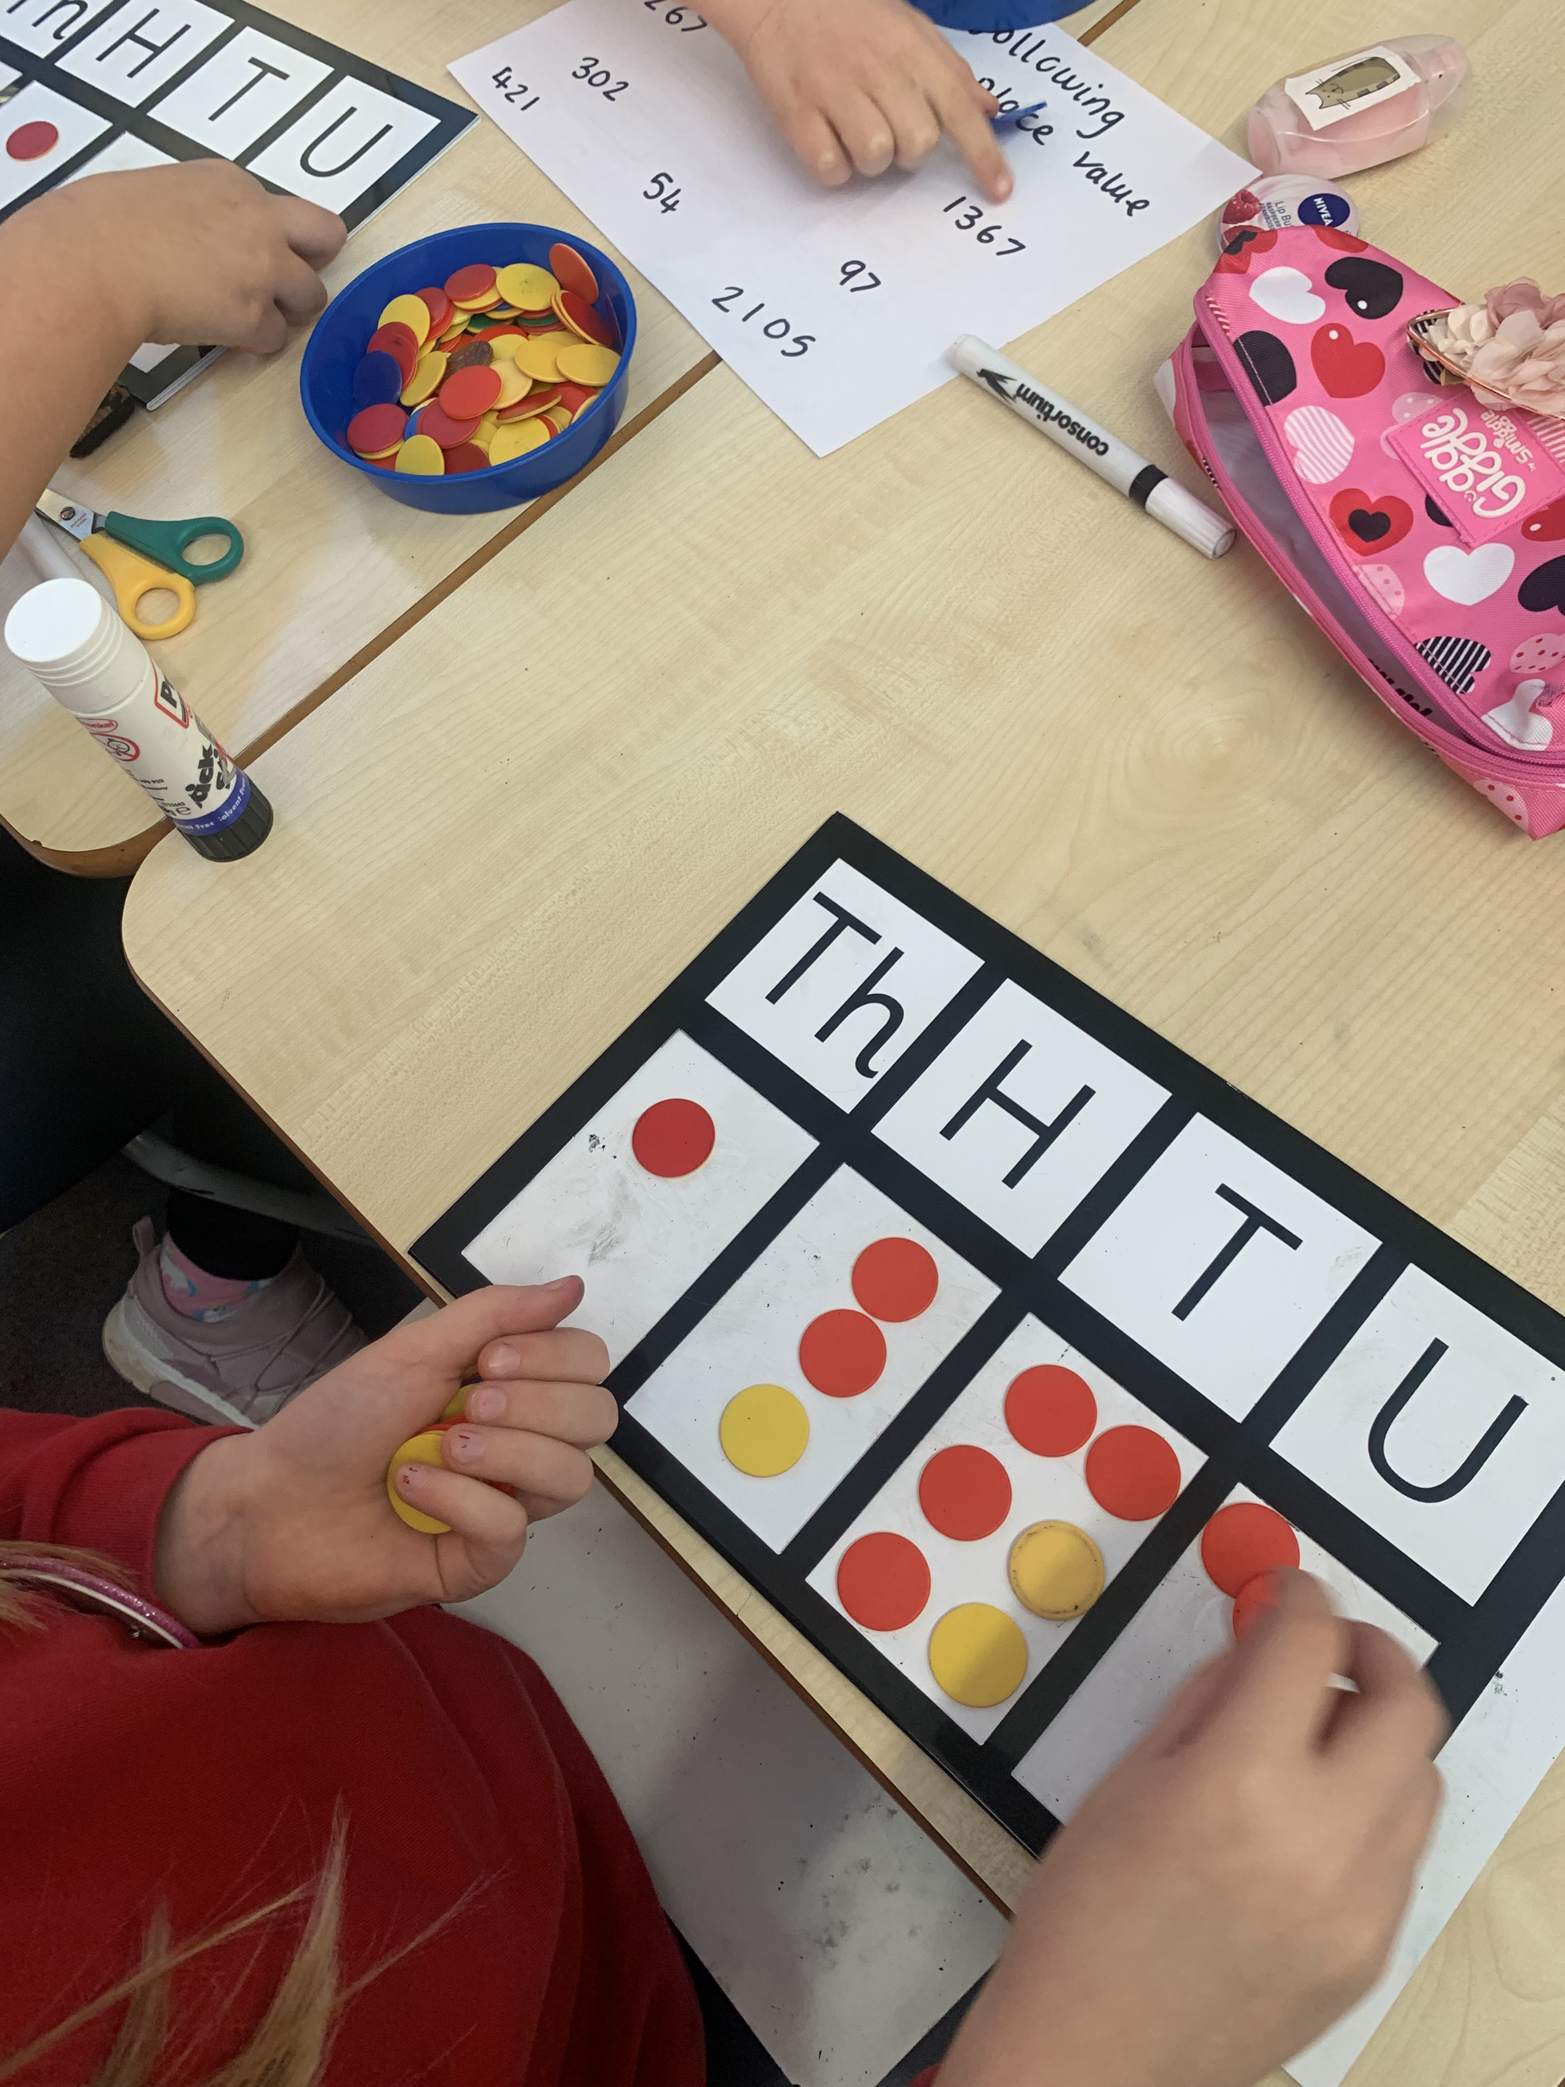
What is The MTC?
It’s a new national test for Year 4 students
We’re not worried
Under the national curriculum primary school children are expected to know their 12 times tables by the end of Year 4
So we’ve been preparing students to know their times tables by the end of Year 4 for quite some time now and are not concerned about the check at all

Slide 4
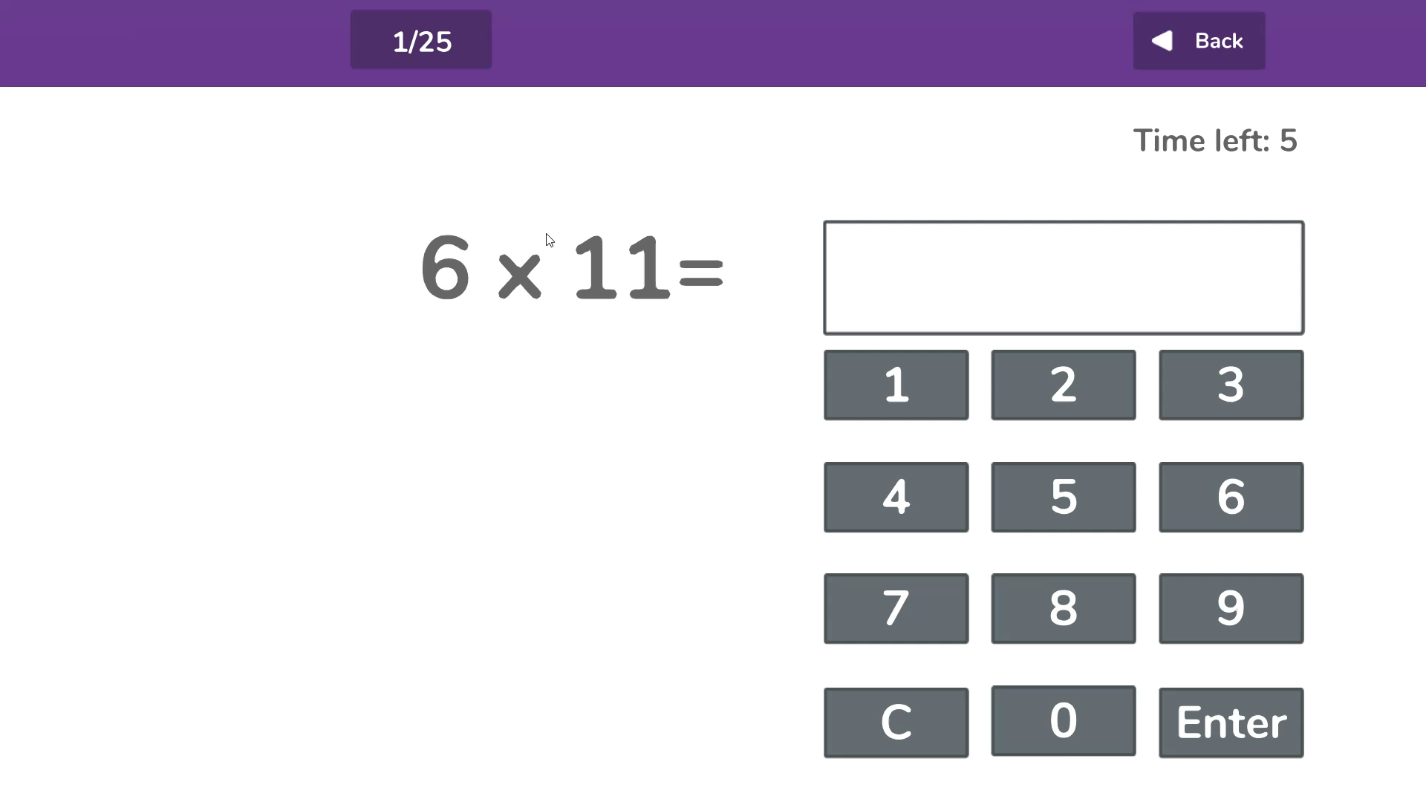
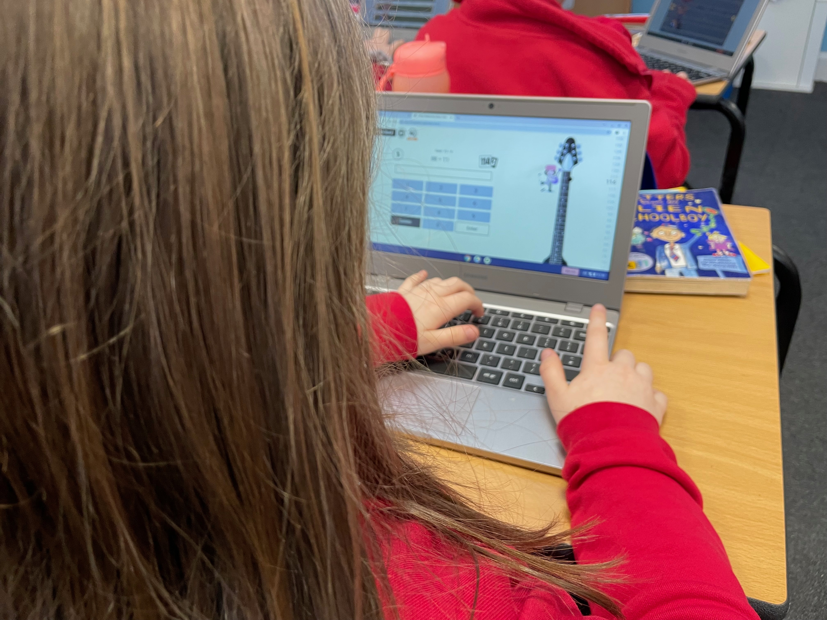
The practicalities
The Check Itself.
Takes place in June
Is done on a tablet or computer
Will take no longer than 5 minutes
There are 25 questions
Pupils have 6 seconds to answer each question
There’s no problem solving or division just simple “3 x 4 = ?” type questions
The results are for Teachers
There is no pass or fail mark
Results are not published

Slide 5
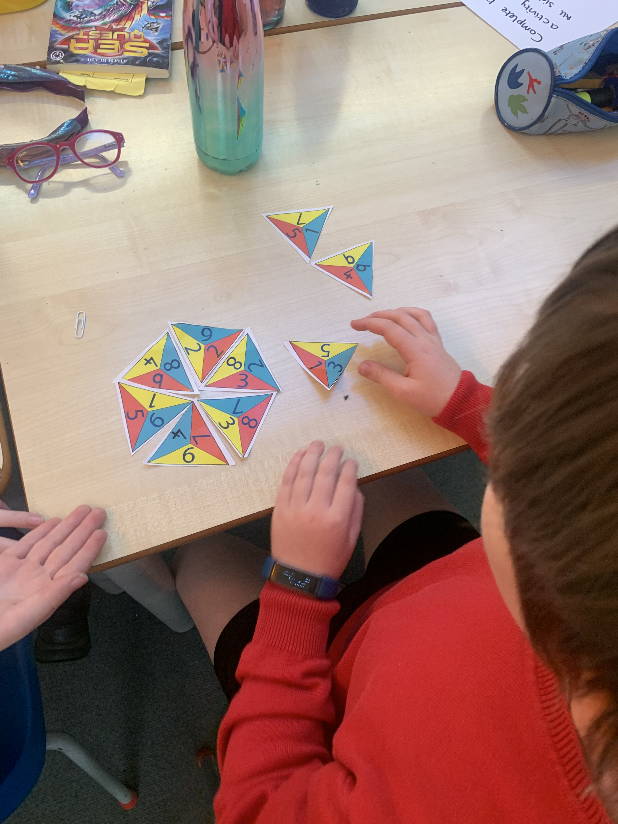
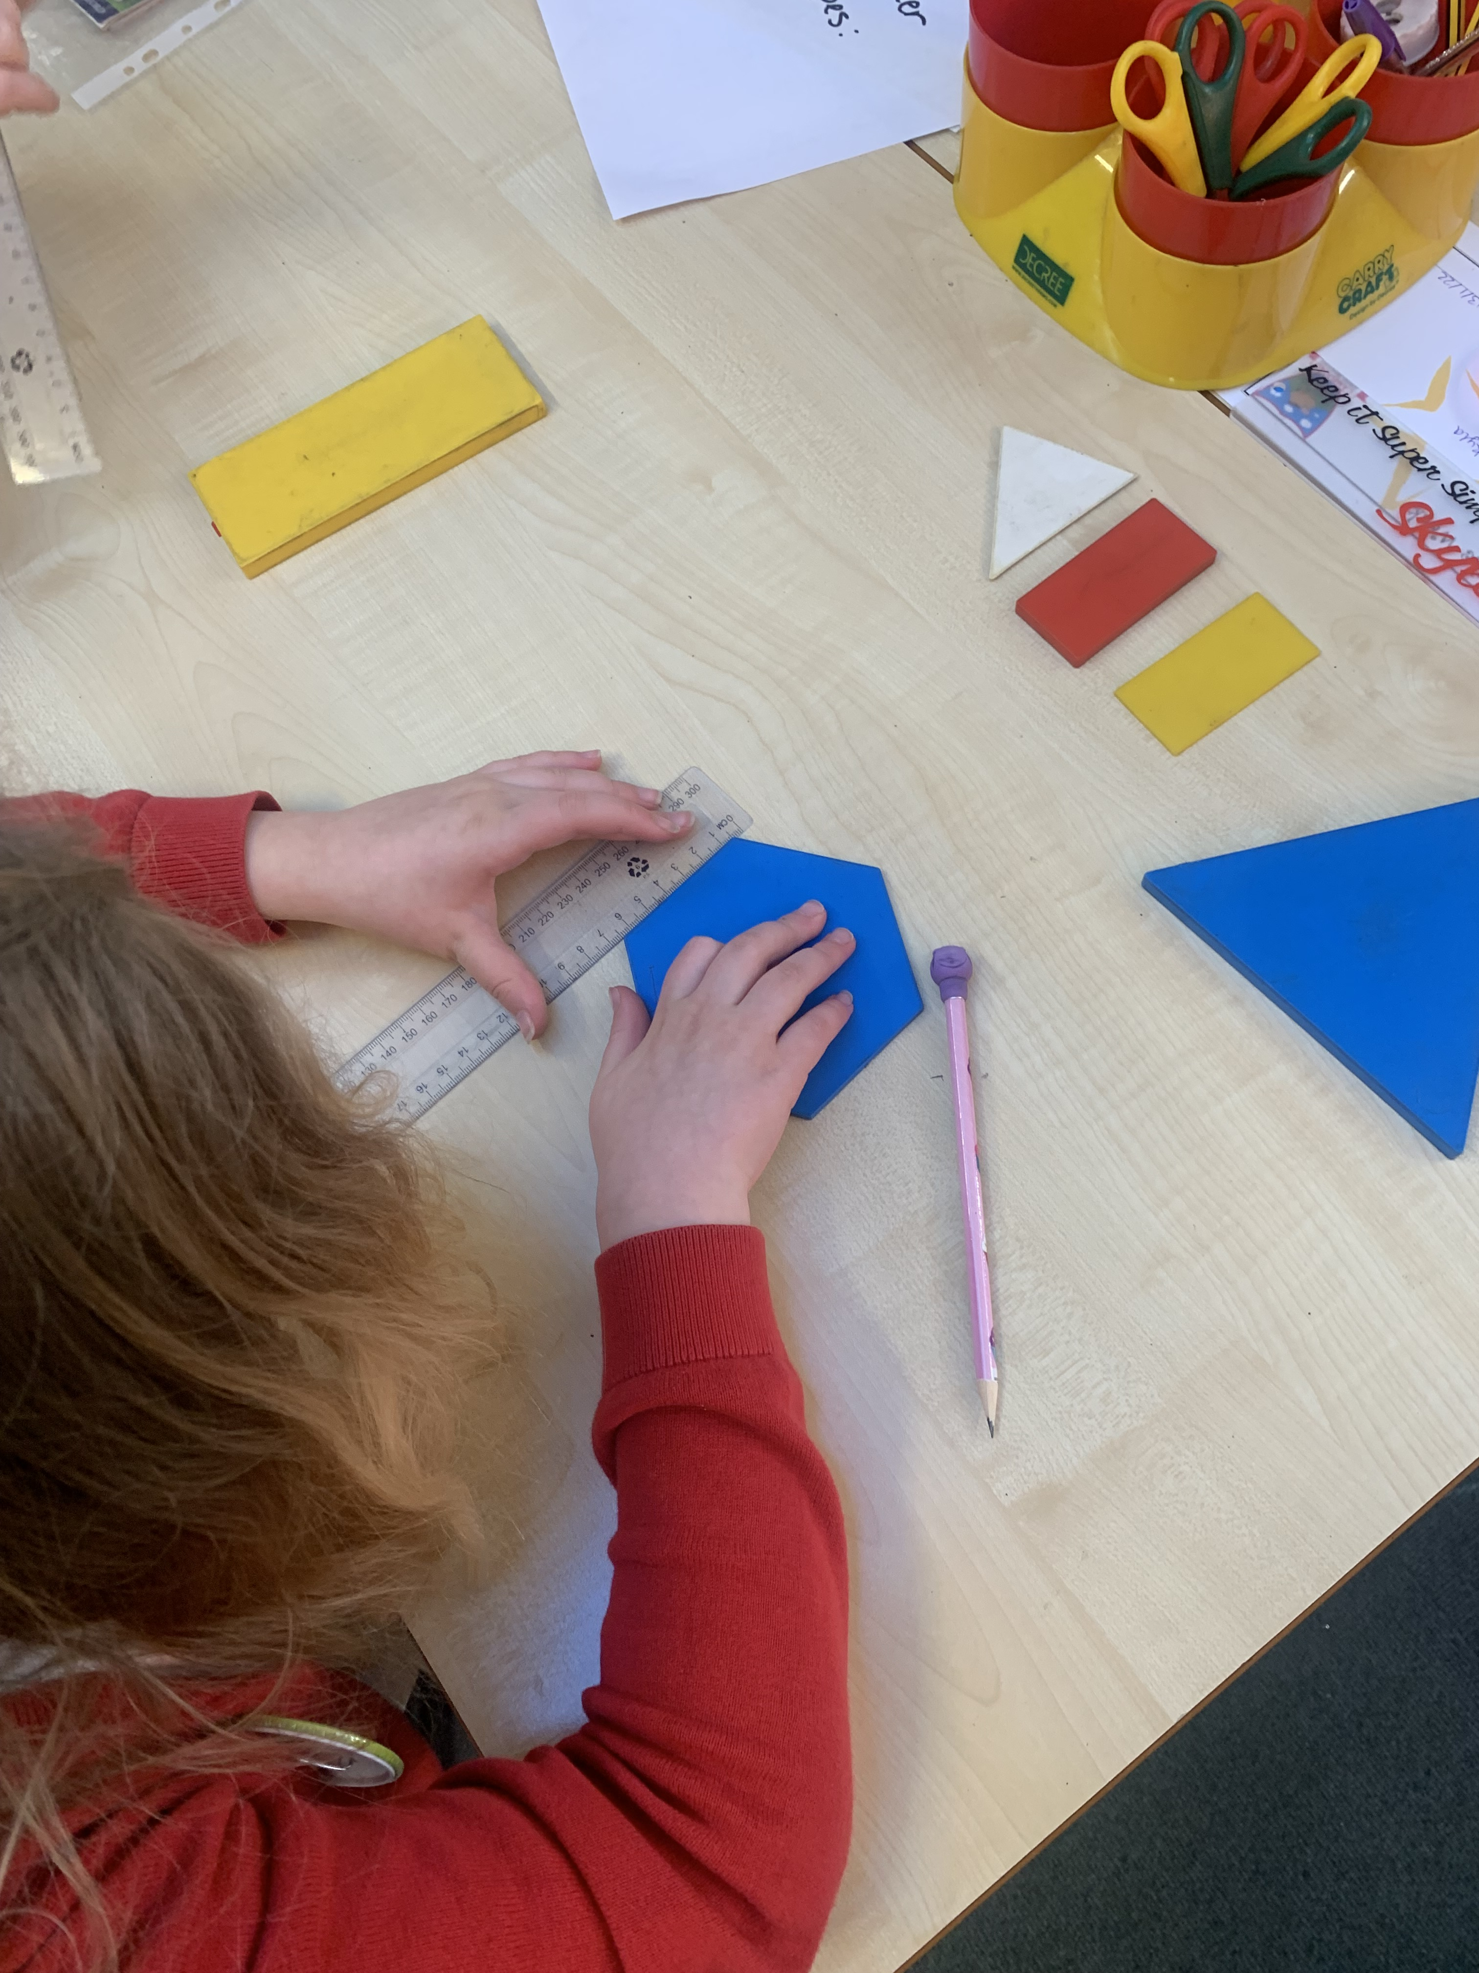
Access arrangements
These can be made for children who:
- have an Education, Health and Care (EHC) plan
- have an Individual Education Plan (IEP)
- have English as an additional language and have limited fluency in English
If you have any questions, please ask at the end

Slide 6
What if my child does not achieve full marks in the MTC?
The MTC will serve as a measure of how well children understand and can recall their times table knowledge.
Times tables are vital to the Year 5 and Year 6 curriculum and gaps in their knowledge will hold them back when completing work in Years 5 and 6.
Any child who does not achieve full marks in the MTC will receive further additional support in the form of interventions to plug any gaps in their times table knowledge in Years 5 and 6.
The MTC will serve as a helpful tool for teachers and schools in identifying children with gaps in their mathematical knowledge.

Slide 7
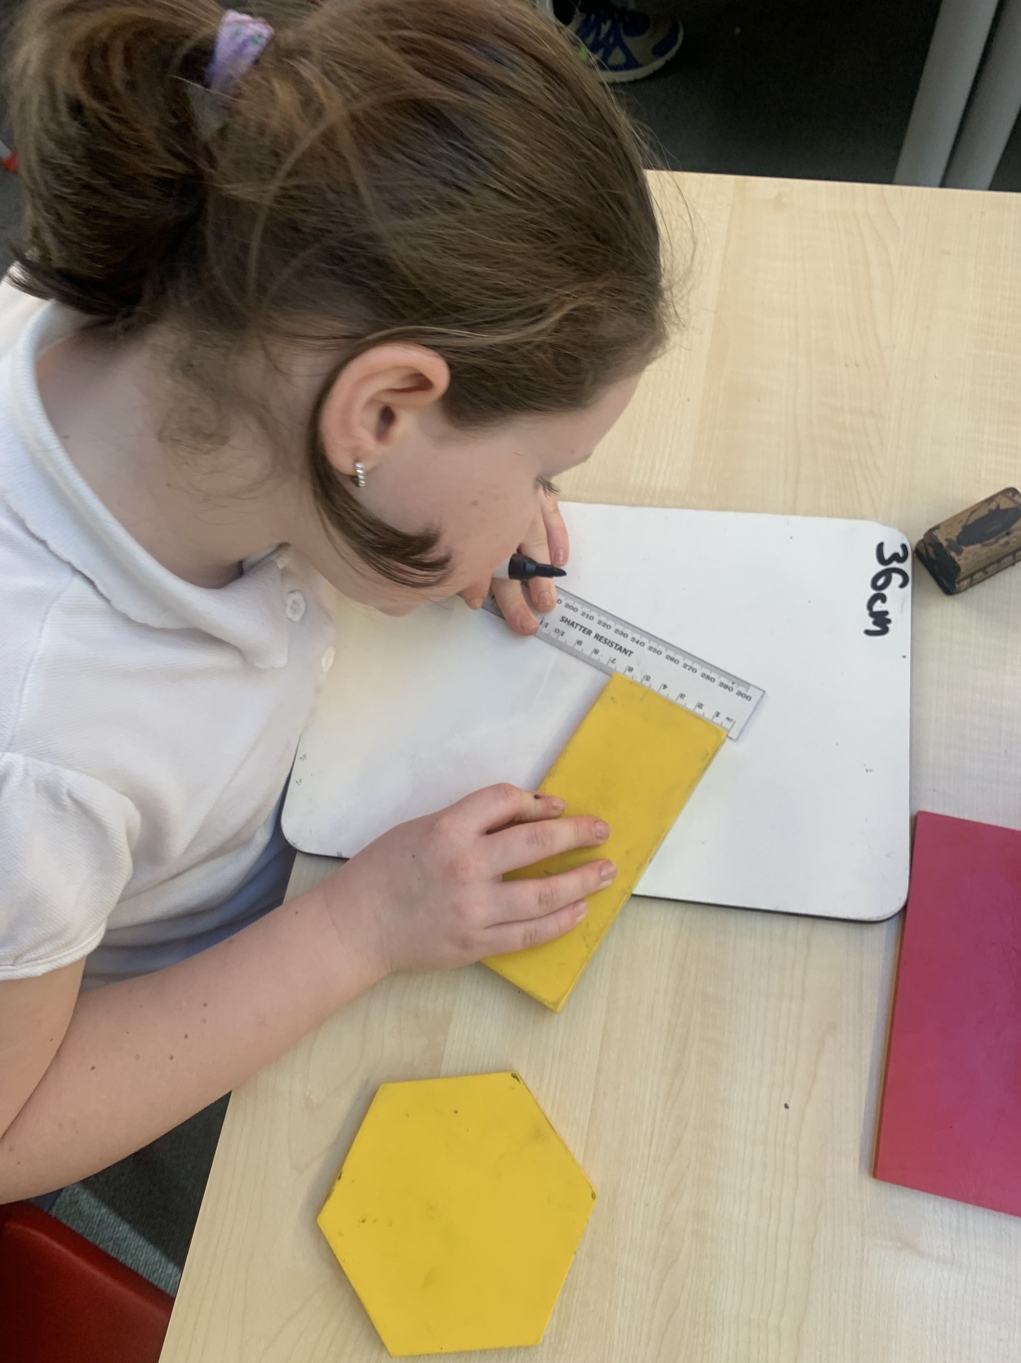
No Stress
Government has called it a “check” rather than a “test” or “exam” for a reason.
We will endeavour not to draw students’ attention to the check so will be not be referencing in class unduly.
Please be supportive of this approach and refrain from talking about the checks at home.

Slide 8


How You Can Help YouR Child?
Practise at Home
We will of course continue to teach the full curriculum, and would love your continued support to help practise the times tables with your children.
Some easy ways to do this include:
asking questions such as “What’s 7 x 8?”
reciting times tables by Rote (4 times 1 is 4, 4 times 2 is 8, etc)
singing times tables songs (there are loads online)
using apps and games (like TTRS / 99 club)

Slide 9

Thank
You
for your continued support

