Slide 2





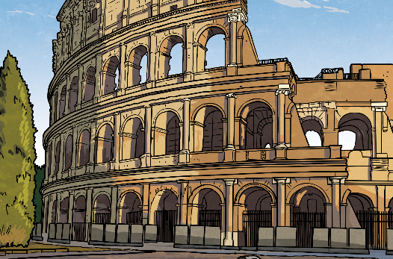
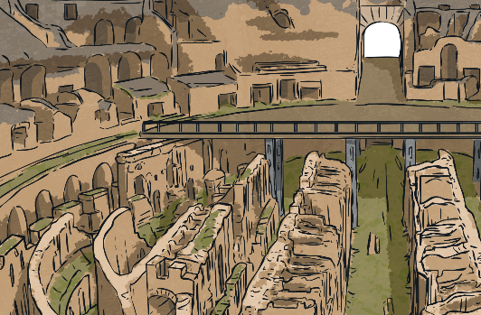

Diving into Mastery
Diving
Use the conversion charts to help you convert between these different measurements and complete the table.
÷ 10
÷ 100
÷ 1000
millimetres (mm)
centimetres (cm)
metres (m)
kilometres (km)
× 10
× 100
× 1000
mm | cm | m | km
 |  | 300
 | 65 000
 |  |  | 2.45
300 000
30 000
0.3
650 000
650
0.65
2 450 000
245 000
2450

Slide 3

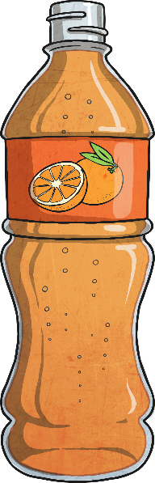
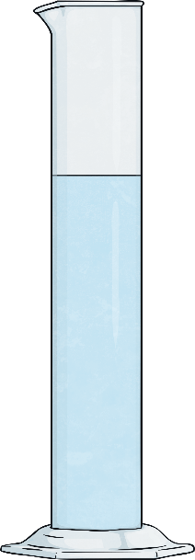
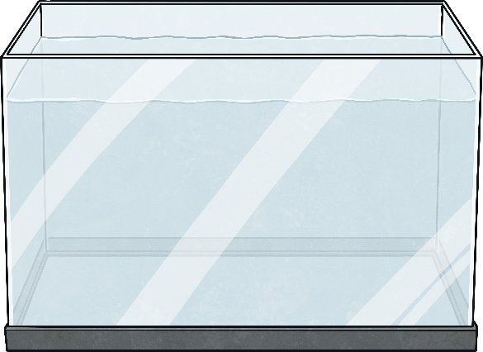
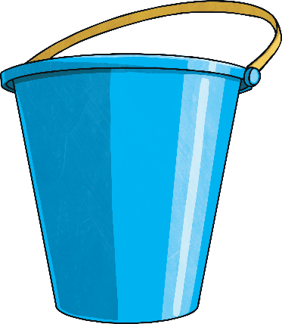
Diving into Mastery
Deeper
True or false? Explain your answer. The four volumes shown are correctly ordered from smallest to greatest.
5l
4l
3l
3.5l
3450ml
2l
3.55l
1l
×
÷ 1000
Smallest
volume
Greatest
volume
False: It is easier to compare if all the measurements are in the same units. The smallest volume is 3.45l in the aquarium. Next smallest is the bottle, holding 3.5l. Then the 3.55l in the bucket is less liquid than the 3.6l in the cylinder.
millilitres (ml)
litres (l)
× 1000
Help

Slide 4

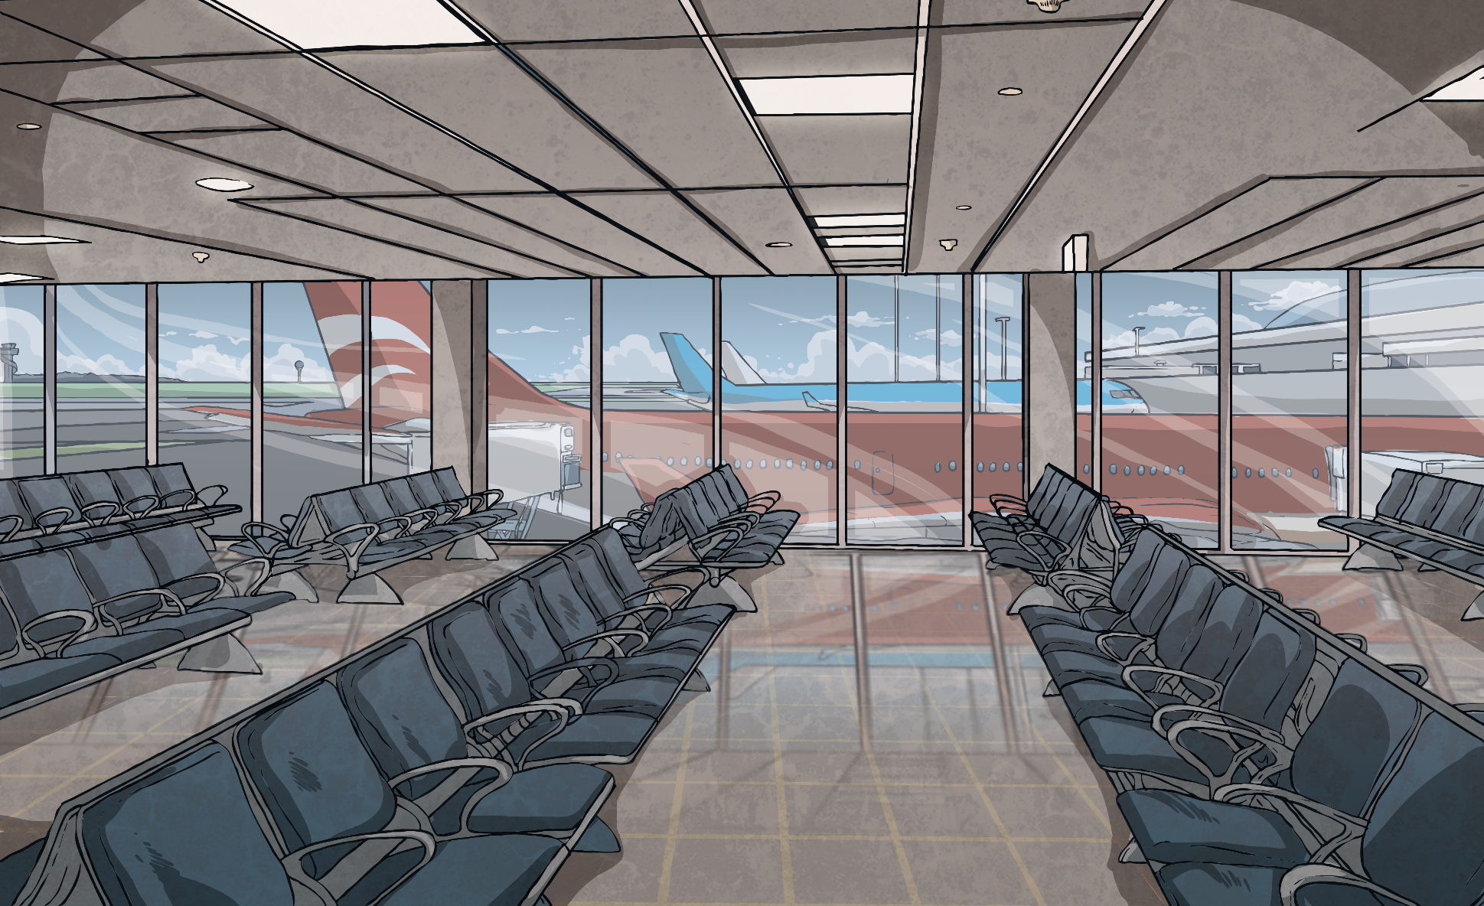
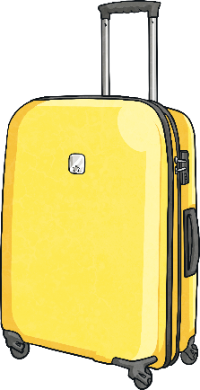
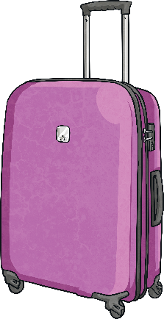
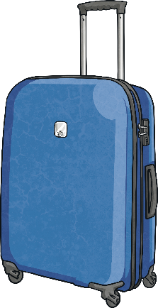
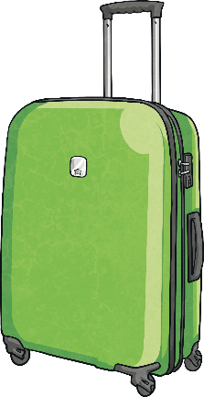
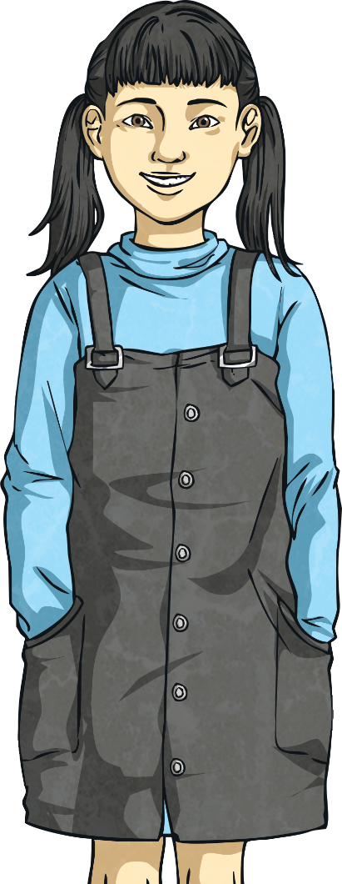
Diving into Mastery
Deepest
A family is going on holiday. When they used their unreliable scales at home, they got an approximate mass for their suitcases.
Keeva
Morgan
Dad
Mum
12.4kg-
12.8kg
14 000g-
14 500g
16.6kg-
17kg
Less than
20 000g
×
As the total is given in kilograms, you may prefer to convert all the masses in grams into kilograms.
Many answer are possible.
Keeva 12.6kg; Morgan 14.2kg; Dad 16.9kg; Mum 18.4kg
Keeva 12.55kg; Morgan 14.25kg; Dad 16.8kg; Mum 18.5kg
Keeva 12.5kg; Morgan 14.3kg; Dad 16.91kg; Mum 18.39kg
÷ 1000
At the airport, they placed their suitcases on the baggage weighing scales to find the exact mass. The total mass of
all four suitcases was 62.1kg. Give a possible mass for each
suitcase. Find three different solutions to the problem.
grams (g)
kilograms (kg)
× 1000
Help

Slide 5
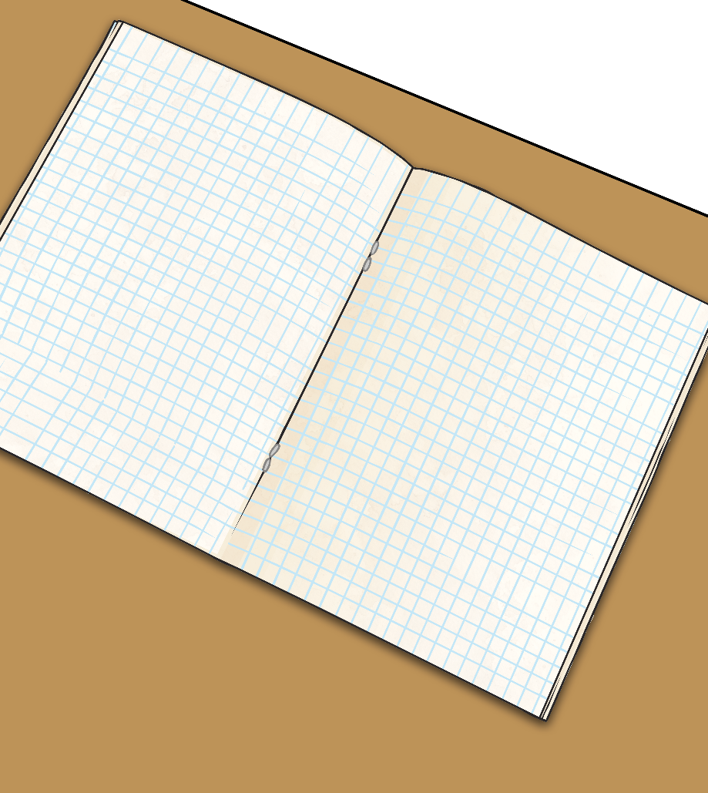
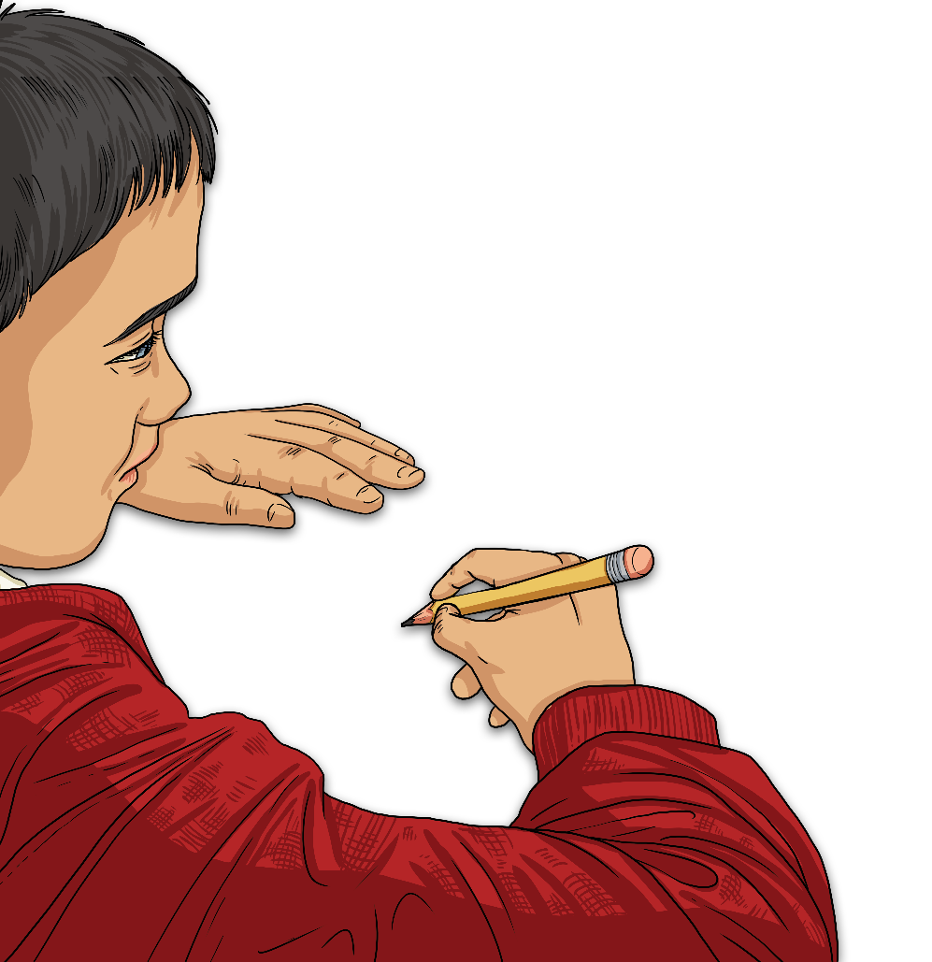
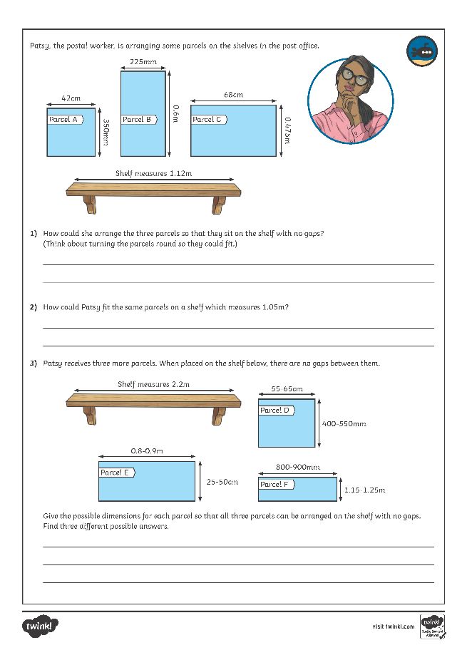
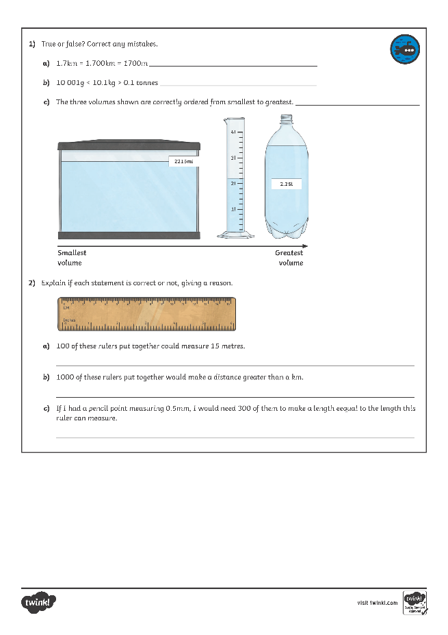
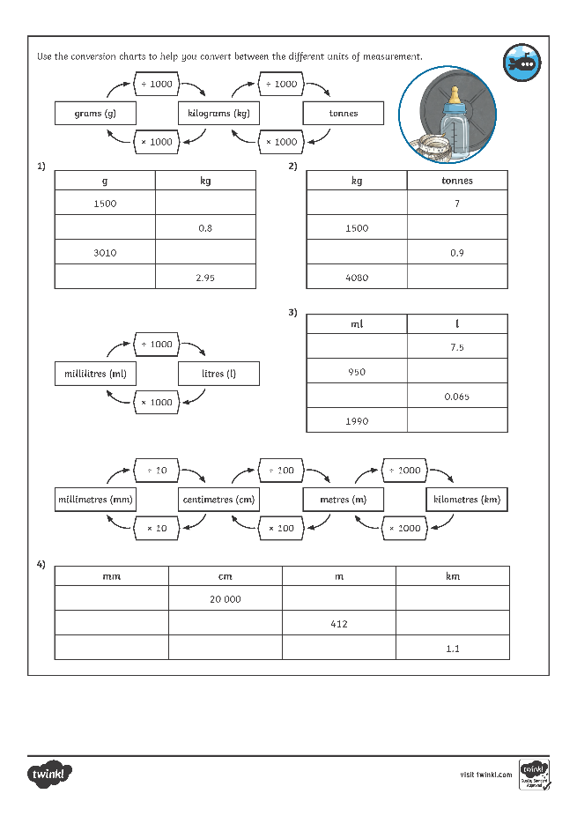
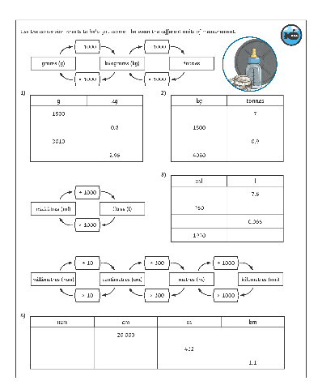
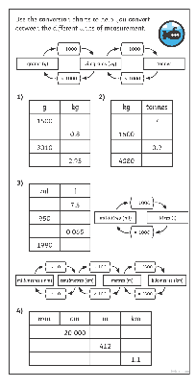
Diving into Mastery
Dive in by completing your own activity!

Slide 6
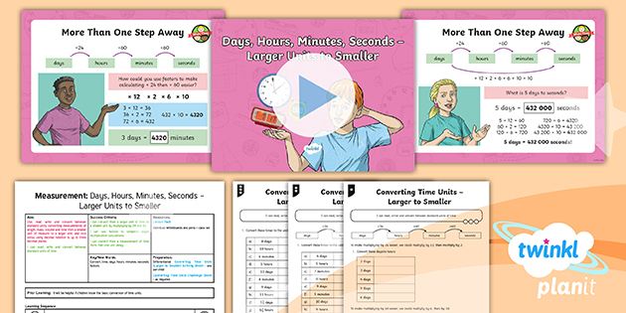
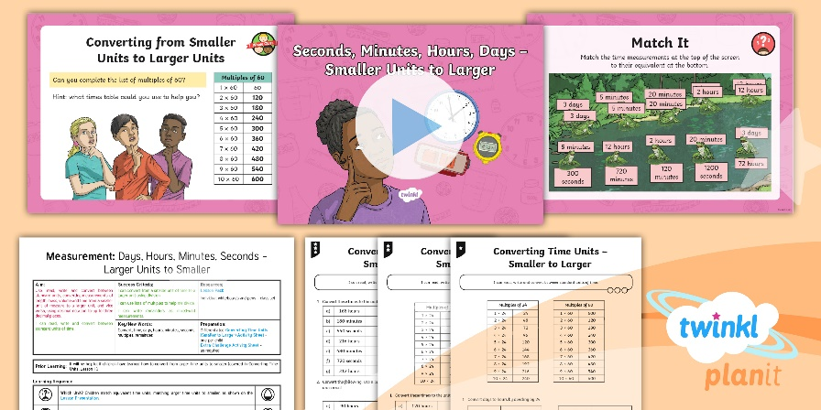

Need Planning to Complement this Resource?
National Curriculum Aim
Use, read, write and convert between standard units, converting measurements of length, mass, volume and time from a smaller unit of measure to a larger unit, and vice versa, using decimal notation to up to three decimal places.
For more planning resources to support this aim, click here.
Twinkl PlanIt is our award-winning scheme of work
with over 4000 resources.

