Slide 1

Maths
Home Learning
Week 6

Slide 2
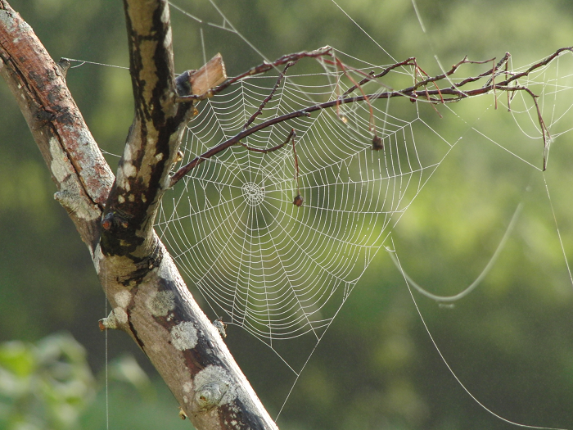
Challenge 1
Story Talk
Listen to The Very Busy Spider by Eric Carle
In this story we see the spider spending his whole day making his beautiful web. When you go out today see if you can spot a spider’s web.
How is it attached to the leaves or building?
Can you find a way to describe the pattern?
Story Talk

Slide 3
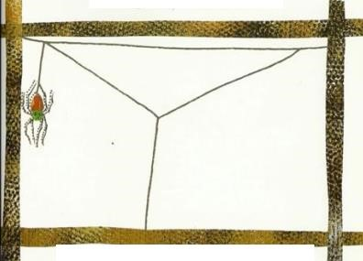
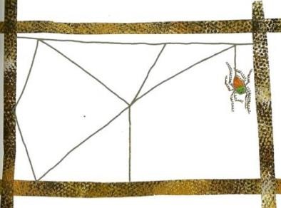
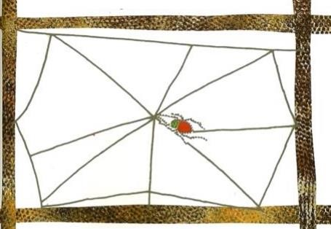
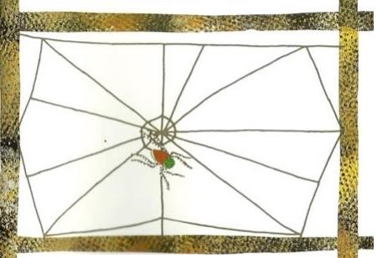
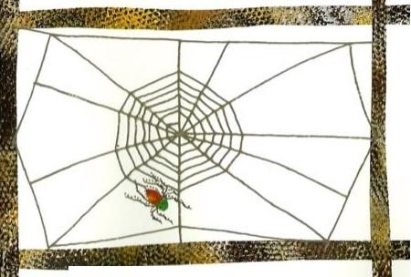
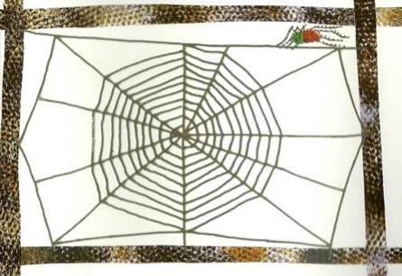
Have a go at drawing a spider’s web. You might like to copy the steps from the pictures in the story.
Once the spider has created the basic frame work, she starts in the middle and works out.
This is called an orb pattern.

Slide 4
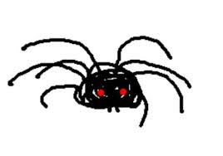
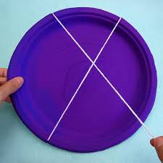
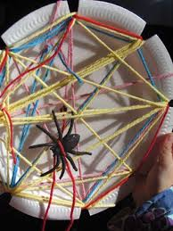
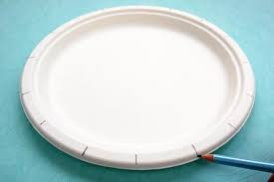
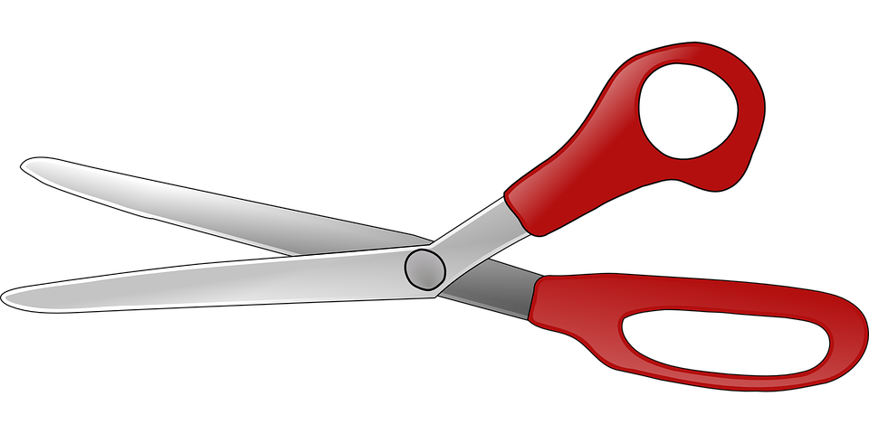
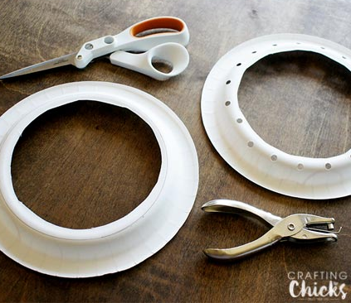
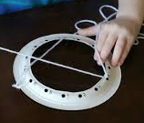
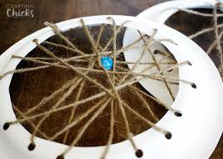
You might like to weave your own web. Can you make it strong enough to hold a spider?
Or you could make it like this.

Slide 5
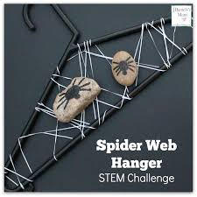
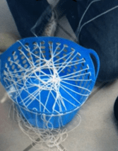
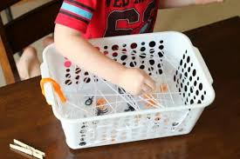
Can you make a web big enough and strong enough to hold a stone spider?

Slide 6

Challenge 2
True or false
At the end of the story the tired spider has finally finished making the web and catches a fly for her tea.
Sometimes spiders must catch more than one fly!
On the following slides are some number stories for you to listen to but are they correct? Your challenge is to prove whether they are true or false statements.
Thank you to White Rose Maths for the use of some of their slides.

Slide 7

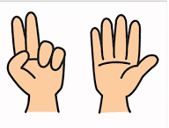
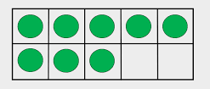
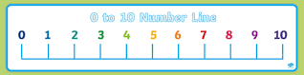
Play true or false. Listen to the spider story then prove to your grown up whether the statement is true or false.
First the very busy spider caught 8 flies, then she ate 4 of them. Now she has 5 left.

Slide 8
Listen again. True or false? How do you know?
First the very busy spider caught 7 flies, then she ate 3 of them. Now she has 4 left.

Slide 9
Last one. How did you get on? What did you use to help you prove whether it was true or false?
First the very busy spider caught 10 flies, then she ate 4 of them. Now she has 7 left.

Slide 10
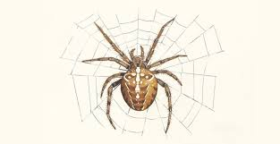
Challenge 3
Number Bonds to 8
We know that a spider has 8 legs. How many legs does it have each side of its body?
4 + 4 = 8

Slide 11
What if the spider was a little bit wonky and had an uneven number of legs each side of its body…
? + ? = 8

Slide 12
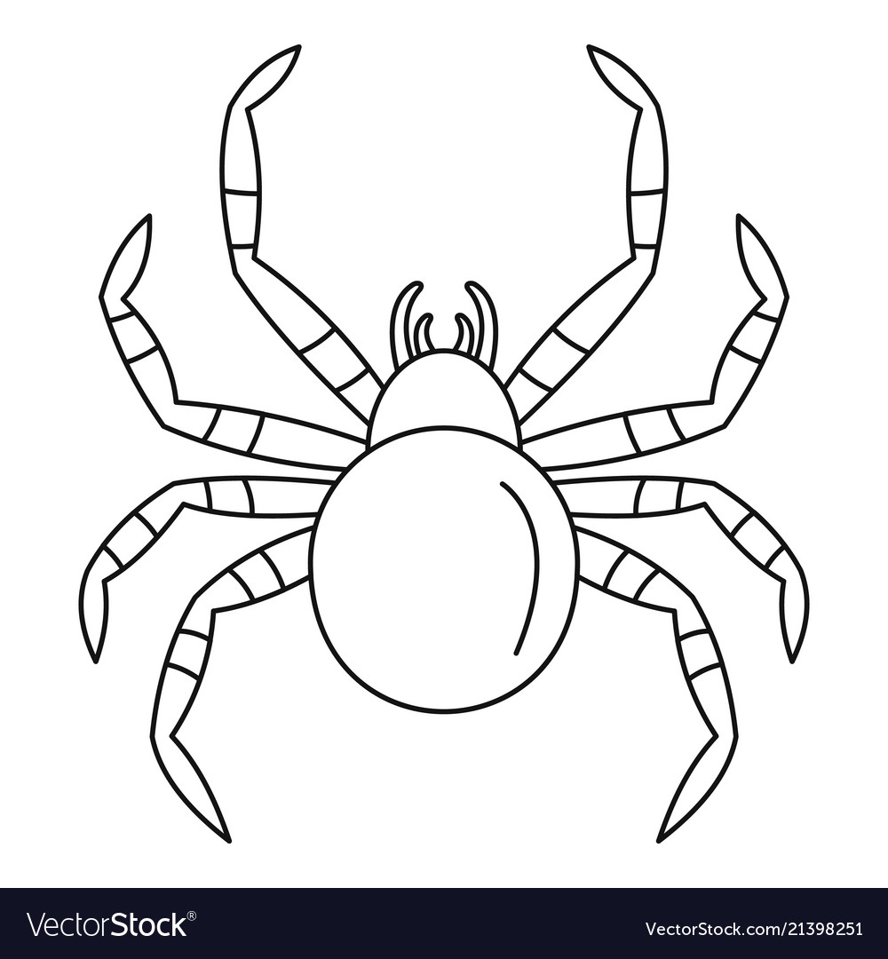
How many different ways can you find of arranging the legs on the spider?
? + ? = 8
? + ? = 8
? + ? = 8
? + ? = 8
4 + 4 = 8
? + ? = 8
? + ? = 8
? + ? = 8
? + ? = 8

Slide 13
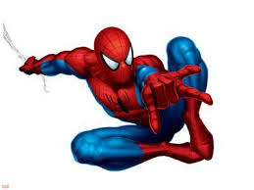

Challenge 4
Colour by Numbers
Can you use your super maths skills to create a super hero mask?

Slide 14
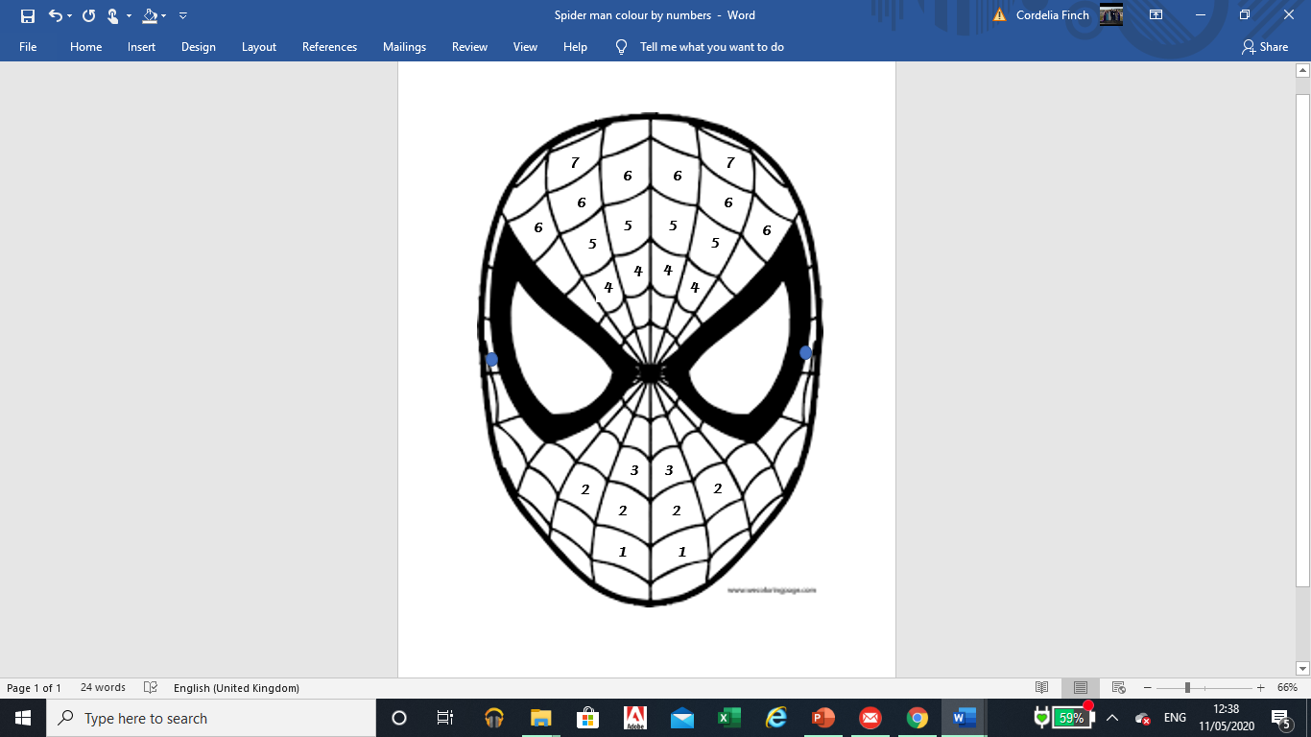
Colour by numbers ~ Spider man mask
First ask your grown up to work with you to decide on a key. See the example here.
Then read one of the number questions.
Next find the answer – what are you going to use to help you do this?
Finally, colour in the section of the picture that has the answer to your question. You can colour all the sections with that answer in one go or you can read another number question.
1 | red
2 | orange
3 | yellow
4 | green
5 | blue
6 | pink
7 | purple

Slide 15
0 + 1 = ?
10 – 3 = ?
1 + 1 = ?
10 – 7 = ?
5 – 0 = ?
10 – 6 = ?
10 – 4 = ?
4 + 0 = ?
6 – 4 = ?
10 – 9 = ?
5 – 1 = ?
7 – 1 = ?
10 – 5 = ?
5 + 1 = ?
0 + 3 = ?
10 – 8 = ?
0 + 2 = ?
2 + 2 = ?
5 + 2 = ?
5 + 0 = ?
2 + 3 = ?
4 + 2 = ?
9 – 3 = ?
3 + 3 = ?

Slide 16
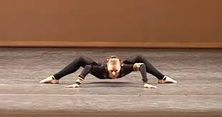
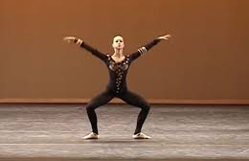
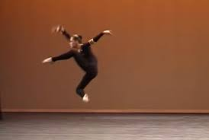
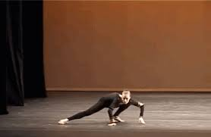
Challenge 5
Can you move like a spider?
See if you can move around your house or garden like a spider.
How many things can you scuttle under?
How many things can you scuttle over?
How many things can you scuttle around?
You might like to watch this ballerina do her spider dance. She has spent many years practising to be so good!
https://www.youtube.com/watch?v=JItkRLVlf-c

Slide 17
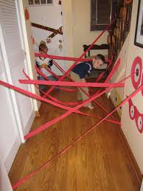
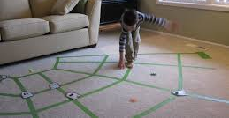
Perhaps you could create a huge spider’s web at home and see if you can move across it without breaking it or falling off it!
You will have to think carefully about the space you have got, how far you can travel, how you will change your body to fit the space and how you will balance.
In this house they have used tape on the floor.
How many treasures can you collect as you balance along the silken threads, without falling off?
In this house they have used a roll of paper. You could use string or wool or even masking tape!

