Slide 1
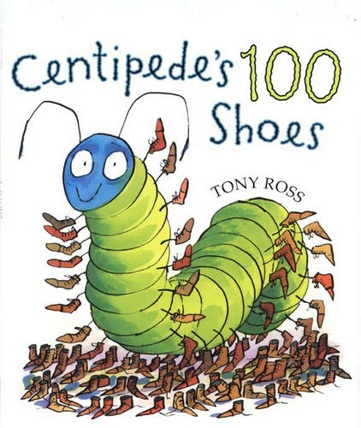
Maths
Home Learning
Week 5

Slide 2
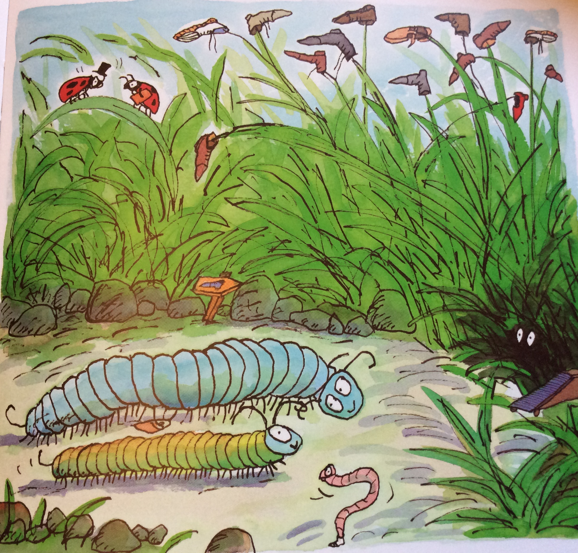
Challenge 1
Story Talk
Listen to Centipede’s 100 Legs by Tony Ross
In this story the little centipede goes to the shoe shop to buy shoes. There are lots to choose from. In the end he chooses lace-ups because he says they are more grown up.
There are all sorts of shoes in shoe shops and often in our homes amongst our family.
Talk to someone in your house about the different types of fastenings. What is the fastening on your shoe?
Story Talk

Slide 3
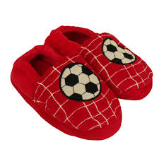
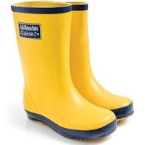
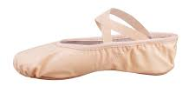
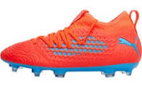
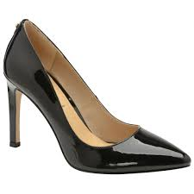
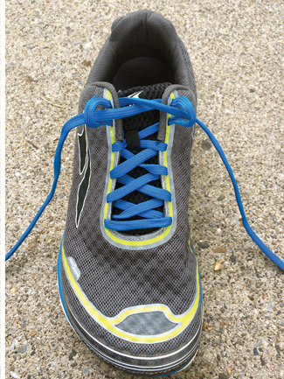
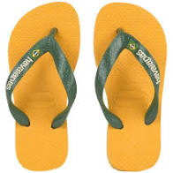
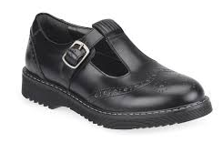
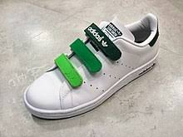
Carry out an investigation into the different types of footwear in your home and decide how you could sort them – what would be your rule?

Slide 4
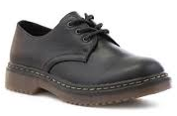
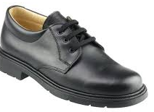
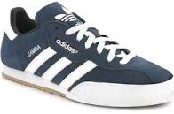
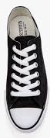
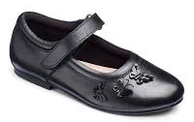
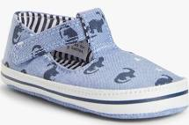
You might decide to do some more shoe maths.
You could make a repeating shoe pattern. Will you make a simple AB pattern or something more complex like ABBA, for example? What is the unit of repeat of my pattern below?
You could order all the shoes in your house by size.

Slide 5
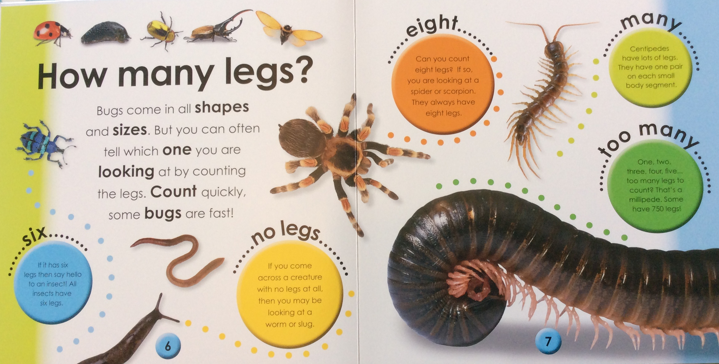
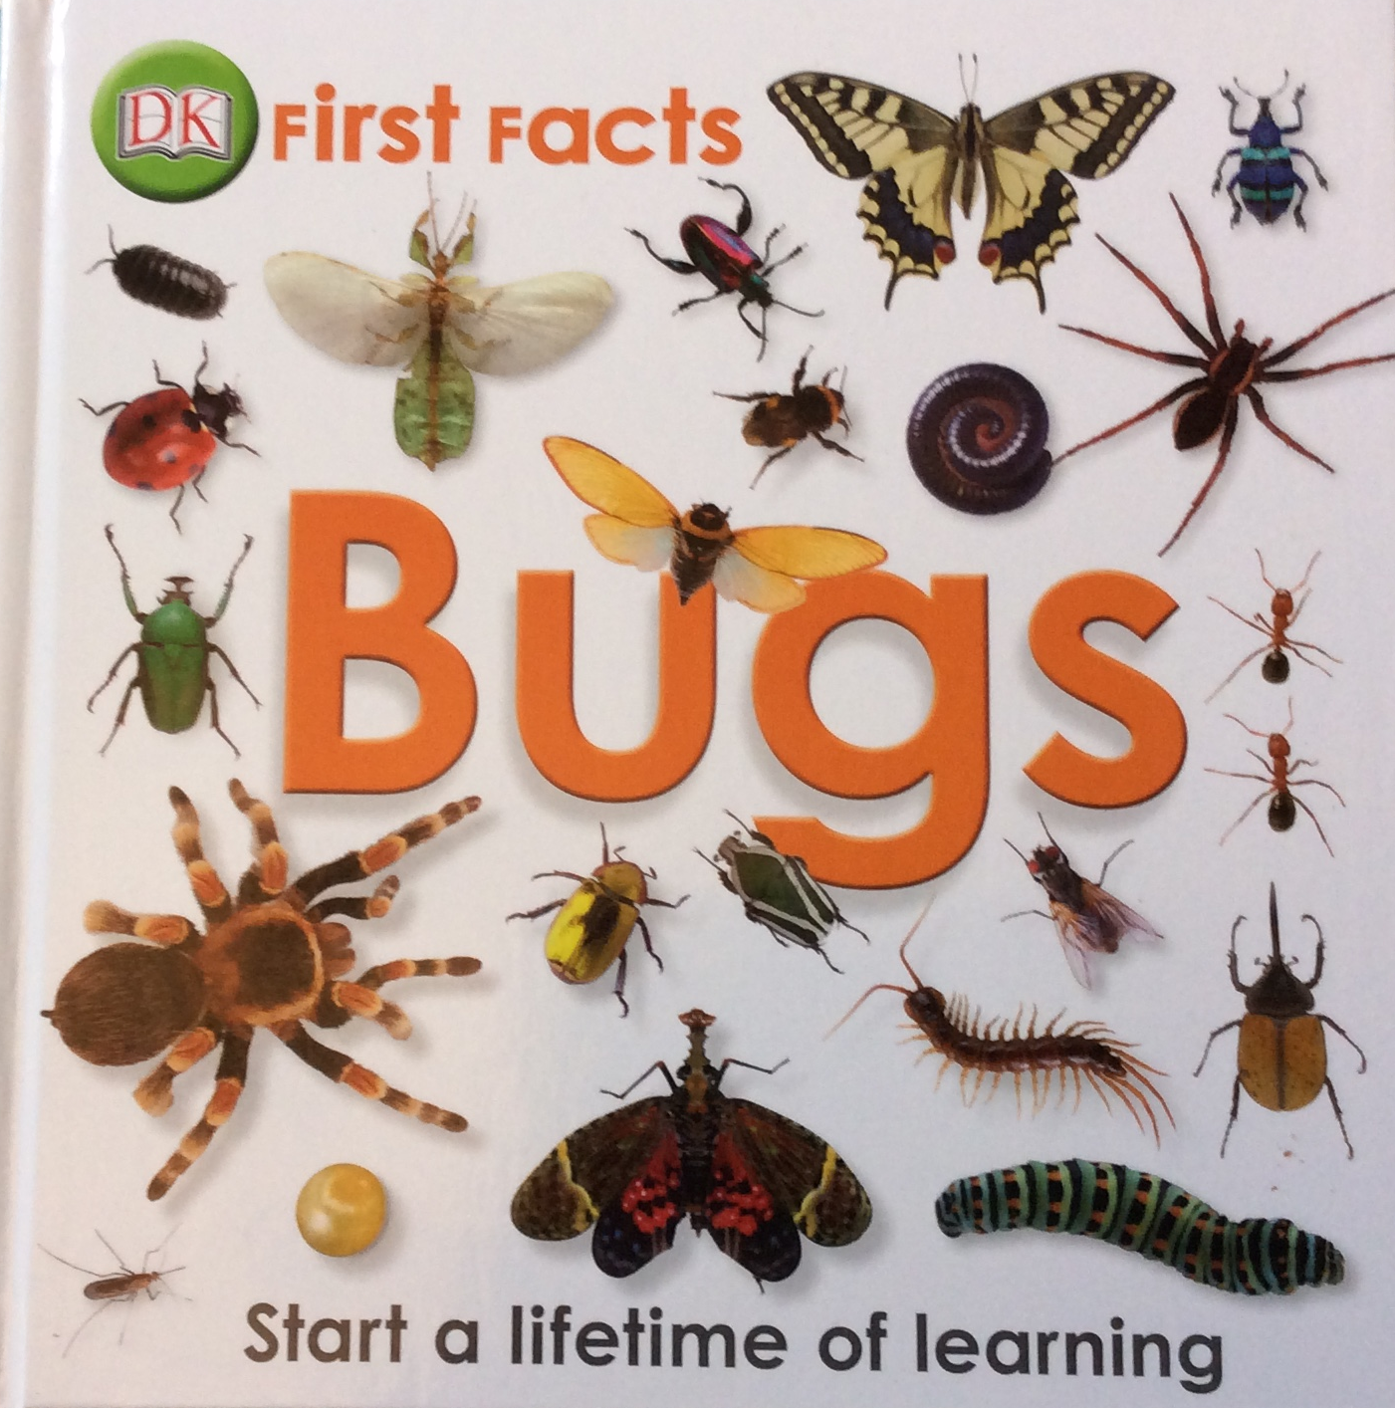
Challenge 2
Minibeasts
In the story little centipede gives away his shoes and socks to a number of different types of minibeasts
Have a look at the picture on the next page. What can you see? The information below might help you work out what type of minibeasts they are.
Minibeasts

Slide 6
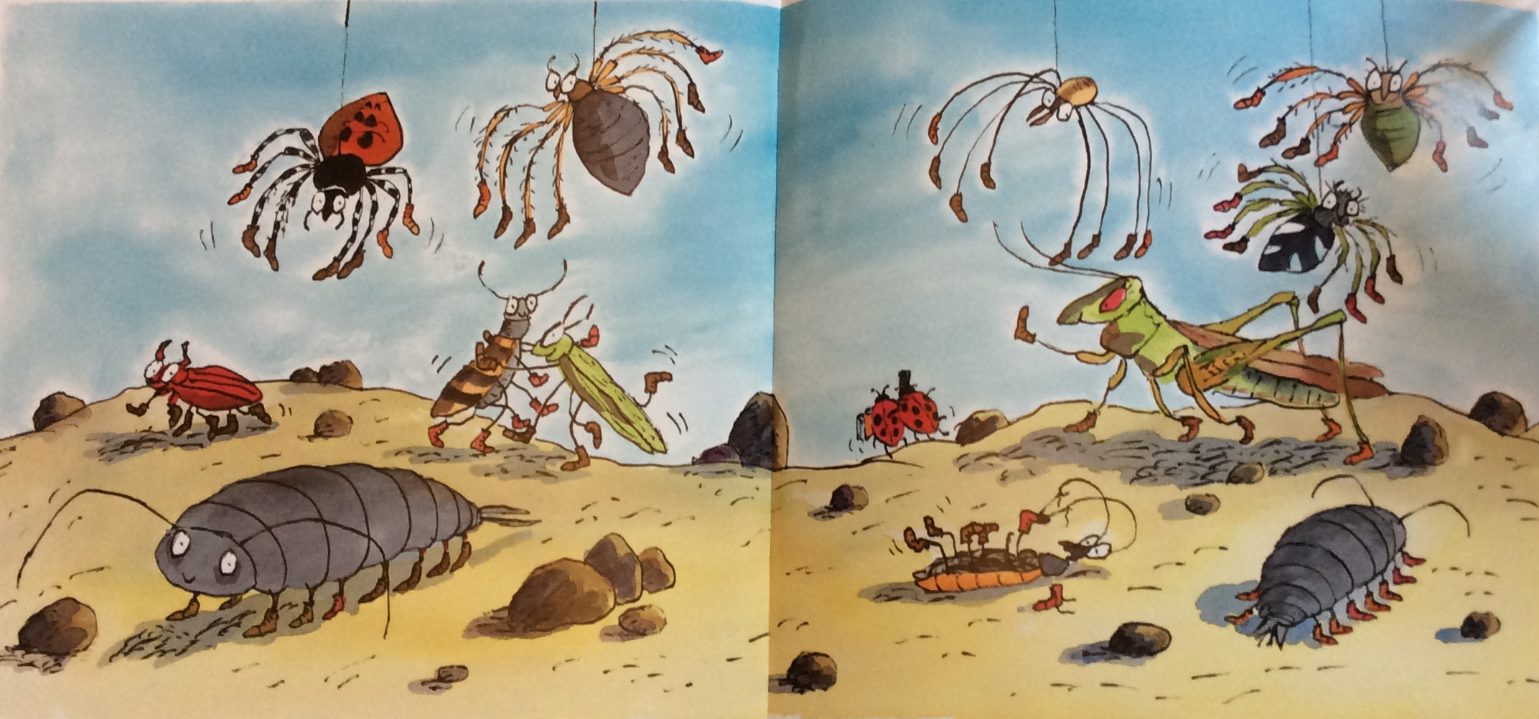
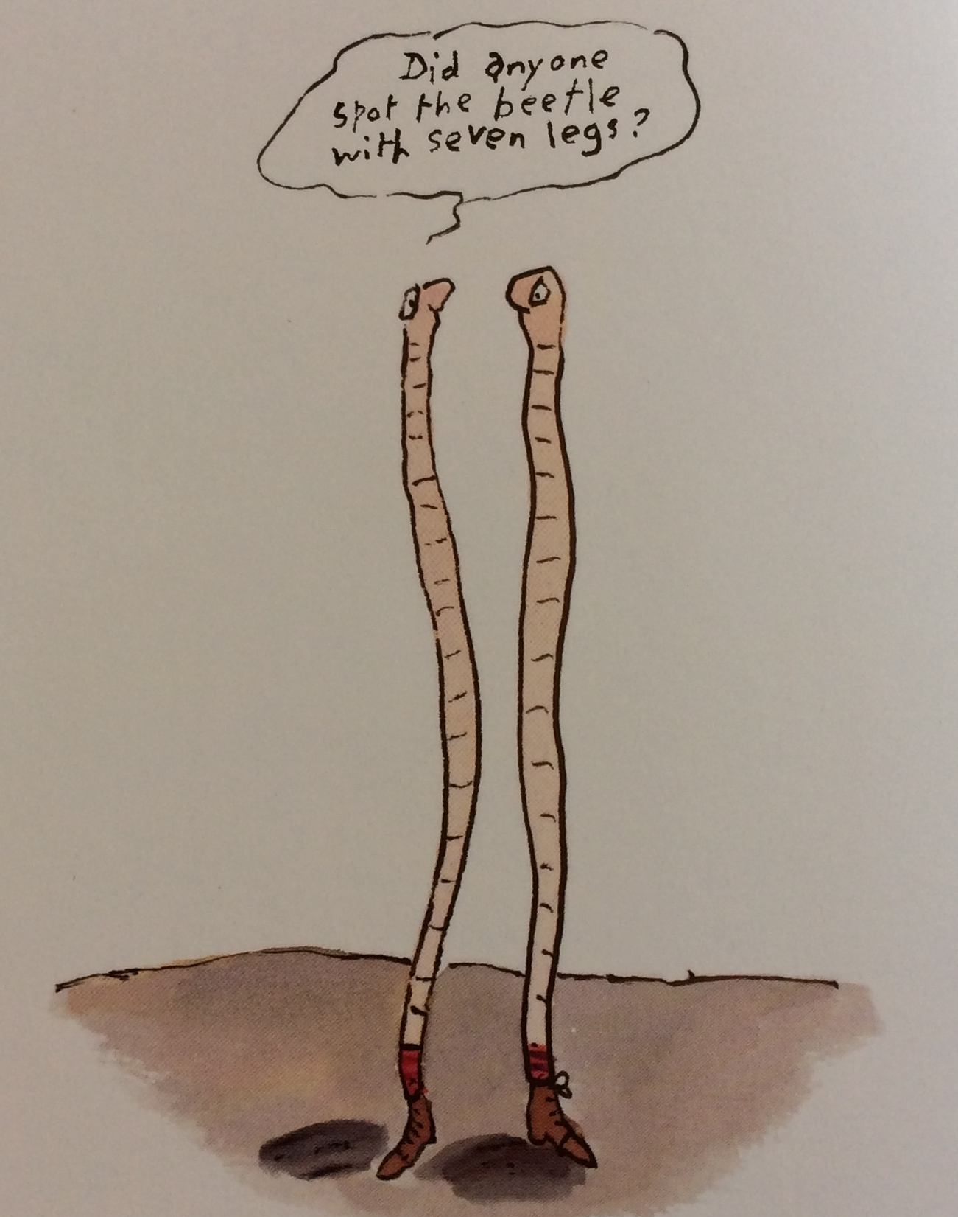

Slide 7
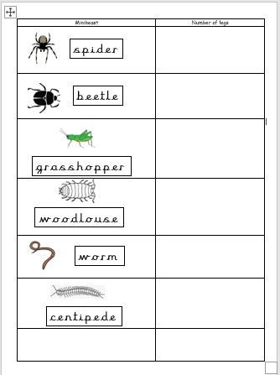
You might like to draw up a table to show how many legs each minibeast has.
If you have found out how many, you might like to try a problem solving challenge

Slide 8
How many shoes would 2 beetles need?
How many shoes would 5 spiders need?
You can make up your own number problem.
What will you use to help you? You could use ten frames, a number line or a 100 square maybe.

Slide 9
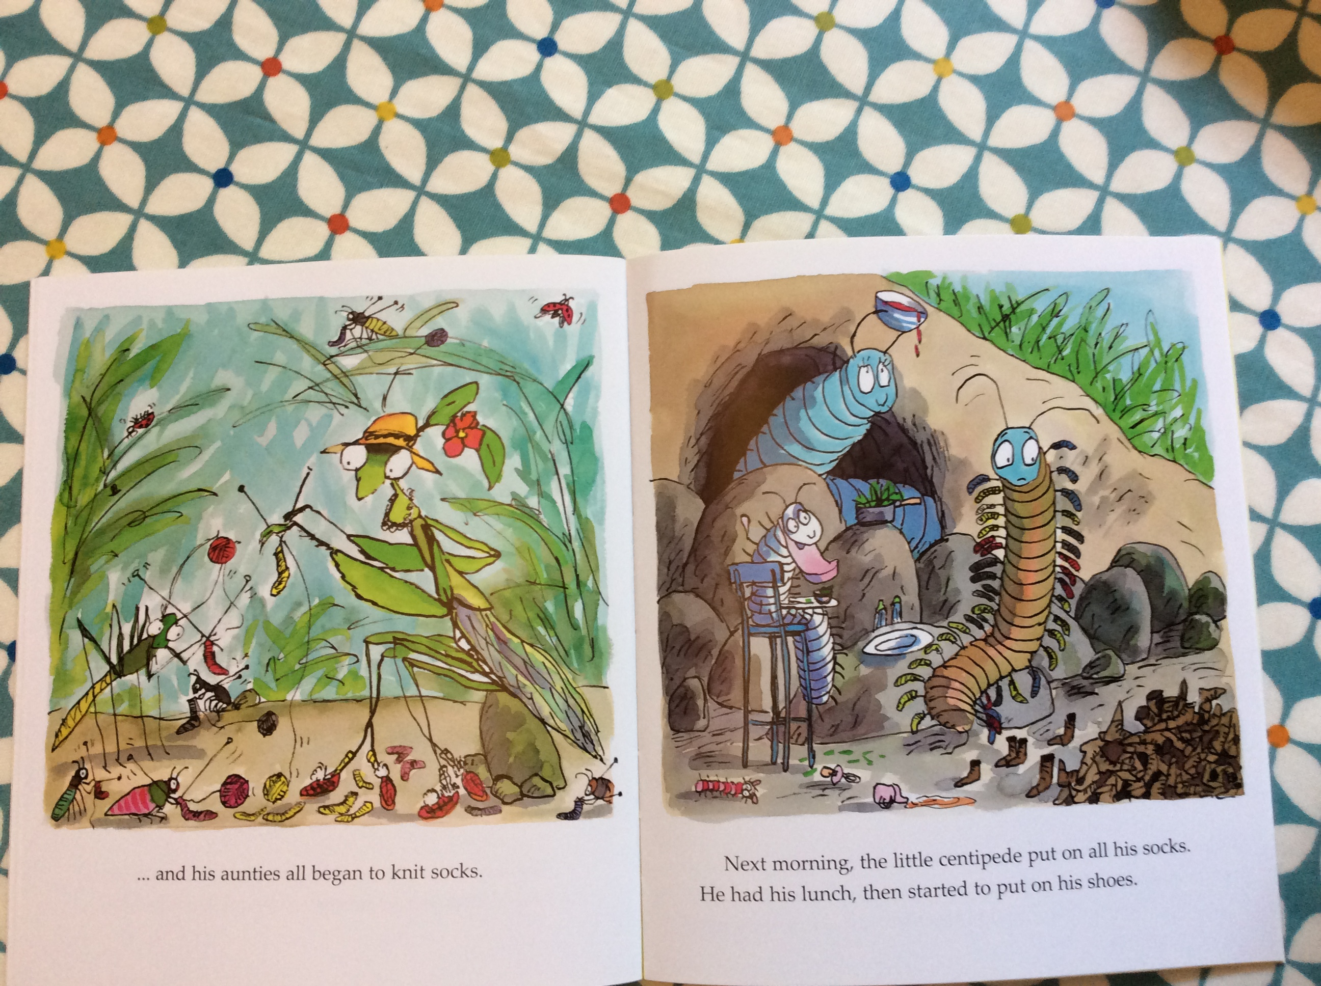
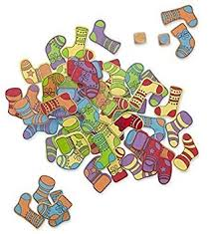
Challenge 3
Pairs
When the little centipede’s feet were sore his aunties knitted him lots of socks.
Socks and shoes come in pairs. A pair means 2 items that go together.
For this challenge you will need to gather an assortment of socks or shoes or both and you will need a timer.

Slide 10

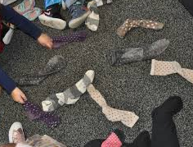

How quickly can you sort the socks in to pairs?
Did you match them correctly?
Don’t forget to check size, pattern and colour.

Slide 11
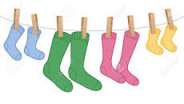
Challenge 4
Counting in 2s
Little centipede needed so many socks for all his little feet- it’s a good job his aunties were good at knitting!
When there are lots of things to count it is often really useful to have a way of counting them more quickly. I think the aunties might have needed to do this.
Today we are going to learn to count pairs of socks without counting every single one.
You will need to gather lots of pairs of socks again – perhaps you can use the ones from the timed challenge!

Slide 12
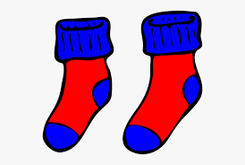
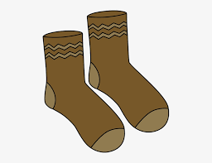
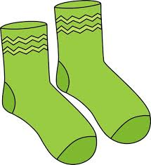
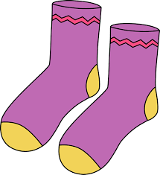
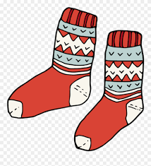
Arrange your socks in pairs in a line – you can pretend you are hanging them on a line to dry.
2
4
6
8
10
How many pairs of socks do you have?
Count all of the socks to find out how many.
Now you are going to do some adding and recording
Put a label on the first pair of socks to show how many.
Keep adding on the next two socks and recording how many so far.

Slide 13
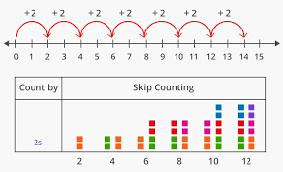
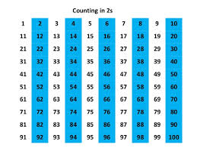

Use a number line or a 100 square to find the counting in 2s pattern.
When you are counting in 2s you are adding on 2 more each time.
2 4 6 8

Slide 14
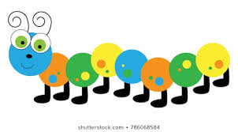
You might like to draw a minibeast a bit like a centipede to show the counting in 2s pattern.
Count 2 sections and colour it in.
Count on 2 more and colour it in.

Slide 15
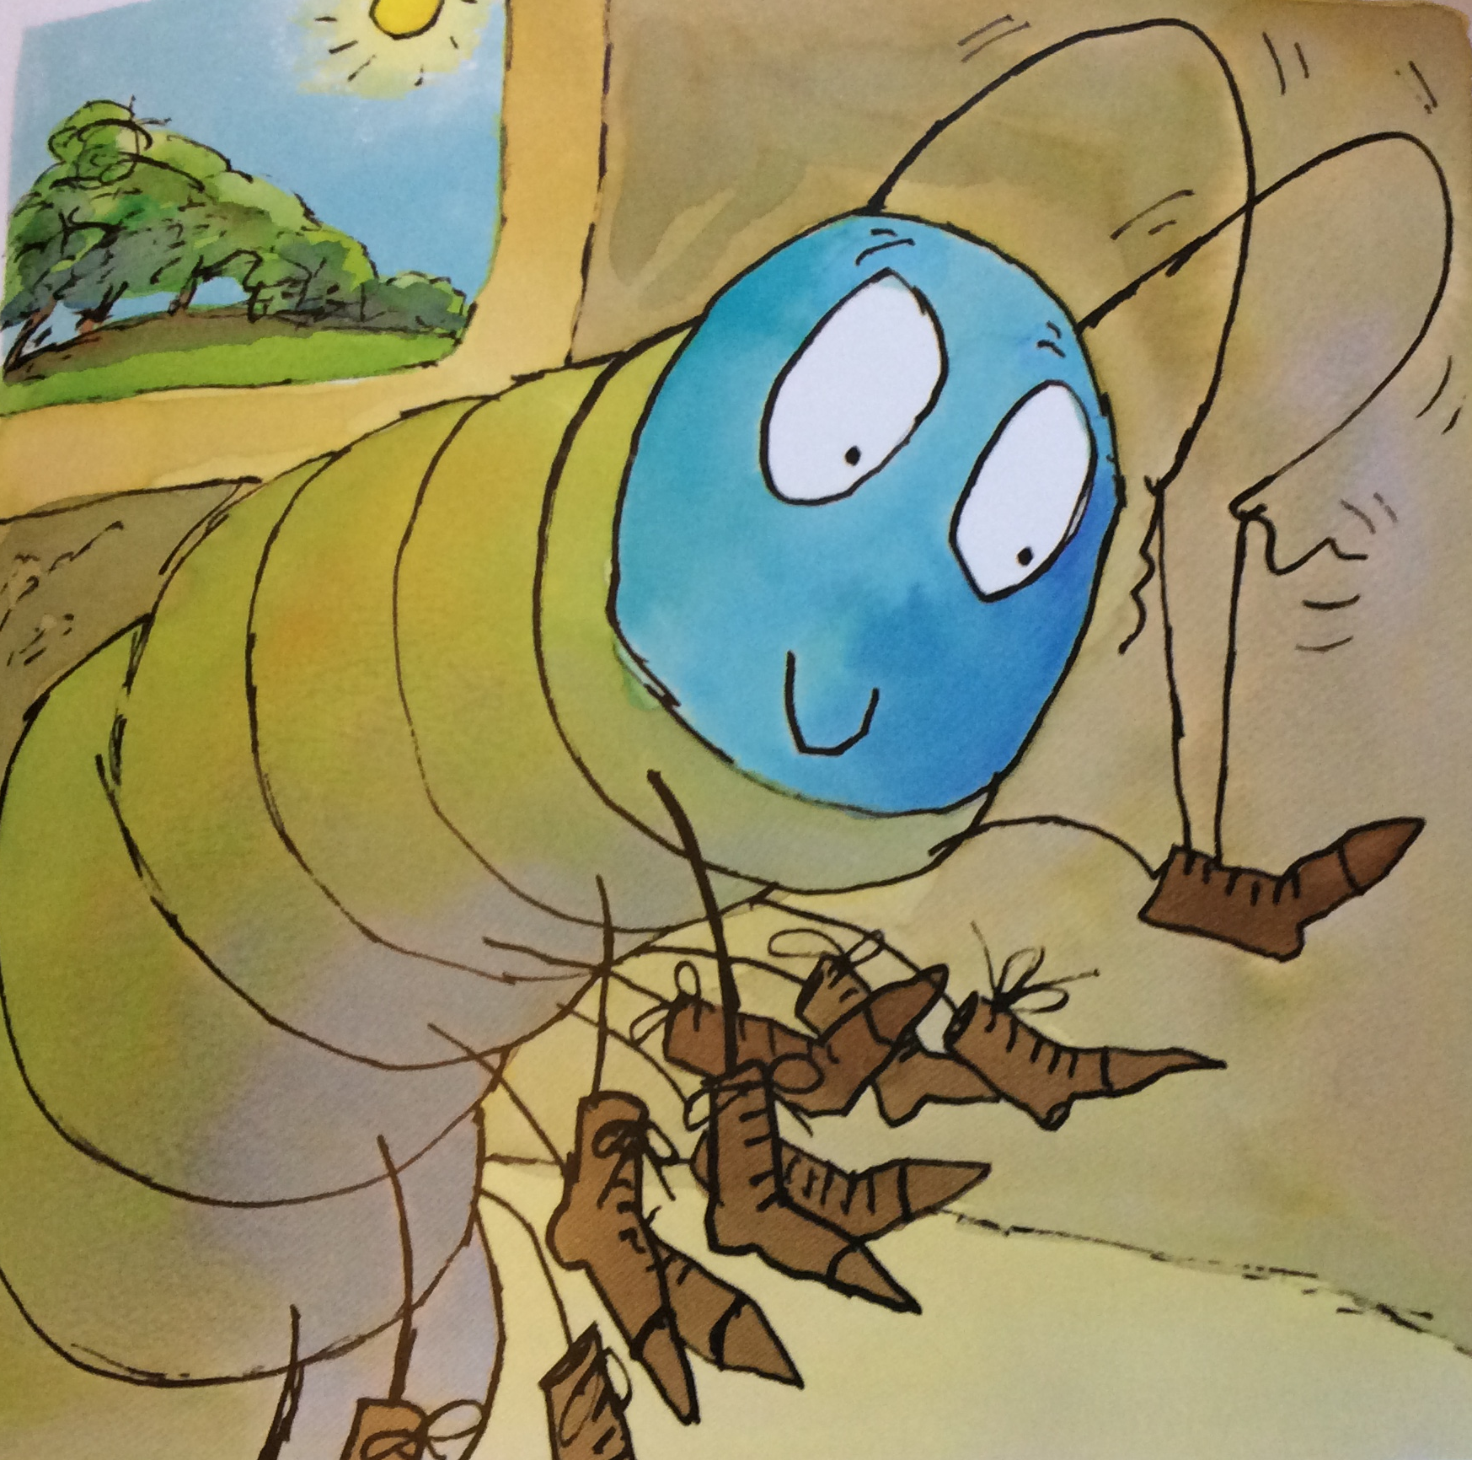
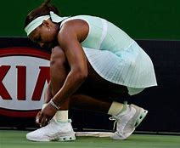
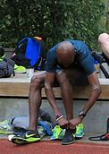
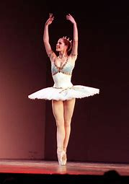
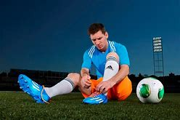
Challenge 5
Tying shoe laces
It took the little centipede a very long time to tie up all his shoe laces. Luckily he had been practising and knew how to do it!
Your challenge is to have a go at learning to tie shoe laces. You might not need it yet but you are likely to one day!
Learning to tie a bow can be useful in all sorts of situations.

Slide 16
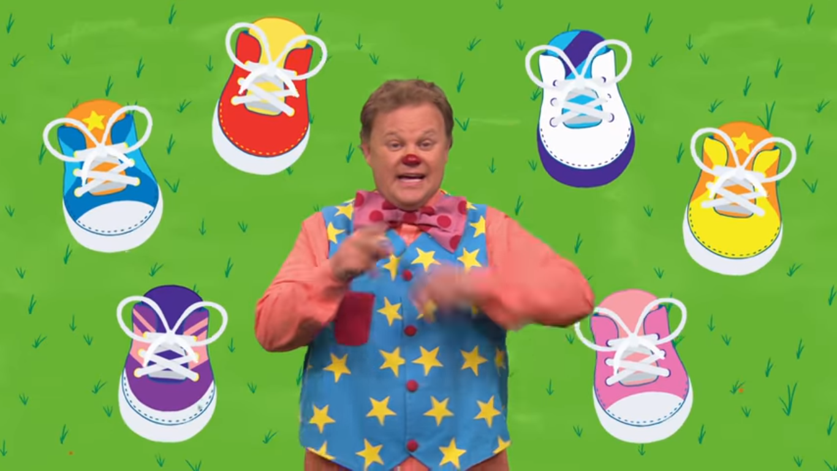

Watch Mr Tumble’s Shoelace Song
https://www.youtube.com/watch?v=biPlP4yiyQs

Slide 17
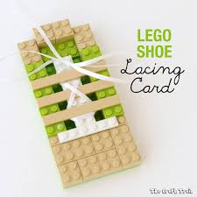
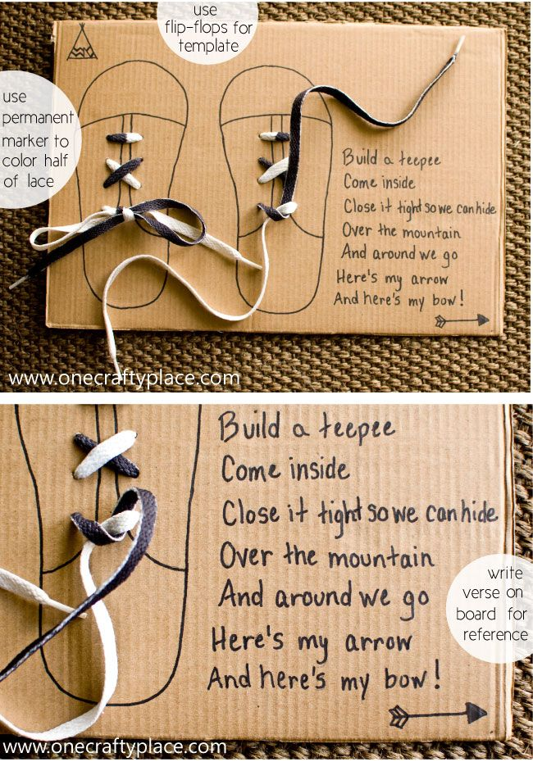
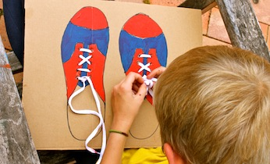
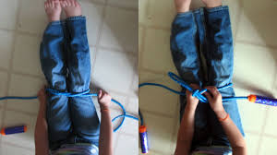
Here are some ideas…

