Slide 1
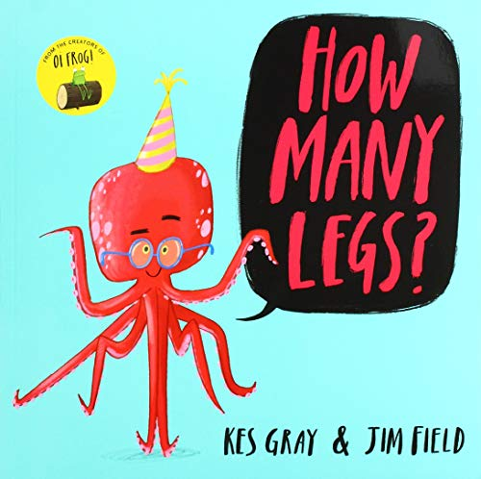
Maths
Home Learning
Week 4

Slide 2
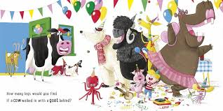
Challenge 1
Story Talk
Listen to How Many Legs?’ by Kes Gray and Jim Field
In this story the characters are getting together for a party. A party could be held for all sorts of reasons; a wedding, a Christening, a birthday, a home coming, a special achievement but they are always joyous occasions.
Talk to someone at home about a special event that you have enjoyed as a family or with other family members or friends.
Story Talk

Slide 3
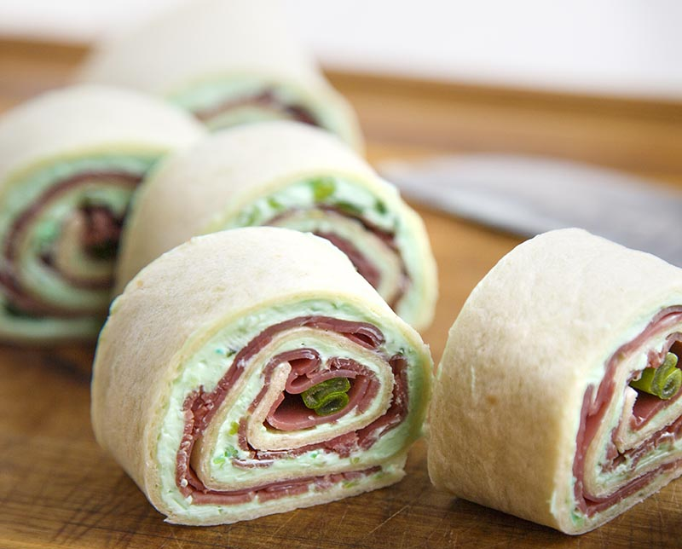
In the story we can see all the party food on the table. Often there will be food at a party for everyone to share and enjoy.
In the Finch family pinwheel sandwiches were a firm favourite for parties. May be you would like to have a go at making some.
Look out for these shapes while you are making them!
2D rectangle
and
3D cylinders.

Slide 4
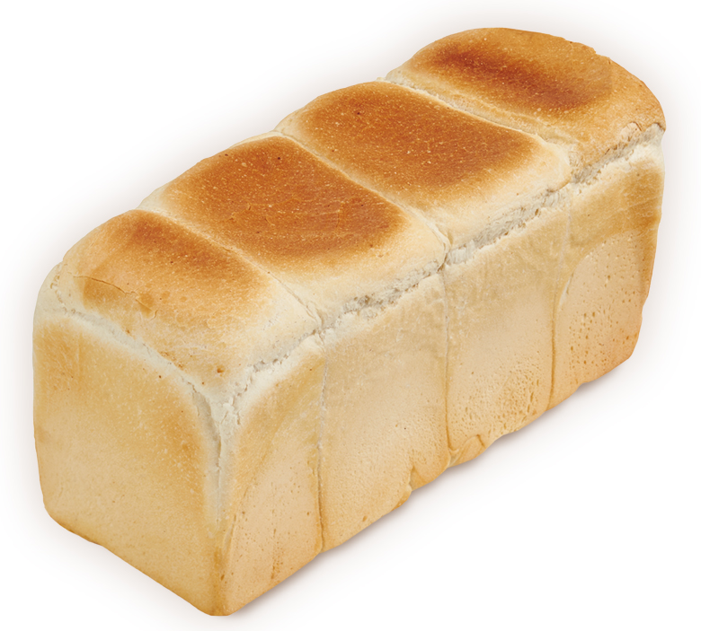
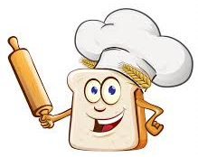
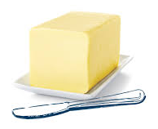
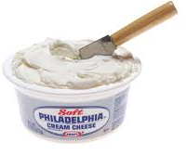
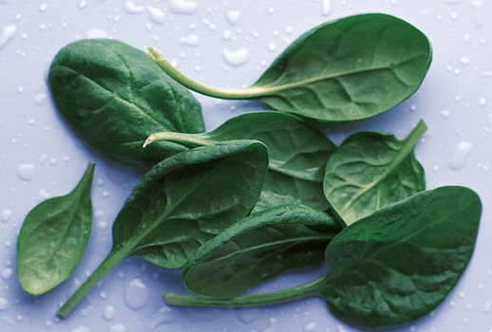
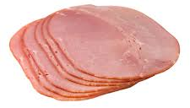
Pinwheel Sandwiches
You will need:
Rolling pin
An uncut white loaf of bread
Butter or spread
Filling of your choice

Slide 5
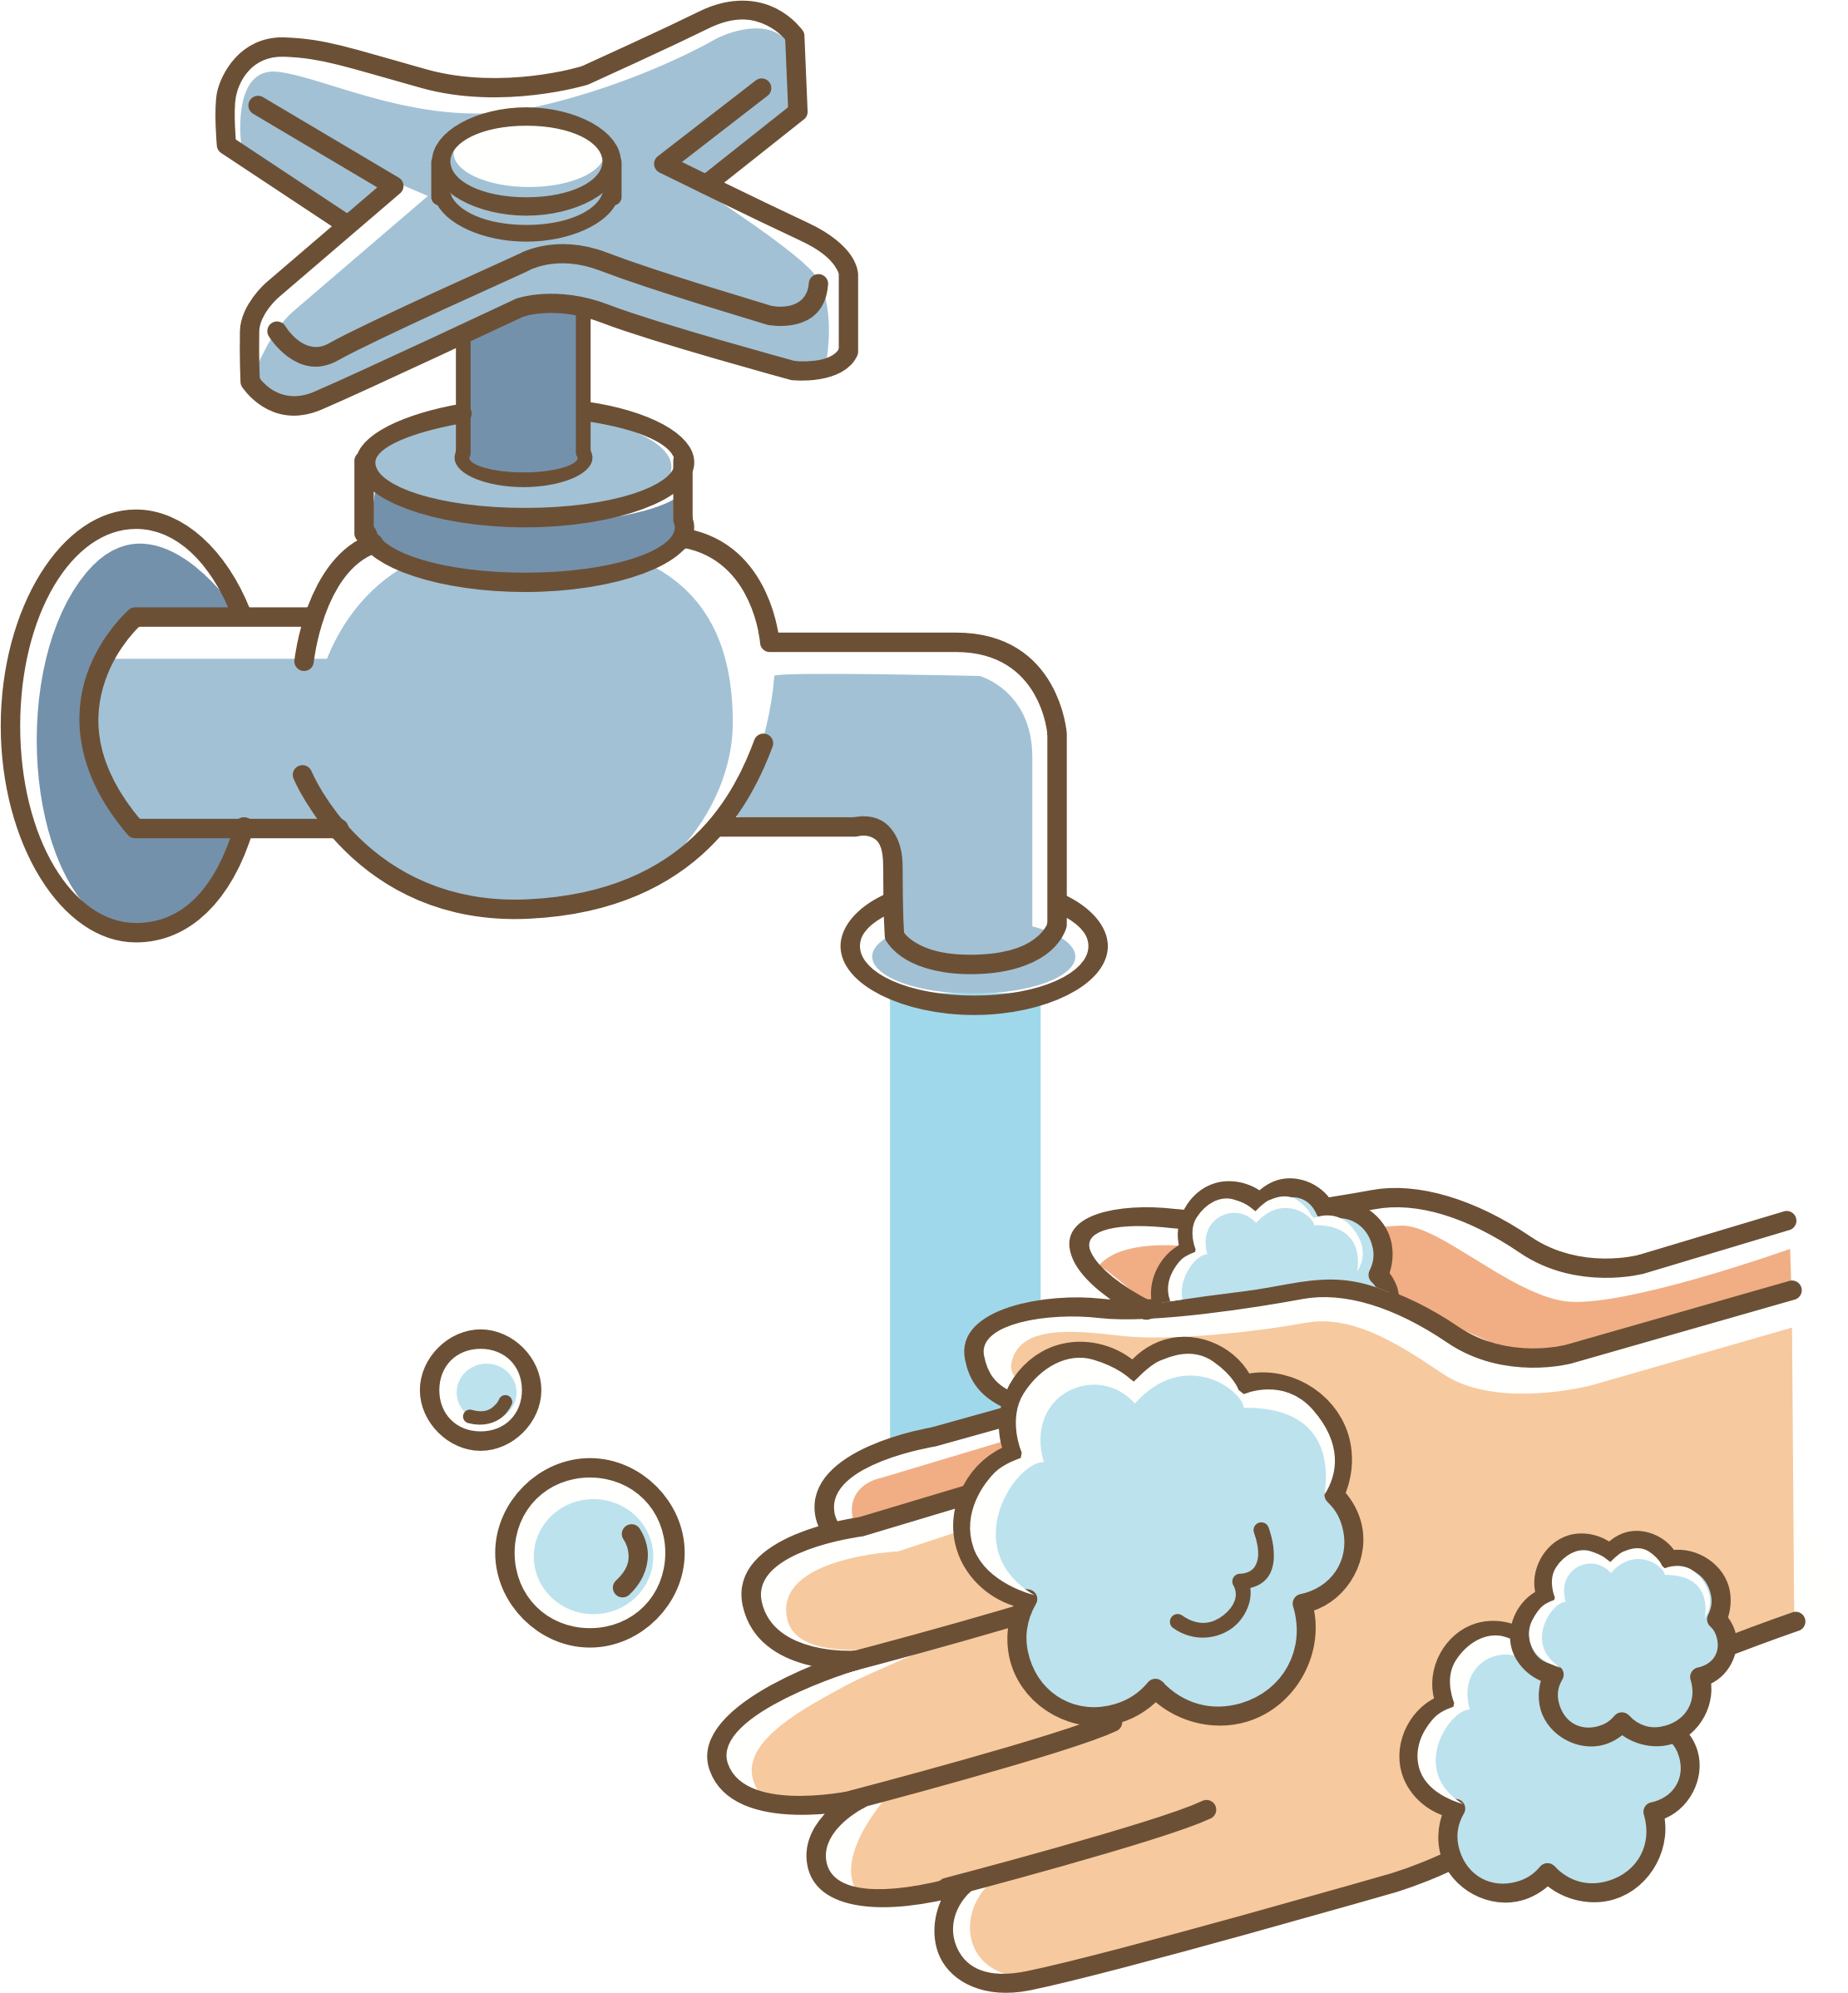
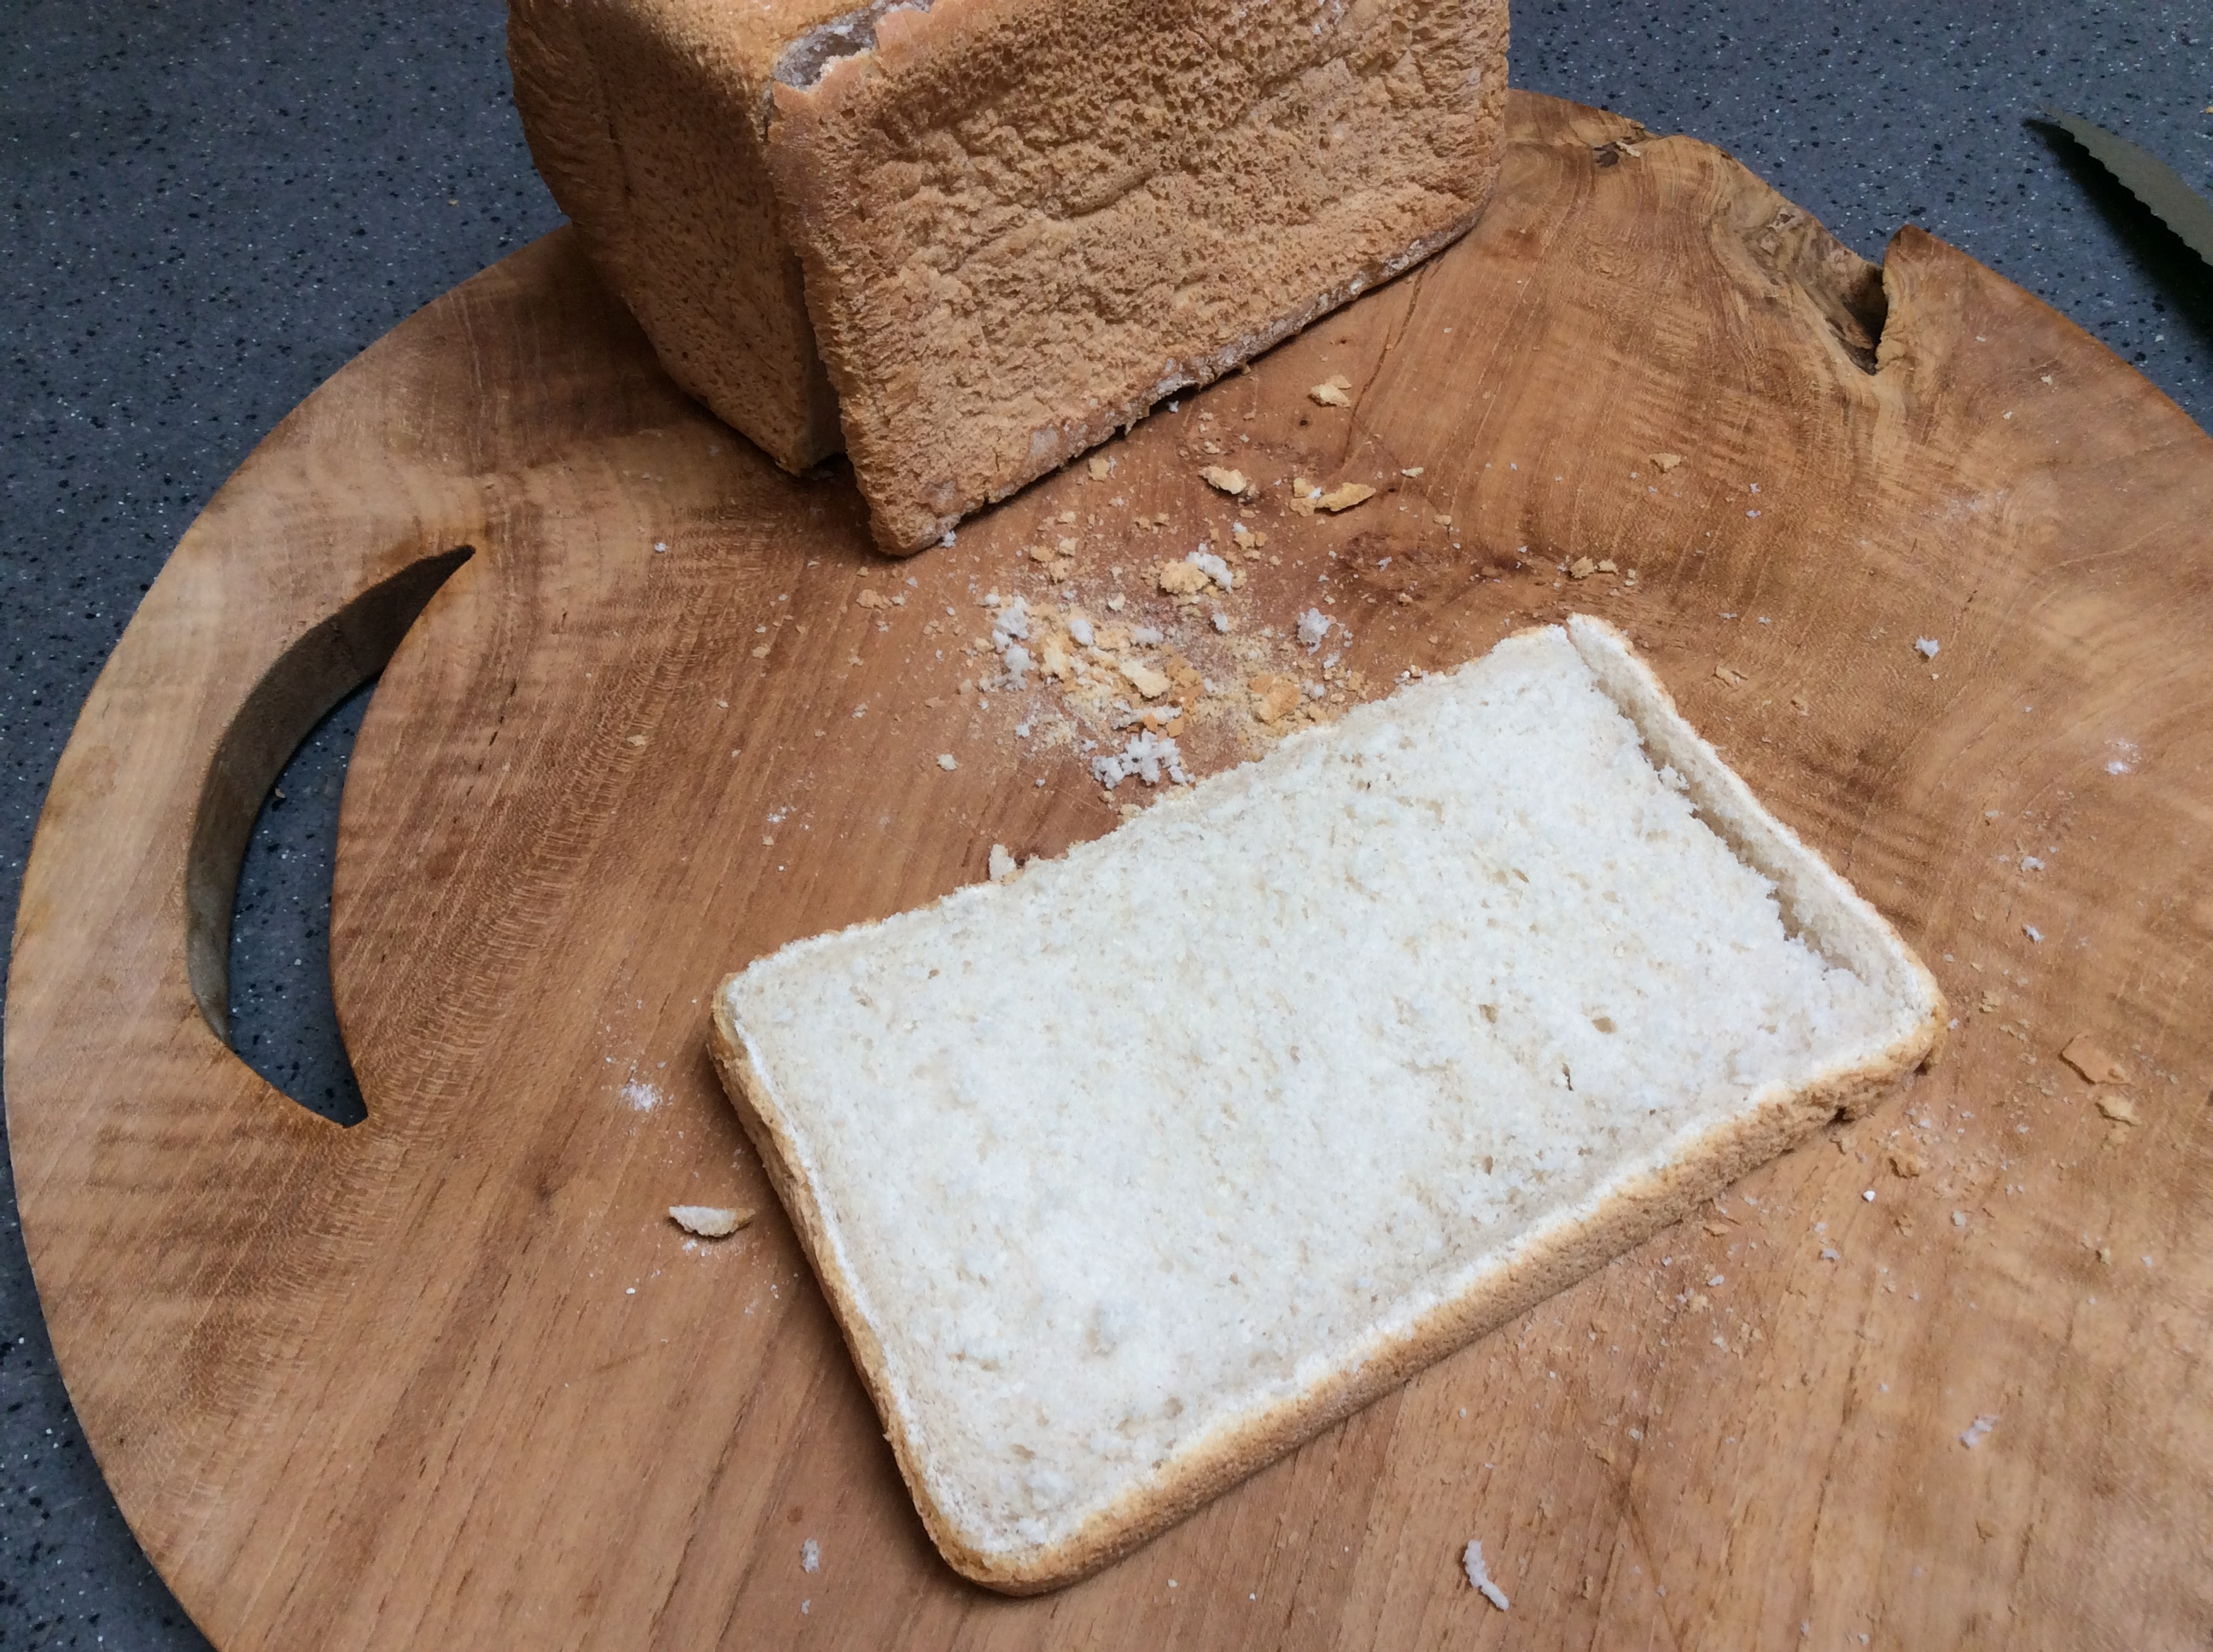
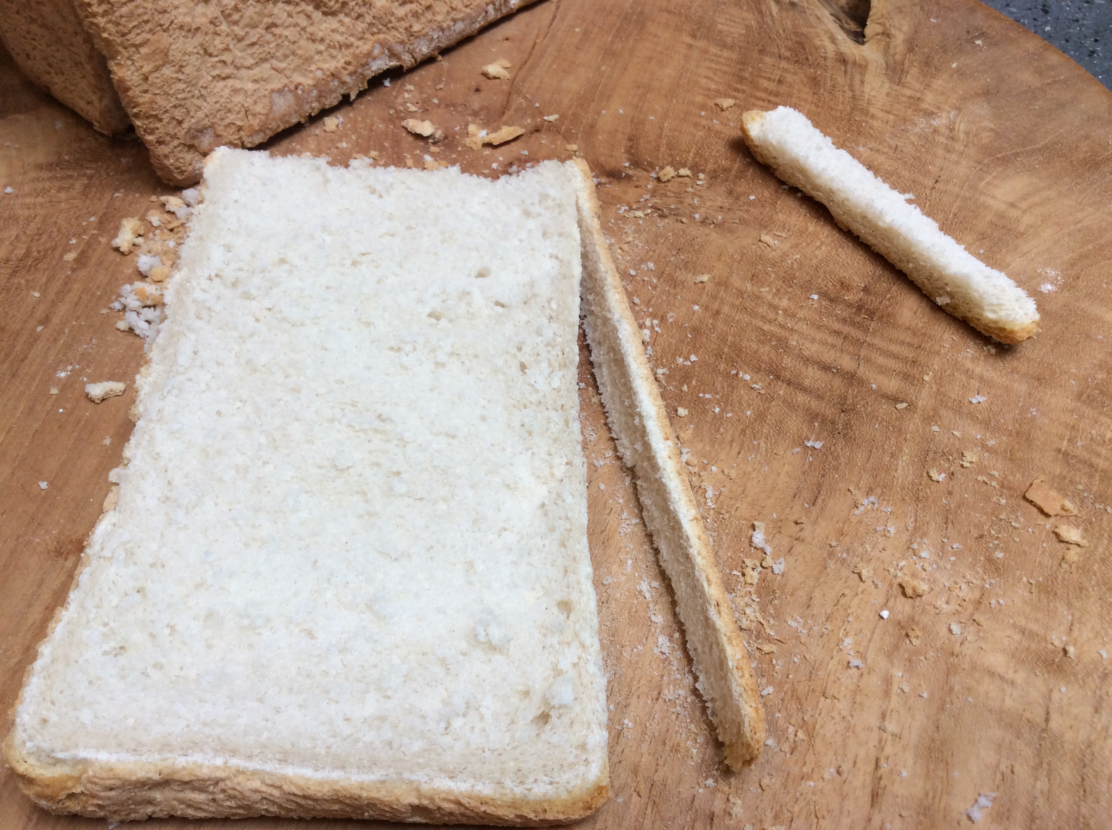
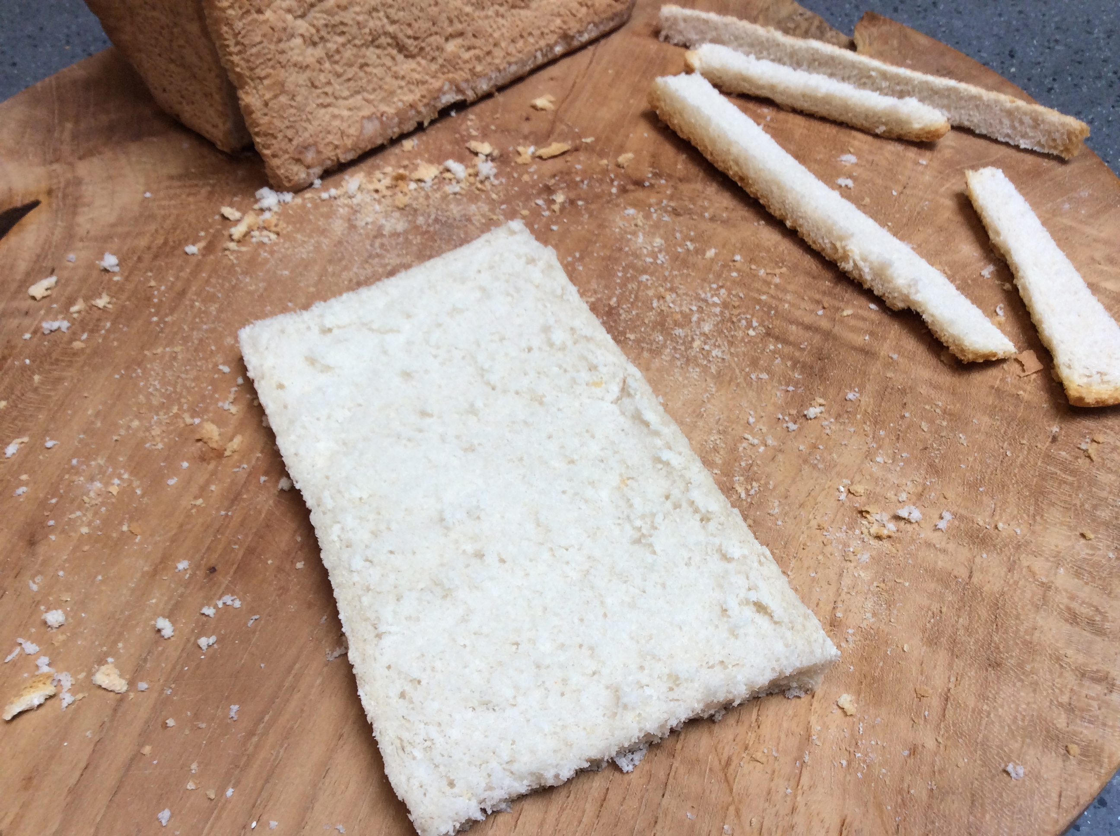
First job needs to be done by an adult!
Method:
1. Wash your hands.
2. Your adult cuts the bread.
This works best with a long soft white loaf.

Slide 6
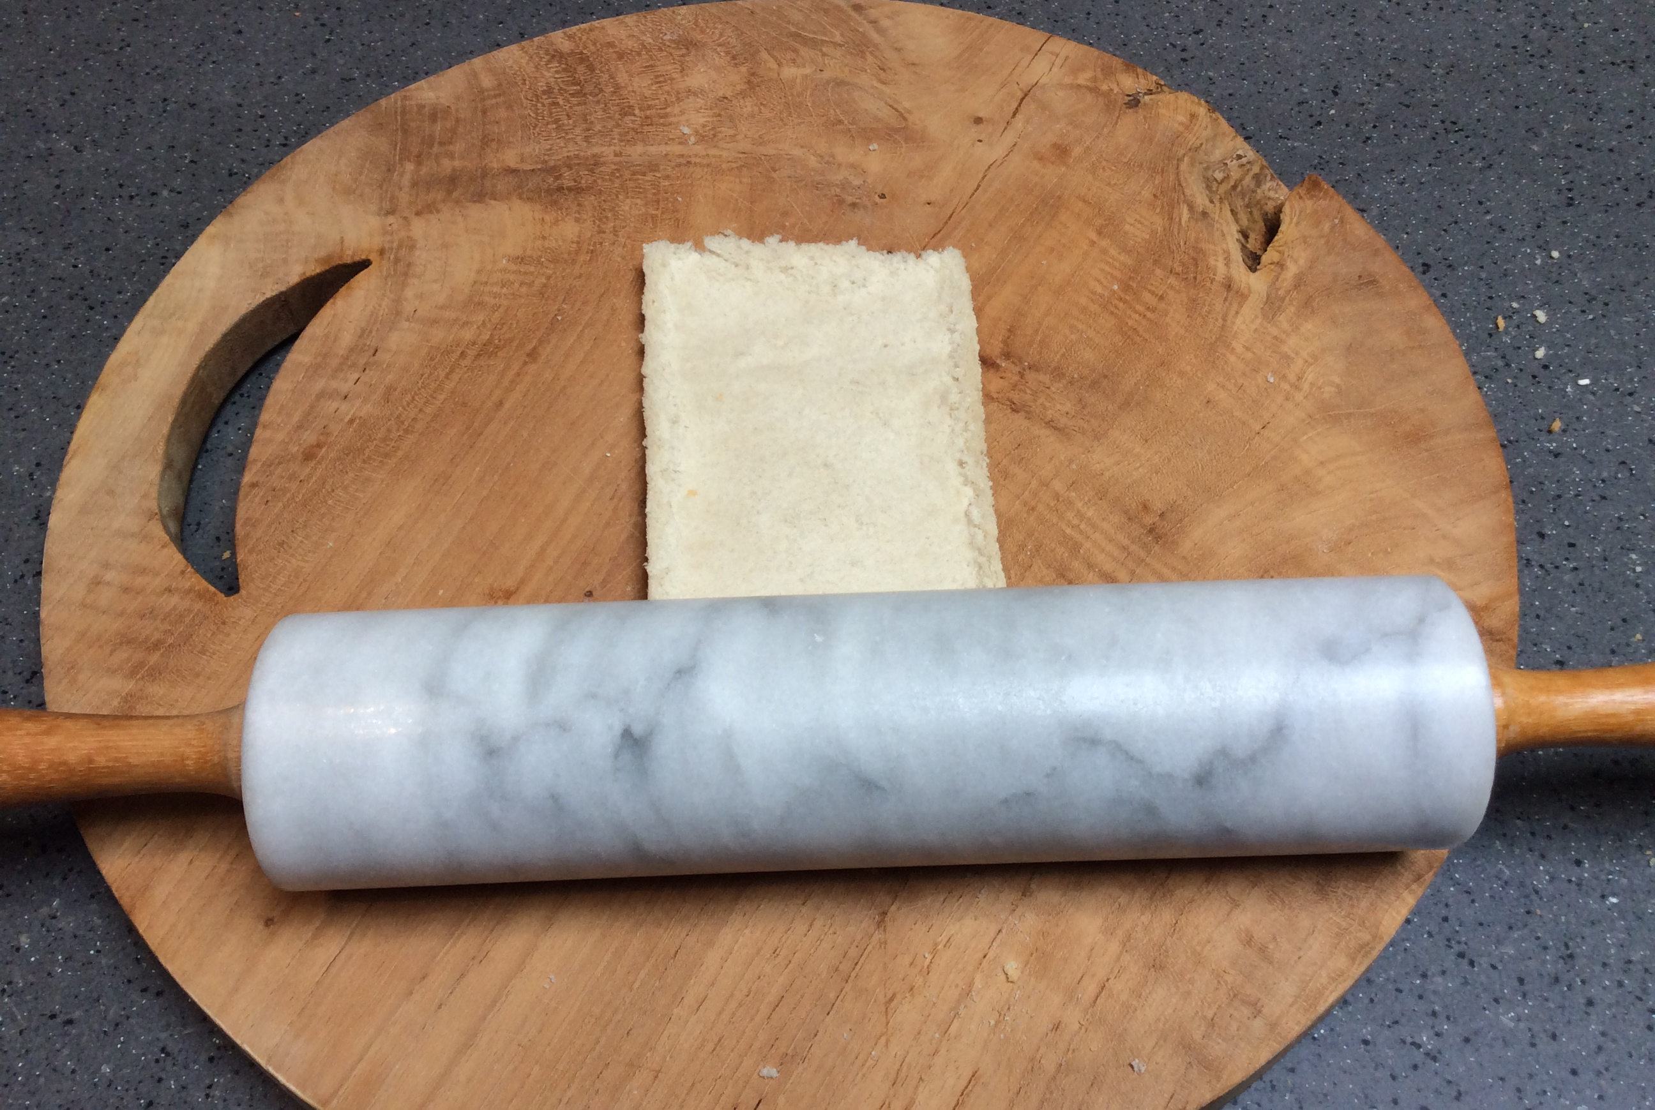
Method:
You should have a rectangle. It will almost be a 2D shape because it will be so flat!
3. Roll the bread so that it is thin and flat.
Tell your grown up how you know that it is a rectangle.
‘I know it is a rectangle because it has…’

Slide 7
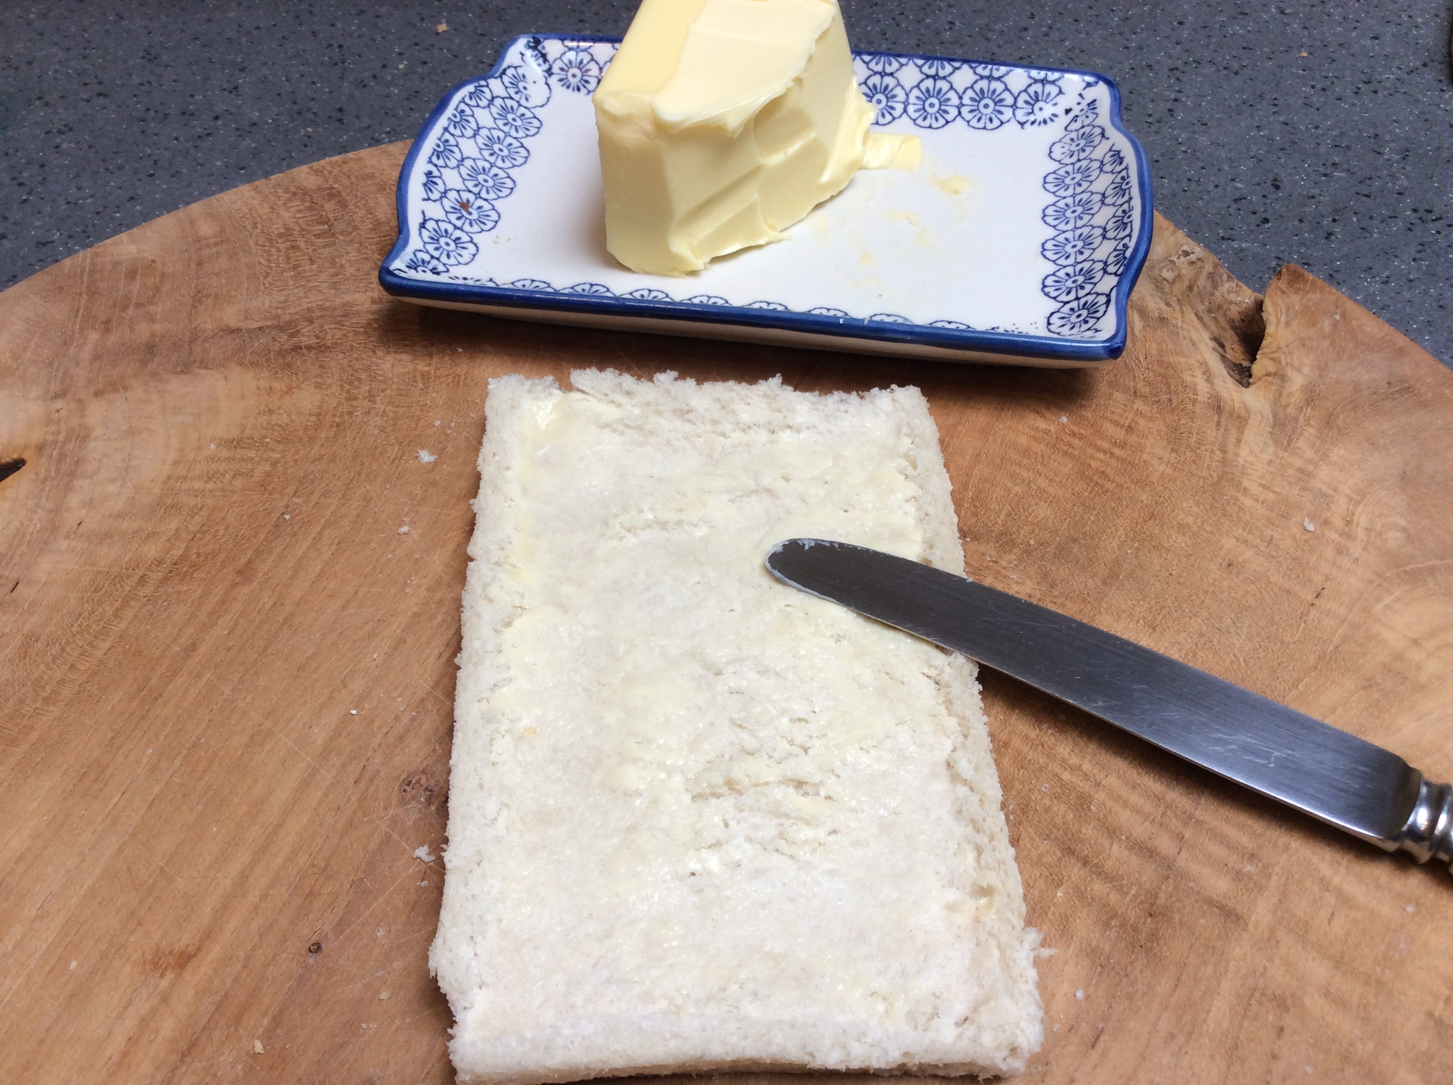
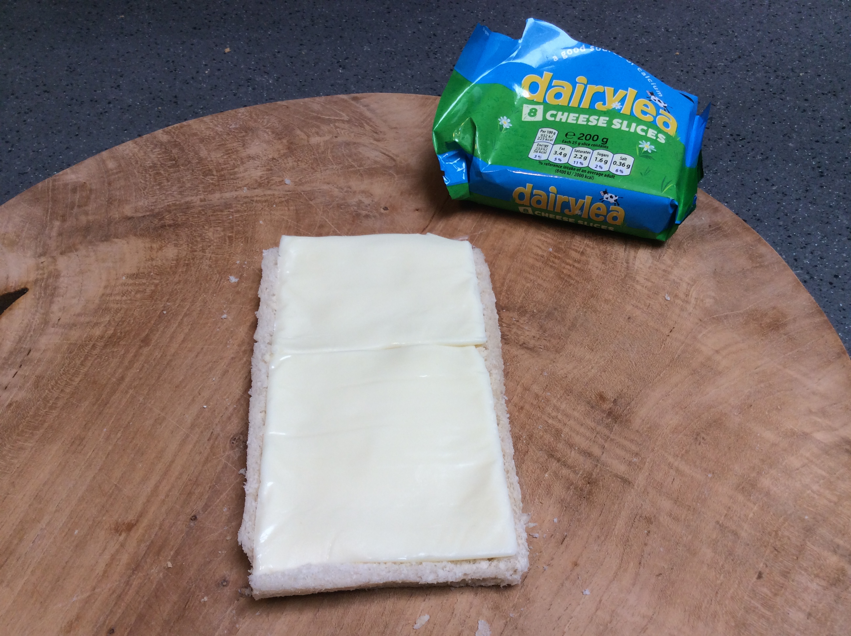
Method:
Make sure it is nice and even.
Your filling needs to be soft enough to roll.
4. Spread the butter.
5. Add the filling.

Slide 8
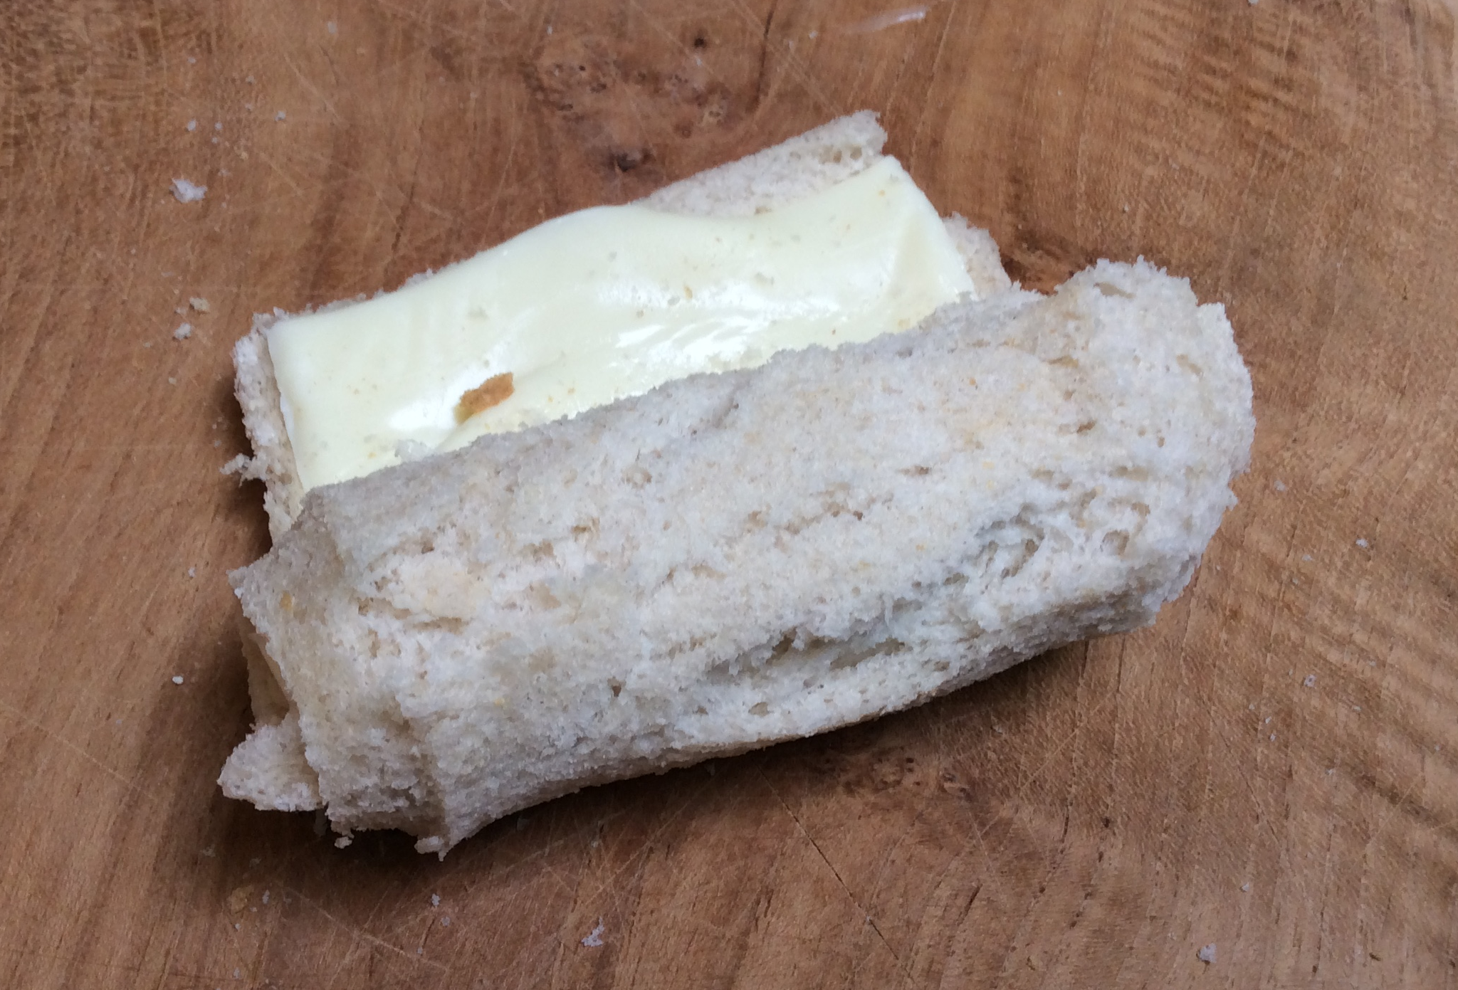
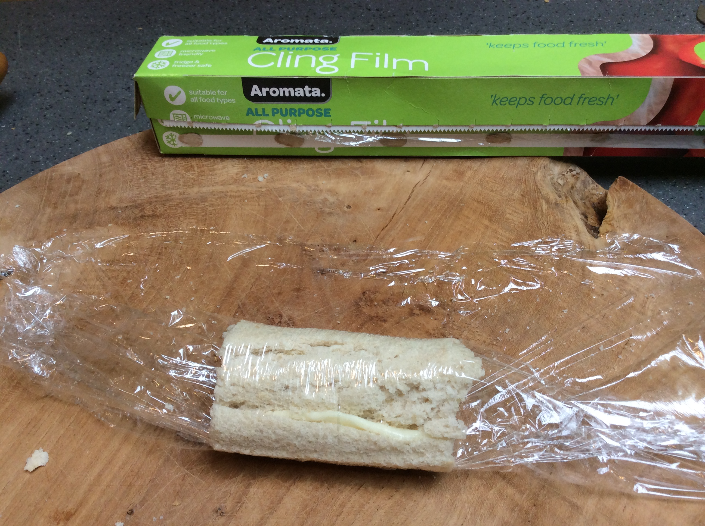
Method:
You will have a cylinder.
6. Roll up the bread.
7.Wrap in cling film or put in a sealed container to go in the fridge.
Explain how you know that it is a cylinder. ’It is a cylinderbecause it has…’

Slide 9
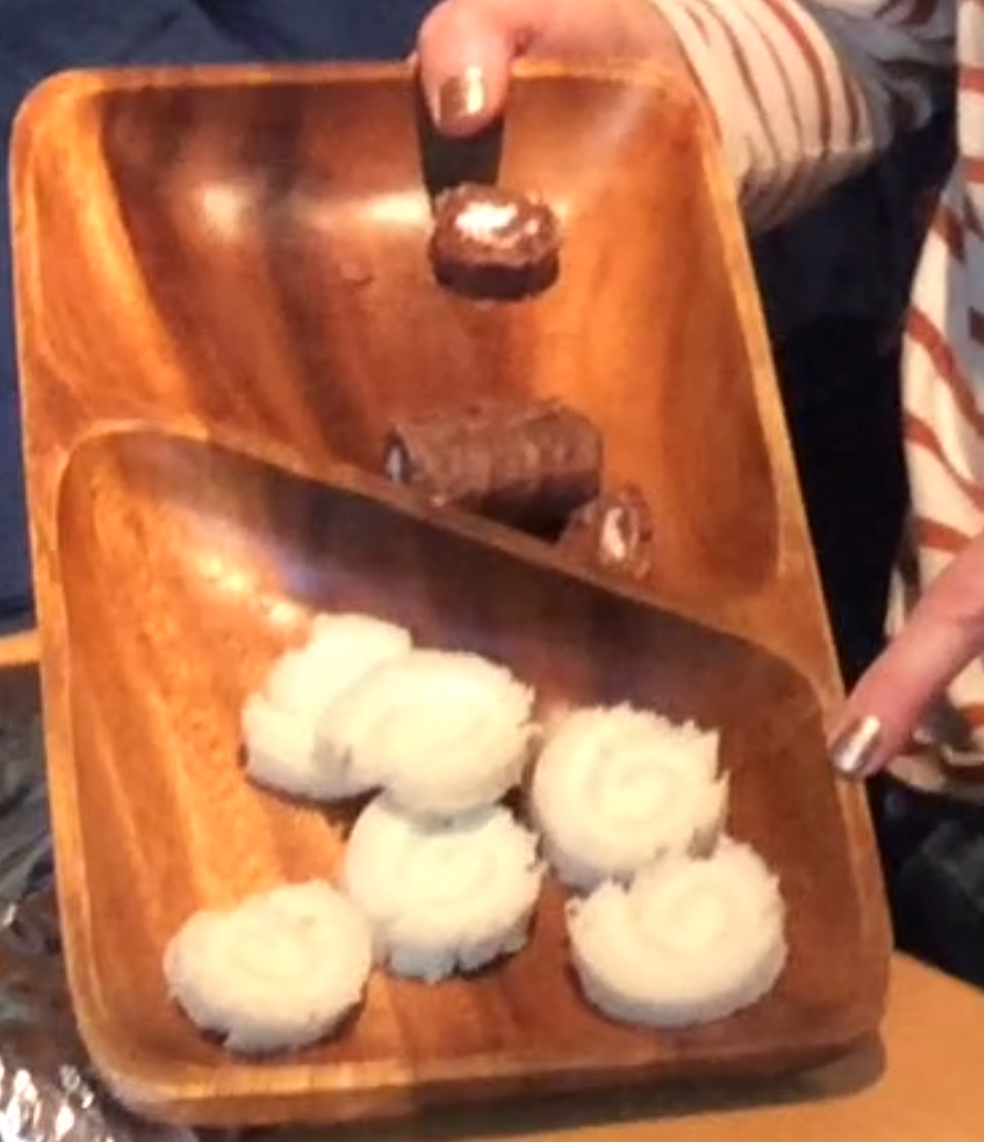

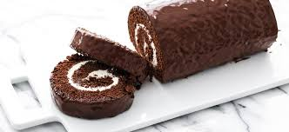
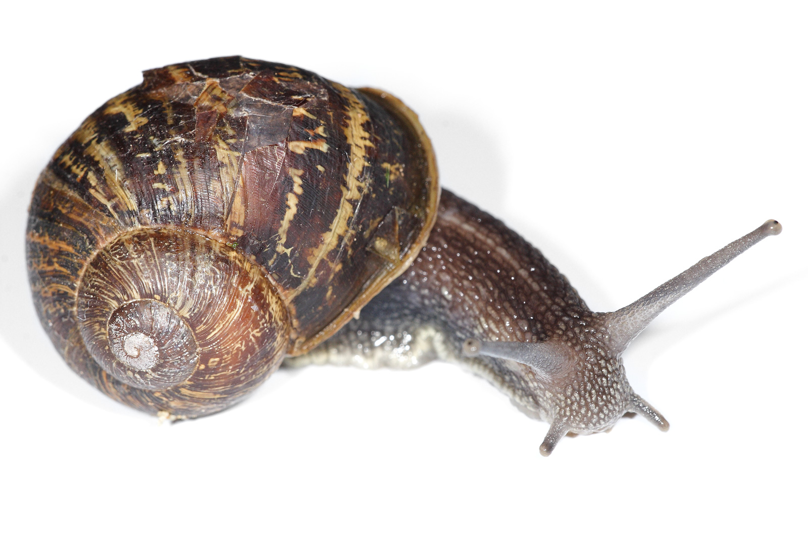
Method:
Share and enjoy!
6. Cut the sandwich in to slices.
What shape did you start with?
What shape are the sandwiches?
What pattern can you see inside?
Where else have you seen this pattern?

Slide 10
Talking about properties of shapes…
A rectangle is a 2D shape.
It has 4 straight sides and 4 corners.
It has 2 long sides and 2 short sides.
A cylinder is a 3D shape.
It has 3 faces.
It has 2 flat faces that are circles.
It has 1 curved surface or face.

Slide 11

Challenge 2
Balloon challenges galore!
In the story we can see that there are lots of balloons in the room. How many can you see?
Balloons
There are games we can play with balloons and challenges! Have a look through and see which challenges you might try.

Slide 12
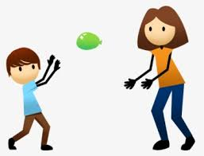
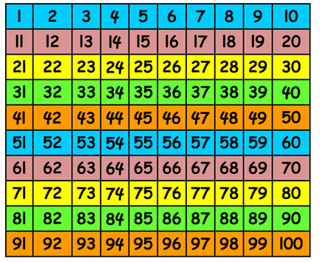
Up in the air
How many times can you pat the balloon in to the air before it falls to the ground?
You could mark your score each time on a number line or even a 100 square if you are really good at this!
What is your highest score?

Slide 13
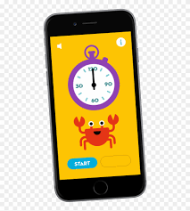
Up in the air ~ time challenge
How many times can you pat the balloon in to the air in 30 seconds or 1 minute?
You could play with someone else and work together to keep the balloon off the ground.

Slide 14
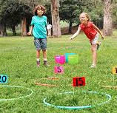
Water balloons~ target addition
You might want to make the biggest number the one that is furthest away and hardest to get.
Fill the balloons with water to make them heavier.
Create some targets with a score for each target.
Take in turns to throw a balloon. You could have 3 goes each.
Add up your score. Add up the score at the end to see who has the biggest score and wins.
You could use ten frames, a number line or a 100 square to add up the score.

Slide 15
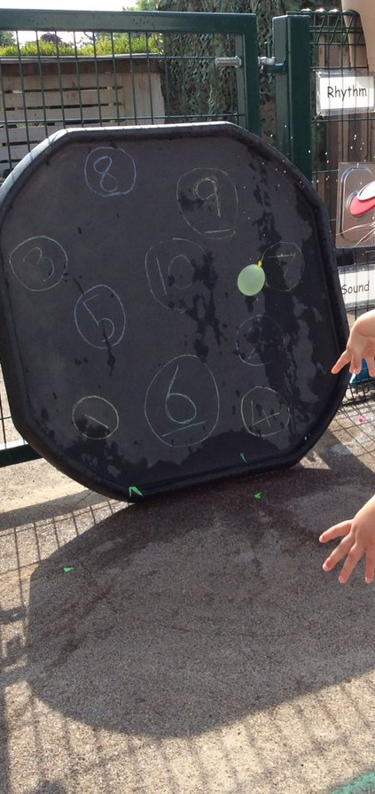
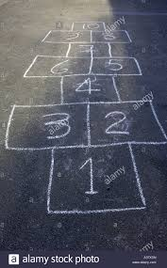
Water balloons~ number recognition
You could write numerals on a patio or path.
If there are some numerals that your child has trouble remembering, this challenge could be a fun way of helping!
Write the tricky numerals on a wall or on a path or paving slab in chalk.
Your child throws and bursts the balloons on the numeral targets saying the number each time and keeps going until the number has been washed off (or you run out of balloons!)

Slide 16
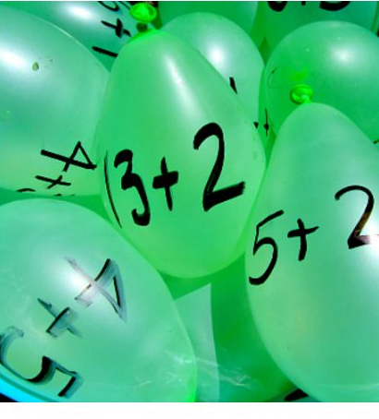
Water balloons ~ addition and subtraction
On the balloons write addition or subtraction sentences to 5 or to 10. For example 6 + 4 = or 6 – 2 = .
On targets – drawn hoops/patio tiles/buckets – write the answers.
Your child works out the answer and throws the balloon in to or on to the target.
How quickly can your child find answers to 3 balloons. Can they do it more quickly next time?

Slide 17

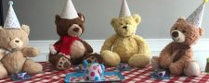
Challenge 3
Hold a party.
Glamorous Elephant is very happy because her best friend, Bear, is feeling better after being poorly.
Glamorous Elephant is holding a ‘Feeling better party’ and is inviting some friends.
You might like to hold a party for your toys.
Look on the next slide to see what Glamorous Elephant did.
Party time

Slide 18
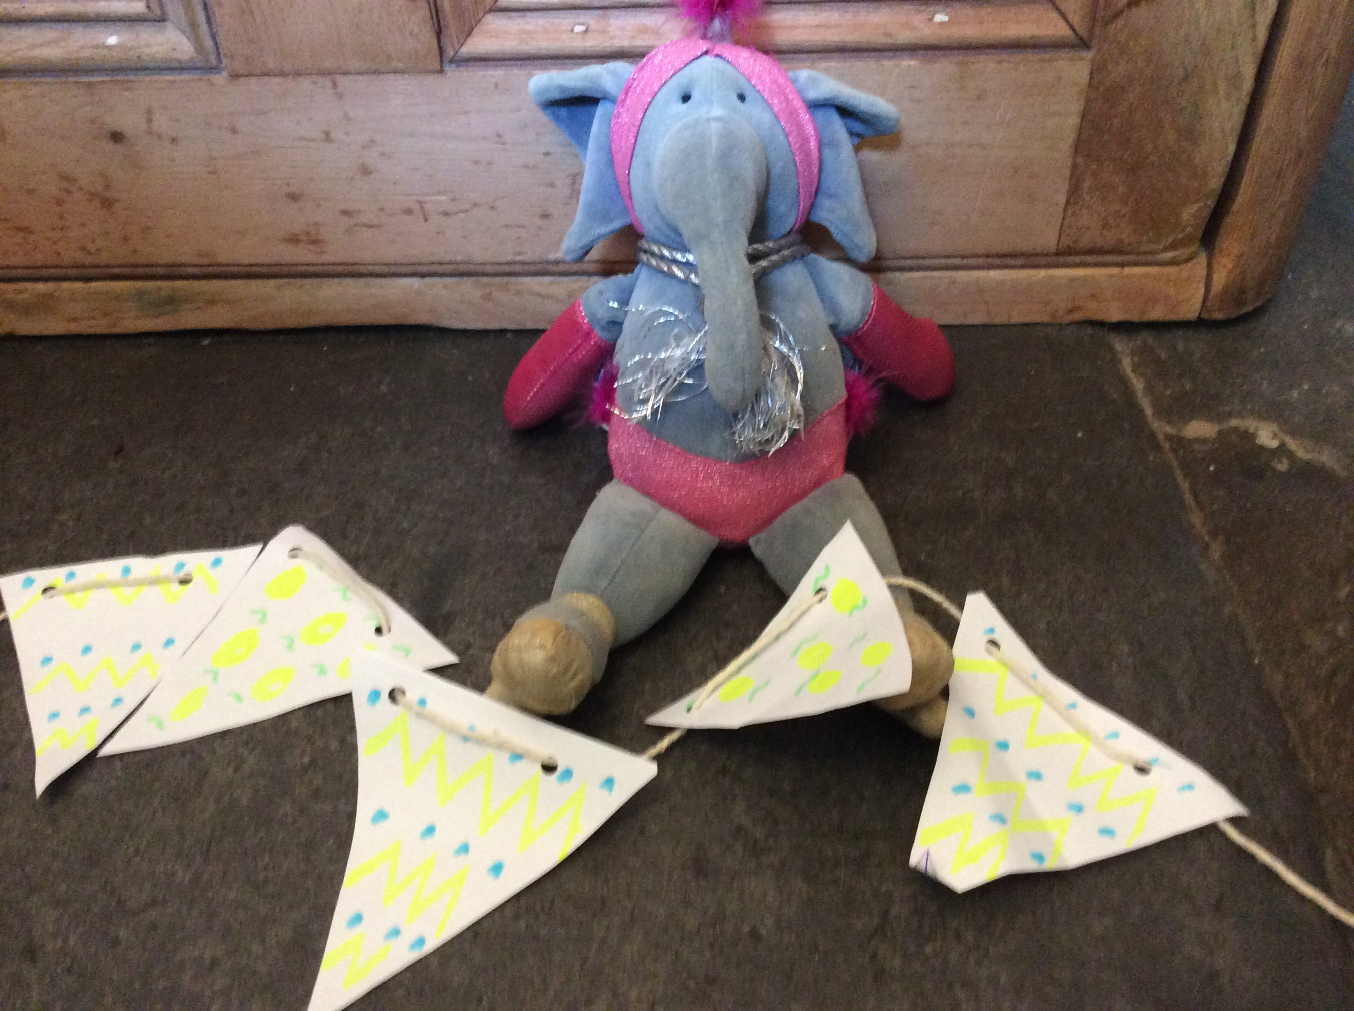
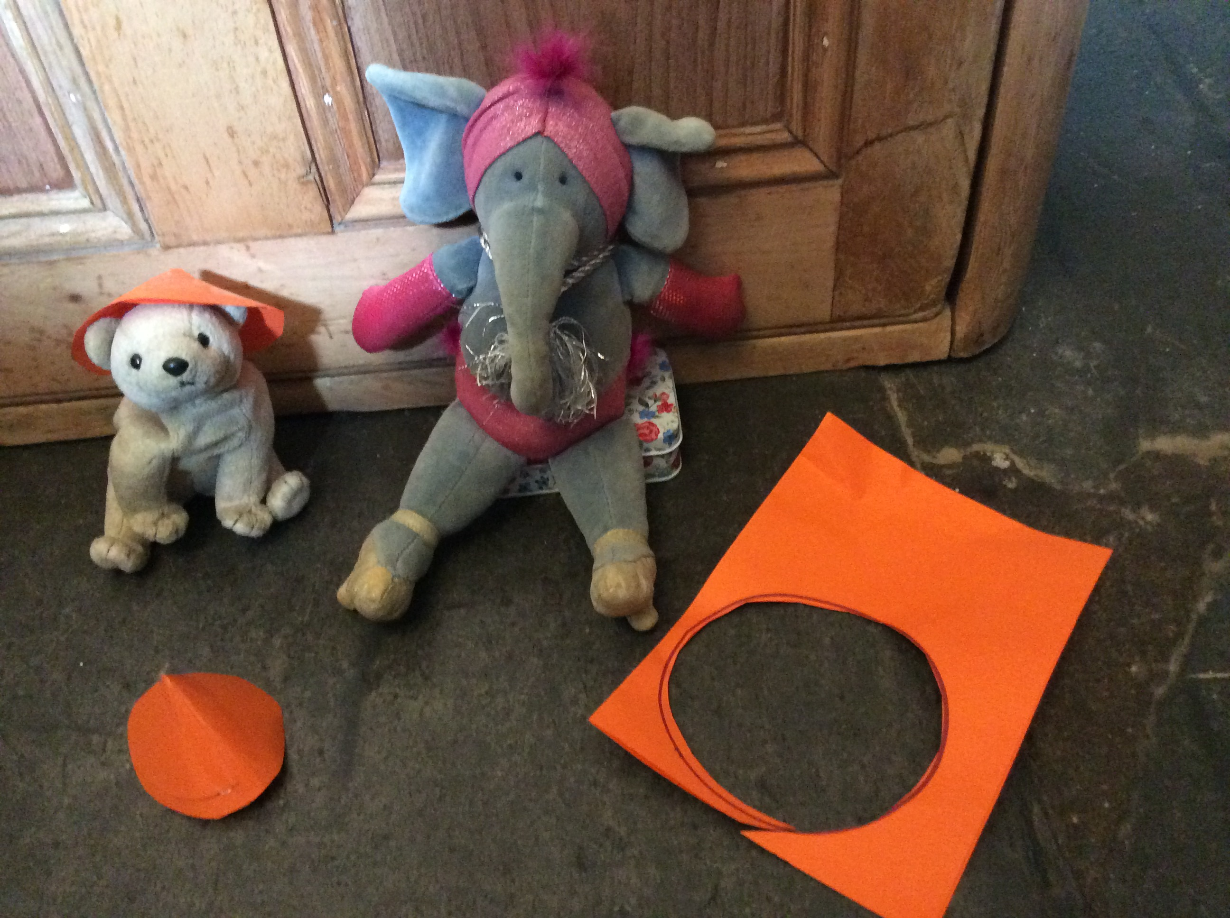
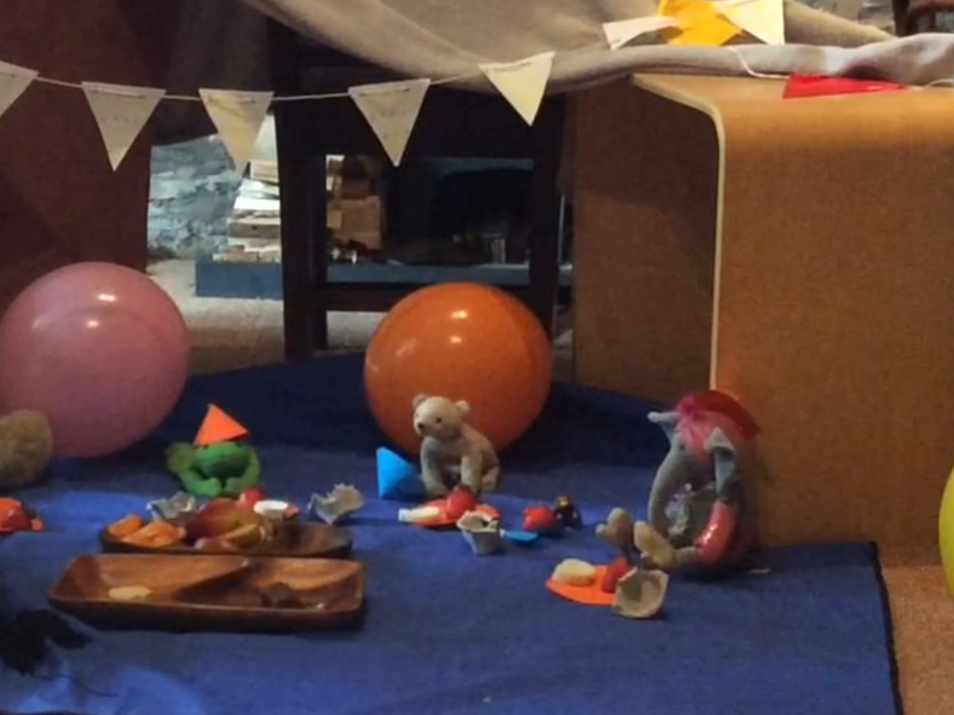
What did Glamorous Elephant do?
She counted out the right number of plates and cups she needed for all the guests.
She cut circles and made them in to cones for party hats.
She cut out triangles to make bunting.

Slide 19
Finally
Glamourous Elephant shared out the food to make sure she had enough for everyone and that it was fair.

Slide 20
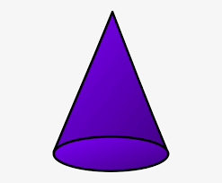
Talking about properties of shapes…
A triangle is a 2D shape.
It has 3 straight sides and 3 corners.
It has 3 straight sides.
A cone is a 3D shape.
It has 2 faces.
It has 1 flat face that is a circle
It has 1 curved surface or face.

Slide 21
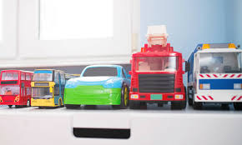
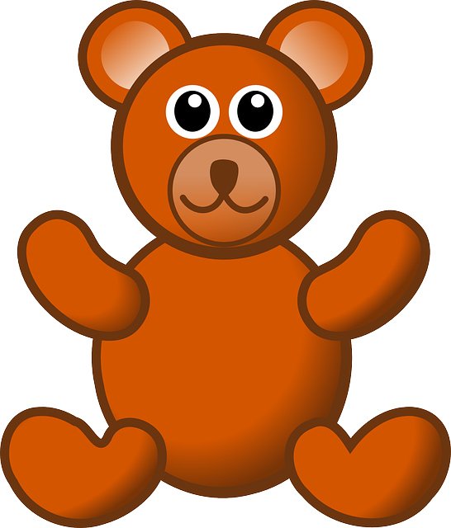
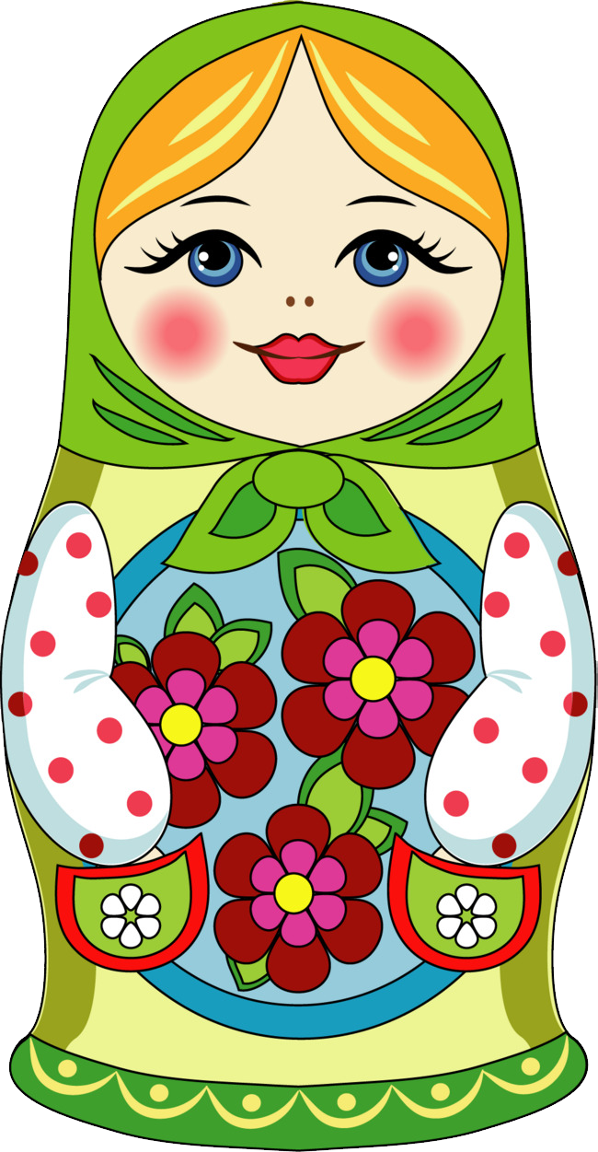
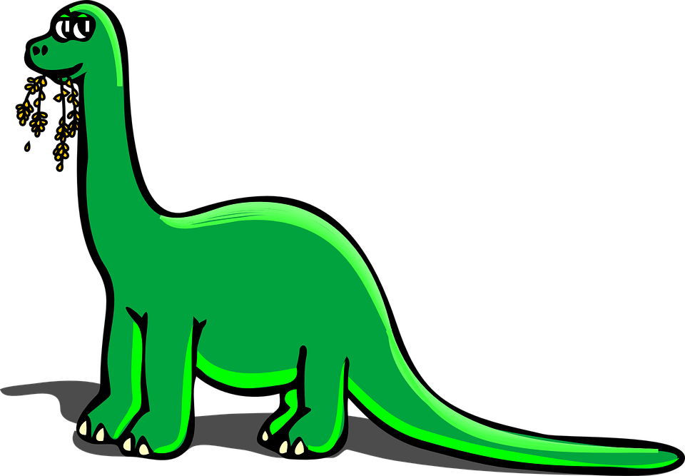
Challenge 4
Ordering by size and measuring.
For this challenge you can choose any toys you like; they can be similar ones like in the picture of vehicles or they could be completely different!
Put your toys in order of size – you can start with the smallest or the biggest – you choose. What is wrong with the picture below?
This Photo by Unknown Author is licensed under CC BY-NC

Slide 22
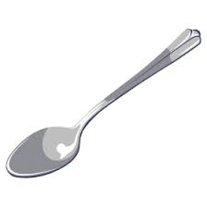
Measuring
You could have a go at measuring how tall your teddy is using a non-standard measure (a standard measure would be centimetres on a ruler for example).
You could see how tall your teddy is using teaspoons! Make sure they are all the same length tea spoons!

Slide 23
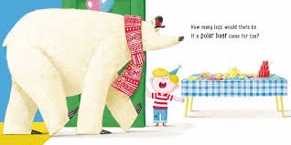
Challenge 5
How many legs?
This is an addition by counting on challenge!
You might like to look at each slide below and find out how many altogether by counting on in each picture or you might like to listen to the whole story again and work out how many legs were at the party altogether!

Slide 24
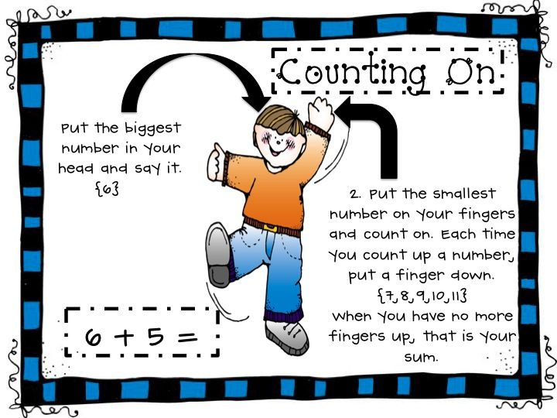
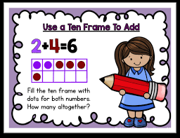
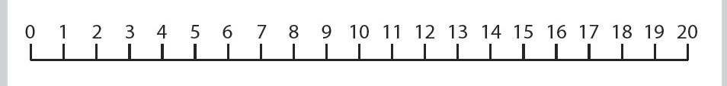
Put the biggest number in your head and the smallest number on your fingers and count on.
How many legs altogether?

Slide 25
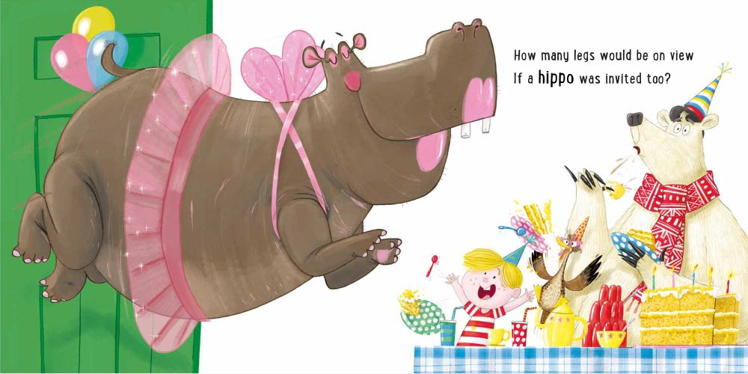
?
8
8
+
?
=
?

Slide 26
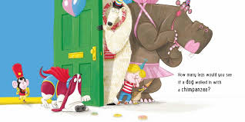
?
12
12
+
?
=
?

Slide 27
Parents – you might like to pause the story at different pages for some more, challenging addition.

Slide 28
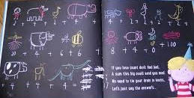
How many legs were at the party altogether?
This is just about being in the Have-a-Go Club and a bit of fun!
You could draw pictures or use tally marks to help you keep track and record.

