Slide 1
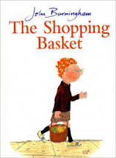
Maths
Home Learning
Week 3

Slide 2
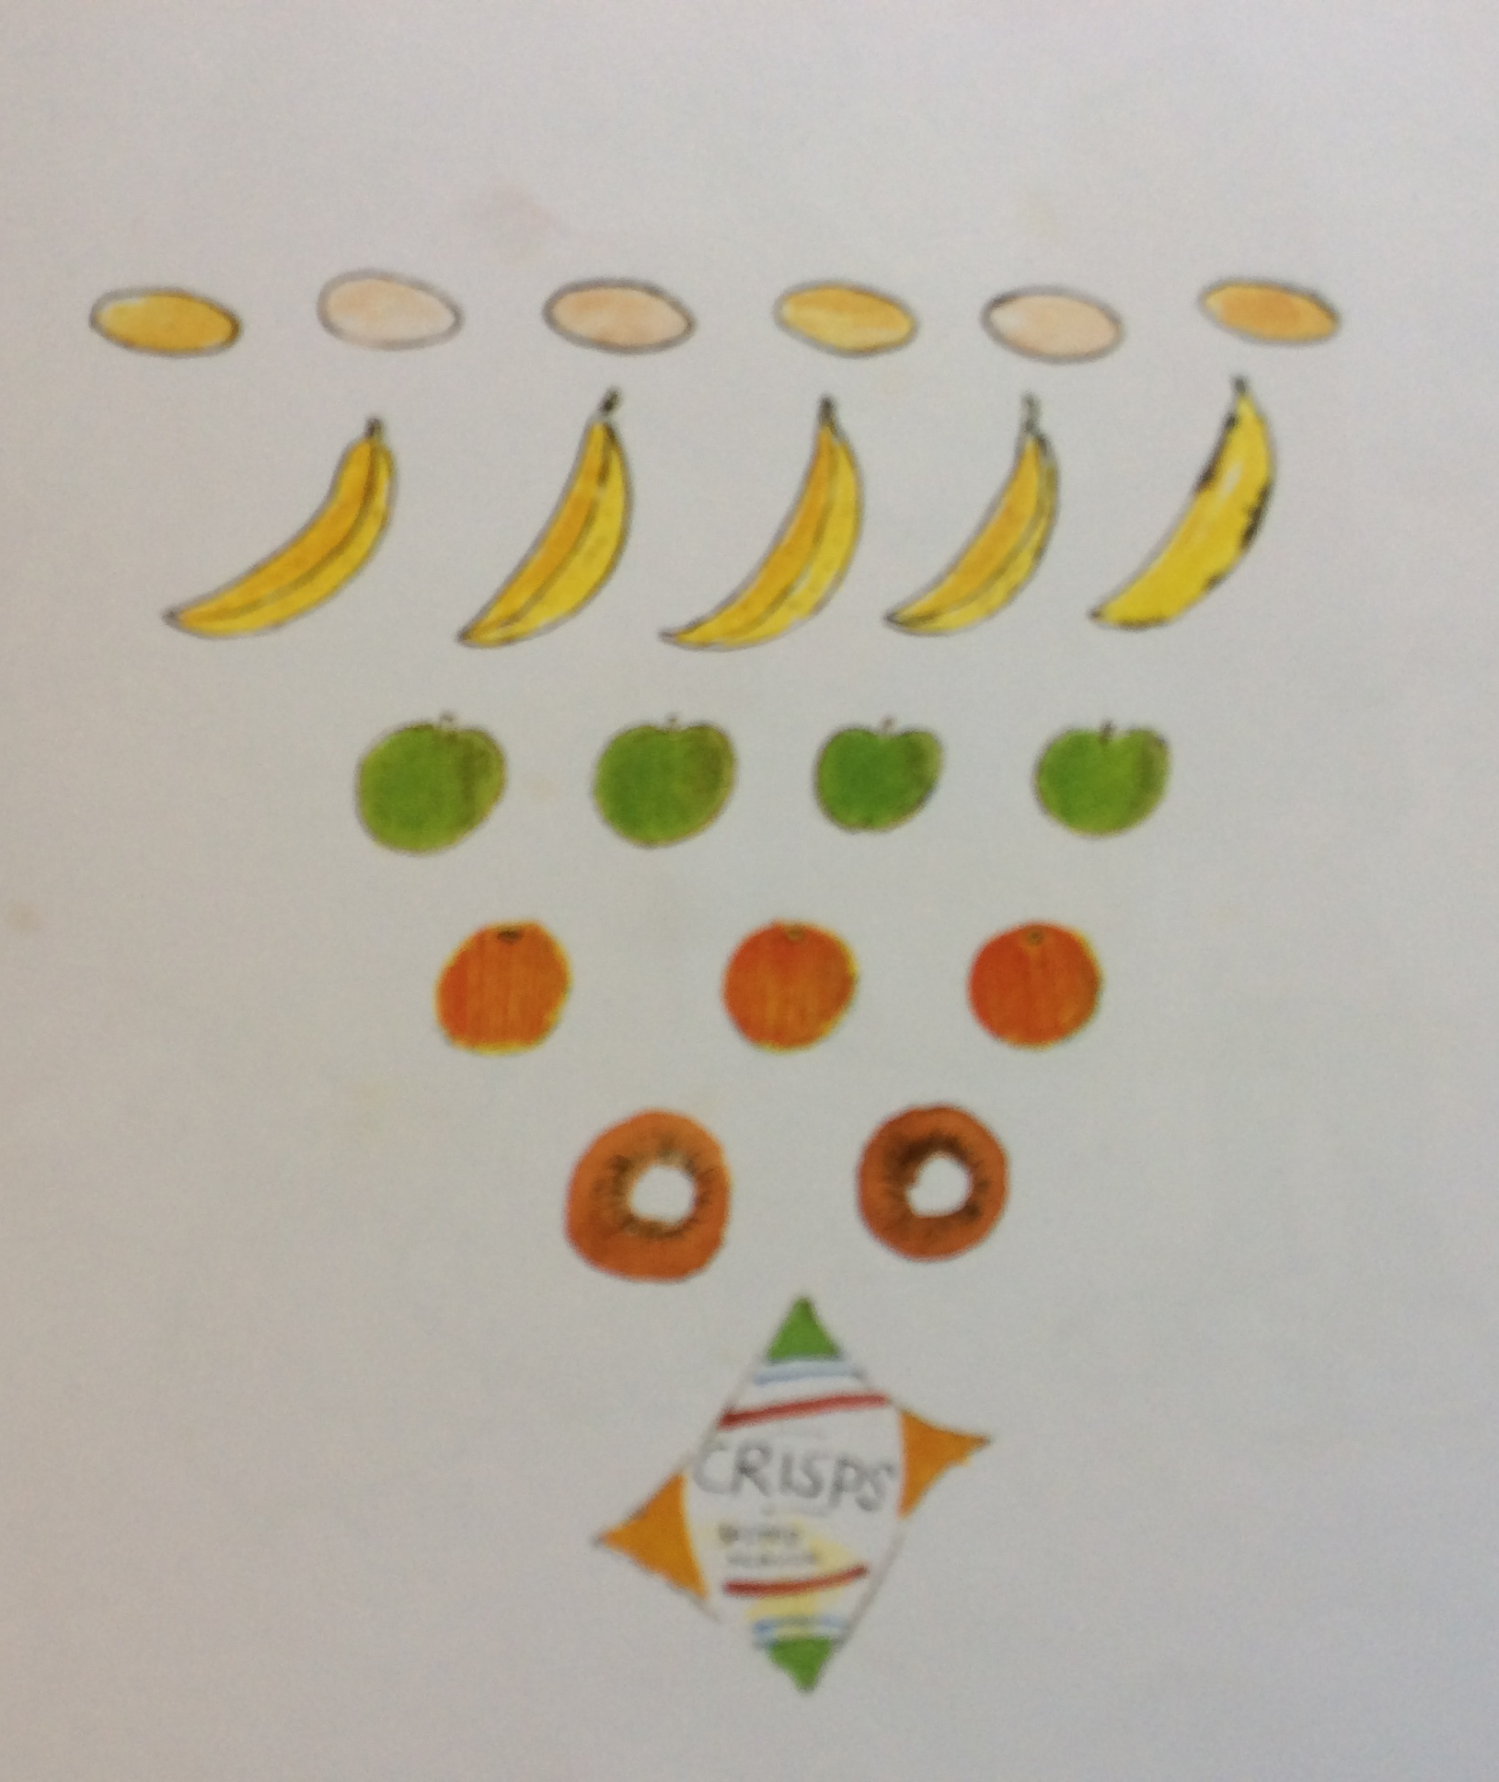
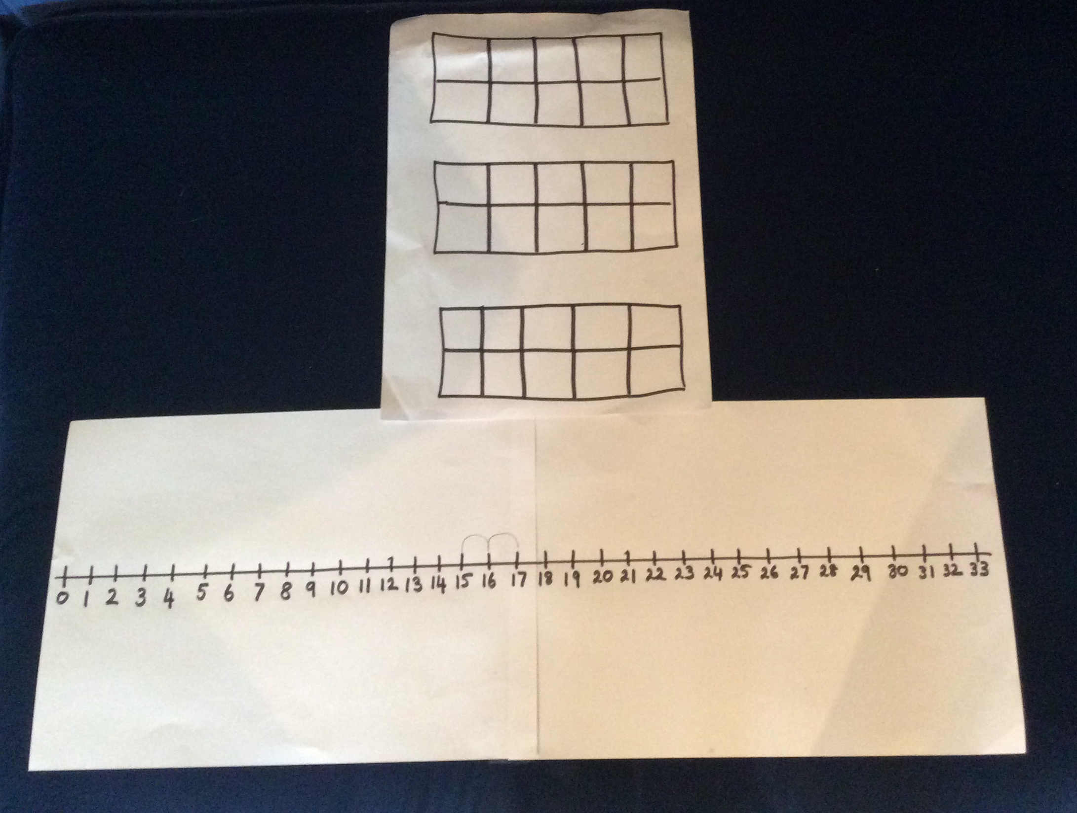
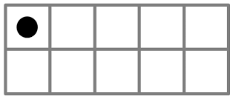
Challenge 1
Story Talk
How many?
Listen to the story of ‘The Shopping Basket’ by John Burningham
How many items did Steven’s mother ask him to buy altogether?
Use ten frames to show how many items Steven needed to buy. I wonder how many frames you will need.
Find the number on a number line. Write down the number.
Story Talk

Slide 3
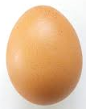
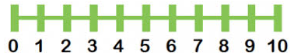
We are going to use a number line to help us count back and find out how many are left when we take some away.
When we are taking away the quantity is less.
6 – 1 = 5
When we are taking away the number is going to be smaller than the one we started with .

Slide 4

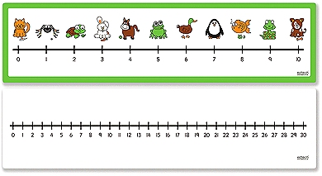
You will need a number line t o 30 for this taking away (subtraction) challenge.
It is a good idea to use a pencil to mark each jump back so that you don’t lose your place!
Listen to the story again and each time Steven takes something out of his shopping basket, count back on your number line.
How many things does Steven give to his mother?
Tell your grown up the story to explain how many Steven started with and how many he finished with.
First Steven had … items in his shopping basket. Then he took… out to trick the bullies.
Now he has…left.

Slide 5
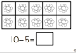
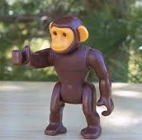
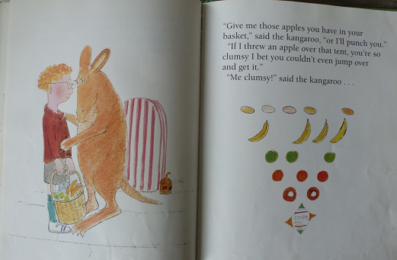
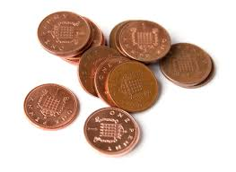
You might like to practise taking away (subtracting) using the number line to count back or ten frames and counters. Here are some problem solving questions for you.
First Steven had 4 apples, then he threw 1 over the tent. How many does he have now?
First Mrs Finch had 12 1p coins, then she gave 5 of the coins to Mr Finch. How many did she have left?
I wonder if you can make up your own taking away story and see if somebody in your family can solve the problem and find out how many are left.
First Mark the Monkey had 11 bananas from the tree, then he ate 2. How many does he have now?

Slide 6
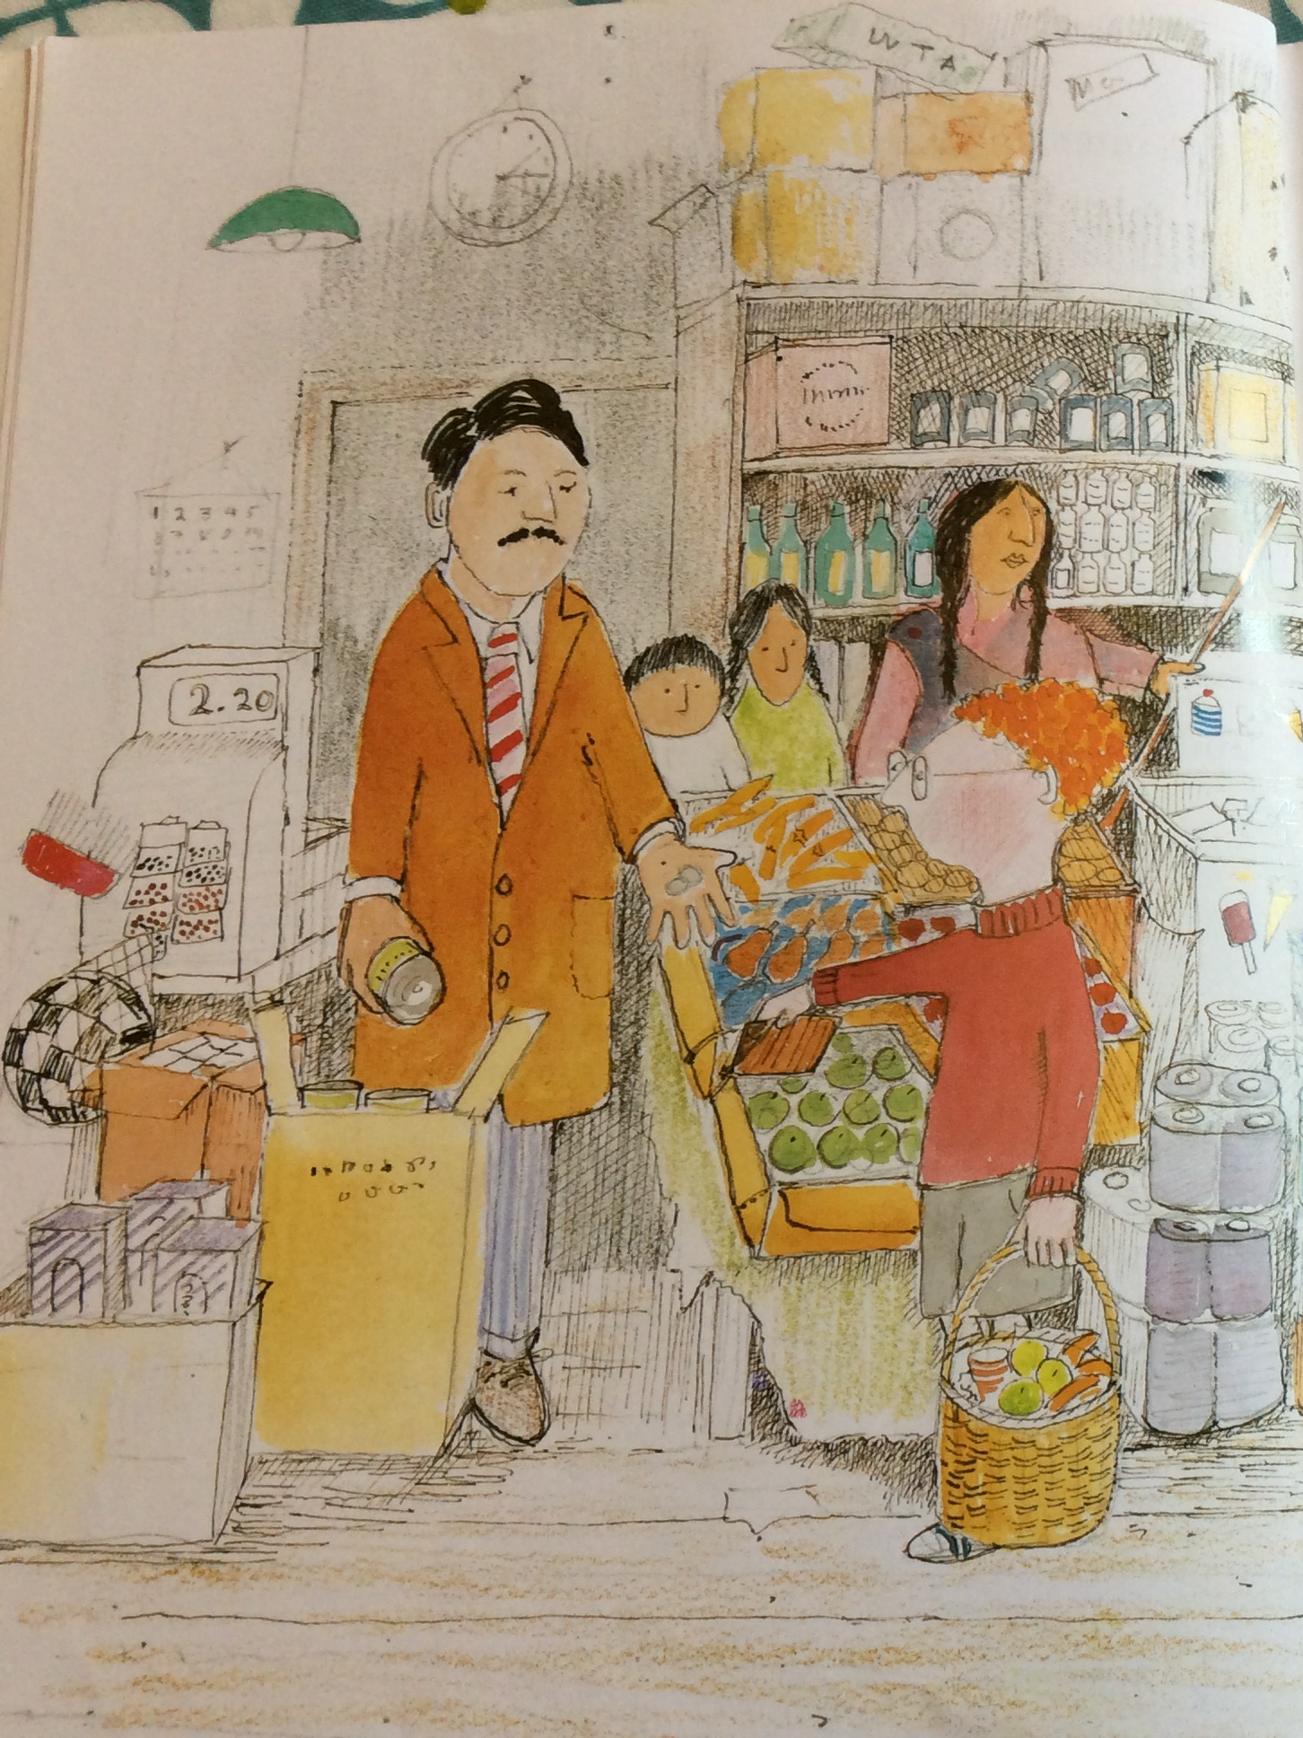
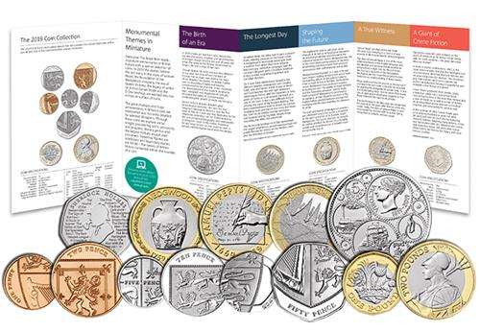
Challenge 2
Investigating coins
Steven paid the shopkeeper for all his shopping.
In the story we can see him giving the shopkeeper some coins or maybe the shopkeeper is giving Steven some change.
Your challenge today is to be a money detective; have a close look at some coins and find out what we call each coin.
Money

Slide 7
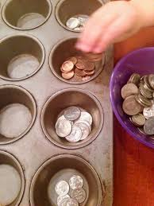
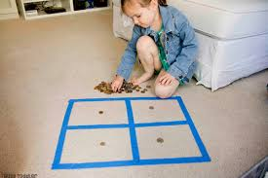

What can you find out about the coins by looking them? How could you sort them?
What pictures can you see?
Which ones are made of silver colour metal?
Which ones are made of copper colour metal?
Which ones are big?
Which ones are small?
Which ones have numbers on them?

Slide 8
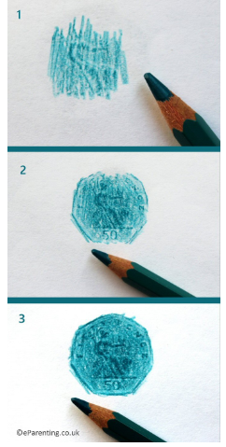
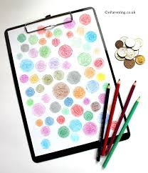
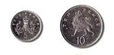

What can you find out about the coins by feeling them?
Can you sort them in to pairs?
Our coins are designed so that people who cannot see can work out which coins they have got by using their sense of touch.
For example, the 5p and the 10p are small and large, both with rough edges.
You might like to try some coin rubbing with pencils or crayons.
Make sure you hold the paper still.
You might need to go over the coin a few times to get a clear rubbing.
Can you match the coin to the rubbing afterwards?

Slide 9
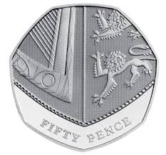
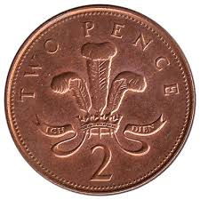
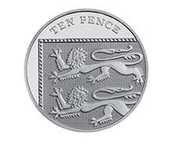
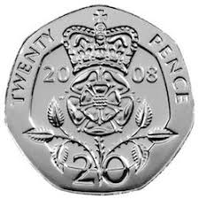
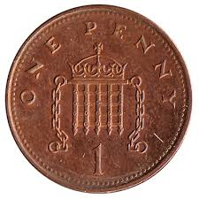
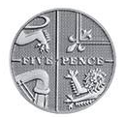
Can you name the coins?
20p
twenty pence
5p
five pence
1p
one pence
2p
two pence
10p
Ten pence
50p
fifty pence

Slide 10
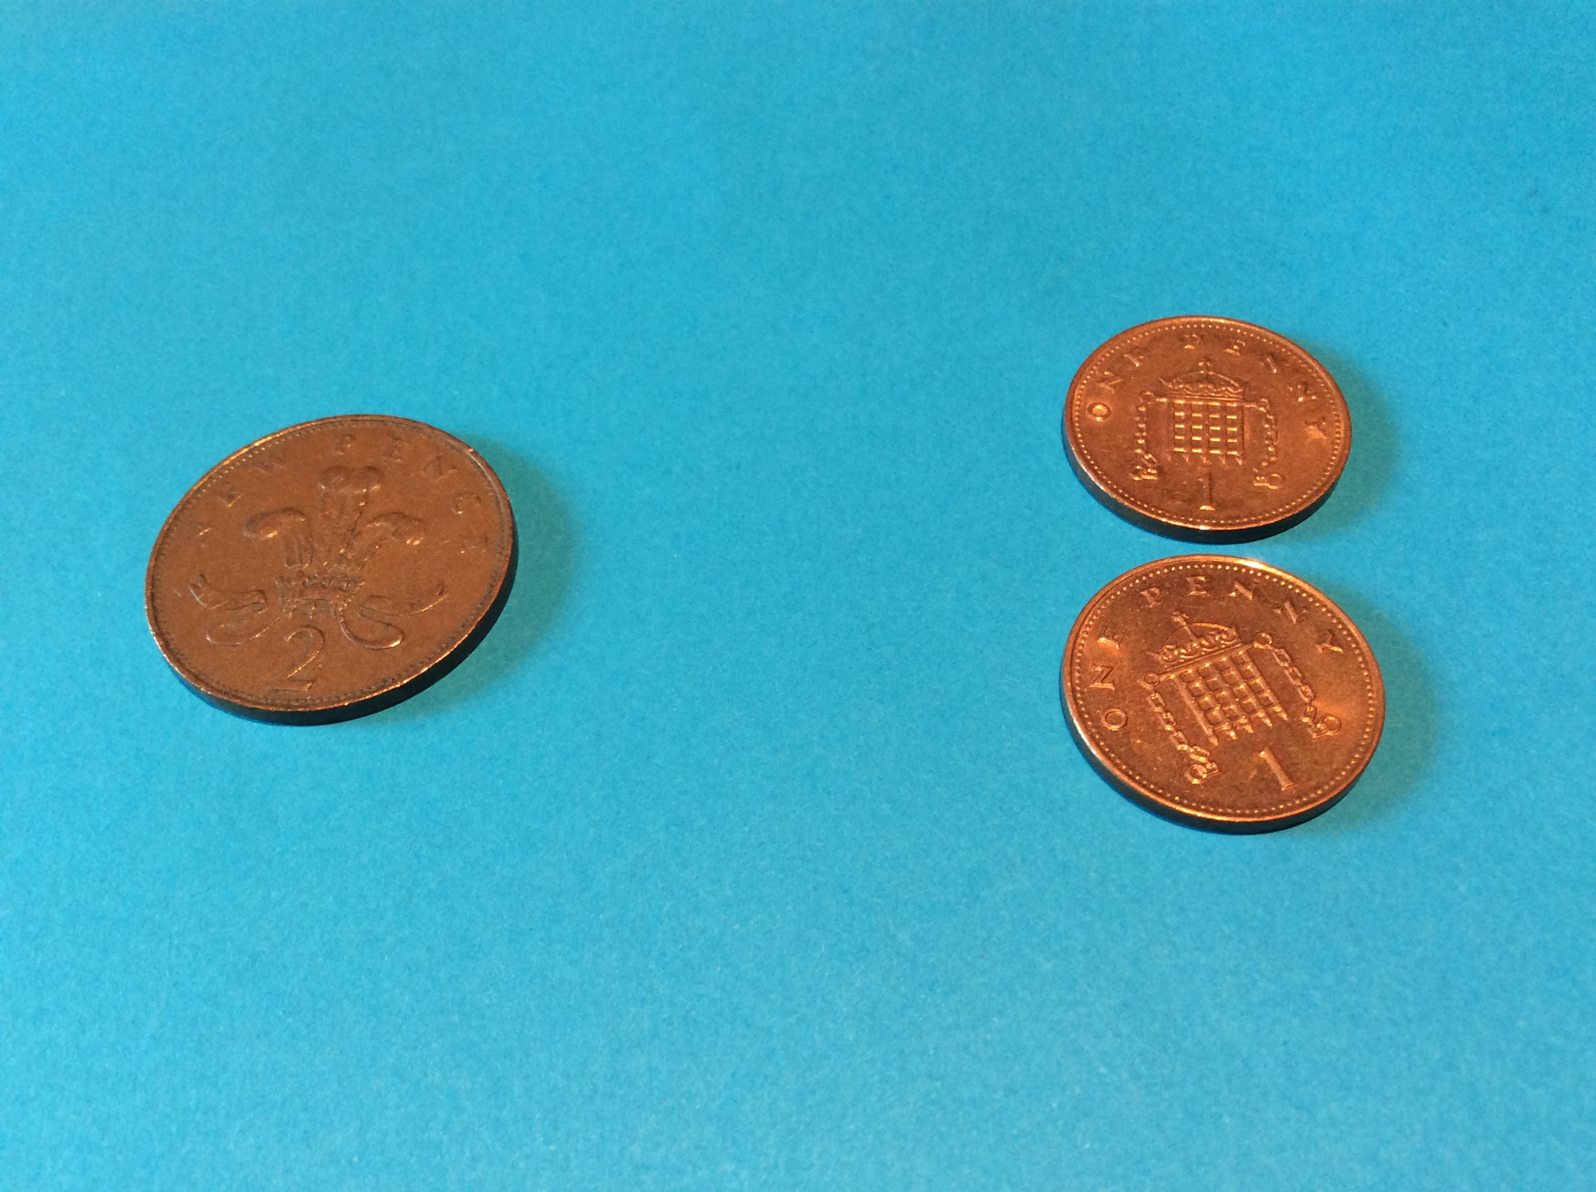
Challenge 3
How much is it worth?
When we go shopping we need to know what we can afford to buy with the money we have; we need to know its value.
2p is a short way of saying 2 pence. It has the same value as 2 lots of 1p.
How much is it worth?
=
+

Slide 11
Can you draw a picture or find a different way to show the value of 10p in 1p coins?
Can you draw a picture to show 5p or 20p in 1p coins?
10p
ten pence
Can you find ways to make 10p using different coins?
10p = 1p + 1p + 1p + 1p + 1p + 1p + 1p + 1p +1p + 1p

Slide 12
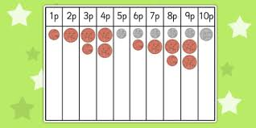
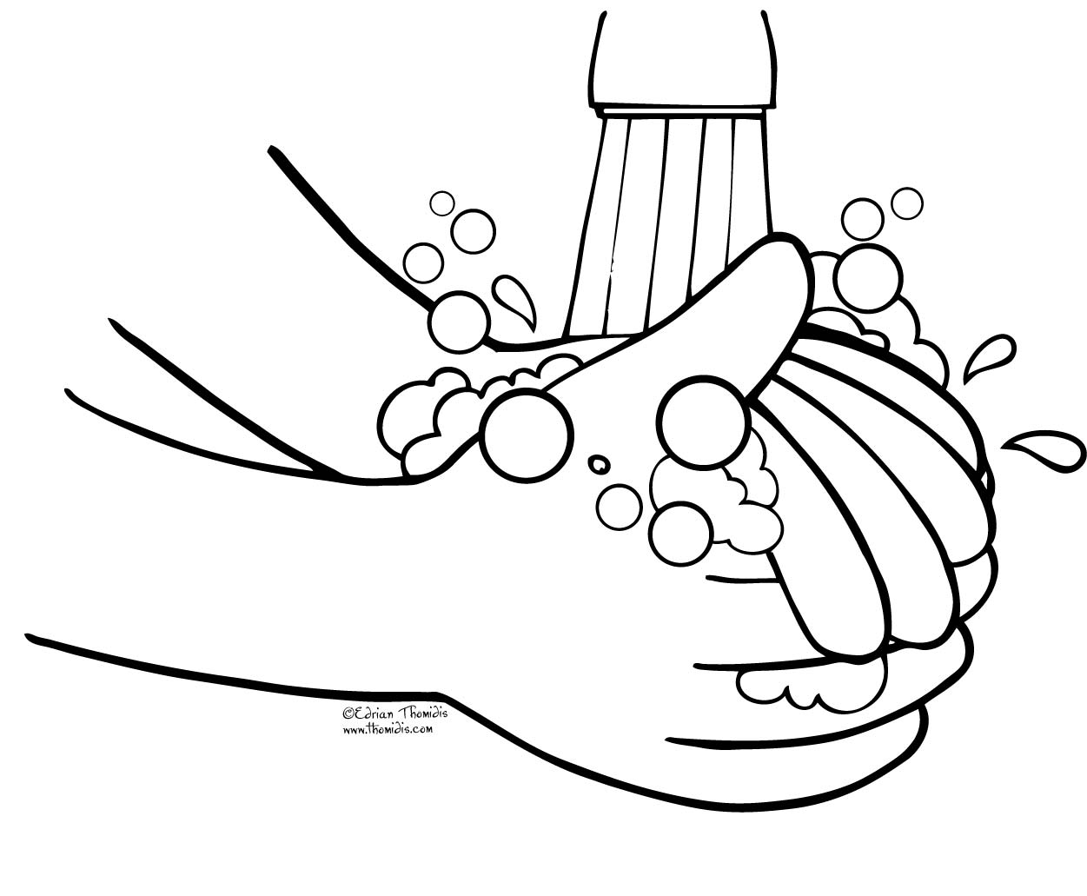
You might like to investigate further and work out how you could create a coin number line using different coins. You are good at adding so I think you will like this one!
Coins get very dirty because so many people handle them so much of the time and over many years. Please make sure you wash your hands well after investigating with coins.

Slide 13
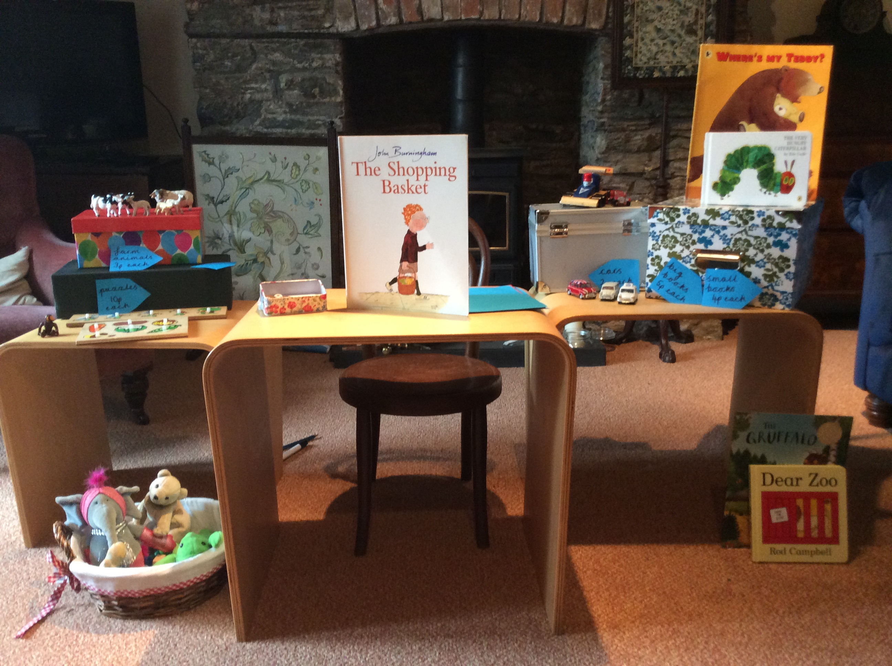
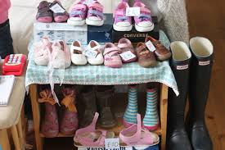
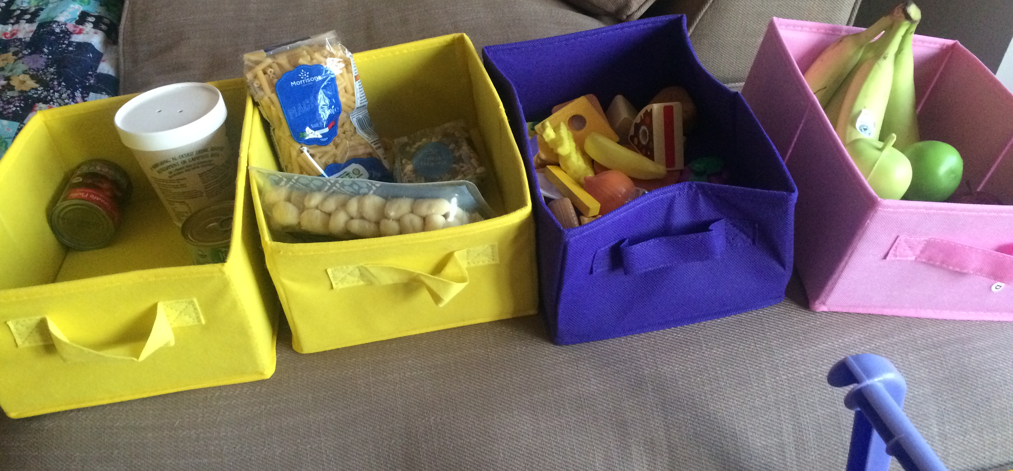
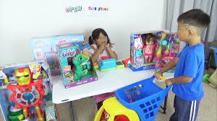
Challenge 4
Using money to pay for items in a shop.
Now that you have had a good chance to investigate coins, you are ready to use them in your own pretend shop at home!

Slide 14
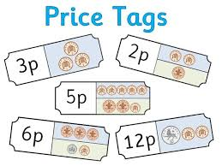
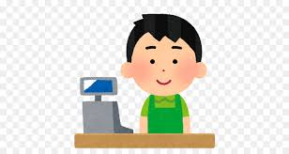
Decide what you are going to sell in your shop.
5p for the eggs and 2p for the carrots. That comes to 7p please.
You will need;
some items to sell
some paper to write price tags
Some coins in a purse and some coins for the shopkeeper
You will need to do lots of adding up and maybe taking away too!
Yes, can I help you sir?

Slide 15
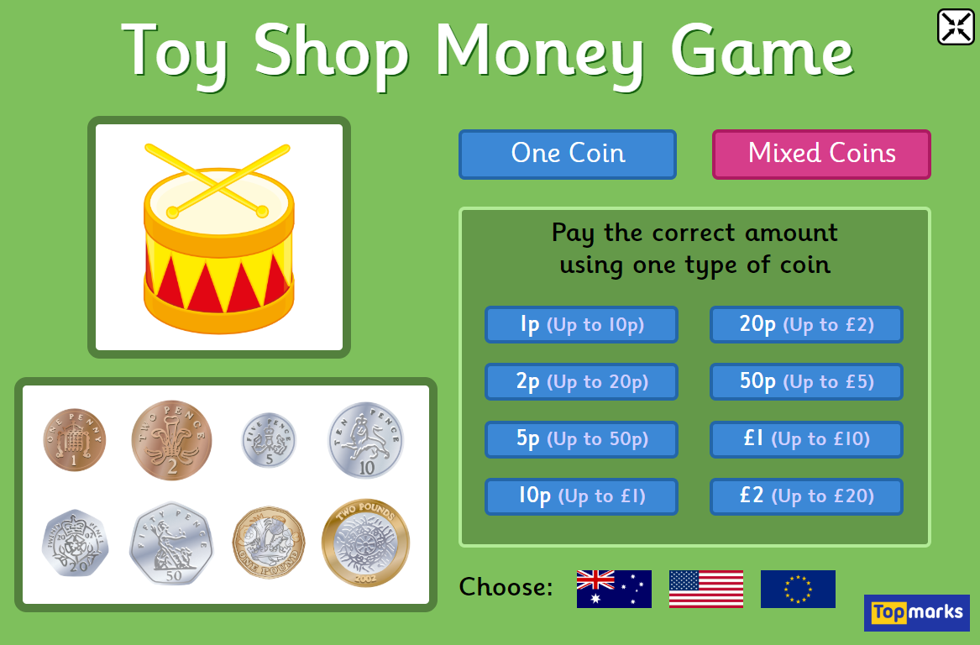
You might like to try one of these games on the Topmarks website.
https://www.topmarks.co.uk/money/toy-shop-money

Slide 16
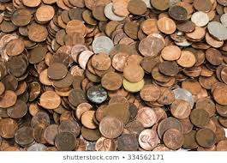
Challenge 4
Now that you have thoroughly examined coins and practised using them I thought you might like a little science investigation!
The Big Clean Up!

Slide 17
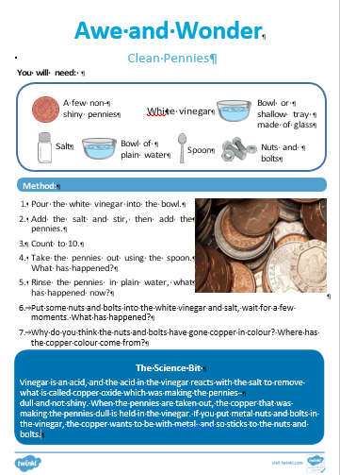
You will need:
Dull (not shiny) copper coins – 1p or 2p
White vinegar
Salt
A glass bowl
A bowl of clean water
A spoon
Some nuts and bolts

Slide 18



Method:
What do you see?
What do you think?
What do you wonder?
What could have happened?
What do the coins look like now?
Pour some vinegar and some salt in to the empty bowl.
Add some pennies
Count to 10.
Take the pennies out using the spoon.
Wash the pennies in the bowl of clean water
Put some nuts and bolts into the white vinegar and salt, wait for a few moments.
What is happening to the nuts and bolts?

Slide 19
The Science:
Vinegar is an acid, and the acid in the vinegar reacts with the salt to remove what is called copper-oxide which was making the pennies dull and not shiny.
When the pennies are taken out, the copper that was making the pennies dull is held in the vinegar. The copper wants to be with metal and so sticks to the nuts and bolts.
Thanks to Twinkl resources for this super investigation,

