Slide 1
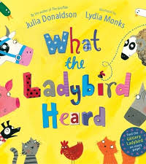
Maths
Home Learning
Monday 20th April

Slide 2
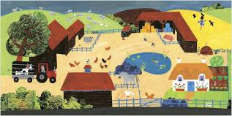
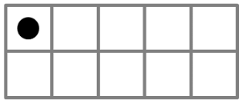
Monday 20th April
Story Talk
How many?
Listen to the story of ‘What the Ladybird Heard’.
You can hear Mrs Egleton read the story again or you can listen to it on YouTube (Bedtime stories with Will).
How many different types of animals were in the story?
Every time you say an animal put a counter in front of you. You might like to add them to a ten frame instead.
How many have you got altogether? Can you say how many without counting?
How many would there be if the ten frame were full?
Look on the next slide. Did you remember them all?
Story Talk

Slide 3

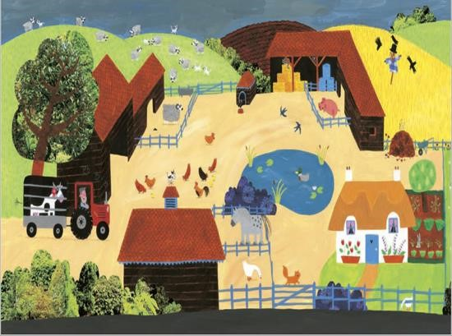
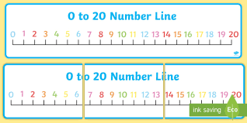

Slide 4

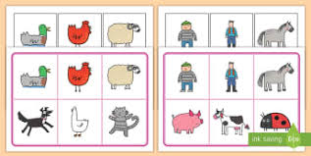
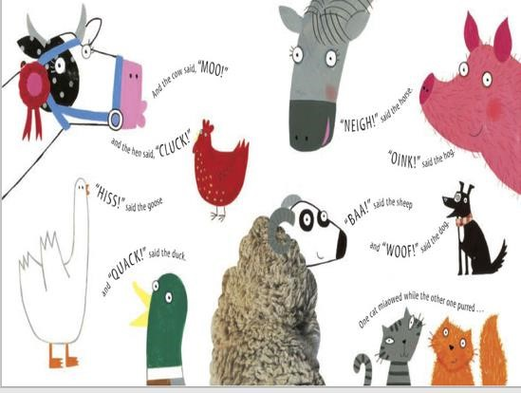
You could…Take it in turns to draw or paint an animal from the story.
Talk about who you are going to draw next e.g. this animal has feathers, this animal has 1 beak or this animal has 4 legs! Can your child guess? Can you guess what your child will draw?
Play guess the animal.
Cut out your animals and arrange them in front of you or if you have toy farm animals you could use those.
I have 2 legs.
I have a beak and I like to swim.
I like to eat grass in a field.
I have 4 legs.

Slide 5
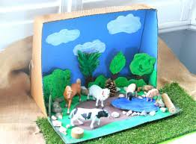
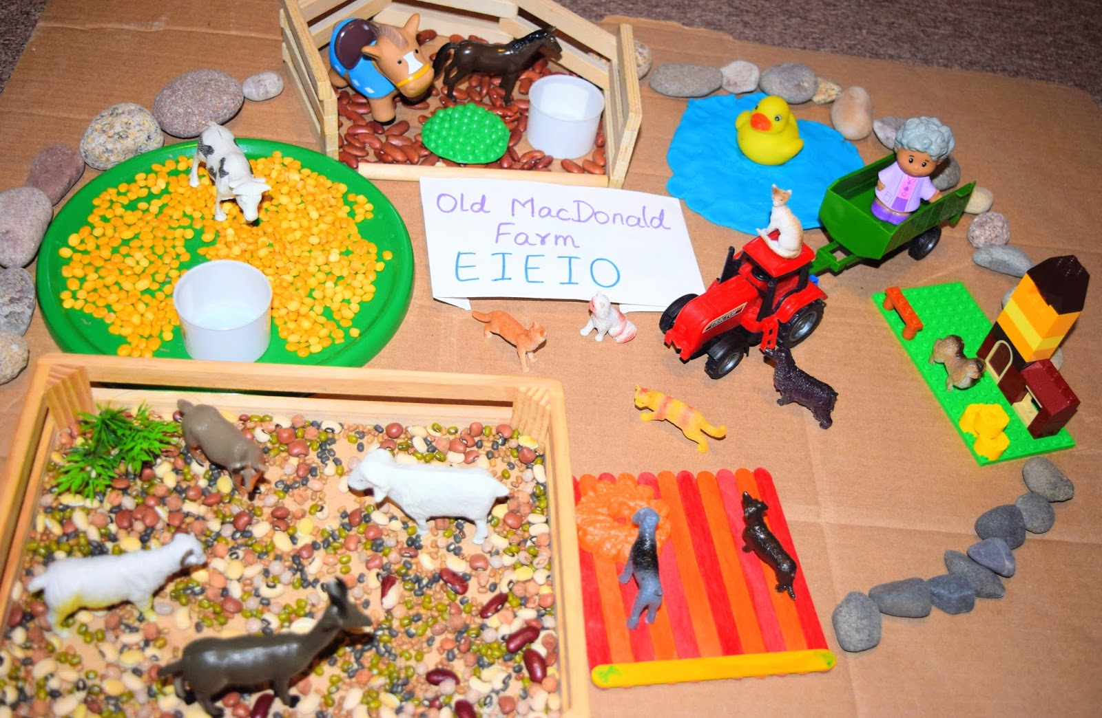
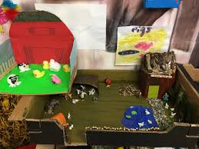
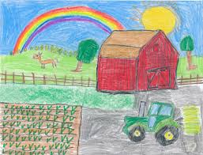
Tuesday 21st^{h} April
Story Talk – Where?
Using positional language
Can you design your own farmyard?
You could draw it on paper or with chalk on the ground outside or you could build one with bricks or junk. Where will you put the pond/barn/field?
Story Talk

Slide 6
Where will you put the animals?
Take it in turns to give instructions to place your pictures of the animals or your toy animals on your design or construction.
Put the horse in front of the house
Put the hen next to the tree.

Slide 7
This is the vocabulary we would like the children to be confident using and understanding…
next to
on top
behind
under
between
in front
below

Slide 8
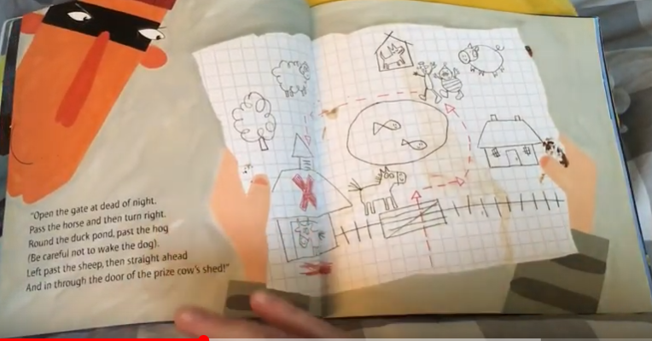
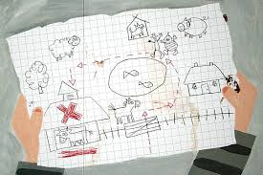
Wednesday 23rd April
Story Talk – Which way?
Using language for direction
Have a look at the map that the robbers drew when they were planning to steal the fine prize cow and listen again to the story to hear how the robbers describe their route when they whisper their plan. Which words did they use?
The Robbers’ Map

Slide 10
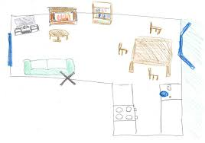
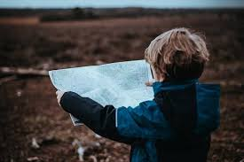
Can you draw a map or plan of your garden or one of the rooms in your home?
Go backwards, you have gone too far!
Go through the gap between the chair and the table
Go backwards, you have gone too far!
Play Hide the Fine Prize Cow.
Take it in turns to hide a toy animal or one of your pictures from yesterday.
Put a sticker or cross on your map to show where it is hidden.
Then give directions to guide each other to the fine prize cow. You will probably have to model this first.
Go forwards then turn past the sofa.
Well done, you have found the fine prize cow!

Slide 11
Vocabulary for direction
This is the vocabulary we would like the children to be confident using and understanding…
This is the additional super vocabulary from the story that would be brilliant for the children to learn and use…
forwards
backwards
turn
past
through
left
right
over
around

Slide 12
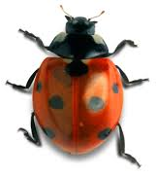
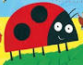
Thursday 24th April
Careful counting, number recognition and addition.
Have a look at the picture of the ladybird. What can you see?
How many legs has it got?
How many antennae?
How many wings?
The Ladybird

Slide 13

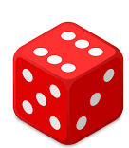

Play Draw a Ladybird with your family.
This is based on the old game Beetle Drive.
You will need;
a line drawing of a ladybird
a die,
paper and pencils, paints or chalks if you are outside

Slide 14
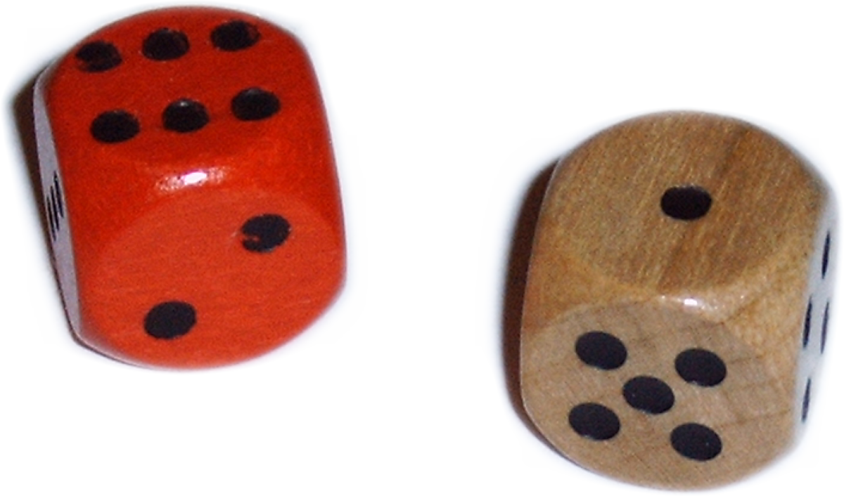
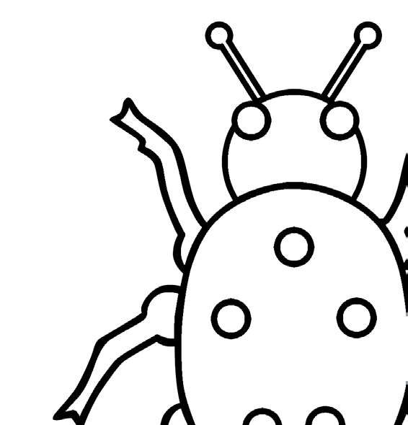


Game one
Preparation:
Draw your template ladybird with the number of spots of your choice and number the parts.
Make sure all the players have a piece of paper and a pencil or paint brush.
Aim:
To be the first person to draw your ladybird!
Play:
Players take in turns to roll the die.. You can only start when you have rolled a 6 to draw the body and you can only add eyes and antennae when you have drawn the head.
Can your child say how many spots without counting? This is called subitising.
Have fun! See the next slide for variations on the game.
5 head
3 antennae
4 eyes
6 body
1 leg
2 spots

Slide 15
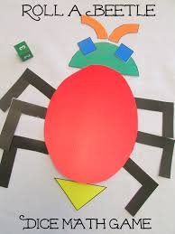
Game Two: Addition
Game Three: Shapes or Drawing
You could make it in to an addition game by numbering the parts of the ladybird 7-12 and throwing 2 dice. Encourage your child to count on from the biggest number. For example if your child throws a 5 and a 2, ask them to say 5 and then count on 6, 7.
You could build a ladybird or beetle with shapes instead..

Slide 16
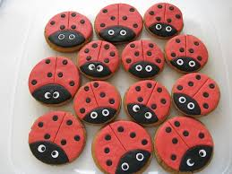
Friday 25th^{th} April
Careful counting and number bonds
The Ladybird

Slide 17
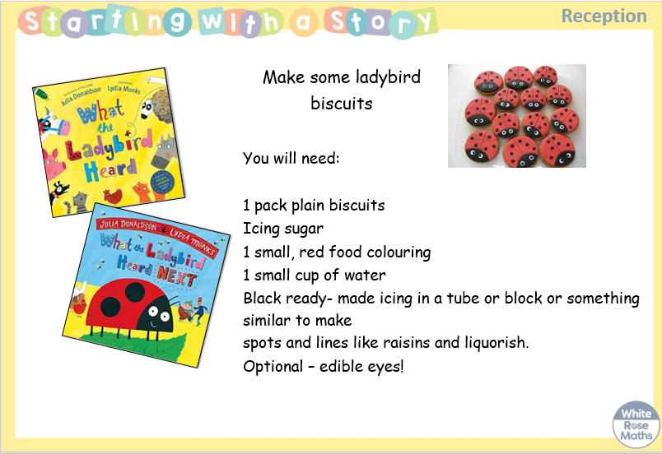

Slide 18
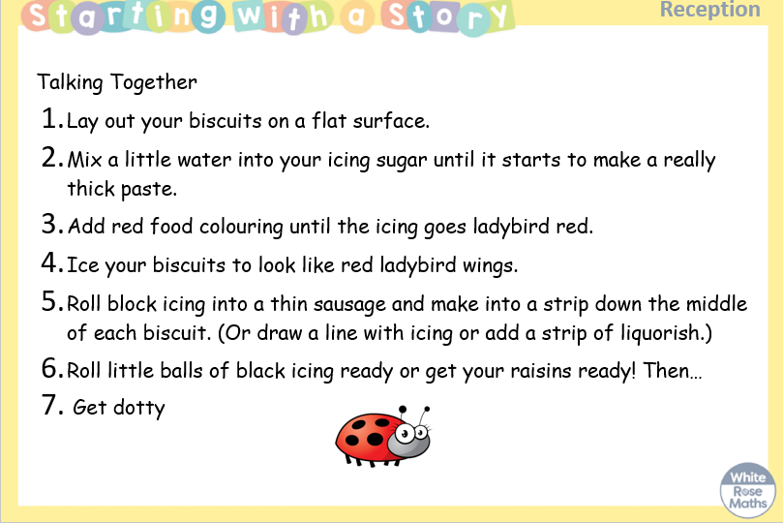

Slide 19
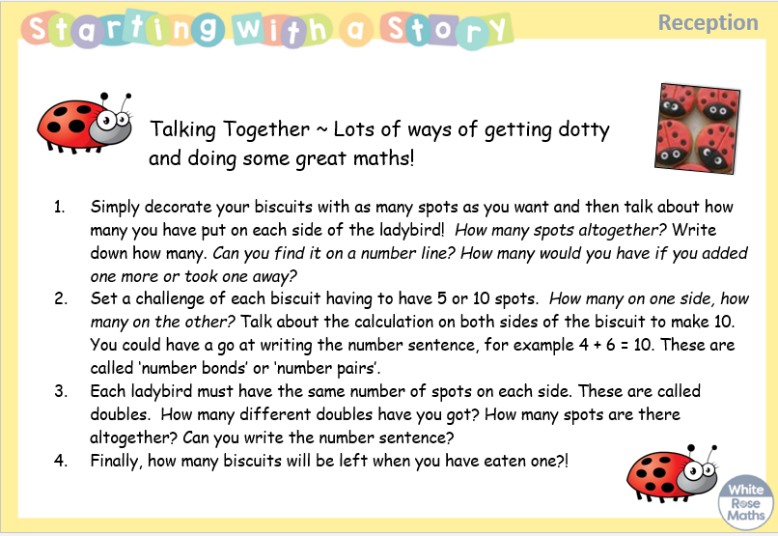

Slide 20
