Slide 1
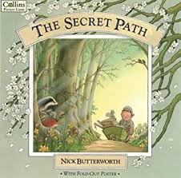
Maths
Home Learning
Week beginning
Monday 13th April

Slide 2
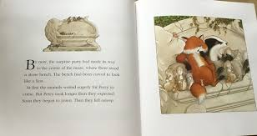
Monday 13th April
Story Talk
Listen to the story of ‘The Secret Path’ by Nick Butterworth.
It is spring time in the park with Percy. You might have spotted the daffodils in the pictures.
April is the last month of spring. What season will it be next?
When we get back to school we will have to have a look at our pear trees and see what changes have taken place.
When you go out for your walk today you might like to take a small tub to collect a mixture of treasures that you find.
Story Talk

Slide 3
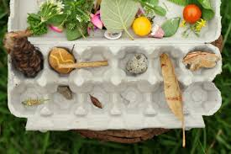
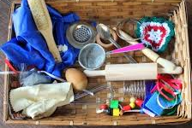
Sorting and classifying
You could play, Guess My Rule – we have played this in school.
You can collect a variety of treasures from around your home too.
When you get home, spread out all your treasures.
What is similar about them?
What is different?
How could you sort them?
One of you must decide on a rule for sorting, for example ‘It has to be made of wood’ or ‘It has to be soft’ but don’t tell the other players!
The other players have to work out the rule by asking if they can put different items of treasure into your empty pot or basket.
If it doesn’t fit your rule, it can’t go in the basket.

Slide 4
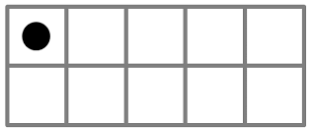
Tuesday 14th April
Story Talk
How many?
Listen to the story of ‘The Secret Path’ by Nick Butterworth. A lot of animals are in the park preparing to surprise Percy.
Can you remember all the different types of animals there are in the story?
How many different types of animals are there? Every time you say an animal put a counter in front of you. You might like to add them to a ten frame instead.
How many have you got altogether? Can you say how many without counting?
How many would there be if the ten frame were full?
Story Talk

Slide 5
Careful counting, recognising and ordering numbers
Remember to point and count saying one number for each animal
Look on the number line if you are not sure what the number looks like.
Have a look at the pictures on the following slides.
For each picture:
find out how many animals you can see altogether
write down how many on a piece of paper or card. Make sure you form your numbers correctly and they are the correct way round!
When you have found out how many and written down the number I have an extra challenge for you!

Slide 6
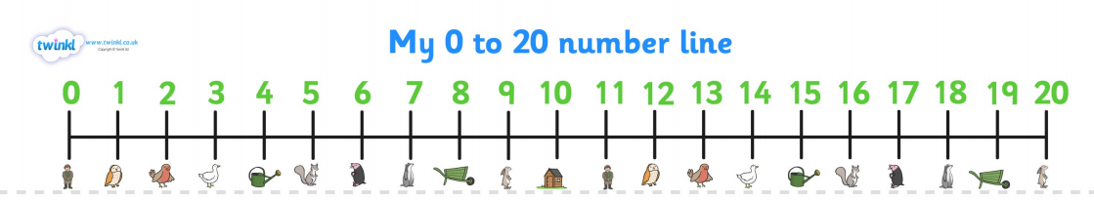

Slide 7
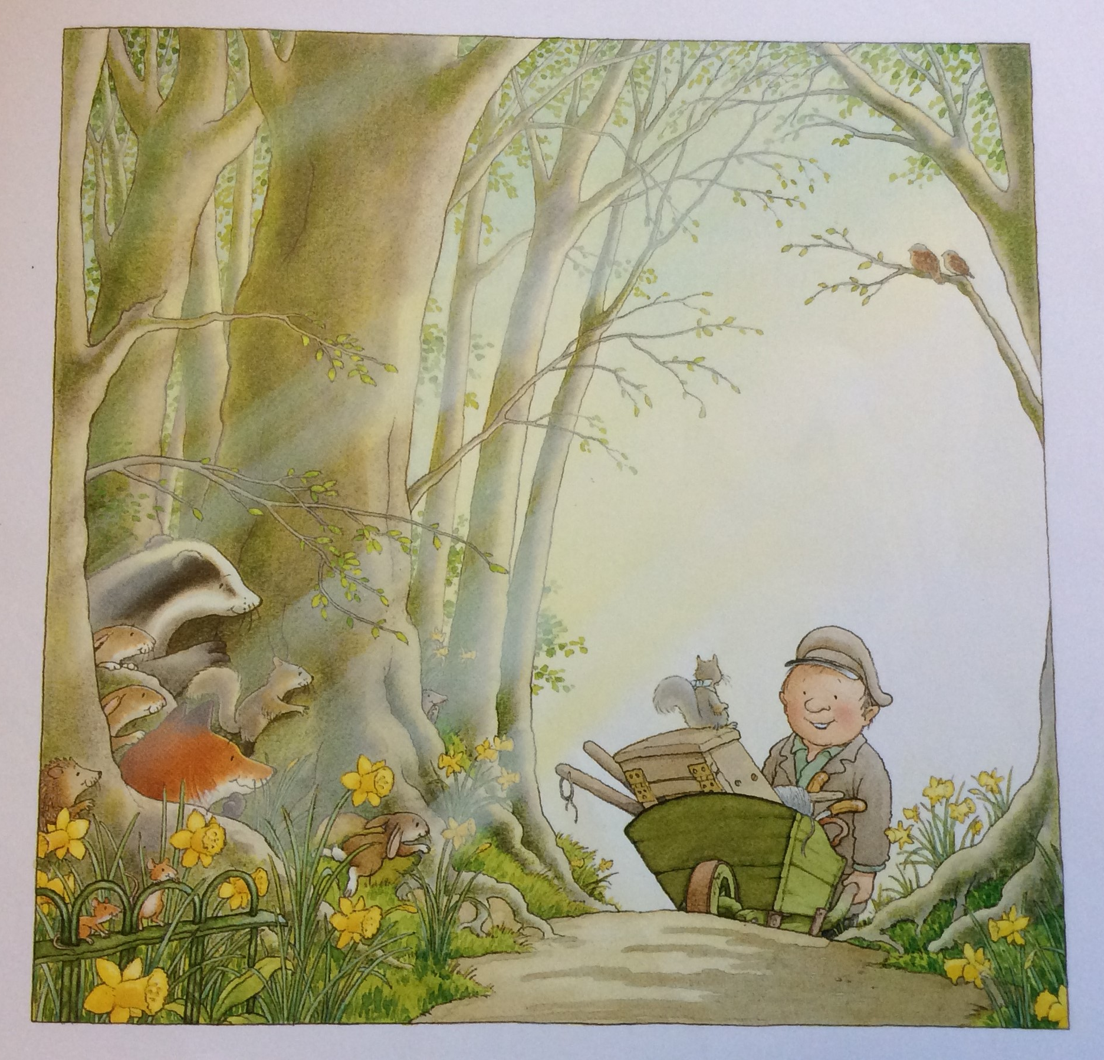

Slide 8
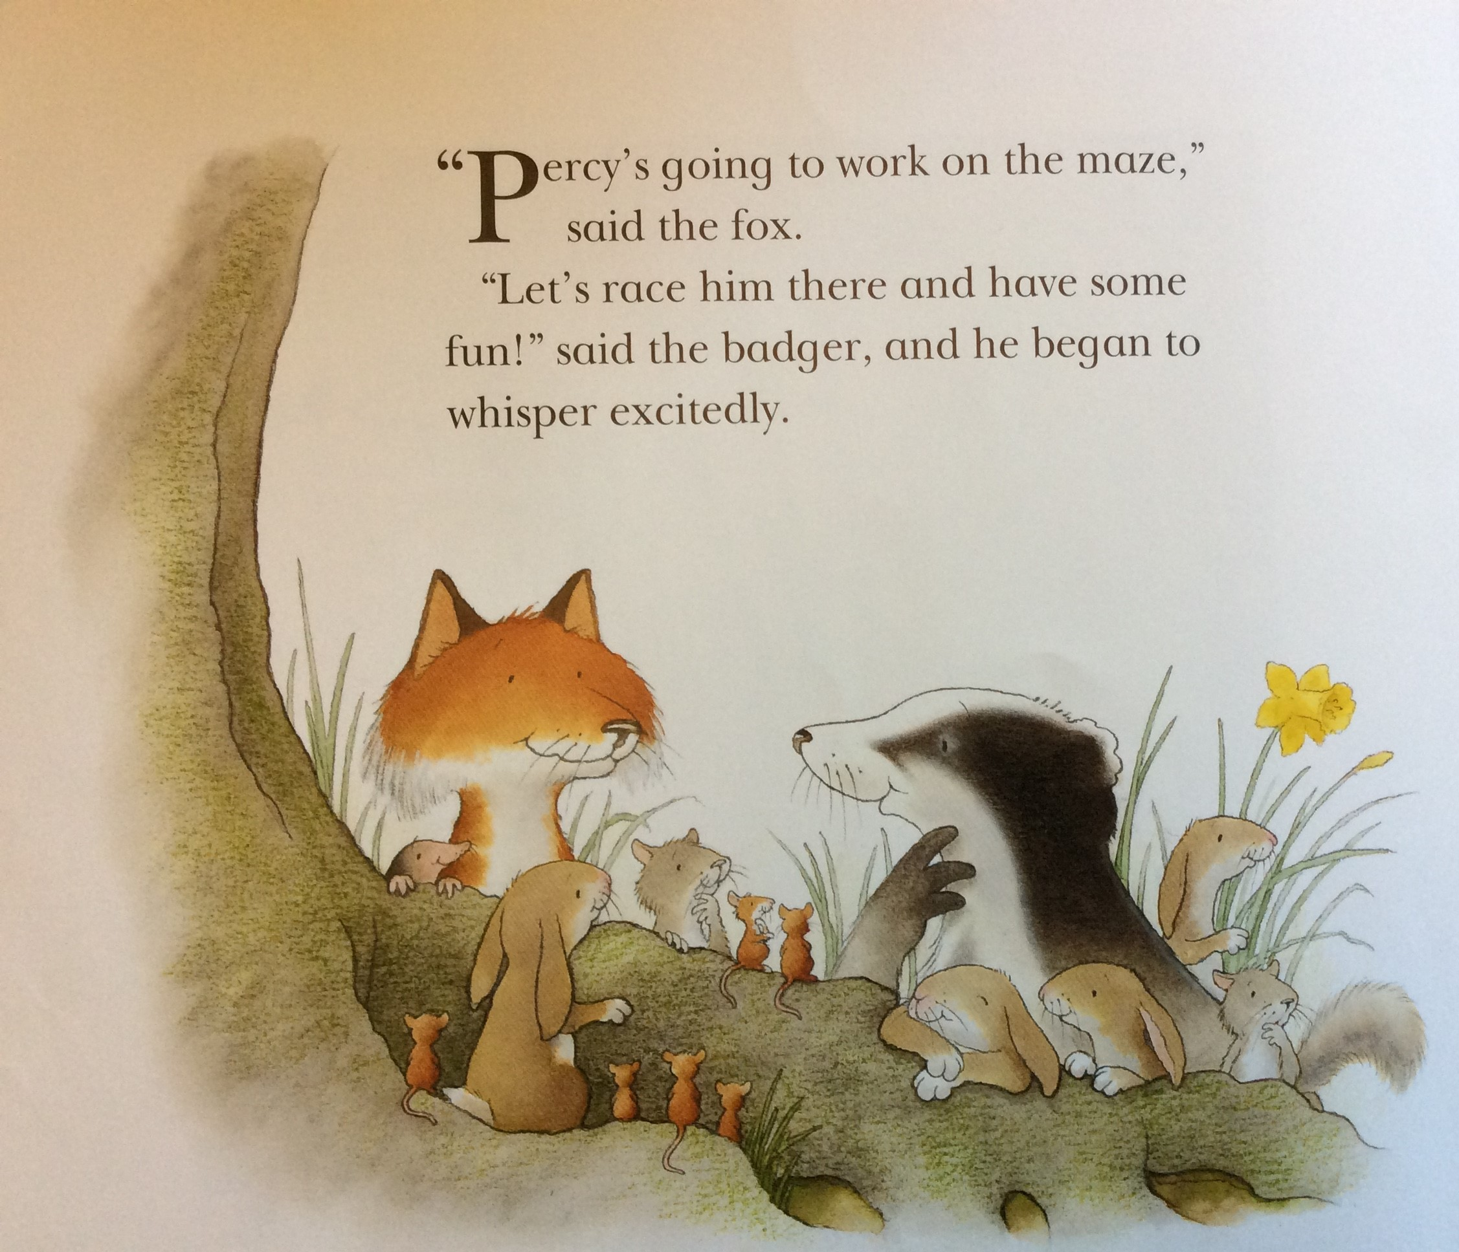

Slide 9
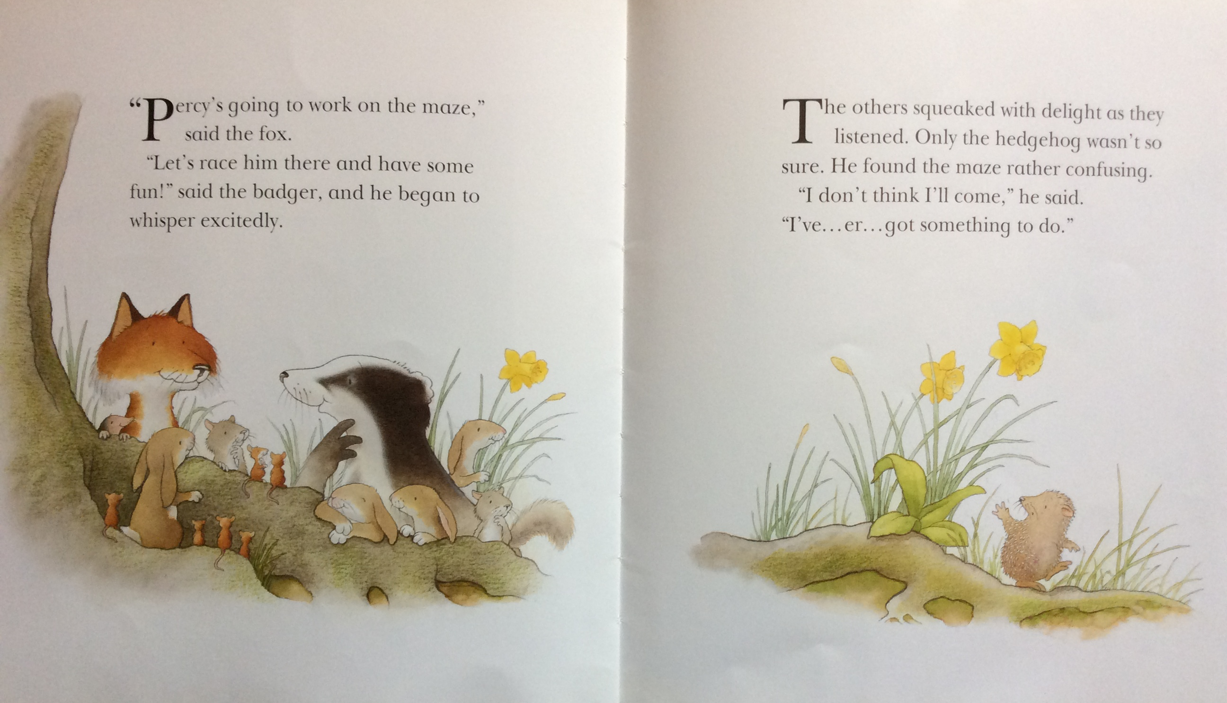

Slide 10
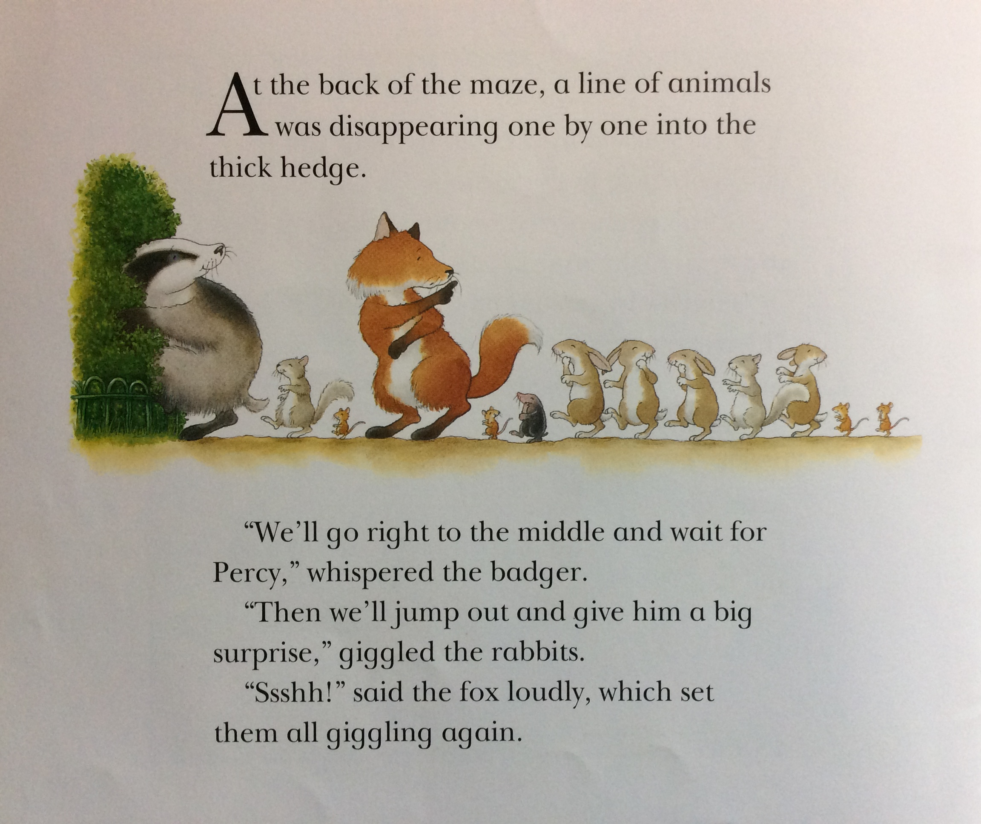

Slide 11
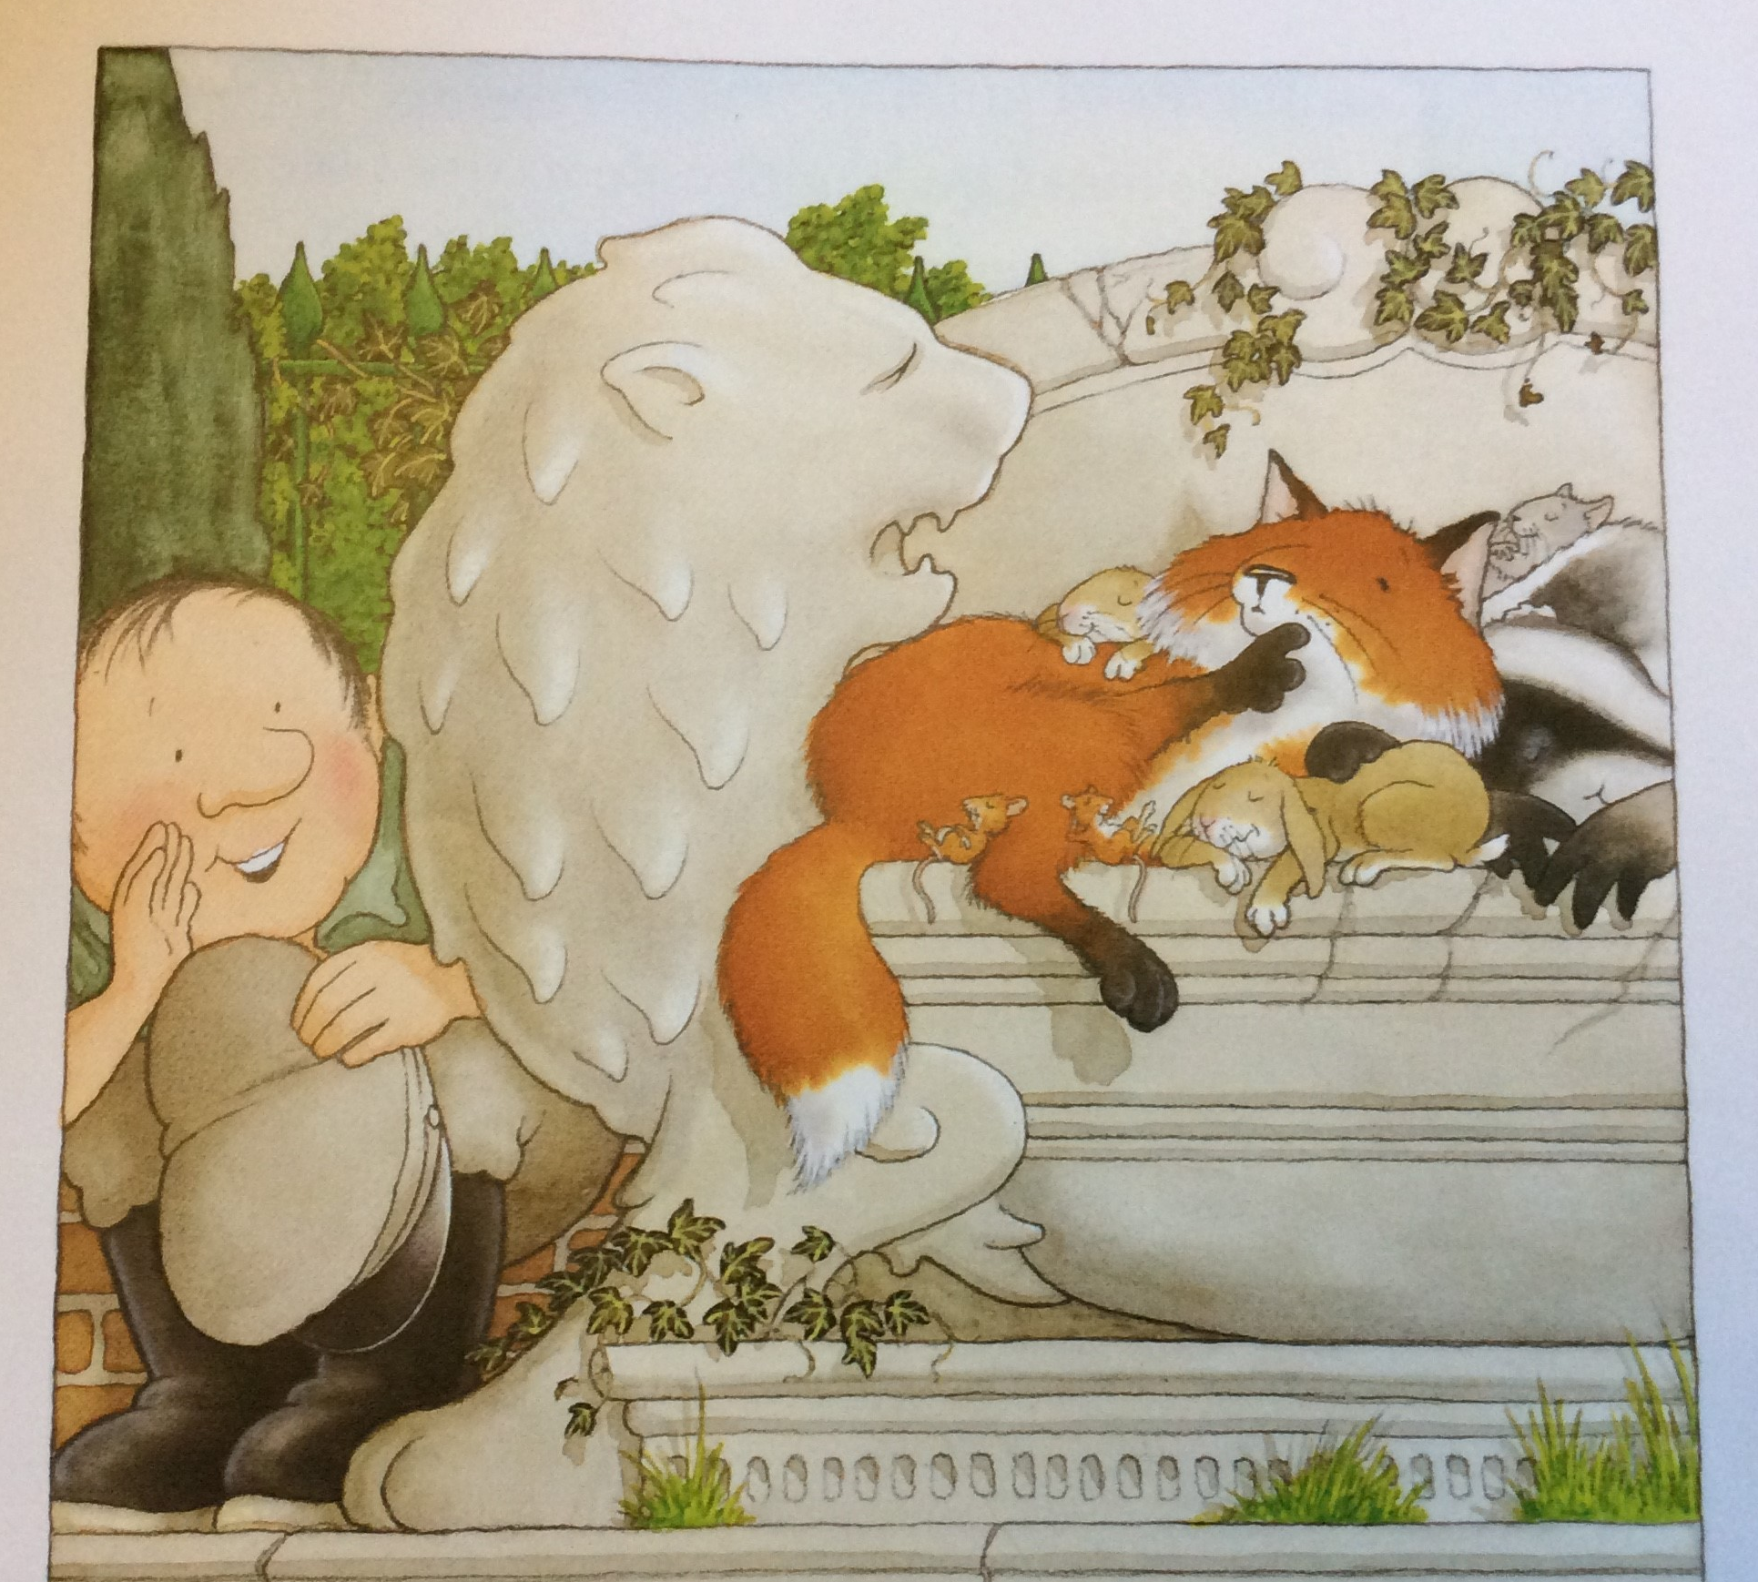

Slide 12
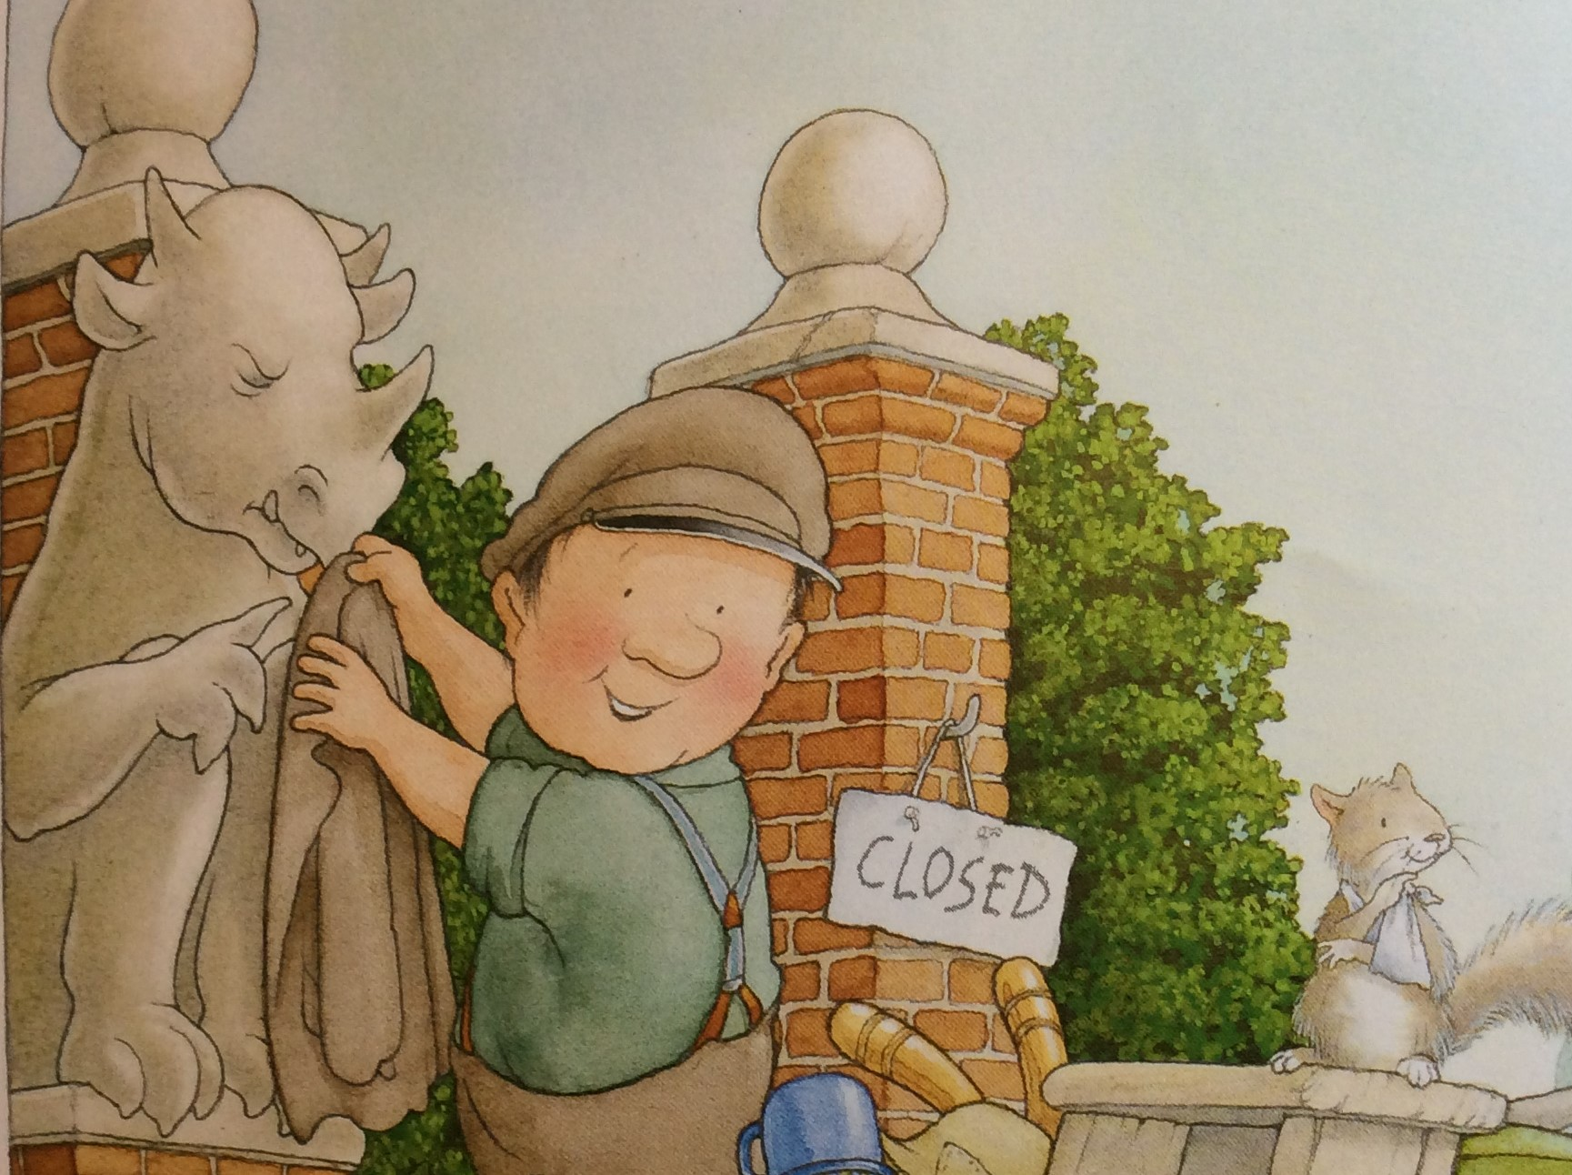

Slide 13
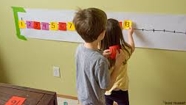
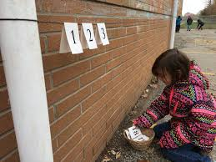
Now for your challenge!
Remember your number line is not starting at one…
and there might be gaps in your number line!
Set your number cards out in front of you and read all the numbers out loud.
Which is the biggest number?
Which is the smallest number?
Have you got any the same?
Now put them in order starting with the smallest number. It is a good idea to look at a number line if you can.
Which numbers are missing? Can you fill in the gaps so that you start at 12 and go up to 20?

Slide 14
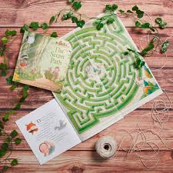
Wednesday 15th April
Story Talk –
The maze in Percy’s park is amazing! What did Percy use to make sure he didn’t get lost? (At least, what did he try to use?)
Mazes are set out in a very regular fashion.
There is another name for a maze. Can you find out what it is?
Have a look at Percy’s maze on the next slide.
Can you help Percy find his way out of the maze?
Story Talk ~ The Maze

Slide 15
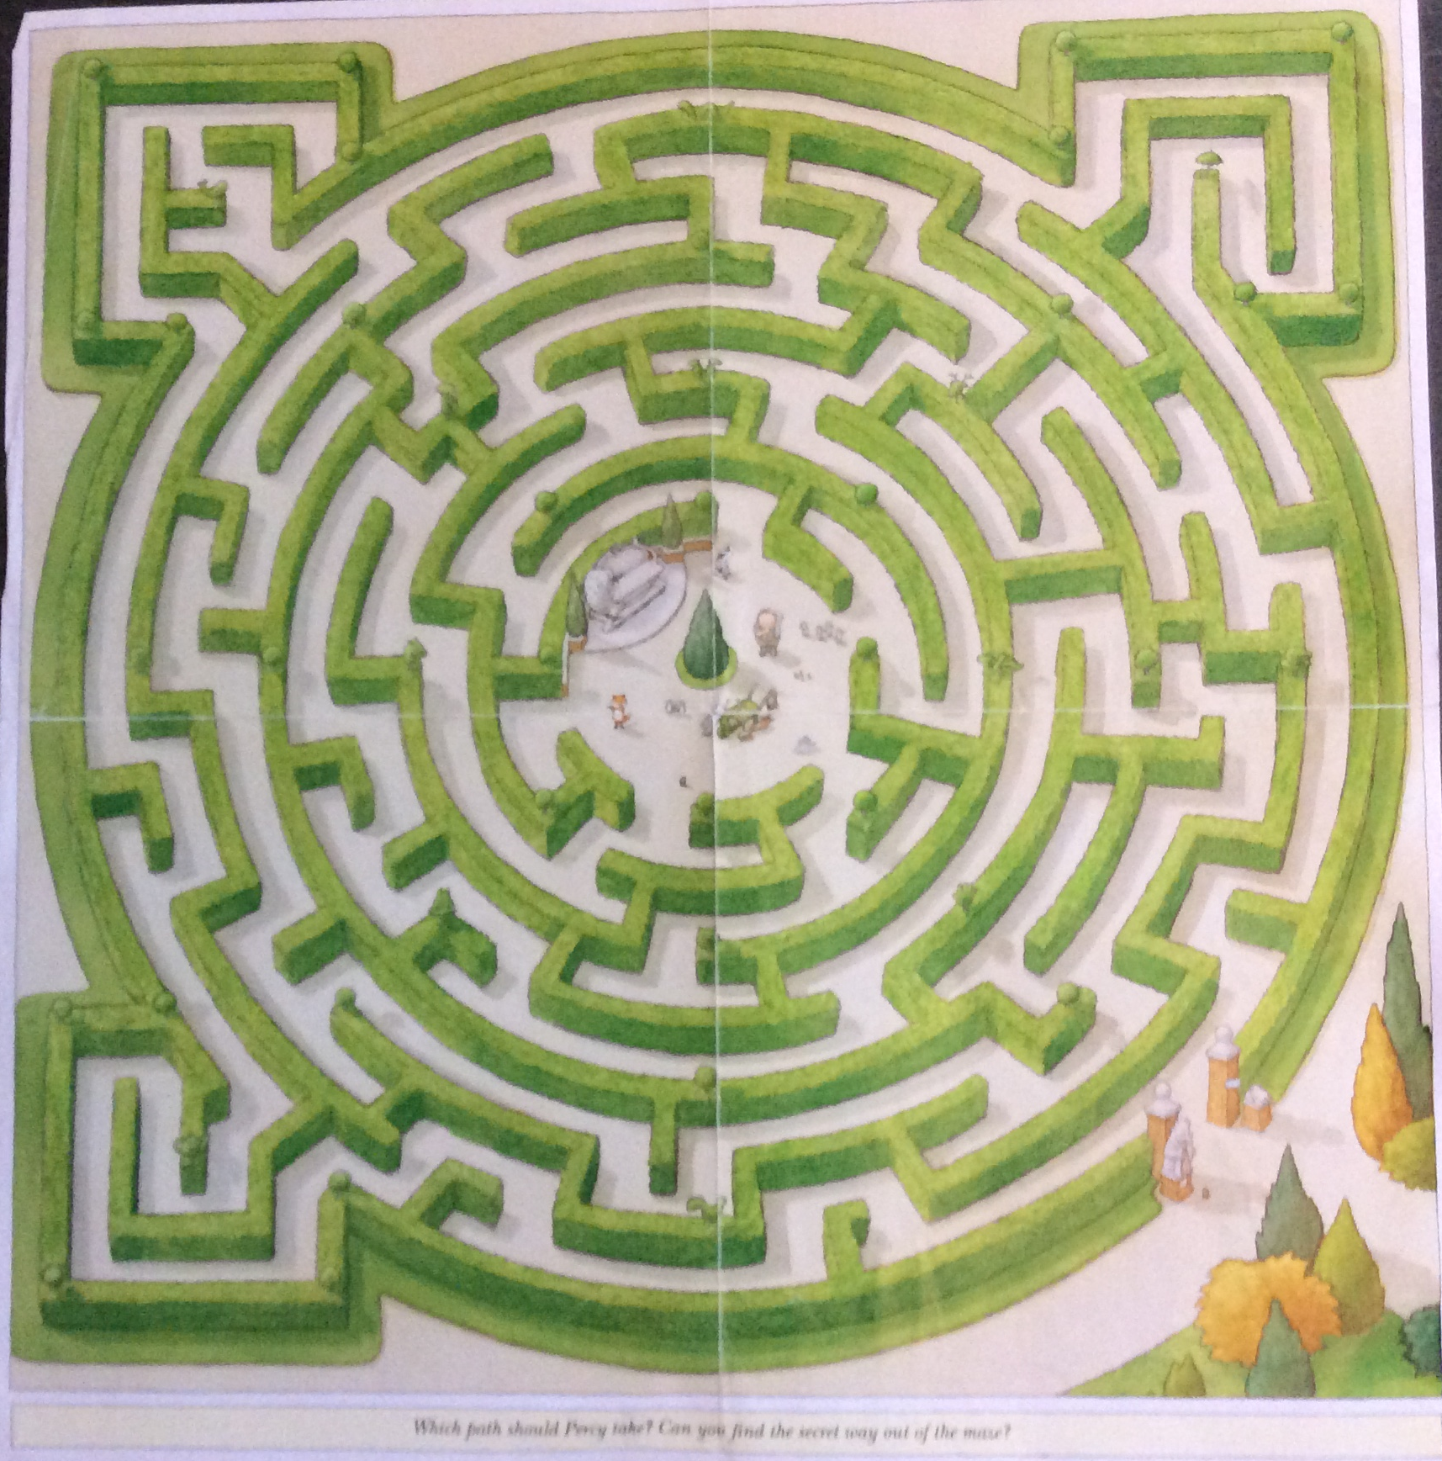

Slide 16
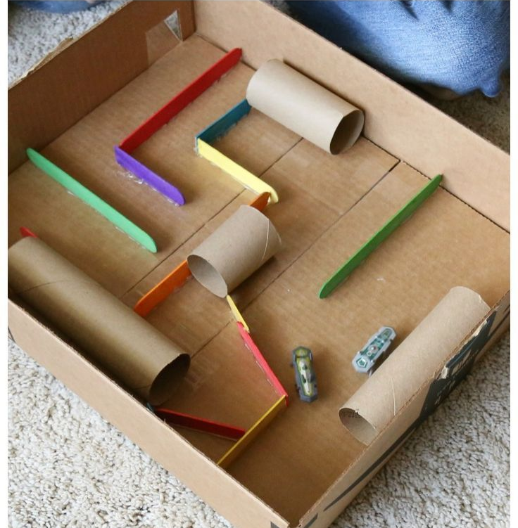
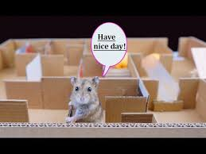
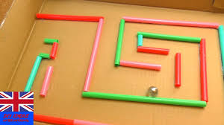
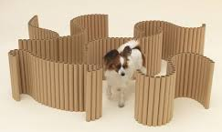
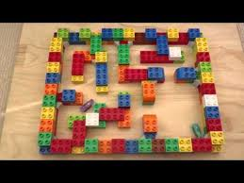
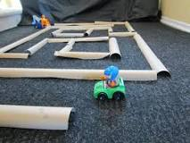
I wonder what else you could use to make a maze?

Slide 17
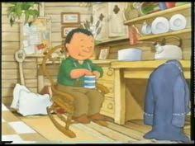
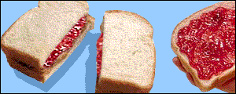
Thursday 16th April
Story Talk –
At the end of the day Percy was looking forward to a toasted tea cake for his tea.
I wonder if sometimes he might have a jam sandwich instead.
Percy’s tea time
Percy’s teatime

Slide 18
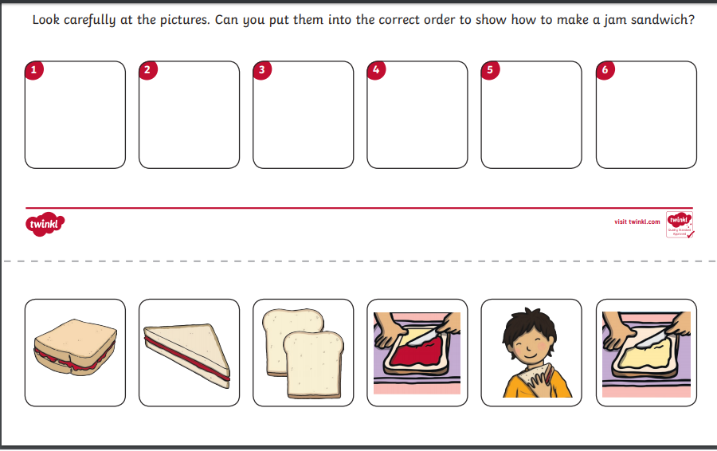
Have a look at the pictures below.
Which picture would have to go in which box to make a jam sandwich successfully?
Perhaps you would like to have a go at making a jam sandwich. You could draw your own pictures and number them.

Slide 19
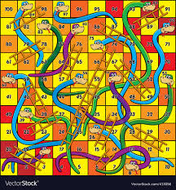
Friday 17th April
Careful counting, number recognition and addition.
I don’t know if Percy and his friends like playing board games but I have an idea that they might.
If you have snakes and ladders or another board game at home, you might like to play with your family. Can you show them how we use 2 dice in school to practise our adding?
On the next slide are some ideas of games you could make to play at home.
Board Games

Slide 20
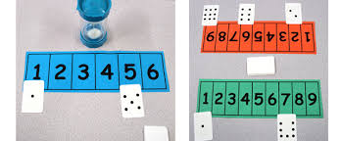
Two games to make and play at home.
For this game you will need two number lines to 9 and at least two sets of cards with spots 1-9 on them.
Take in turns with a partner to turn over a card and match it to the numeral. If you already have a spotty card, miss a go.
Who will complete their spotty number line first?
Can you think of how you could make another game with different numbers?
You will need a number line to 6, a set of cards with spots 1-6 on them and something to time 1 minute.
Can you match the spotty cards to the numerals before the timer runs out?
How quickly can you match the spotty cards to the timer?

