Slide 1
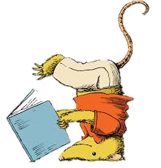
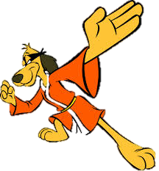
Reading Karate!

Slide 2
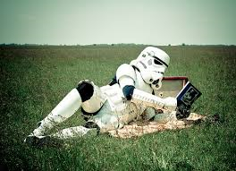
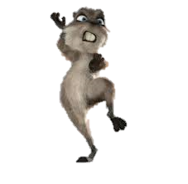
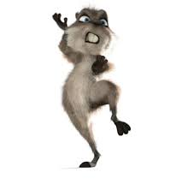
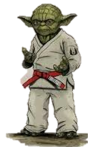
Earn ‘belts’ for reading!

Slide 3
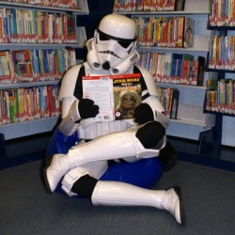
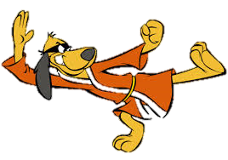
How to earn ‘belts’ (wristbands)
Read with, to or in the presence of an
adult or Reading Mentor and get them
to sign your Reading Record.

Slide 4
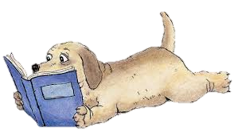
One ‘read’ is at least 10
minutes and you can only
get one read a day signed off.

Slide 5
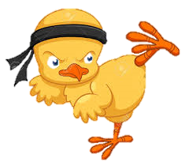

Bring your signed Reading Record into class so that
your ‘reads’ can be ticked off
on the Reading Karate chart.

Slide 6

The ‘Belts’
White ~ 10 ‘reads’
Yellow ~ 15 ‘reads’
Orange ~ 20 ‘reads’
Green ~ 20 ‘reads’
Blue ~ 25 ‘reads’
Brown ~ 30 ‘reads’
Black ~ 30 ‘reads’

Slide 7


We kick off on
Monday kids!

